Slide 1
Lesson 1 Computers and Operating Systems
Computer Literacy BASICS: A Comprehensive Guide to IC³, 5th Edition
Morrison / Wells / Ruffolo

Slide 2
About the Presentations
The presentations cover the objectives found in the opening of each lesson.
All lesson objectives are listed in the beginning of each presentation.
You may customize the presentations to fit your class needs.
Some figures from the lessons are included. A complete set of images from the book can be found on the Instructor Resources disc.
2

Slide 3
Objectives
Describe the importance of computers in daily life.
Explain the difference between system software and application software.
Describe the four major types of operating systems.
Identify the tasks an operating system performs.
Start a computer.
Use an operating system and start an application.
Lock and shut down a computer.
3
3

Slide 4
Words to Know
application software
boot process
buffer
command-line interface
data
driver
embedded operating system
graphical user interface (GUI)
hardware
icon
information processing cycle
4
4

Slide 5
Words to Know (continued)
multiuser operating system
open-source software
operating system
random access memory (RAM)
server operating system
software
swapping
system software
utility program
virtual memory
5

Slide 6
Understanding the Importance of Computers
Computers are everywhere.
Computers are used in your cell phone, in ATMs, in your home thermostat, and in your car’s cruise control.
Computers assist you in most parts of your daily life and play a central role in worldwide communications, entertainment, education, commerce, and other business activities.
6
6

Slide 7
Understanding the Importance of Computers (continued)
Computers have been around since the late 1940s.
Then, they were massive, special-purpose machines with names such as UNIVAC and ENIAC and were designed for use by the military and government.
They took hours to complete a calculation, occupied small buildings or entire city blocks, and cost millions of dollars.
7
7

Slide 8
Understanding the Importance of Computers (continued)
Today’s smartphones have more processing power than a UNIVAC, cost less than any of its components, and fit in the palm of your hand.
The future promises innovations such as wearable computers, using human thought as input, and computer-controlled, micro-controlled robots that treat and possibly cure cancer.
8
8

Slide 9
Understanding the Importance of Computers (continued)
Understanding what a computer is and how it works can help you appreciate and use it more effectively.
A computer is an electronic device that receives data (input), processes data, stores data, and produces a result (output).
Data is a collection of raw unprocessed facts, including text, numbers, sound, images, and video.
9
9

Slide 10
Understanding the Importance of Computers (continued)
The actual machine—wires, transistors, and circuits—is called hardware.
Software consists of instructions or programs for controlling the computer.
Data is text, numbers, sound, images, or video.
The computer receives data through an input device, processes the data, produces the output information on an output device, and stores the information on a storage device.
10
10

Slide 11
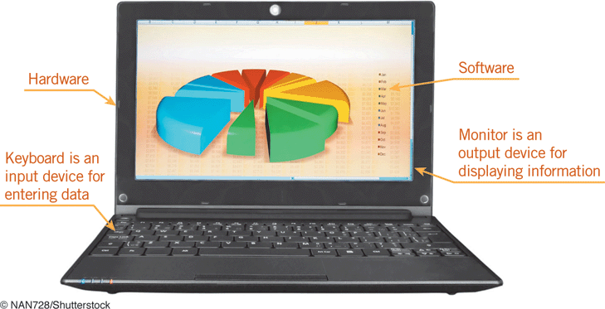
Understanding the Importance of Computers (continued)
The input and output devices, such as keyboards and monitors, are types of hardware called peripherals.
Data transformed into meaningful form becomes information.
11
11

Slide 12
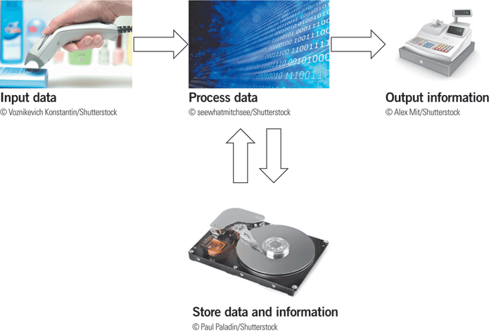
Understanding the Importance of Computers (continued)
Input, processing, output, and storage (IPOS) is called the information processing cycle.
12
12

Slide 13
Understanding the Importance of Computers (continued)
Computer Literacy
To be computer literate means that you can use today’s computers efficiently to enhance your life and the lives of those around you.
Computer literacy also means you understand a wide range of information about current technology and how it is used to solve problems.
A digital divide is an economic gap between those who are computer literate and have access to computer technology, and those who do not.
13
13

Slide 14
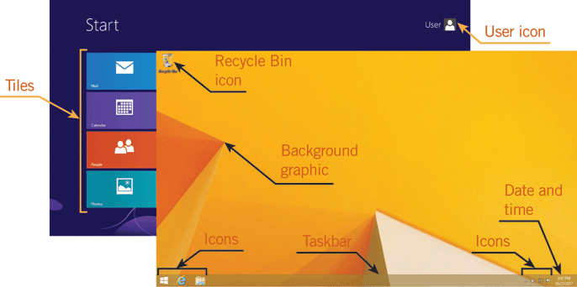
Types of Software
Software provides the means for you to interact with the computer’s hardware.
A graphical user interface (GUI) displays pictures called icons that allow you to interact with data and execute commands.
14
14

Slide 15
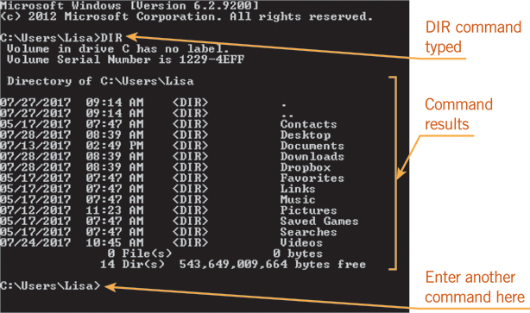
Types of Software (continued)
Some software uses a command-line interface, which requires you to type text commands to interact with the computer.

Slide 16
Types of Software (continued)
System Software and Application Software
A computer relies on two types of software: system software and application software.
System software runs a computer and includes the operating system and utility programs.
An operating system is software that coordinates the resources and activities on a computer.
A utility program helps the operating system set up, maintain, and protect a computer.

Slide 17
Types of Software (continued)
System Software and Application Software (continued)
Application software is the software used to directly complete a specific task or to create something electronically.
Application software helps you perform tasks such as writing a report, creating a video, viewing a Web page, or sending photos to a friend.

Slide 18
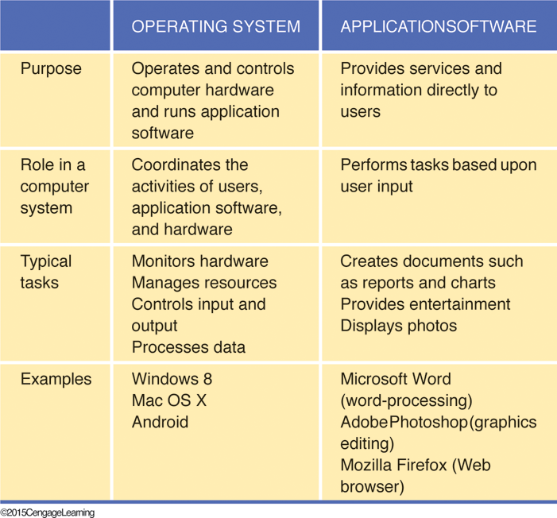
Types of Software (continued)
System Software and Application Software (continued)

Slide 19
Types of Operating Systems
Operating systems fall into four major categories depending on the type of device for which they are designed:
Personal computers
Mobile computing devices
Servers
Devices other than computers

Slide 20
Types of Operating Systems (continued)
Personal Computer Operating Systems
Personal or desktop operating systems are installed on a single computer and are called single-user operating systems because one user interacts with the operating system at a time.
They are multitasking operating systems, which means they let you work with more than one program at a time.
The three most popular personal computer operating systems are Windows, Mac OS, and Linux.

Slide 21
Types of Operating Systems (continued)
Personal Computer Operating Systems (continued)
Windows XP (2001) and Windows 7 (2009) were both widely used Windows versions. Windows 8 (2012) is the most recent version of Windows.
Windows became widespread because it ran on inexpensive personal computers created by a variety of computer manufacturers.
Windows is easy to use and to personalize, and it runs more types of applications than other operating systems.

Slide 22
Types of Operating Systems (continued)
Personal Computer Operating Systems (continued)
Mac OS runs only on Apple Macintosh computers.
Mac OS X is the current version of the operating system.
Mac OS set the standard for GUI operating systems and is liked by its users for being a very secure, reliable, and easy-to-maintain operating system.

Slide 23
Types of Operating Systems (continued)
Personal Computer Operating Systems (continued)
Linux is a personal computer operating system related to UNIX, which is an operating system developed in the late 1960s that is frequently used by scientists and programmers.
Linux is released to the public as open-source software, meaning anyone can use, modify, and distribute it.
Linux is available in versions called distributions, including commercial and noncommercial distributions.

Slide 24
Types of Operating Systems (continued)
Mobile Operating Systems
A mobile operating system is designed for small handheld computing devices.
It includes features similar to a personal operating system but is simpler and smaller.
A smartphone is a cell phone that includes many features of a computer.
Tablets are one-piece mobile computers that usually include a touchscreen, which is a screen you touch to interact with the GUI.

Slide 25
Types of Operating Systems (continued)
Mobile Operating Systems (continued)
iOS is a version of Mac OS X written for Apple’s mobile devices, including iPhones and iPads.
Google’s Android is an open-source operating system designed to run on many types of smartphones and tablets, and is derived from Linux.
Windows Phone and Windows RT are similar to Windows 8.
Mobile operating systems primarily work as single-user, single-tasking operating systems.

Slide 26
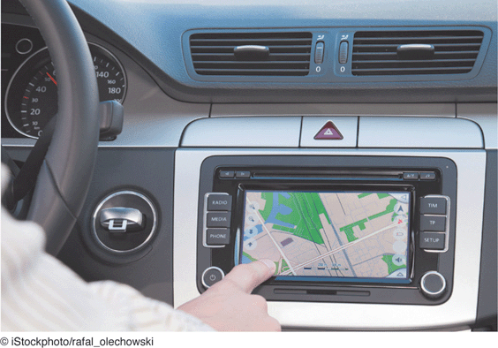
Types of Operating Systems (continued)
Embedded Operating Systems
Embedded operating systems run devices such as ATMs, navigation systems, portable media players, and digital recorders.
They are designed to meet a specific purpose and perform a single task, such as providing maps and directions.

Slide 27
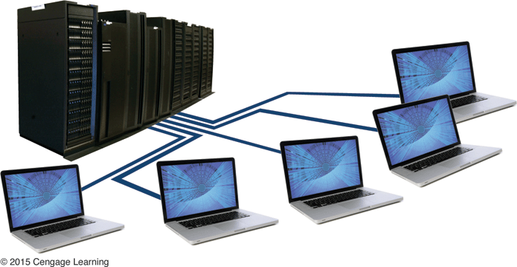
Types of Operating Systems (continued)
Server Operating Systems
A server operating system resides on a server and is used to manage a network (a group of two or more computers linked together).
A server is a computer that provides network services such as e-mail to other computers, or clients.

Slide 28
Types of Operating Systems (continued)
Server Operating Systems (continued)
Server operating systems are sometimes called network operating systems.
Each client on a network has its own personal operating system.
The server operating system manages the requests for services from the client computers.
An expert called the network administrator uses the server operating system to manage the network and its users.

Slide 29
Types of Operating Systems (continued)
Server Operating Systems (continued)
Server operating systems are multiuser operating systems because they allow many users to run programs and use the server’s resources at the same time.
Windows, Mac OS, Linux, and UNIX all have server versions of their operating systems.
UNIX is used for many servers that handle e-mail and Internet access.

Slide 30
Operating System Tasks
The operating system controls your computer from the time you turn on the power to the time you turn it off.
It takes care of technical tasks such as start-up steps, managing memory, processing input and output, controlling hardware, and ending a computer session.

Slide 31
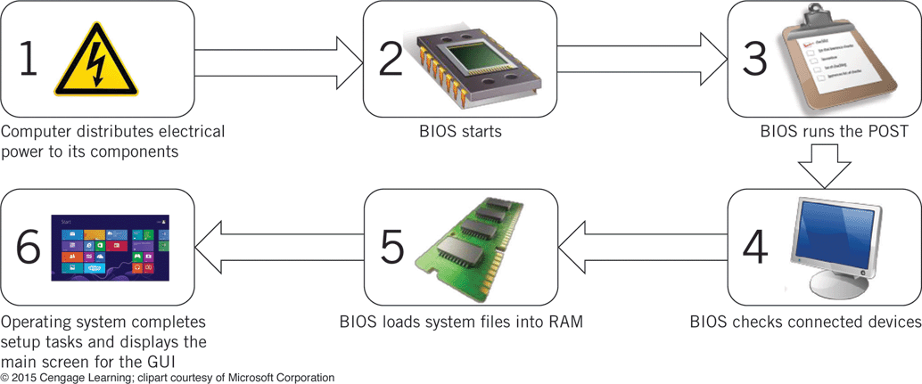

Operating System Tasks (continued)
Completing Start-Up Steps
The boot process is a series of steps the operating system must complete before you can interact with the operating system.

Slide 32
Operating System Tasks (continued)
Managing Memory
After starting up, the operating system manages computer resources.
A resource is any component the system requires to do work.
The main resources are memory, processing components, storage space, and peripherals.

Slide 33
Operating System Tasks (continued)
Managing Memory (continued)
The operating system manages random access memory (RAM) efficiently.
All programs need space in RAM to run.
When you start an application, the operating system allocates RAM to the program. When you close the application, the operating system reclaims the RAM.

Slide 34
Operating System Tasks (continued)
Managing Memory (continued)
If you run too many applications at a time, the computer can run out of RAM.
In that case, the operating system might close an application or shut down the computer unexpectedly (called a crash).
Operating systems can take advantage of virtual memory, a part of a computer’s hard disk that can work as additional RAM.

Slide 35
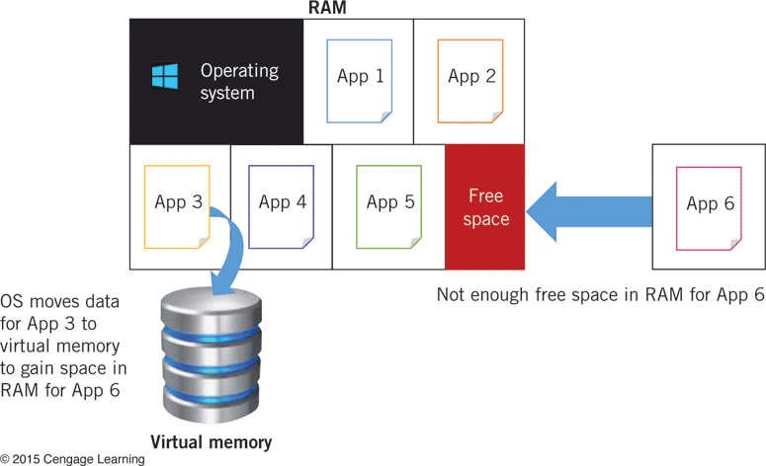

Operating System Tasks (continued)
Managing Memory (continued)
To gain memory, Windows moves data from one running application out of RAM and into virtual memory, a process called swapping.

Slide 36
Operating System Tasks (continued)
Processing Input and Output
Another major task of the operating system is processing input and output.
Often, the operating system must handle many input and output tasks at the same time.
To keep your computer running smoothly, the operating system sets a sequence for processing input and output tasks.
The operating system places data into a buffer, which is part of memory or storage where data waits until it can be transferred to a device.

Slide 37
Operating System Tasks (continued)
Controlling Hardware
The operating system considers every hardware device connected to the computer as an input or output device.
The operating system communicates with a driver (aka device driver), which is a small program that enables the operating system to interact with the device.
Each device must have a driver and is typically provided by the device manufacturer.

Slide 38
Operating System Tasks (continued)
Controlling Hardware (continued)
The operating system includes drivers for common devices.
When you install new hardware, the operating system searches for the correct driver and installs it so you can use the new hardware right away. This feature is called Plug and Play.

Slide 39
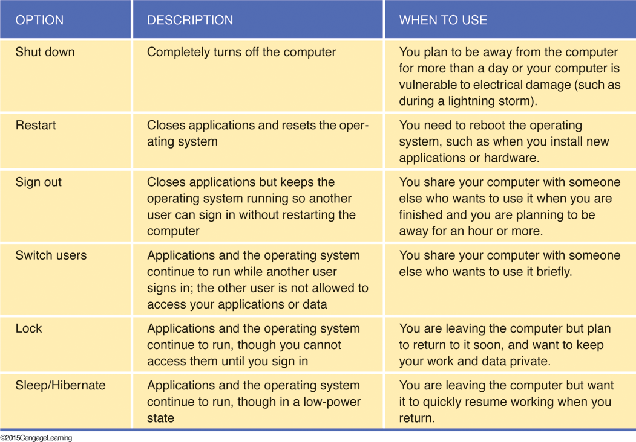
Operating System Tasks (continued)
Ending a Computer Session
When you end a session, the operating system takes care of the tasks to shut down, restart, sign out, switch users, or lock the computer.

Slide 40
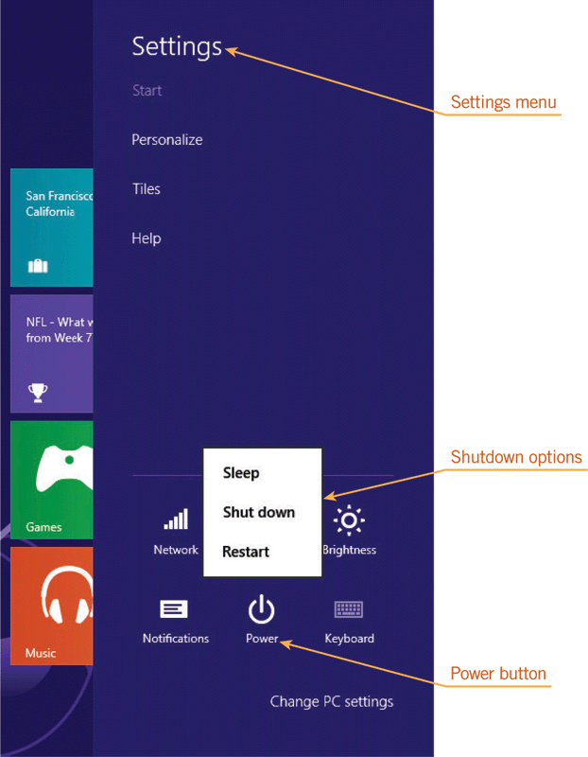
Operating System Tasks (continued)
Ending a Computer Session (continued)
To shut down a computer (aka log off), the operating system follows a series of steps:
Checks users
Closes applications
Closes system software
Turns off the power

Slide 41
Summary
In this lesson, you learned:
A computer is an electronic device that receives data (input), processes data, stores data, and produces a result (output).
A computer includes hardware (physical equipment such as wires and circuits) and software (instructions or programs for controlling the computer).
41
41

Slide 42
Summary (continued)
To keep up with the changes in computer technology, you need to be computer literate, which means that you can use today’s computer hardware and software efficiently to enhance your life and the lives of those around you.
42
42

Slide 43
Summary (continued)
You interact with software through its user interface, which allows you to enter and receive information.
Most contemporary software has a graphical user interface (GUI), which uses icons and other graphics to accept data and commands.
Other software uses a command-line interface, which requires you to type text commands to interact with the computer.
43
43

Slide 44
Summary (continued)
A computer runs two main types of software: system software and application software.
System software is the software that runs a computer, and includes the operating system and utility programs.
A utility program helps the operating system set up, maintain, and protect a computer.
44
44

Slide 45
Summary (continued)
An operating system is software that coordinates the resources and activities on a computer.
Application software is software you use to carry out your work or personal tasks.
45
45

Slide 46
Summary (continued)
Personal computer operating systems run on personal computers.
Mobile operating systems are designed for handheld computers such as tablets and smartphones.
Embedded operating systems are part of an electronic device or system other than a computer. Server operating systems run servers, which are the computers that coordinate networks.
46
46

Slide 47
Summary (continued)
Single-user, single-tasking operating systems let only one user perform a single task at one time. Most mobile and embedded operating systems fall into this category.
Single-user multitasking operating systems let one user run many programs at the same time, and include all personal computer operating systems.
Multiuser operating systems, such as server operating systems, let many users run programs and take advantage of the computer’s resources at the same time.
47
47

Slide 48
Summary (continued)
The technical tasks an operating system performs include completing start-up steps, managing memory, processing input and output, controlling hardware, and ending a computer session.
The boot process is a series of steps the computer and operating system must complete before you can interact with the operating system.
48
48

Slide 49
Summary (continued)
The resources an operating system manages include memory (RAM), processing components, storage space, and peripheral devices.
To supplement RAM, operating systems take advantage of virtual memory, which is part of a computer’s storage space that can work as additional memory.
49
49

Slide 50
Summary (continued)
To keep your computer running smoothly, the operating system sets a sequence for processing input and output tasks and uses buffers, which are parts of memory or storage where data waits until it can be transferred to a device.
To control a hardware resource, the operating system communicates with a device driver, a small program that tells the operating system how to interact with the device.
50
50

Slide 51
Summary (continued)
A personal operating system needs to know when you’re finished working with a computer so it can protect itself and other software, and keep your information private while you are away.
Although you select an option to end a session, the operating system takes care of the tasks, which range from shutting down, to restarting, signing out (also called logging off), switching users, and locking the computer.
51
51

