Slide 1
Lesson 2 Software and Hardware Interaction
Computer Literacy BASICS: A Comprehensive Guide to IC³, 5th Edition
Morrison / Wells / Ruffolo

Slide 2
Objectives
Identify hardware components that affect computer performance.
Explain how the central processing unit (CPU) processes software instructions.
Describe types of computer memory.
Explain how to use system requirements.
Explain the purpose of software updates.
Use Windows Update to keep the operating system up to date.
2
2

Slide 3
Words to Know
arithmetic/logic unit (ALU)
byte
cache
central processing unit (CPU)
circuit board
clock speed
control unit
execution cycle (E-cycle)
gigahertz (GHz)
instruction cycle (I-cycle)
machine cycle
megahertz (MHz)
3
3

Slide 4
Words to Know (continued)
motherboard
multicore processor
multiprocessing
multithreading
nonvolatile memory
read-only memory (ROM)
register
system unit
thrashing
volatile memory
4
4

Slide 5
Identifying Hardware Components in a Computer
How efficiently hardware and software complete tasks is called performance.
The system unit is the case that contains a computer’s main system components.
The computer’s main circuit board is called the motherboard.
A circuit board is a thin metal plate with an extensive electronic circuit.
All of the essential chips and the circuitry that connects them are on the motherboard.

Slide 6
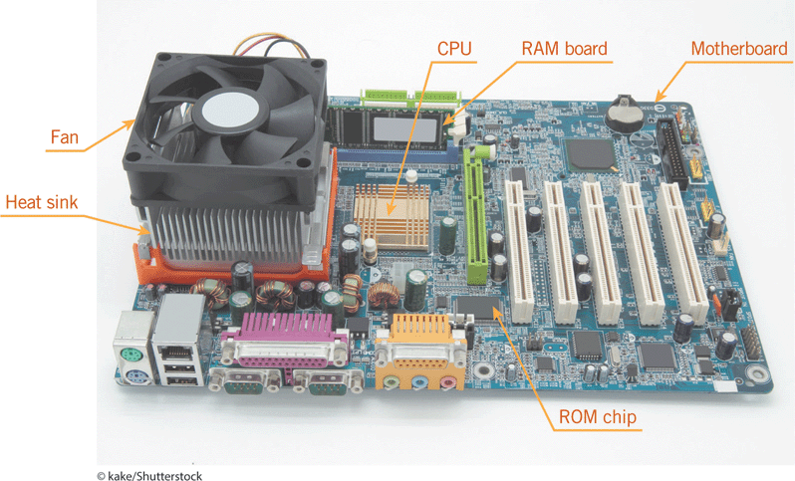
Identifying Hardware Components in a Computer (continued)

Slide 7
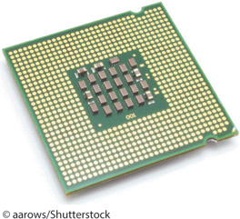
Identifying Hardware Components in a Computer (continued)
Central Processing Unit
The central processing unit (CPU) is a single computer chip that contains all the electronic circuitry a computer needs to process data.
A chip is a small, thin piece of silicon containing electronic circuits, which is why a chip is called an integrated circuit (IC).

Slide 8
Identifying Hardware Components in a Computer (continued)
Parts of a CPU
The arithmetic/logic unit (ALU) performs arithmetic calculations and logical operations.
The control unit coordinates all the processor’s activities and manages the flow of information through the processor.
Registers are memory cells for temporarily storing data needed by the ALU to perform its calculations.

Slide 9
Identifying Hardware Components in a Computer (continued)
Machine Cycle
The CPU carries out software instructions by repeating four basic operations in the machine cycle.
Fetching and decoding make up the instruction cycle (I-cycle).
Fetching retrieves an instruction or a data item from memory.
Decoding translates the instruction into a form the computer can execute.

Slide 10
Identifying Hardware Components in a Computer (continued)
Machine Cycle (continued)
Executing and storing make up the execution cycle (E-cycle).
Executing carries out the commands in the instruction.
Storing writes the result to memory (not to a storage medium).

Slide 11
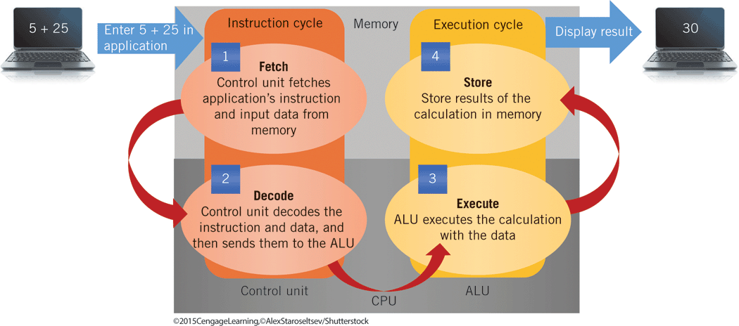
Identifying Hardware Components in a Computer (continued)
Machine Cycle (continued)

Slide 12
Identifying Hardware Components in a Computer (continued)
Clock Speed
Machine cycles are measured in microseconds, nanoseconds, and even picoseconds.
The faster the machine cycle, the faster your computer processes data.
The speed of the processor directly influences the speed of the machine cycle.
The processor’s speed is also called the clock speed, which is the number of instructions the CPU can process per second.

Slide 13
Identifying Hardware Components in a Computer (continued)
Clock Speed (continued)
The computer has a system clock that generates a regular electronic beat to set the pace and timing of system operations.
Each beat of the system clock is called a cycle.
Clock speed is stated in megahertz (MHz), which is a million cycles per second, and gigahertz (GHz), which is a billion cycles per second. (A hertz is one cycle per second.)

Slide 14
Identifying Hardware Components in a Computer (continued)
Bit Size
Another measure of CPU performance is bit size, which is how many bytes of data the CPU can retrieve from RAM at once.
A byte of data is roughly equivalent to one character.
An 8-bit CPU can process 1 byte at a time.
A 16-bit CPU can process 2 bytes at a time.
A 32-bit CPU can process 4 bytes at once.
A 64-bit CPU can process 8 bytes at once.

Slide 15
Identifying Hardware Components in a Computer (continued)
Types of Processors
A multicore processor is a single chip that contains more than one processor.
If a computer contains a multicore processor, the operating system can use multiprocessing to split tasks among the processors.
Each processor can work on a different task at the same time.

Slide 16
Identifying Hardware Components in a Computer (continued)
Types of Processors (continued)
A single-core processor can enhance performance using multitasking and multithreading.
Multitasking can run more than one program at the same time.
With multithreading, the operating system handles many parts, or threads, of a single program.

Slide 17
Identifying Hardware Components in a Computer (continued)
Types of Processors (continued)
With a multicore processor, the operating system can use multiprocessing, multitasking, and multithreading to improve performance.
With a single-core processor, the operating system can use only multitasking and multithreading.

Slide 18
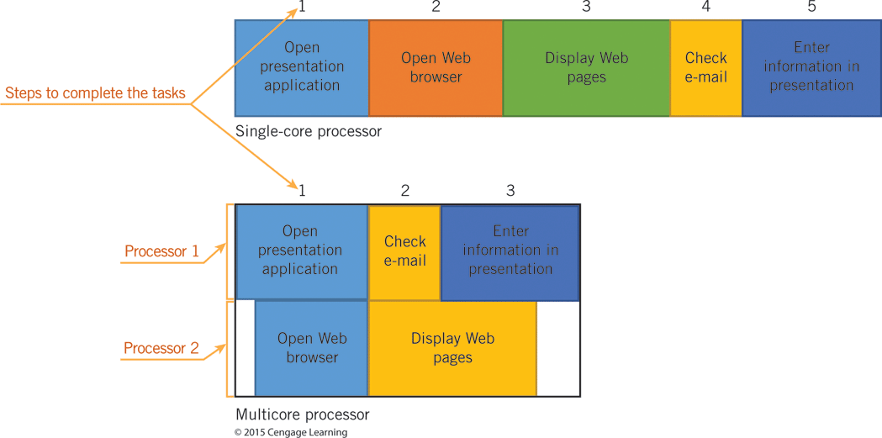
Identifying Hardware Components in a Computer (continued)
Types of Processors (continued)

Slide 19
Identifying Hardware Components in a Computer (continued)
Memory
The CPU, operating systems, and applications use memory (chips inside the system unit) to store data and instructions.
A computer has two types of memory: volatile and nonvolatile.
RAM is volatile memory that loses its contents when you turn off the computer.
ROM is nonvolatile memory because it is permanent; it does not lose its contents when you turn off the computer.

Slide 20
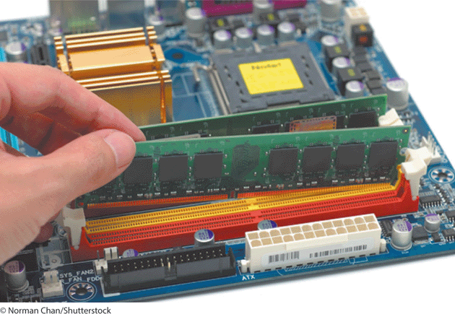
Identifying Hardware Components in a Computer (continued)
RAM
Data, information, and instructions from applications and the operating system are stored temporarily in RAM.
RAM usually consists of several chips on a circuit board called a memory module, which is plugged into the motherboard.

Slide 21
Identifying Hardware Components in a Computer (continued)
RAM (continued)
RAM has a significant effect on performance.
Without enough RAM, the operating system must move data in and out of RAM frequently, slowing performance.
Thrashing means the operating system spends more time swapping data than running software.

Slide 22
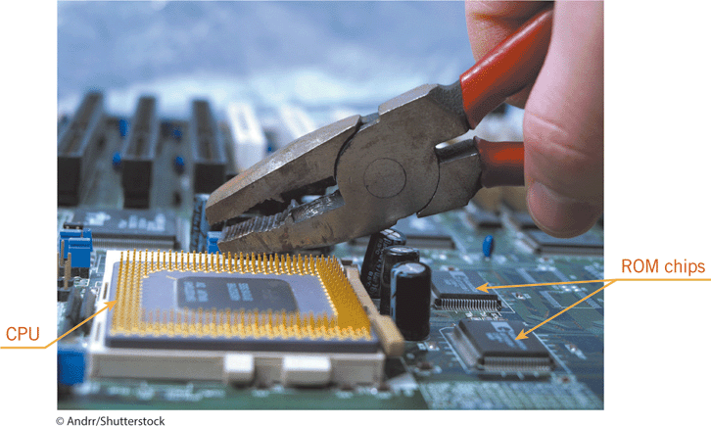
Identifying Hardware Components in a Computer (continued)
ROM
ROM is read-only memory stored on a single chip on the motherboard.
The operating system retrieves data or programs in ROM when it needs them.
The operating system does not write over the contents of ROM.

Slide 23
Identifying Hardware Components in a Computer (continued)
ROM (continued)
Electrically erasable programmable read-only memory (EEPROM) is a type of ROM that is nonvolatile, but can be modified.
Flash memory is a type of ROM that can be updated much more quickly than EEPROM and has largely replaced ROM.
Flash memory is now being used on mobile computers and peripheral devices.

Slide 24
Identifying Hardware Components in a Computer (continued)
Caches
In addition to RAM, the CPU accesses memory caches to speed processing.
Level 1 cache memory is a small amount of memory stored on the CPU itself, apart from the registers, where it is almost instantly available.
Level 2 cache memory is a larger amount of memory that can reside on the CPU or on a chip that has a direct connection to the CPU.

Slide 25
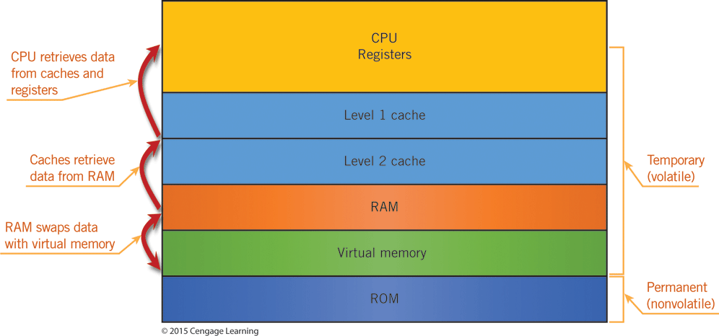
Identifying Hardware Components in a Computer (continued)
Caches (continued)
The closer instructions and data are to the CPU, the faster the CPU can process them.

Slide 26
Identifying Hardware Components in a Computer (continued)
Heat Sinks and Fans
Processors in laptops, desktops, and servers generate a lot of heat.
As the temperature increases, the system slows down to avoid overheating, which severely impairs performance.
To prevent overheating, one or more fans in the system unit draw cooler air into the case from the outside and expel warm air from the inside.
The fan moves air across a heat sink, which collects heat from an electronic component so the fan can cool it quickly.

Slide 27
Identifying Hardware Components in a Computer (continued)
Performance Indicators
You can tell how efficiently a computer is working by tracking its CPU and RAM usage.
You can track the CPU and RAM usage in Windows by using Task Manager.
Task Manager gives you a behind-the-scenes glimpse at how Windows is interacting with hardware resources and other software.

Slide 28
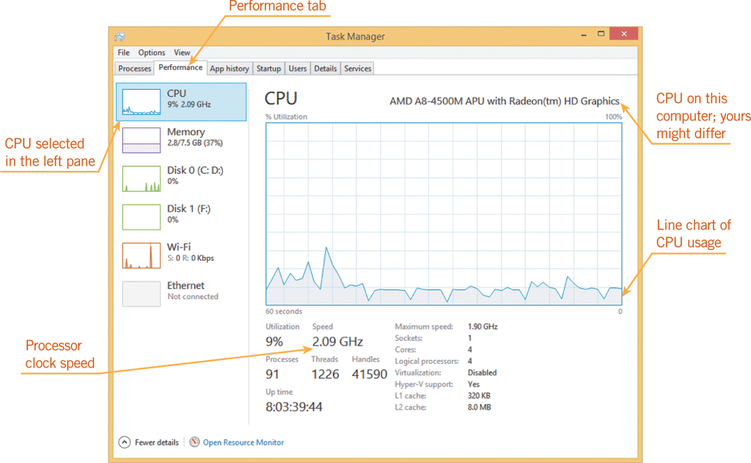
Identifying Hardware Components in a Computer (continued)
Performance Indicators (continued)

Slide 29
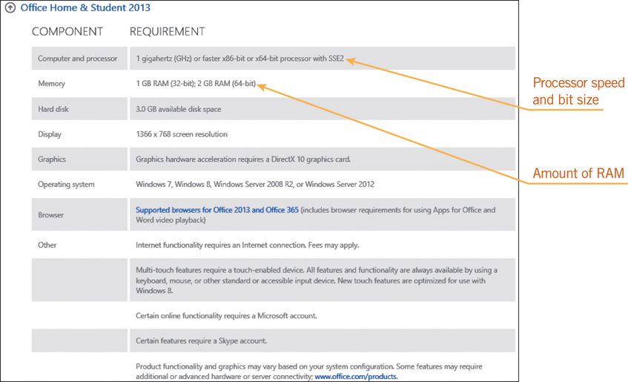
Understanding System Requirements
System requirements are hardware characteristics such as the amount of memory and the processor speed.
An application lists these hardware specifications on the product’s box or Web site.

Slide 30
Understanding System Requirements (continued)
Optional Hardware Requirements
Some applications include features designed for particular hardware.
Many popular applications now include features that accept input from touchscreens so you can use a fingertip to select commands or handwrite text input. These are optional hardware requirements.
You can use the software without the hardware, but having the hardware extends the features of the software.

Slide 31
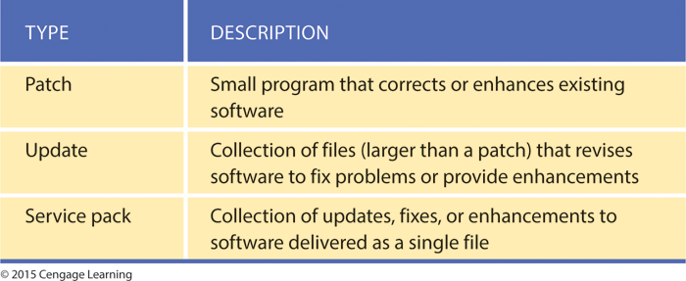
Updating Software
Application software is constantly changing to keep up with hardware developments and user requests.
Software is also revised to address problems.
If you purchased the original version of the software, you can download a patch, an update, or a service pack from the Internet.

Slide 32
Updating Software (continued)
Software developers use version numbers to keep track of the software they release.
The original software is assigned version 1.0.
When developers make major improvements, add new features, or change the software design, the new versions are called upgrades and are numbered 2.0, 3.0, and so on.

Slide 33
Updating Software (continued)
Installing means to move a copy of the software from its distribution location (such as a Web site) to your computer.
System and application software often include tools for managing updates.
An automatic update feature checks for updates and then downloads them when they are available.
When performing a manual update, you download and install the updates yourself.

Slide 34
Updating Software (continued)
Updating Operating Systems
Personal and mobile operating systems provide tools to keep the operating systems up to date by contacting a server and then downloading the files containing the updates.
The tools let you select settings for how and when to update the operating system.

Slide 35
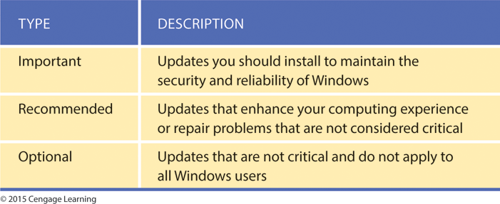
Updating Software (continued)
Updating Operating Systems (continued)
In Windows, you use Windows Update to check for the latest updates to Windows and to review your update settings.
Windows Update can download three types of updates.

Slide 36
Summary
In this lesson, you learned:
The characteristics and capabilities of a computer’s internal hardware components directly influence computer performance.
The system unit is the case that contains a computer’s main system components, including the motherboard, the processor, and memory. All of the essential chips and the circuitry that connects them are on the motherboard.
36
36

Slide 37
Summary (continued)
The internal hardware that processes data is the processor, also called the microprocessor and the central processing unit (CPU), which is a single computer chip that contains all the electronic circuitry for performing a personal computer’s processing tasks.
The processor has a significant effect on a computer’s performance and computing power.
37
37

Slide 38
Summary (continued)
The CPU has two primary sections: the arithmetic/logic unit (ALU) and the control unit.
The ALU performs arithmetic calculations and logical operations.
The control unit coordinates all of the processor’s activities and manages the flow of information through the processor.
38
38

Slide 39
Summary (continued)
The CPU carries out each instruction it receives from software by repeating four basic operations, which constitute the machine cycle: fetching, decoding, executing, and storing.
The fetching and decoding operations make up the instruction cycle.
The executing and storing operations make up the execution cycle.
39
39

Slide 40
Summary (continued)
The clock speed indicates the number of instructions the CPU can process per second. It directly influences the speed of the machine cycle, and, therefore, the overall performance of the computer.
The type of processor in a computer affects how quickly the computer can accept and carry out instructions from software.
A multicore processor is a single chip that contains more than one processor, such as dual-core processors and quad-core processors.
40
40

Slide 41
Summary (continued)
If a computer has a multicore processor, the operating system can use multiprocessing to split tasks among the processors. With multiprocessing, each processor can work on a different task at the same time.
On a computer with a single-core processor, the operating system can use multitasking and multithreading. A multitasking operating system can run more than one program at the same time. A multithreading operating system handles many parts, or threads, of a single program.
41
41

Slide 42
Summary (continued)
To store data and instructions, the CPU, operating system, and applications use memory, which consists of chips inside the system unit.
A computer has two major types of memory: volatile memory such as RAM, and nonvolatile memory such as ROM.
Volatile memory loses its contents when you turn off the power to the computer, while nonvolatile memory is permanent and does not lose its contents when you turn off the power to the computer.
42
42

Slide 43
Summary (continued)
The amount of RAM in your computer has a significant effect on performance. If you do not have enough RAM, the operating system must move data in and out of RAM frequently, which slows performance.
If the operating system spends more time swapping data between RAM and virtual memory than running software, it is said to be thrashing, which makes the computer sluggish or completely unresponsive.
43
43

Slide 44
Summary (continued)
ROM is stored on single chips attached to the motherboard. The operating system retrieves the data or programs stored in ROM when it needs them, such as when the computer starts up.
ROM is read-only memory because the operating system does not regularly write over its contents.
EEPROM and flash memory are types of ROM that are non-volatile, but can be modified.
44
44

Slide 45
Summary (continued)
If you change system components on your computer, by adding RAM, for example, the BIOS stored on a ROM chip must be updated to take these configuration changes into account.
In addition to RAM, the CPU accesses memory caches to speed processing. The small amount of memory stored on the CPU itself, apart from the registers, is called level 1 cache memory. Level 2 cache memory is a larger amount of memory that can reside on the CPU or on a chip that has a direct connection to the CPU.
45
45

Slide 46
Summary (continued)
You can tell how efficiently a computer is working by tracking its CPU and RAM usage. The lower the usage, the more efficiently the operating system is performing tasks. In Windows, you use Task Manager to track CPU and RAM usage.
Applications have system requirements, which are hardware specifications such as the amount of memory and the speed of the processor. If your computer does not meet the application’s system requirements, the application will not be able to run or will run ineffectively.
46
46

Slide 47
Summary (continued)
Some applications include features designed for special hardware such as touchscreens, which allow you to use a fingertip to select commands or handwrite text input. Microsoft Word includes a button that lets you switch to Touch Mode, which adapts the Ribbon for touchscreen users.
Software developers are constantly updating system and application software to keep up with hardware innovations and changes, user requests, and security threats. They release updated software as a patch, an update, or a service pack.
47
47

Slide 48
Summary (continued)
When developers make major improvements to software, add new features, or change the design, the new version is called an upgrade. The first upgrade is assigned version 2.0, the next is version 3.0, and so on.
You can download software, including new versions and updates, and installation instructions from a Web site. When you install software, you move a copy from its distribution location to your computer. During installation, the operating system changes its settings to make sure the software runs with your hardware.
48
48

Slide 49
Summary (continued)
To update system and application software, you can use the software’s automatic update feature, which automatically checks for software updates and then downloads them when they are available; or you can perform a manual update, where you download and install the updates yourself.
You use Windows Update to check for the latest updates to Windows and to review your update settings. Windows Update can download important, recommended, and optional updates.
Windows Update is a tool provided in the Control Panel, which is a window containing specialized tools you use to change the way Windows looks and behaves.
49
49

