Slide 1
Lesson 3
Windows File Management
Computer Literacy BASICS: A Comprehensive Guide to IC³, 5th Edition
Morrison / Wells / Ruffolo

Slide 2
Objectives
Describe how Windows stores files.
Identify parts of the File Explorer window.
Use File Explorer to navigate folders on your computer.
Copy, move, delete, and rename files.
Create and use shortcuts.
Search for files.
Identify file types.
2
2

Slide 3
Words to Know
application file
Clipboard
contextual tab
data file
disk
drive
executable file
file attribute
file path
file system
file type (file format)
folder
library
pin
3
3

Slide 4
Words to Know (continued)
Recycle Bin
removable media
root directory
shortcut
subfolder
system file
tag
USB drive
4
4

Slide 5
Understanding How Windows Stores Files
A file is a collection of data stored together.
Files are stored in folders, which are containers for related files, and on drives, which are storage devices.
Drives contain certain types of disks, which are storage media, including removable media and hard disks.

Slide 6
Understanding How Windows Stores Files (continued)
Removable media are disks that you insert or attach to a computer, such as USB drives (also called flash drives and thumb drives) and digital video discs (DVDs).
The term hard disk refers to a disk installed in the system unit that can store many gigabytes of data economically.
An external hard disk is contained in a removable drive that you can attach to your computer.

Slide 7
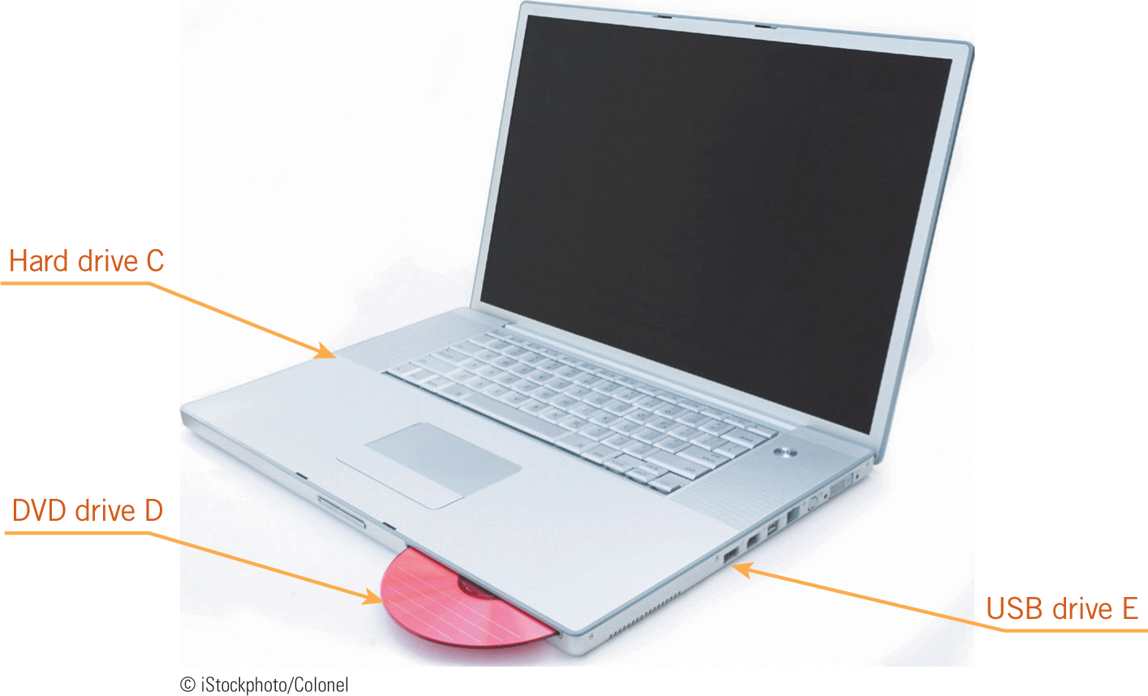
Understanding How Windows Stores Files (continued)
Windows names the drives on the computer by assigning each drive a letter.
The hard drive containing the operating system is named drive C by default.
The remaining drives can have any other letter from D to Z, followed by a colon (:).

Slide 8
Understanding How Windows Stores Files (continued)
Windows organizes the folders and files in a structure, or hierarchy, called a file system.
At the top of the file system is the root directory, which is where Windows stores system files and folders.
These folders contain other folders, called subfolders, in which you can store your own files.

Slide 9
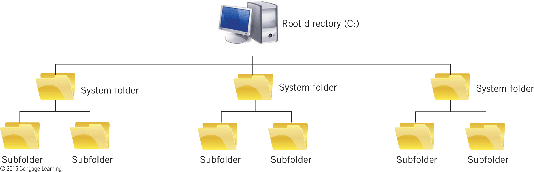
Understanding How Windows Stores Files (continued)

Slide 10
Using File Explorer
File Explorer is the Windows 8 file management tool you use to organize your files.
File Explorer displays the contents of your computer, using icons to represent drives, folders, and files.
Windows provides four folders for your personal files: Documents, Music, Pictures, and Videos.
The Desktop folder provides access to system resources such as the Recycle Bin.
The Download folder is for files you download, or copy from the Internet.

Slide 11
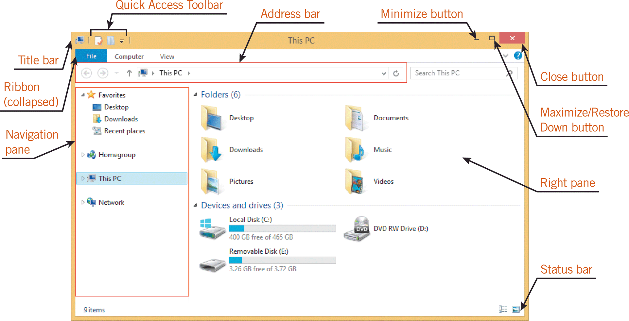
Using File Explorer (continued)

Slide 12
Using File Explorer (continued)
Folder Navigation
To work with files and folders, you can use the Navigation pane.
When you select a folder in the Navigation pane, the contents of that folder appear in the right pane.
To view the subfolders contained in a folder, you click on the expand icon.
You click on the collapse icon to hide the folder’s subfolders.
You can also double-click any device, drive, or folder in the right pane to display its contents.

Slide 13
Using File Explorer (continued)
Folder Navigation (continued)
A library displays similar types of files together, no matter where they are stored, so you can access them easily.
In contrast, a folder stores files in a specific location.
A contextual tab contains options related to your current task or location.

Slide 14
Using File Explorer (continued)
Navigating to Your Data Files
The file path indicates where a file is stored on your computer by leading you through the folder and file organization to your file.
  Removable Disk (E:)—The drive name
  Module 1—A top-level folder on drive E
  Lesson 3—A subfolder in the Module 1 folder
  Basics.docx—The full filename of the file

Slide 15
Using File Explorer (continued)
Changing View Settings
Using File Explorer, you can view the contents of a folder in eight ways: Extra large icons, Large icons, Medium icons, Small icons, List, Details, Tiles, and Content.
To change the File Explorer view setting to any one of the eight views, you use the View tab on the Ribbon.
To switch to Details view or Large icons view, you can use the view buttons on the status bar.

Slide 16
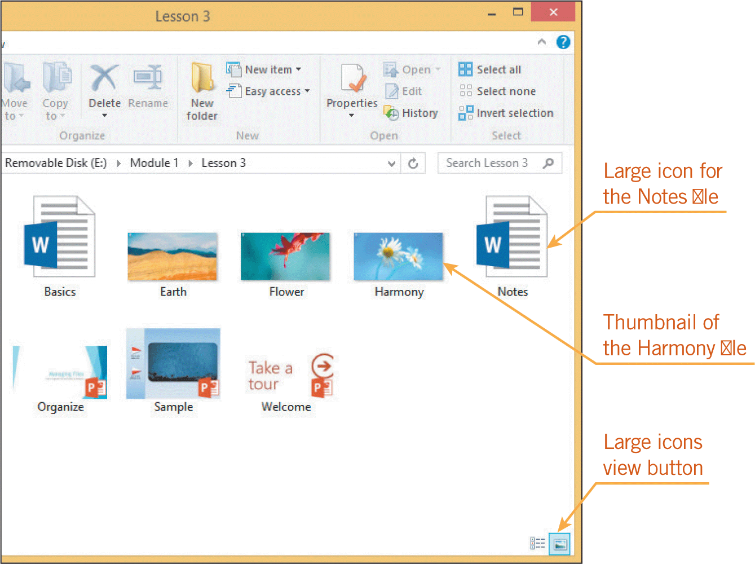
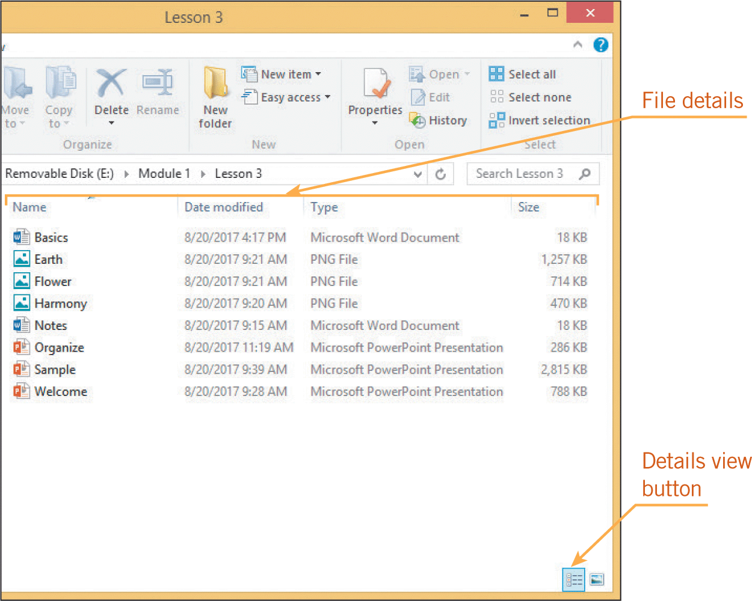
Using File Explorer (continued)
Changing View Settings (continued)

Slide 17
Managing Files
To organize files, you group similar files together in a folder, preferably a subfolder in one of the Windows default folders, such as Pictures or Documents.
Separate files into subfolders depending on the purpose or subject matter of the files, and then organize the subfolders from the top down.

Slide 18
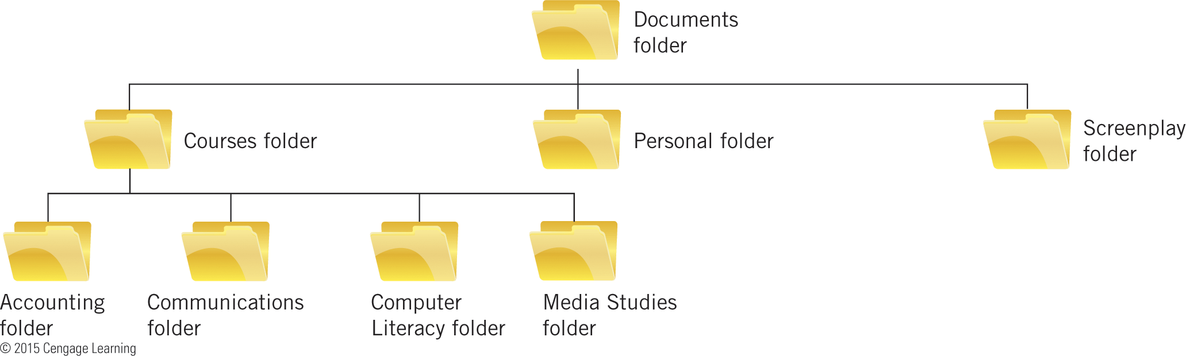
Managing Files (continued)

Slide 19
Managing Files (continued)
Creating Folders
Before you create files, you use File Explorer to create folders to contain the files.
You can use three methods in File Explorer to create folders: the Home tab on the Ribbon, a shortcut menu, and the Quick Access Toolbar.
A shortcut menu is a menu that appears when you right-click an object on the screen.
Shortcut menus list commands you can use with the object you right-clicked.

Slide 20
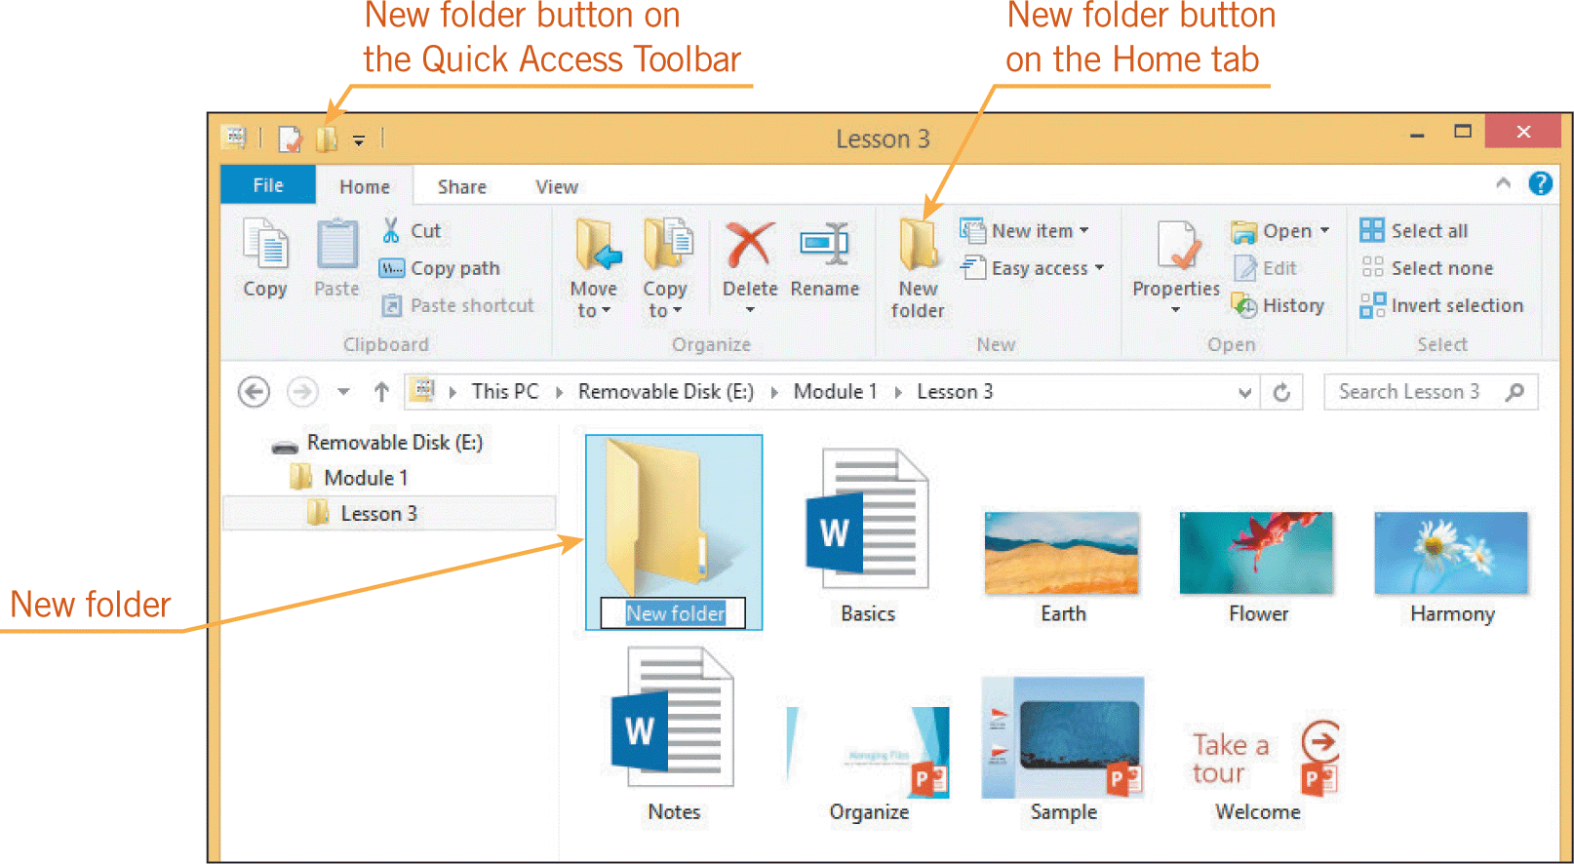
Managing Files (continued)
Creating Folders (continued)

Slide 21
Managing Files (continued)
Copying and Moving Files and Folders
To organize files into folders, you can copy or move the files.
Copying places a duplicate of a file in a new location.
Moving removes a file from its current location and places it in the destination folder.
File Explorer provides several methods for copying and moving files and folders.
Some methods use the Clipboard, which is a temporary storage area for files and information.

Slide 22
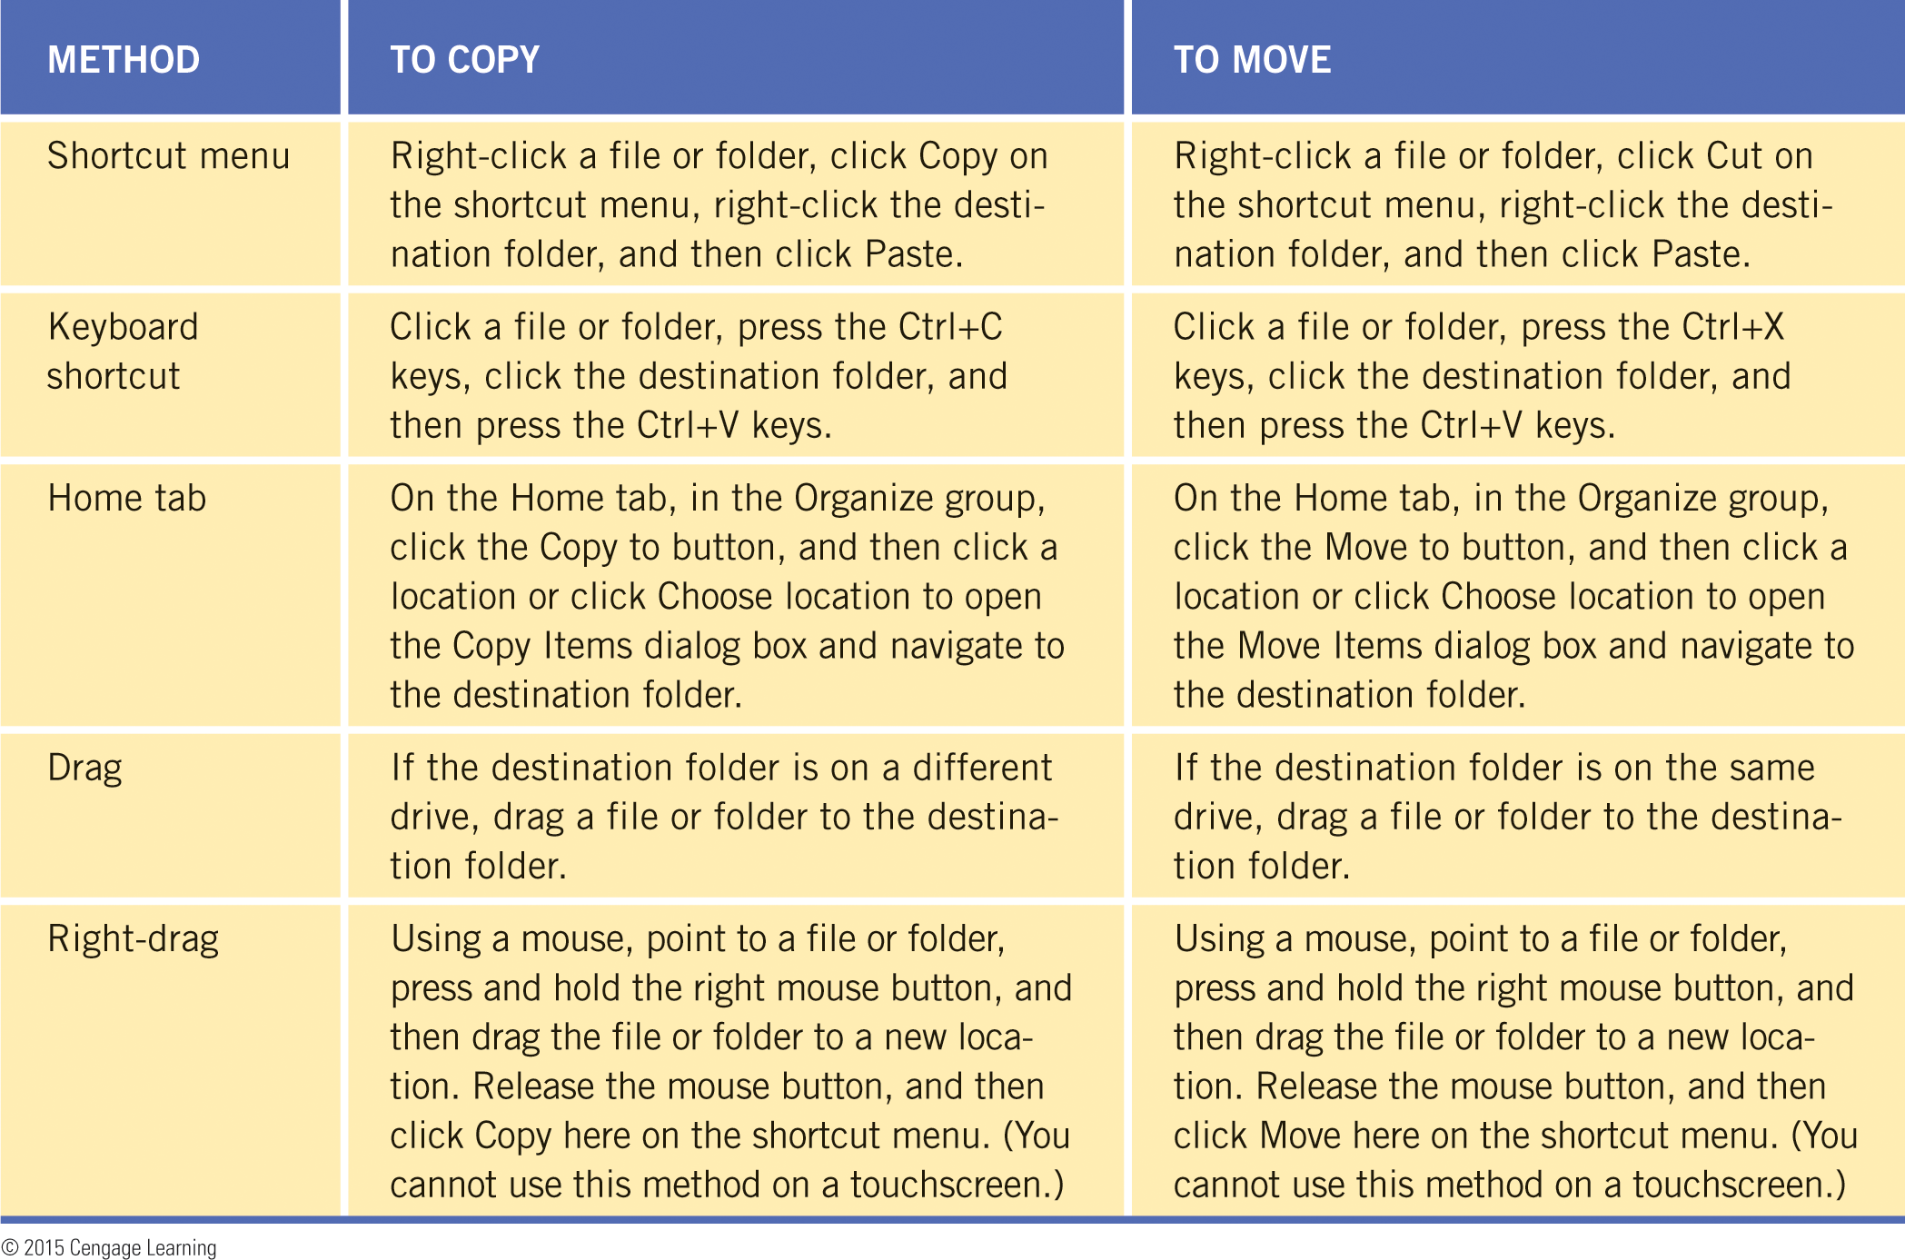
Managing Files (continued)
Copying and Moving Files and Folders (continued)

Slide 23
Managing Files (continued)
Deleting Files and Folders
You should periodically delete files and folders you no longer need.
You delete a file or folder in File Explorer by deleting an icon.
When you delete a file from a hard disk, Windows removes the file from the folder but stores the file contents in the Recycle Bin.
The Recycle Bin is an area on your hard disk that holds deleted files until you remove them permanently.
You can retrieve a file from the Recycle Bin; but after you empty the Recycle Bin, you can no longer recover the files it contained.

Slide 24
Managing Files (continued)
Renaming Files
Filenames should reflect the contents of the file.
The main part of a filename can have up to 255 characters.
You can use spaces and certain punctuation symbols in your filenames, but not the symbols
/ \ : * ? < > or | because these characters have special meanings in Windows.

Slide 25
Managing Files (continued)
Renaming Files (continued)
Keep the following guidelines in mind as you name files:
  Use descriptive names—Use filenames that are long enough to be meaningful, but short enough to be read easily on the screen.
  Do not change the file extension—If you change the file extension, Windows might not be able to find a program to open it.
  Follow a pattern—Use a consistent naming scheme that is clear to you.

Slide 26
Managing Files (continued)
Creating Shortcuts
In Windows, a shortcut is an icon or a tile that provides a quick way to perform an action such as opening a folder or a file.
You can create a shortcut in two places: on the Start screen and on the desktop.
You can add, or pin, a folder to the Start screen, where it appears as a tile.
You can create shortcuts on the desktop to access drives, folders, files, Web pages, applications, or other computer resources.

Slide 27
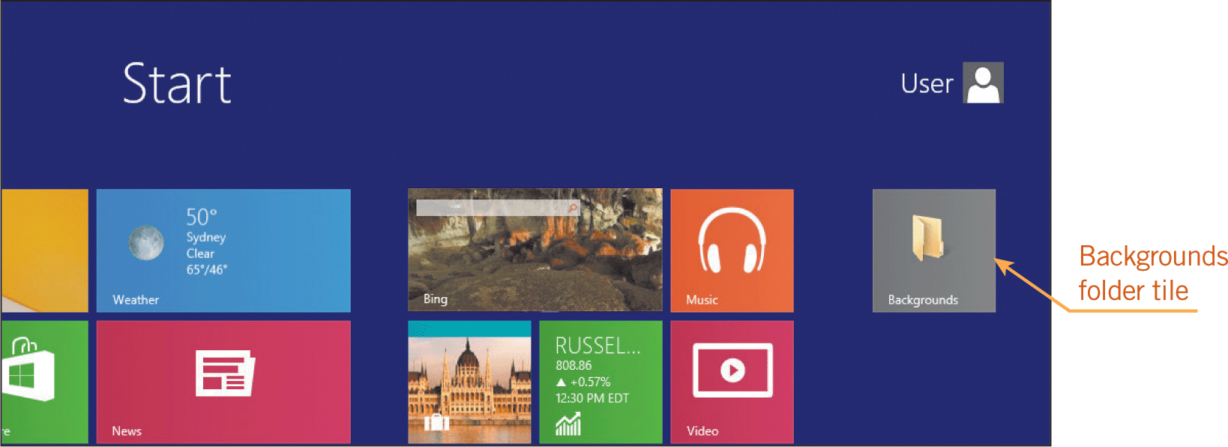
Managing Files (continued)
Creating Shortcuts (continued)

Slide 28
Managing Files (continued)
Searching for Files
If you are not sure where a file is stored, you can use the Search box in File Explorer to find a file.
Start typing text associated with the file into the Search box. Windows searches for the file by examining the names of the files displayed in the current folder and files in its subfolders.
If Windows finds a file whose filename contains a word with the search text you specify, it displays that file in the File Explorer window.

Slide 29
Understanding File Types
A computer can contain three categories of files: system files, application files, and data files.
System files are those necessary for running the operating system.
An application file is part of an application, such as a word-processing application, and it is a necessary file for running the software.
A data file is one you create when working with an application.
Many system and application files are executable files that perform tasks automatically when you open them.

Slide 30
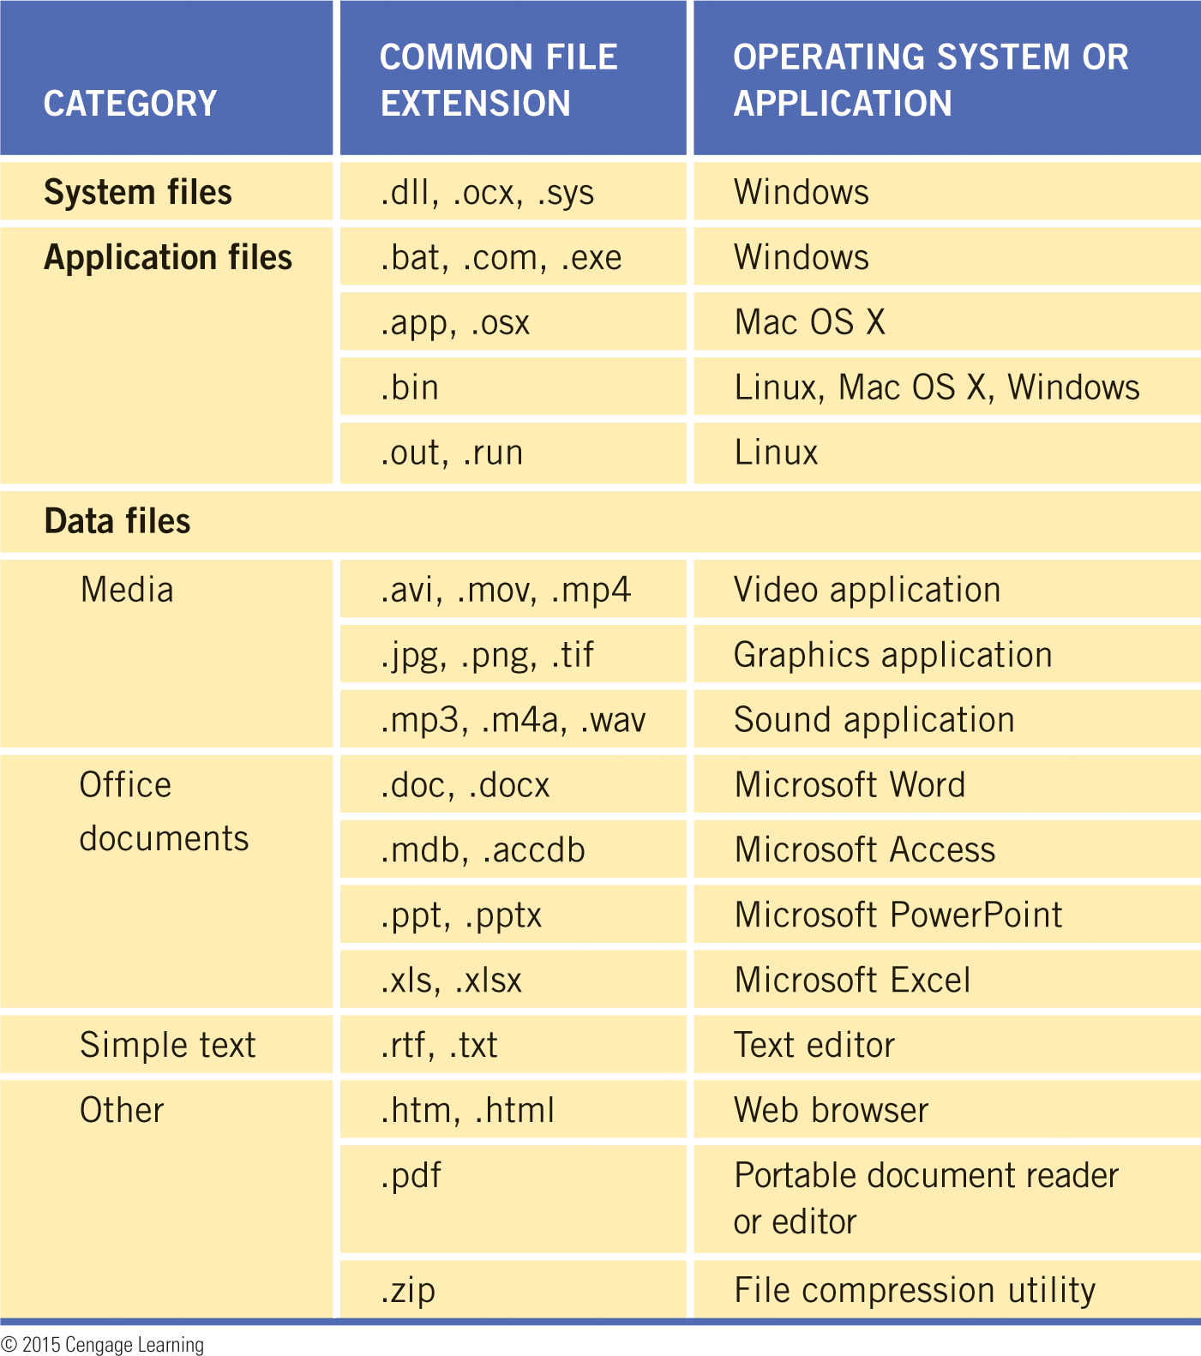
Understanding File Types (continued)

Slide 31
Summary
In this lesson, you learned:
The characteristics and capabilities of a computer’s internal hardware components directly influence computer performance.
You store files in folders, which are containers for related files, and on drives, which are storage devices. You use folders to organize your files on a drive.
A computer can store folders and files on different types of disks, including removable media and hard disks. Before your computer can access a removable disk, you must insert the disk into a drive, which Windows names by assigning it a drive letter.

Slide 32
Summary (continued)
Windows organizes the folders and files in a computer in a hierarchy called a file system. At the top of the file system is the root directory, which is where Windows stores system files and folders.
The file management tool in Windows 8 is called File Explorer. You use File Explorer to display files and folders, navigate the Windows file system, and perform other file management tasks.

Slide 33
Summary (continued)
To navigate a computer with File Explorer, you click expand icons in the Navigation pane until you find the folder that you want. Then, you click the folder icon in the Navigation pane to view the folders and files it contains, which are displayed in the right pane.
A file path is a notation that indicates where a file is stored. A file path includes the drive name and letter, folder and subfolders, and the full filename.

Slide 34
Summary (continued)
A full filename includes the main part of the filename, a dot, and the file extension, which is usually three or four characters that identify the file type.
Using File Explorer, you can view the contents of a folder in eight ways, including Details view, which lists details about each file, and Large icons view, which displays a preview of the file’s content if the file includes graphics.

Slide 35
Summary (continued)
To organize files, you group similar files together in a folder, preferably a subfolder in one of the Windows default folders. Separate the files into subfolders depending on the purpose or subject matter of the files, and organize the subfolders from the top down.
After creating folders and subfolders according to your file organization, you can copy and move files into the folders using several methods. Some methods use the Clipboard, which is a temporary storage area for files and information that you copy or move from one place and plan to use somewhere else.

Slide 36
Summary (continued)
You should delete files and folders you no longer need to stay organized. When you delete a file from a hard disk, Windows removes the file from the folder but stores the file contents in the Recycle Bin until you remove them permanently.
The names of folders and files should reflect their contents, and can contain up to 255 characters, except for certain characters that have special meanings in Windows.

Slide 37
Summary (continued)
In Windows, a shortcut is a quick way to perform an action such as opening a folder or a file. You can create shortcuts on the Start screen and on the desktop.
To find a file using File Explorer, you click the Search box and then start typing text associated with the file, such as a word in the filename.

Slide 38
Summary (continued)
The three categories of files on a computer are system files, application files, and data files. A system file is one necessary for running the operating system. An application file is a necessary file for running the application. A data file is one you create when working with an application.
You should be able to recognize common files types and their file extensions so you know which files to avoid (system and application files), and to identify applications you can use to open files.

