Slide 1
Lesson 6
Classifying and Evaluating Computers
Computer Literacy BASICS: A Comprehensive Guide to IC³, 5th Edition
Morrison / Wells / Ruffolo

Slide 2
Objectives
Identify types of personal computers.
Describe desktop computers.
Compare laptops and tablets.
Evaluate smartphones.
Describe embedded computers.
Describe servers and other large computers.
2
2

Slide 3
Words to Know
all-in-one desktop
convertible tablet
desktop computer
e-book reader
electronic paper display
embedded computer
enterprise server
file server
handheld game device
laptop computer
mainframe computer
netbook computer
network adapter
notebook
3
3

Slide 4
Words to Know (continued)
personal computer (PC)
portable media player
scalability
supercomputer
tower
ultrabook
Web server
4
4

Slide 5
Preparing to Purchase a Computer
Computers can be organized into three categories: personal computers, embedded computers (such as ATMs), and large computers (such as servers).
A personal computer (PC) is a computing device than can perform input, processing, output, and storage activities on its own and is designed to be used by one person at a time.
The personal computer you decide to buy depends on how you plan to use it, your budget, and its value.

Slide 6
Preparing to Purchase a Computer (continued)
Computer usage typically falls into the following ranges:
  Basic—Occasional use for visiting Web sites, exchanging e-mail, and creating word-processing documents
  Intermediate—Frequent use for a variety of tasks including playing games, watching videos, shopping online, and using productivity software
  Advanced—Performing tasks that require the maximum amounts available in processing speed, memory usage, or storage capacity

Slide 7
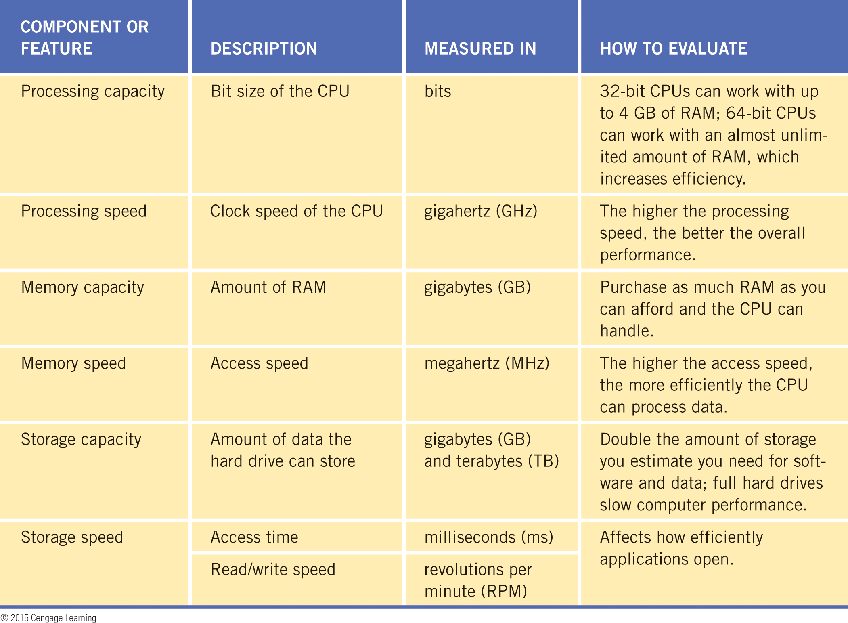
Preparing to Purchase a Computer (continued)
The quality of a computer is determined primarily by the performance of its system components.

Slide 8

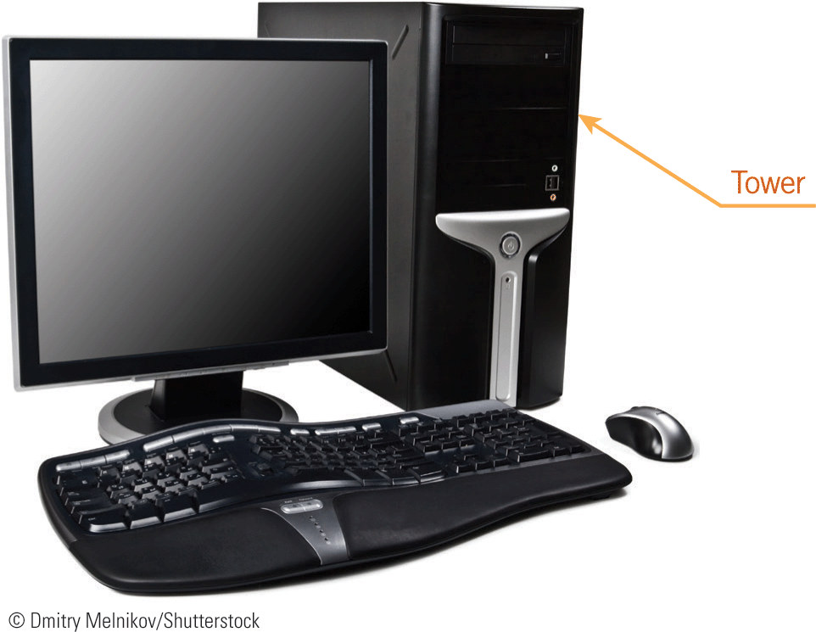
Preparing to Purchase a Computer (continued)
Desktop Computers
A desktop computer is a computer that fits on or next to a desk.
The system unit containing the processing components is called a tower.

Slide 9
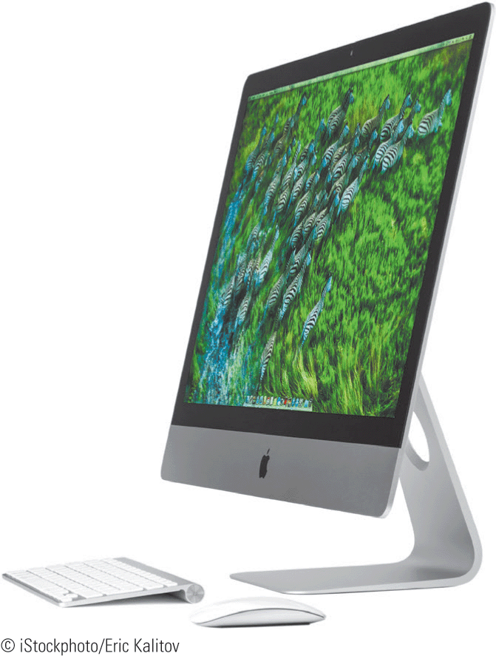

Preparing to Purchase a Computer (continued)
Desktop Computers (continued)
An all-in-one desktop houses the processing components in the same case that holds the monitor; there is no tower.

Slide 10


Preparing to Purchase a Computer (continued)
Laptop Computers
A laptop computer (sometimes called a notebook) is a lightweight mobile computer about the size of a paper notebook that includes the system components, keyboard, pointing device, and display screen in a single unit.

Slide 11
Preparing to Purchase a Computer (continued)
Laptop Computers (continued)
Netbook computers (also called ultrabooks) look like laptops but are smaller and lighter.
Netbook computers have less power and storage capacity, lack a CD/DVD drive, and provide a smaller keyboard and display screen than laptops, but they include batteries that hold a charge longer.
Netbooks are suitable for mobile users who access the Internet frequently or for long periods of time and don’t need to store a lot of data or software on a hard drive.

Slide 12

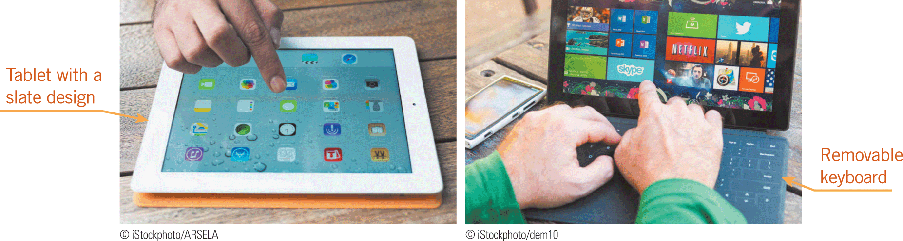
Preparing to Purchase a Computer (continued)
Tablet Computers
A tablet computer is a one-piece handheld computer that typically includes a touchscreen.
True tablets use a slate design; they are rigid and do not fold.
Convertible tablets use a hybrid design that includes a swivel screen or removable keyboard.

Slide 13
Preparing to Purchase a Computer (continued)
Comparing Tablets and Laptops
For many people considering a new computer, the choice is between a tablet and a laptop.
To compare tablets and laptops, consider their input devices, battery life, storage capacity, performance, physical factors, and price as well as your computer usage.

Slide 14

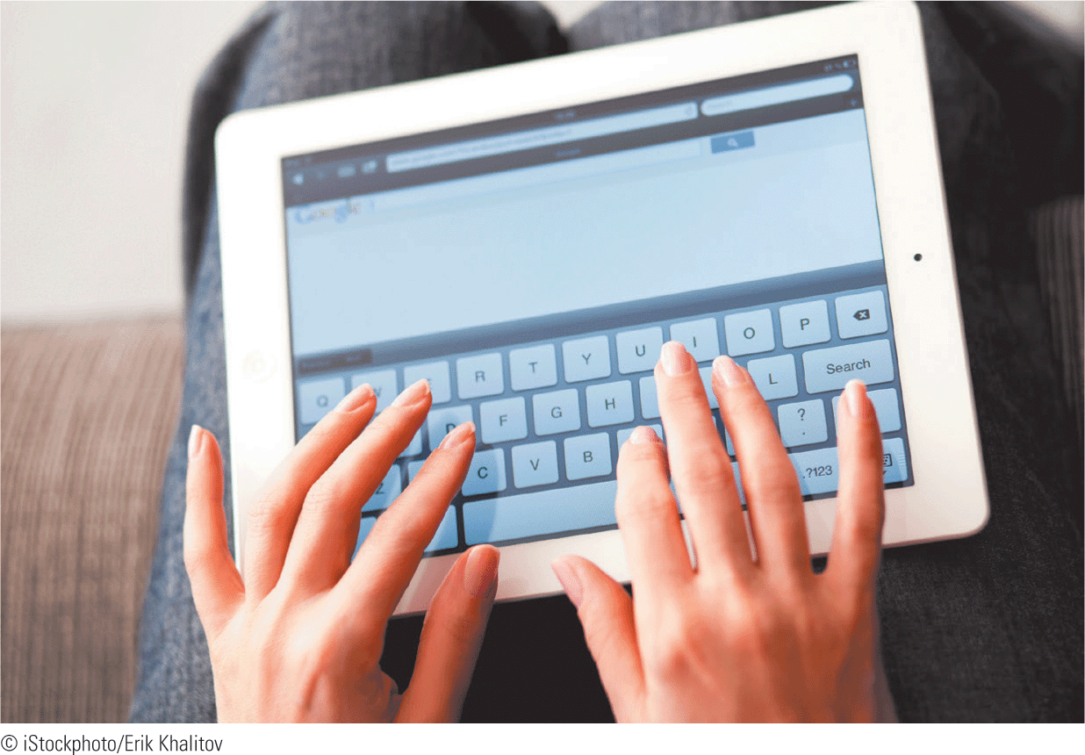
Preparing to Purchase a Computer (continued)
Comparing Tablets and Laptops (continued)
  Input devices—A laptop provides a physical keyboard and pointing device, whereas a tablet using a slate design has a virtual keyboard and touchscreen.

Slide 15
Preparing to Purchase a Computer (continued)
Comparing Tablets and Laptops (continued)
  Battery life—Because tablet hardware requires less power than laptops, tablets can run on battery power much longer than laptops.
  Storage capacity—Overall, although tablet storage devices can access data quickly and require less power than laptops, they offer limited storage capacities.

Slide 16
Preparing to Purchase a Computer (continued)
Comparing Tablets and Laptops (continued)
  Performance—Most tablets use low-power dual-core processors, so their performance lags behind that of a laptop.
  Physical factors—Tablets are smaller than laptops, ranging from about 7 to 10 inches diagonally. They also weigh less, around 1 pound on average, while laptops range from 2 to 5 pounds.

Slide 17
Preparing to Purchase a Computer (continued)
Comparing Tablets and Laptops (continued)
  Price—Entry-level tablet computers are more expensive (about $500) than entry-level laptops. A laptop is the best value because it provides better components at a lower price.
  Computer usage—Laptops are well-suited to productivity tasks; tablets are ideal for consumption tasks.

Slide 18
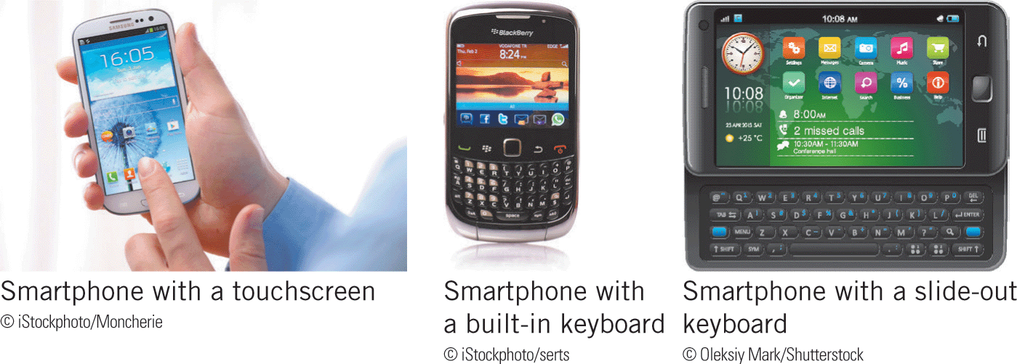

Preparing to Purchase a Computer (continued)
Smartphones
A smartphone is a cell phone that includes many features of a computer.
Smartphones connect wirelessly to the Internet; include built-in cameras, music players, and global positioning systems (GPSs); and let you send and receive phone calls, e-mail, messages, and text messages.

Slide 19
Preparing to Purchase a Computer (continued)
Evaluating Smartphones
To evaluate smartphones, use the same set of criteria used to compare laptops and tablets—input devices, battery life, storage capacity, performance, physical factors, price, and computer usage.
  Input devices—The physical keyboards provided with some smartphones are small, and were designed for typing short phrases used in Internet search text and electronic messages. Touchscreens are more common and easier to use.

Slide 20
Preparing to Purchase a Computer (continued)
Evaluating Smartphones (continued)
  Battery life—Battery usage on smartphones varies significantly depending on your activities. Accessing the Internet uses more battery power than having a phone conversation.
  Storage capacity—Similar to tablets, smartphones use solid-state drives to store data, with capacities of 16 to 64 GB. In addition, smartphones from some manufacturers include slots for microSD cards that can hold up to 64 GB of data.

Slide 21
Preparing to Purchase a Computer (continued)
Evaluating Smartphones (continued)
  Performance—Smartphones pack a lot of processing power into a small space, with most models boasting multicore processors and 2 GB of RAM.
  Physical factors—Smartphones are lightweight, about 4 to 6 oz. To compensate for small screens, smartphones increase the screen resolution.

Slide 22
Preparing to Purchase a Computer (continued)
Evaluating Smartphones (continued)
  Price—Prices for smartphones have been falling recently, with an average price of around $300 expected in 2017.
  Computer usage—If you use a computer only to access the Internet and communicate with others, a smartphone might be the only computer device you need. If you need to use more productive or full-featured software, purchase a smartphone as a supplement to another personal computer.

Slide 23
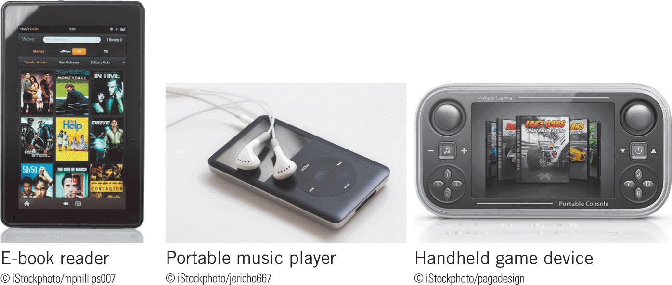
Preparing to Purchase a Computer (continued)
Other Mobile Devices
Mobile devices besides laptops, tablets, and smartphones include electronic book (e-book) readers, portable media players, and handheld game devices.

Slide 24
Preparing to Purchase a Computer (continued)
Other Mobile Devices (continued)
Each of these devices is dedicated to a particular purpose, and only lets you perform tasks related to that purpose.
  E-book readers—You use an e-book reader (also called an e-reader) to download and read electronic versions of printed books, magazines, and newspapers. E-book readers use electronic paper displays, which consume less power and provide higher contrast in bright lighting than LCDs.

Slide 25
Preparing to Purchase a Computer (continued)
Other Mobile Devices (continued)
  Portable media players—A portable media player is a mobile device that can store digital media such as songs, videos, and photos, typically on a small hard drive. Portable media players are also called MP3 players, a term that refers to the MP3 file format used for many digital audio files.
  Handheld game device—A handheld game device is a mobile device for a single video game player to use one at a time.

Slide 26
Understanding Embedded Computers
An embedded computer is a processor built into a household appliance or other device such as an ATM, navigation system, refrigerator, television, or other consumer electronics.
The appeal and strength of an embedded computer are that it adds computing power to a device without needing intervention from a user.

Slide 27
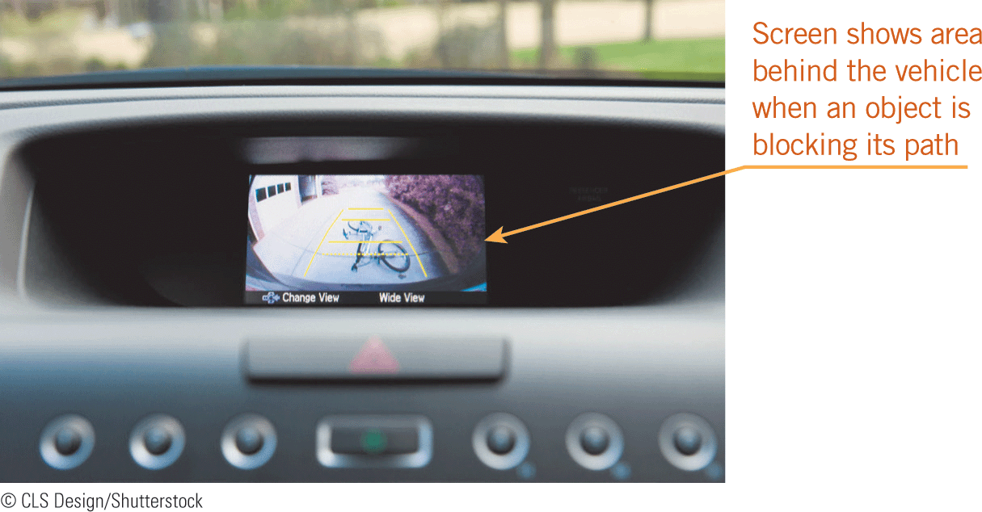

Understanding Embedded Computers (continued)
Features such as your car sensing when it moves out of its lane or when a person or an object is blocking your path as you back up are controlled by embedded computers.

Slide 28
Understanding Servers and Other Large Computers
Servers, mainframes, and supercomputers are large computers because they are designed for use by more than one person, up to tens of thousands of people in many cases.
Large computers need much more processing, power, and storage than personal computers.

Slide 29
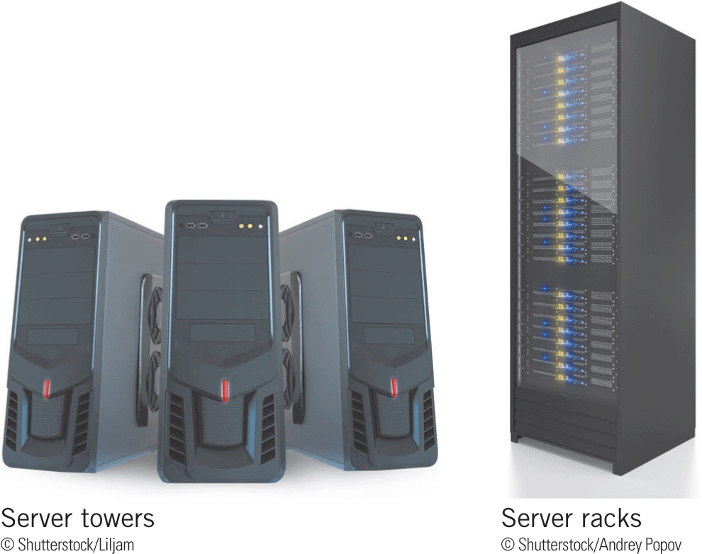

Understanding Servers and Other Large Computers (continued)
Servers
Servers are dedicated to handling data with minimal user interaction.
They do not include optical storage devices, speakers, high-end graphic displays, or other peripherals.

Slide 30
Understanding Servers and Other Large Computers (continued)
Servers (continued)
A server is usually dedicated to a single type of task.
A Web server handles the exchange of information across the Internet.
Large corporations use enterprise servers to provide employees access to special software used to run the company’s business.
Smaller businesses use file servers to share files and programs among employees.

Slide 31
Understanding Servers and Other Large Computers (continued)
Servers (continued)
A basic server can have processing, memory, and storage capabilities similar to a powerful desktop computer.
As the number of server users increases, servers must be able to increase their processing capacity to handle the additional data, a feature called scalability.
All servers need a reliable network adapter, which is a card installed on the motherboard that connects the server to a larger network or the Internet.

Slide 32
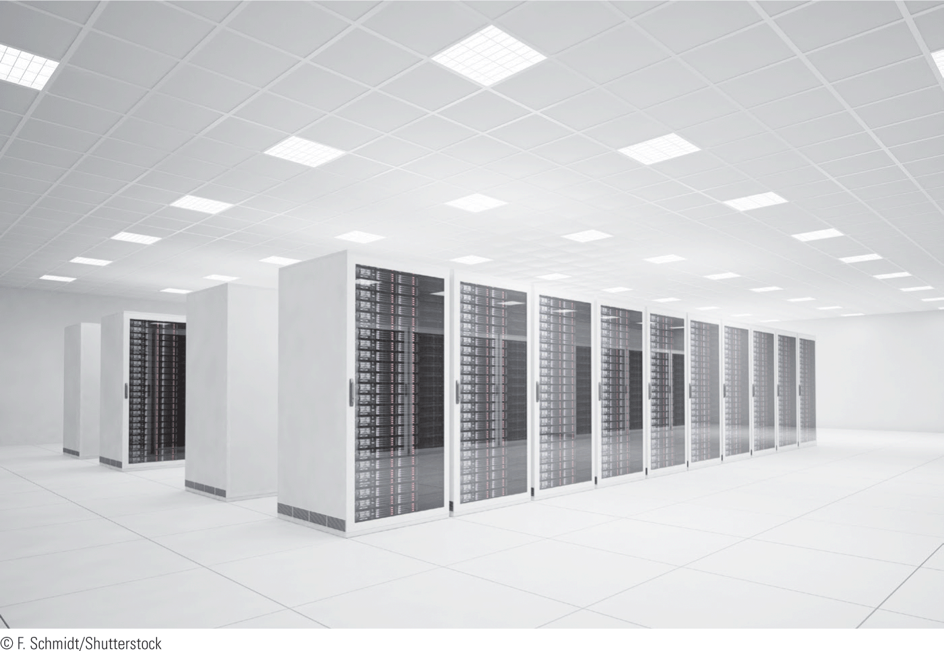

Understanding Servers and Other Large Computers (continued)
Mainframes
A mainframe computer is a powerful computer designed for processing huge amounts of data for hundreds or thousands of users at the same time.

Slide 33
Understanding Servers and Other Large Computers (continued)
Mainframes (continued)
Mainframes are larger and more expensive than servers, and are typically located in climate-controlled, secure data centers to keep the processing components cool and the data safe.
Mainframes are designed to handle extremely large volumes of data on their own, while servers transfer data around a network, responding to requests from client computers to retrieve, send, and store data.

Slide 34
Understanding Servers and Other Large Computers (continued)
Mainframes (continued)
Large organizations rely on mainframes to process and store records of data that are too large for other computers.
Data storage is one reason mainframes are more expensive than servers, starting at around $75,000 for a mainframe computer compared to $500 for a server.
Most mainframe computers can run without interruption for decades, which is why they are worth the investment to large organizations.

Slide 35
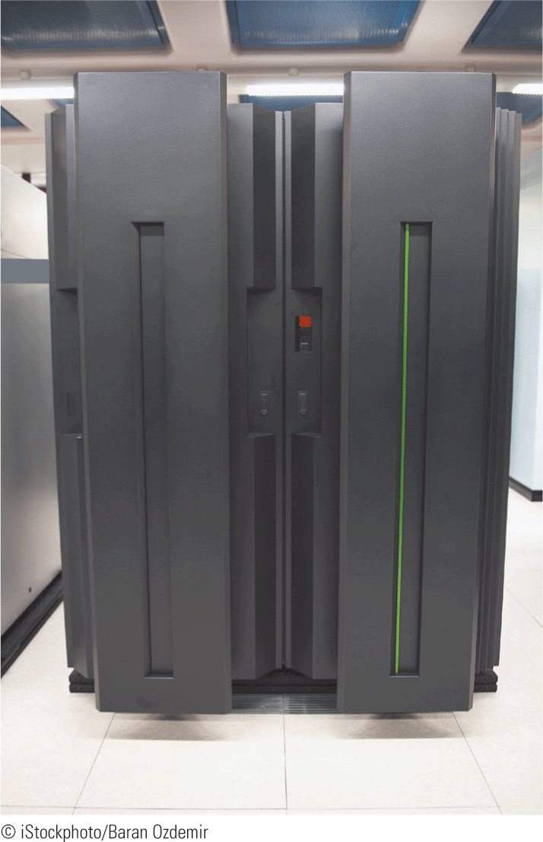

Understanding Servers and Other Large Computers (continued)
Supercomputers
A supercomputer is a very powerful computer distinguished by its processing capacity, especially its speed of calculation.
Supercomputers have processors with a million or more cores, and are used primarily for scientific applications that need to perform complex calculations very rapidly.

Slide 36
Summary
In this lesson, you learned:
A personal computer is a computing device that can perform input, processing, output, and storage activities on its own and is designed to be used by one person at a time.
The personal computer you decide to buy depends on how you plan to use it, your budget, and its value, which is the quality of the computer’s features, construction, and components compared to the price.
36
36

Slide 37
Summary (continued)
Computer use can be basic, intermediate, or advanced. Basic usage involves occasionally visiting Web pages and creating word-processing documents. Intermediate usage involves more frequent work on the computer to access the Internet and productivity software. Advanced usage involves tasks that require the maximum or near the maximum amounts available in processing speed, memory usage, or storage capacity.
37
37

Slide 38
Summary (continued)
The quality of a computer is determined primarily by the performance of its system components, including the capacities and speeds of the processor, RAM, and storage devices.
When considering a personal computer to purchase, you can select from four major types: desktop computers, laptops, tablets, and smartphones.
38
38

Slide 39
Summary (continued)
A desktop computer fits on or next to a desk, is designed to be stationary, and runs on power from a wall outlet. With a traditional desktop computer, the system unit, monitor, keyboard, and pointing devices are separate pieces of equipment. The computer case containing the processing components is called a tower.
39
39

Slide 40
Summary (continued)
A recently developed type of desktop computer is called an all-in-one desktop, which houses the processing components in the same case that holds the screen, not in a tower.
Traditional desktop computers are preferred by computer enthusiasts who plan to upgrade their systems. People who want a desktop computer but lack enough physical space can consider an all-in-one desktop, which is more compact than a traditional desktop computer, can be moved more easily, often includes a touchscreen, and has a sleek, attractive style.
40
40

Slide 41
Summary (continued)
A laptop computer (sometimes called a notebook) is a lightweight mobile computer about the size of a paper notebook that includes the system components, keyboard, pointing device, and display monitor in a single unit.
41
41

Slide 42
Summary (continued)
Today’s laptops have as much computing power and perform as well as most desktop computers because laptops can include top-notch processors and large amounts of RAM and hard disk storage capacity. However, because it costs more to produce components that fit a laptop’s compact design, laptops are slightly more expensive than desktop computers with the same power, speed, and storage capacity.
42
42

Slide 43
Summary (continued)
Netbook computers (also called ultrabooks) look like laptops but are smaller and lighter, have less power and storage capacity, lack a CD/DVD drive, and provide a smaller keyboard and display screen, but include batteries that hold a charge longer.
43
43

Slide 44
Summary (continued)
Like laptops, tablets run on battery power and can be plugged into a wall outlet as necessary. True tablets use a slate design; they are rigid and do not fold. Convertible tablets use a hybrid design that includes a swivel screen or removable keyboard so you can use the computer as a laptop or tablet.
44
44

Slide 45
Summary (continued)
To compare tablets and laptops in general, consider their input devices, battery life, storage capacity, physical factors, and price as well as your computer usage.
Smartphones connect wirelessly to the Internet; include built-in cameras, music players, and global positioning systems; and let you send and receive phone calls, e-mail messages, and text messages.
45
45

Slide 46
Summary (continued)
To evaluate smartphones, you can use the same set of criteria for comparing laptops and tablets: input devices, battery life, storage capacity, performance, physical factors, price, and computer usage.
Mobile devices besides laptops, tablets, and smartphones include electronic book (e-book) readers, portable media players, and handheld game devices.
46
46

Slide 47
Summary (continued)
An embedded computer is a processor built into a household appliance or other device. Its appeal and strength are that it adds computing power to a device without needing intervention from a user.
Servers, mainframes, and supercomputers are large computers because they are designed for use by up to tens of thousands of people in many cases. To support that many users, large computers need much more processing power, memory, and storage capacity than personal computers.
47
47

Slide 48
Summary (continued)
Servers are dedicated to handling data with minimal user interaction. Most include system components only—no monitor, keyboard, or other peripherals. Types of servers include Web servers, enterprise servers, and file servers.
A basic server can have processing, memory, and storage capabilities similar to a powerful desktop computer. As the number of server users increases, servers must be able to increase their processing capacity to handle the additional data, a feature called scalability.
48
48

Slide 49
Summary (continued)
A mainframe computer is a powerful computer that is larger and more expensive than a server and is designed for processing huge amounts of data with stability, reliability, and accuracy.
To be classified as a supercomputer, a computer must be one of the fastest computers in the world. Supercomputers are used primarily for scientific applications that need to perform complex calculations very rapidly.
49
49

