Slide 1
Lesson 10 Data and Hardware Protection
Computer Literacy BASICS: A Comprehensive Guide to IC³, 5th Edition
Morrison / Wells / Ruffolo

Slide 2
Objectives
Understand types of backups.
Select a backup method.
Determine a schedule for backing up data.
Back up and restore files and folders.
Protect a computer from theft and physical damage.
2
2

Slide 3
Words to Know
backup
backup plan
backup software
differential backup
encryption
full system backup
incremental backup
local backup
online backup
redundancy
remote backup
restore
selective backup
synchronize
uninterruptible power supply (UPS)
3
3

Slide 4
Backing Up and Restoring Files
A backup is a duplicate copy of a file you can use if the original file is lost, damaged, or destroyed.
To use a backup file, you need to restore it, which means to copy the file to its original location on your computer.
You need to make two major decisions before you back up a file: the type of backup to create, and which backup method to use.

Slide 5
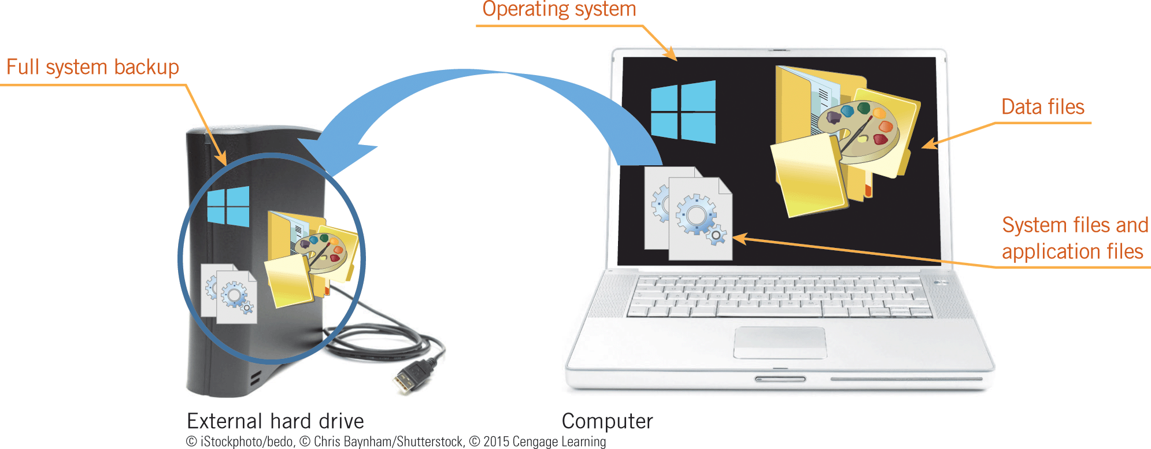
Backing Up and Restoring Files (continued)
Understanding Types of Backups
The four most common types of backups are full system backups, differential backups, incremental backups, and selective backups.
A full system backup is an exact duplication of the hard drive including data files, system files and settings, application files, and the operating system.

Slide 6
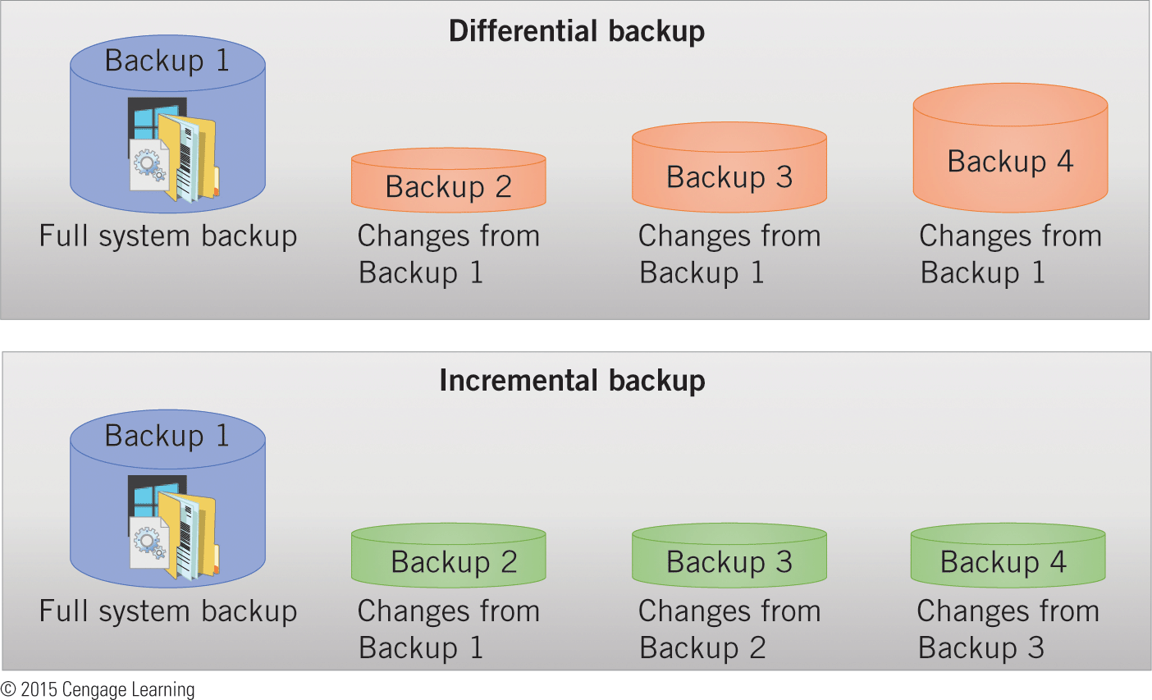
Backing Up and Restoring Files (continued)
Understanding Types of Backups (continued)
A differential backup contains copies of the files that have changed since the last full system backup.
An incremental backup contains copies of the files that have changed since the last full system backup or the last incremental backup.

Slide 7
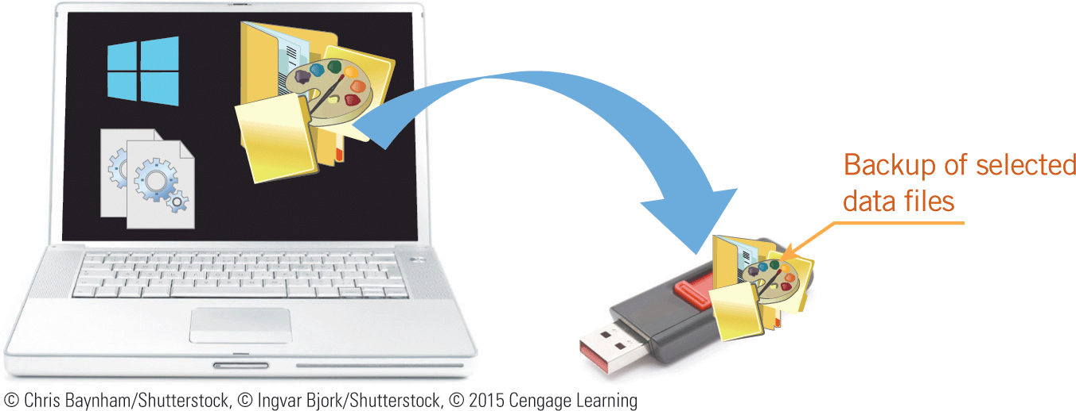
Backing Up and Restoring Files (continued)
Understanding Types of Backups (continued)
When you perform a selective backup, you select the folders and files you want to back up.

Slide 8
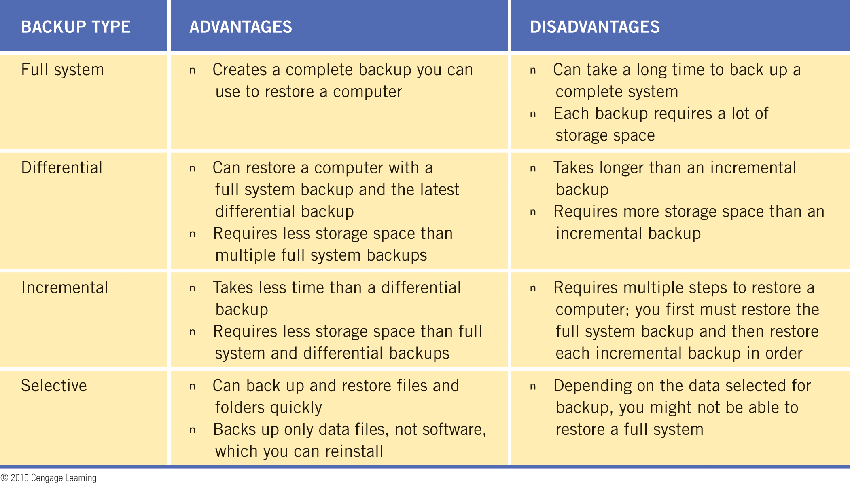
Backing Up and Restoring Files (continued)
Understanding Types of Backups (continued)

Slide 9
Backing Up and Restoring Files (continued)
Selecting a Backup Method
To create a backup, you can use software installed on your computer, an online backup service provider, or a combination of both.
Using Backup Software
Backup software is a set of system utilities for creating and updating backups, and restoring files from a backup.
Backup software compresses all the files selected for a backup into a single large file.

Slide 10
Backing Up and Restoring Files (continued)
Selecting a Backup Method (continued)
Using Backup Software (continued)
Along with the compressed files, backup software stores an index of file details, including their original locations, to restore the files.
Mobile operating systems also include backup software you can use to create full system and incremental backups.
You can also install other backup software to use instead of, or in addition to, backup software provided by operating systems.

Slide 11
Backing Up and Restoring Files (continued)
Selecting a Backup Method (continued)
Using Backup Software (continued)
When using backup software, you set a schedule and select a location for the backups.
When you select a location for the backups, select one other than your hard drive so you can access the backup files in case of hard drive failure or other major computer problems.
You typically choose an external hard drive, a USB flash drive, an optical disc, or a network folder as a location for backups.

Slide 12
Backing Up and Restoring Files (continued)
Selecting a Backup Method (continued)
Using Backup Software (continued)
You can store the backup medium (external hard drive, USB flash drive, or optical disc) close to the computer, which is considered a local backup, or take it to an off-site location for safekeeping.
Creating and storing a backup on a network folder is also considered a local backup if you are using a local area network.

Slide 13
Backing Up and Restoring Files (continued)
Selecting a Backup Method (continued)
Using Backup Software (continued)
In addition to setting schedules and selecting locations, backup software usually allows you to select the following options:
Backup type—You can choose whether to perform a full system, differential, or incremental backup.
Encryption—Encryption is a security method that encodes data so that only authorized people can access it.

Slide 14
Backing Up and Restoring Files (continued)
Selecting a Backup Method (continued)
Using Backup Software (continued)
In addition to setting schedules and selecting locations, backup software usually allows you to select the following options (continued):
Media spanning—This feature allows you to use more than one drive to store the backup file.
Verification—After backing up the files, backup software compares every file in the backup location to the corresponding file on your hard drive to make sure it did not skip a file.

Slide 15
Backing Up and Restoring Files (continued)
Selecting a Backup Method (continued)
Using Online Backup Service Providers
An alternative to installing and using backup software is subscribing to an online backup service, which automatically creates backups on a secure server.
When you create a backup on a server, you are creating an online backup or a remote backup.
You typically pay a fee to the service provider to use an online backup service.

Slide 16
Backing Up and Restoring Files (continued)
Selecting a Backup Method (continued)
Using Online Backup Service Providers (continued)
The services let you set the same types of options you can set with backup software installed on your computer.
To access the backup file, you enter a username and password.

Slide 17
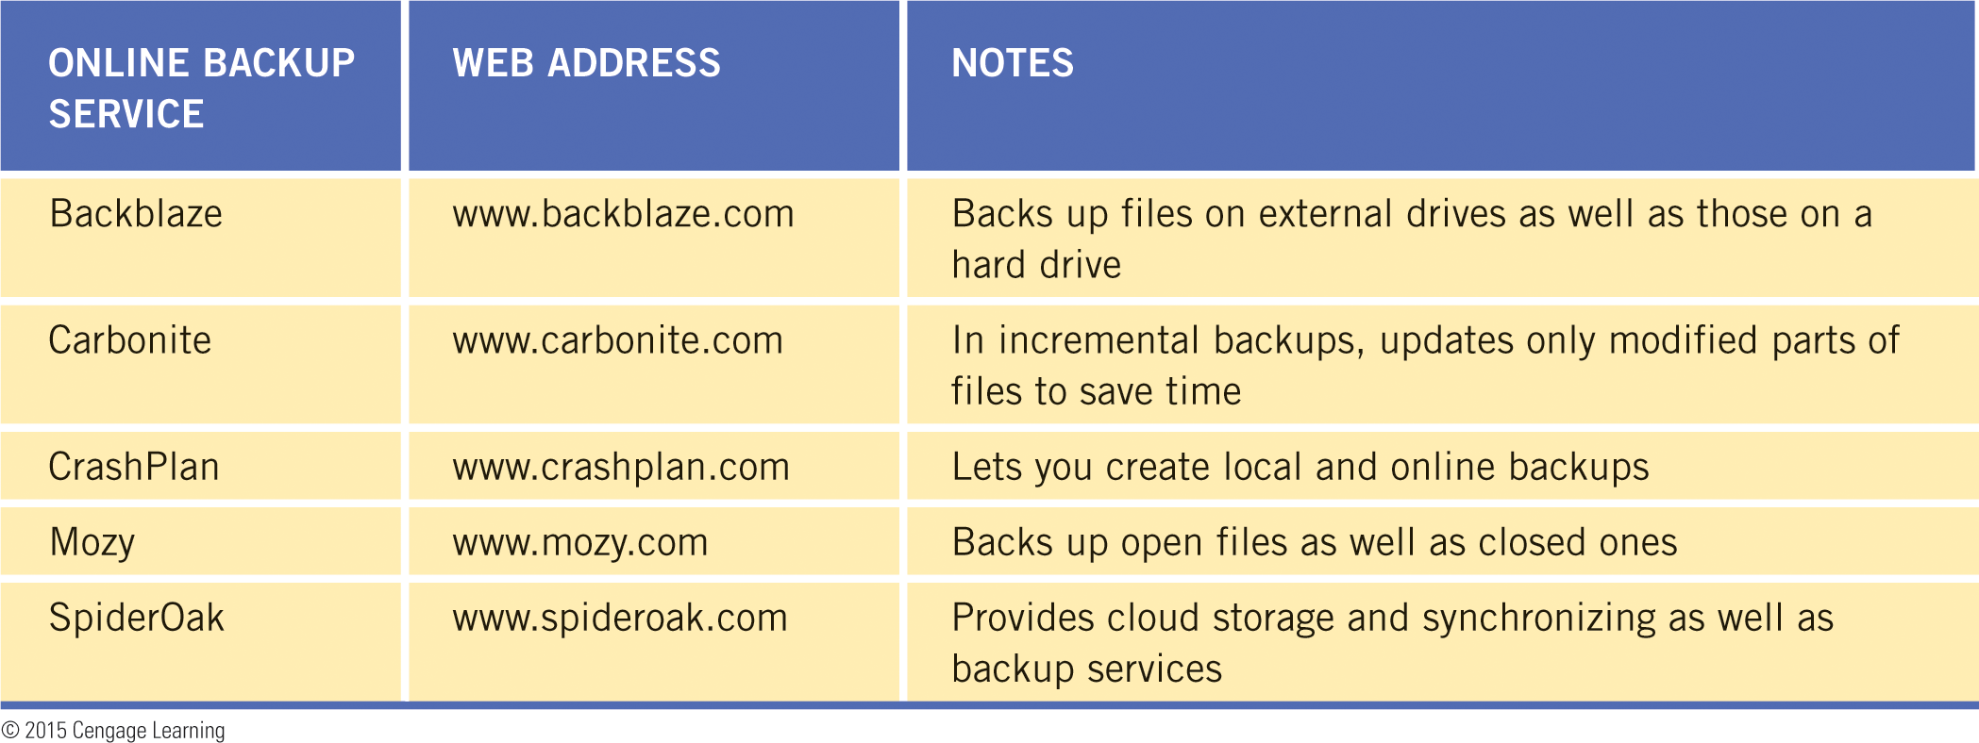
Backing Up and Restoring Files (continued)
Selecting a Backup Method (continued)
Using Online Backup Service Providers (continued)

Slide 18
Backing Up and Restoring Files (continued)
Selecting a Backup Method (continued)
Synchronizing Files
Cloud computing provides online software and services you can use to create and store files online.
You can use software and online services to synchronize your files stored in the cloud with the version of those files stored on your computer’s hard drive by compacting files on the two drives, and then updating files as necessary so the drivers contain the same version of the files.

Slide 19
Backing Up and Restoring Files (continued)
Selecting a Backup Method (continued)
Synchronizing Files (continued)
Synchronizing is not the same as backing up files.
You can perform both actions—synchronizing and backing up—on the same files.
If you want to use files in more than one location, you synchronize the files.
If you want to store a copy of files as a safeguard in case something goes wrong, you back up the files.

Slide 20
Backing Up and Restoring Files (continued)
Following a Backup Plan
A backup plan follows a regular schedule for creating different types of backups.
The ideal plan uses more than one backup method and includes redundancy, which means you create more than one copy of a backup.
You can follow what some experts call the Backup 3-2-1 rule.

Slide 21
Backing Up and Restoring Files (continued)
Following a Backup Plan (continued)
Backup 3-2-1 rule:
3 backups—Maintain two full system backups: one labeled Backup A and one labeled Backup B. Each week, create an incremental or differential backup—the first week using Backup A, and the next week using Backup B. The third backup is a selective backup.
2 types of media—In case a drive or port fails, create the full system backups on two types of media.

Slide 22
Backing Up and Restoring Files (continued)
Following a Backup Plan (continued)
Backup 3-2-1 rule (continued):
1 off-site backup—Store one of the full system backups off-site, and store the other in a safe place in your home or office. When you create an incremental or differential backup each week, swap the on-site copy with the off-site copy.

Slide 23
Protecting Hardware
Backups are the best protection for digital data.
Software tools such as antivirus software protect your operating system and other files.
You also need to protect your hardware—the computer and its peripherals—from theft and physical harm.

Slide 24
Protecting Hardware (continued)
Protecting Against Environmental Damage
Guidelines to protect your computer against environmental hazards:
Temperature—Computer components work best in a temperature range of 68 to 75 degrees (F). Set the heating and cooling system to maintain a temperature in the optimal range for computers.
Humidity—High humidity or extreme dryness can damage internal computer components. Take precautions to keep the humidity between 30 and 50 percent.

Slide 25
Protecting Hardware (continued)
Protecting Against Environmental Damage (continued)
Guidelines to protect your computer against environmental hazards (continued):
Water and other liquids—Water or other liquids in the system unit or any other hardware receiving power can cause a short circuit.
Physical damage—Current mobile computers are designed to withstand shock from moderate drops and bumps. The most likely component to be affected by physical jarring is the hard drive. Transport mobile computers with care, such as in padded cases.

Slide 26
Protecting Hardware (continued)
Protecting Against Environmental Damage (continued)
Guidelines to protect your computer against environmental hazards (continued):
Power fluctuations—To protect against fluctuations in power, you can plug a computer into a surge protector. A surge protector traps short, fast bursts of power before they can harm a computer. To protect against loss of power to a desktop computer or a recharging mobile computer, you can use an uninterruptable power supply (UPS), which contains a battery that provides power if the normal current is interrupted.

Slide 27
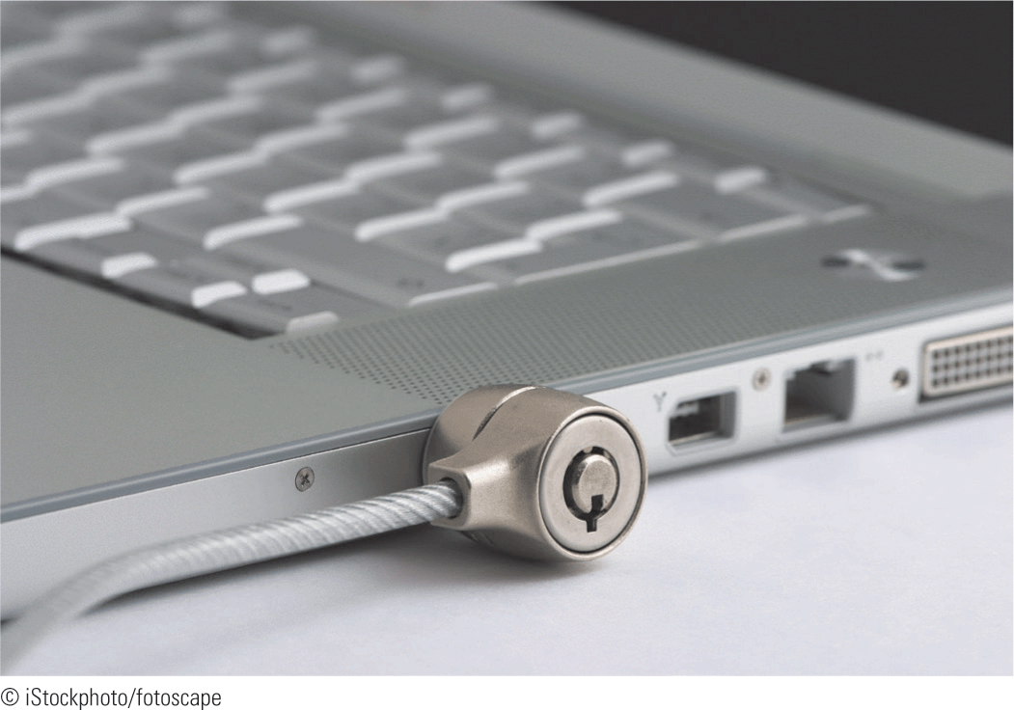
Protecting Hardware (continued)
Protecting Against Theft
Basic precautions such as locking doors, especially to rooms containing computers, can be a deterrent to theft.
You can also use a cable lock to secure a mobile computer to a desk or table, or attach an alarm that sounds when a computer or drive is unplugged.

Slide 28
Protecting Hardware (continued)
Protecting Against Theft (continued)
Installing tracking software increases the chances of recovering a stolen computer.
Features to look for in computer tracking software:
Alarm—An alarm feature repeatedly plays an urgent sound to help you locate a device or to alert others that an unauthorized person has your device.
Data removal—This feature locks the device and lets you erase your data remotely.

Slide 29
Protecting Hardware (continued)
Protecting Against Theft (continued)
Features to look for in computer tracking software (continued):
Unauthorized user notification—This feature lets you set your computer’s camera to take a photo of anyone who enters an incorrect password three times. You can also have the computer send you an e-mail message displaying the photo and location of the unauthorized user.

Slide 30
Protecting Hardware (continued)
Protecting Against Theft (continued)
Features to look for in computer tracking software (continued):
Battery control—After using GPS to find a lost mobile device, you can use the battery control feature to turn off GPS to conserve battery power.

Slide 31
Summary
In this lesson, you learned:
A backup is a duplicate copy of a file that you use if the original file is lost, damaged, or destroyed. To use a backup copy of a file, you first need to restore it, which means to copy the file to its original location on your computer.
The four most common types of backups for individual computer users are full system backups, differential backups, incremental backups, and selective backups. Each of these types has advantages and disadvantages.
31
31

Slide 32
Summary (continued)
A full system backup (also called a system image or a disk mirror) is an exact duplication of the hard drive, including data files, system files and settings, application files, and the operating system.
A differential backup contains copies of the files that have changed since the last full system backup, while an incremental backup contains copies of the files that have changed since the last full system backup or the last incremental backup.
32
32

Slide 33
Summary (continued)
When you perform a selective backup, you select the folders and files you want to back up.
To create a backup, you can use backup software installed on your computer, or you can use an online backup service provider.
33
33

Slide 34
Summary (continued)
Backup software is a set of system utilities for creating and updating backups, and for restoring files from a backup. Operating systems, third-party software developers, and manufacturers of backup media provide backup software. Backup software compresses all the files selected for a backup into a single large file, and stores an index of file details, including their original locations, to restore the files.

Slide 35
Summary (continued)
After installing backup software, you set a schedule and select a location for the backups. The backup software follows the schedule to create backups in the background. Backup locations typically include an external hard drive, USB flash drive, optical disc, or network folder.
Backup software features include backup type options, encryption, media spanning, and data verification.

Slide 36
Summary (continued)
An online backup service automatically creates backups on a secure server. When you create a backup on a server, you are creating an online backup or a remote backup.
To use an online backup service, you typically pay a fee to the service provider, and then set the same types of options you can set with backup software installed on your computer.

Slide 37
Summary (continued)
You can use software and online services to synchronize your files stored in the cloud with the version of those files stored on your computer’s hard drive by comparing files on the two drives, and then updating files as necessary so the drives contain the same versions of the files. Synchronizing is not the same as backing up files, and is not recommended as an alternative to creating backups.

Slide 38
Summary (continued)
A backup plan follows a regular schedule for creating different types of backups. The ideal plan uses more than one backup method, provides for storing on-site and off-site backups, and includes redundancy. An example of a backup plan is one that follows the Backup 3-2-1 rule: 3 backups, 2 types of media, and 1 off-site location.

Slide 39
Summary (continued)
Computers and peripheral devices can be harmed by environmental hazards, including temperature extremes, humidity, electrical fields, and power fluctuations. You need to take precautions to prevent damage from these environmental factors.
To protect computer hardware from theft, you can use locks, alarms, and computer tracking software.

