Slide 1
Lesson 25
Network Fundamentals
Computer Literacy BASICS: A Comprehensive Guide to IC³, 5th Edition
Morrison / Wells / Ruffolo

Slide 2
Objectives
Define communication networks and identify the differences between public and private networks.
Describe common hardware and software components in a computer network.
Identify network types.
Identify the benefits of a network.
Evaluate the risks of network computing.
Identify and resolve common networking connection problems.
2
2

Slide 3
Words to Know
address
cable modem
client
communications protocol
digital subscriber line (DSL)
Domain Name Server (DNS)
Ethernet cable
gateway
hub
IP address
Media Access Control (MAC)
modem
Network Interface Card (NIC)
3
3

Slide 4
Words to Know (continued)
packet switching
public switched network (PSN)
public switched telephone network (PSTN)
router
server
switch
T-1 line
Virtual Private Network (VPN)
4
4

Slide 5
Communication Networks
Networks are used to transmit voice, data, video, and Internet traffic.
Multi-service networks are capable of transmitting a combination of these services on the same system.
Some communication networks support public use, and some networks are designed for private use.

Slide 6
Communication Networks (continued)
Comparing Public vs. Private Networks
Public networks offer access to the public with a connection to other networks.
A public switched network (PSN) is a common carrier network that provides connections among public users.
A public switched telephone network (PSTN) is an international collection of interconnected voice-based public telephone networks.

Slide 7
Communication Networks (continued)
Comparing Public vs. Private Networks (continued)
PSTN was originally created to support one-to-one voice communications using analog transmissions, but today it is largely digital and includes services for both cellular and landline phones.
PSTN sets up a dedicated channel (or circuit) between two points (locally, regionally, nationally, or internationally) for the duration of a call.

Slide 8
Communication Networks (continued)
Comparing Public vs. Private Networks (continued)
Many local Internet Service Providers (ISPs) are connected to the PSTN and employ a range of more advanced technologies to enable consumers to connect to a network.
For example, Integrated Services Digital Network (ISDN) can send voice, video, and data over digital or analog telephone lines.
Voice over Internet Protocol (VoIP) is a system that converts your telephone signal into digital and uses the Internet to deliver voice communications.

Slide 9
Communication Networks (continued)
Comparing Public vs. Private Networks (continued)
Private networks:
  Are owned by one or more establishments for their exclusive use
  Are commonly used in offices and homes so that multiple computers can share printers, files, data, and programs
  Restrict access to authorized users
  Require user names and passwords to gain access to the network

Slide 10
Communication Networks (continued)
Comparing Public vs. Private Networks (continued)
A Virtual Private Network (VPN) is a network service that enables remote users to use a public network to access their private networks.
VPN technology encrypts incoming and outgoing data, and uses a secure connection across a public network.

Slide 11
Understanding Types of Networks
The design of a network is referred to as the architecture.
Networks can be categorized by their scope and the design of their communication methods.
Networks can have wired or wireless connections, or both.

Slide 12
Understanding Types of Networks (continued)
Network types include the following:
  Local area network (LAN): Connects computers, workstations, and other devices that are relatively close to each other within a confined space.
  Wireless local area (WLAN): A variation of the LAN without physical wires to connect devices. WLANs connect devices that are very close to each other, such as homes and small offices.

Slide 13
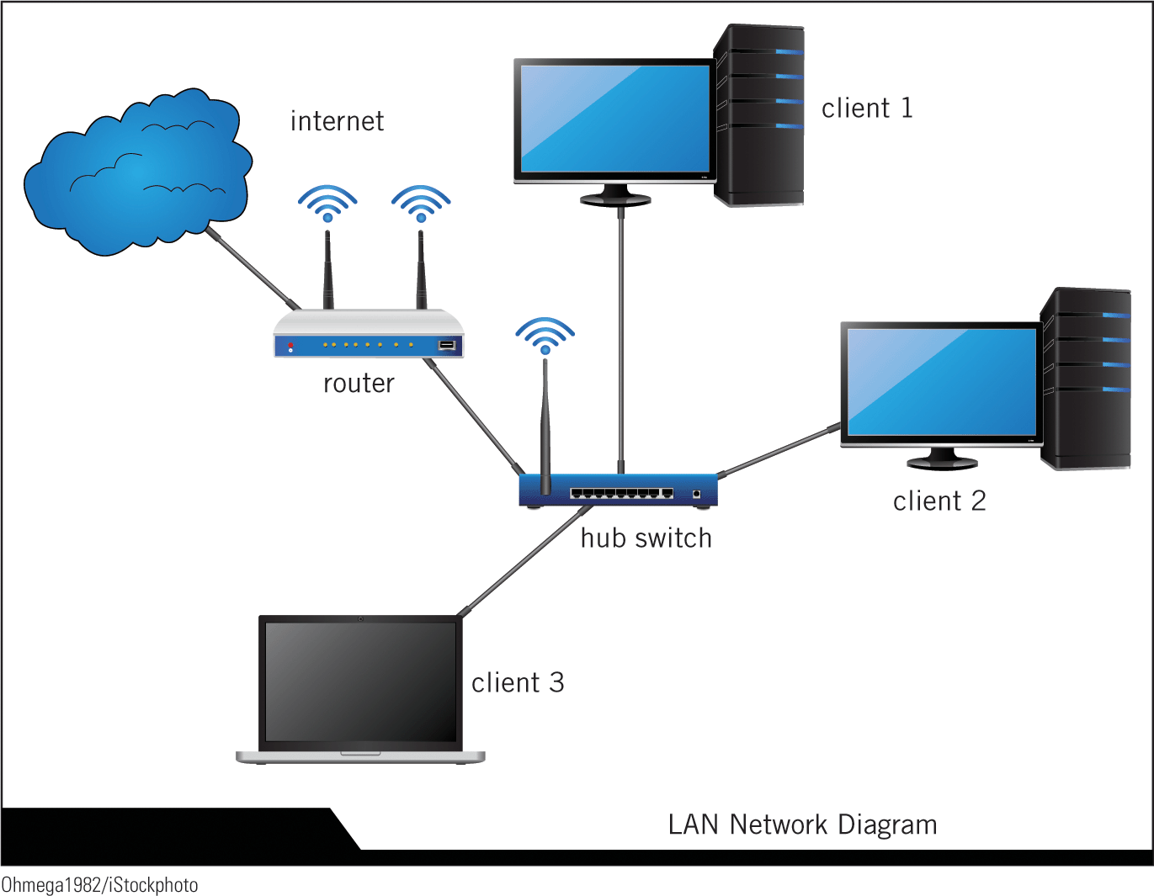
Understanding Types of Networks (continued)

Slide 14
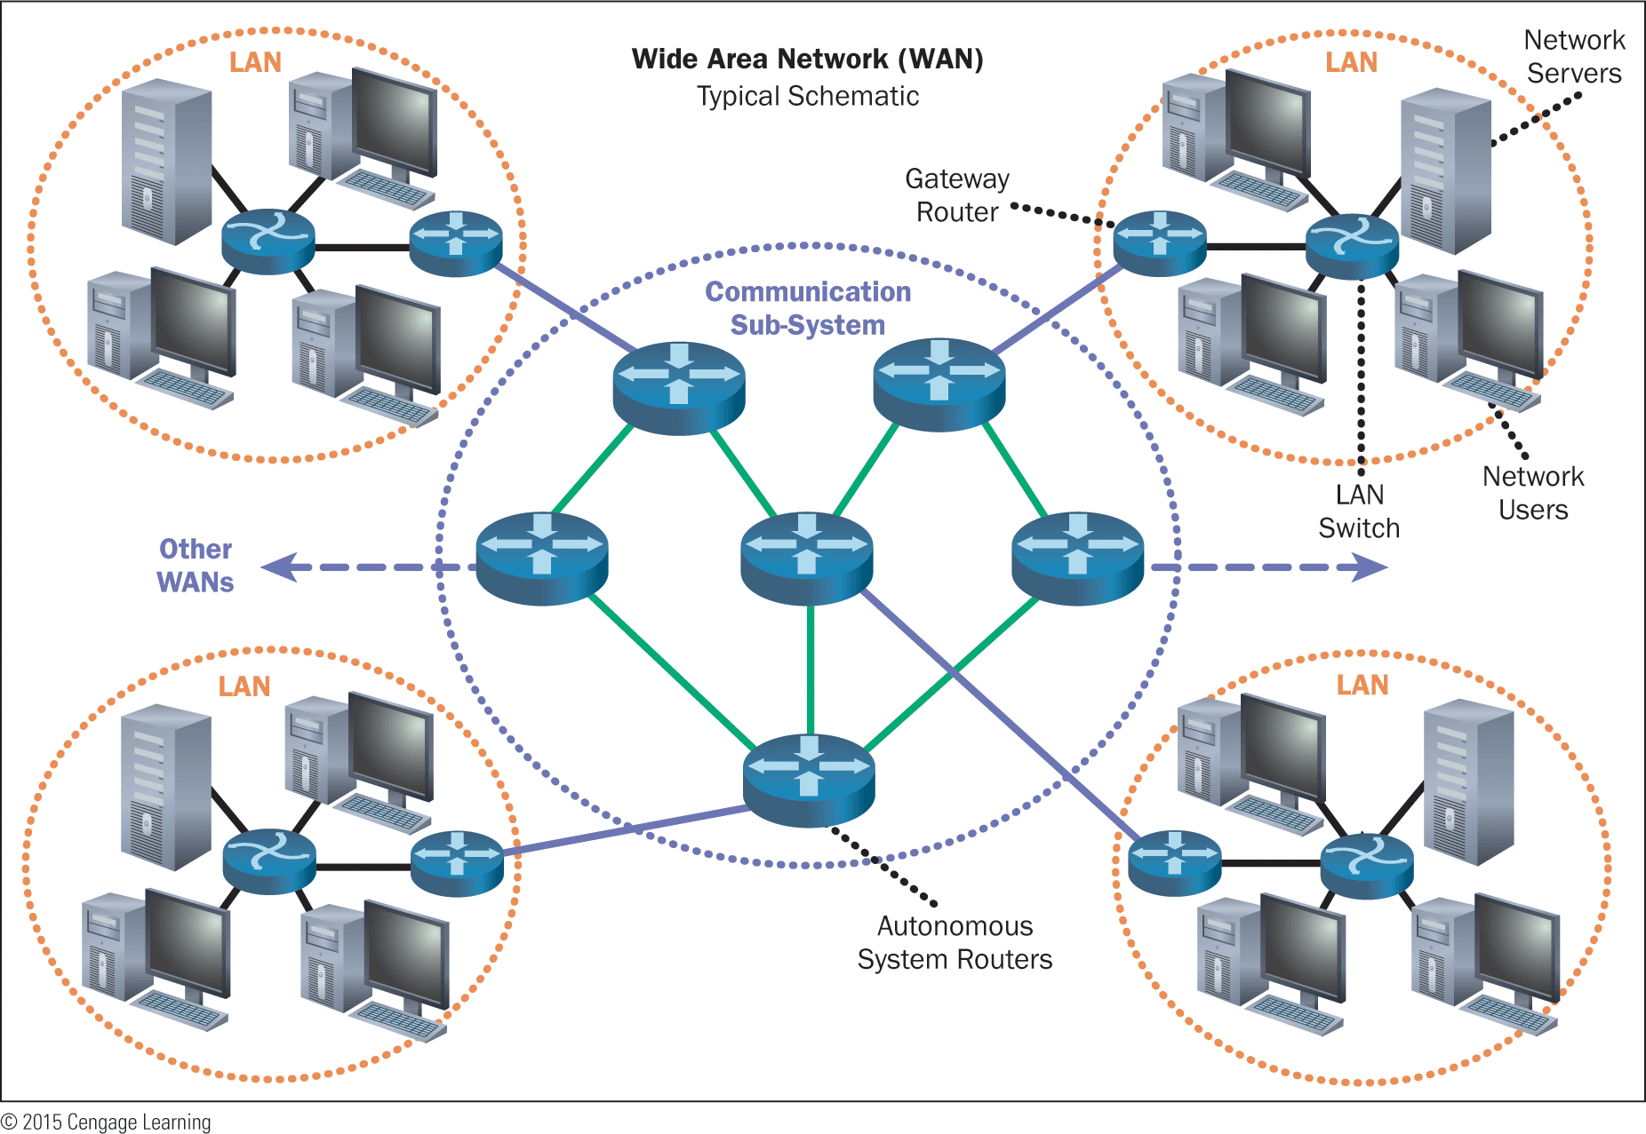
Understanding Types of Networks (continued)
  Wide area network (WAN): A network that contains a substantial number of computers and covers a large geographical area. The largest WAN is the Internet.

Slide 15
Understanding Types of Networks (continued)
  Client/server: One or more computers on the network act as a server. The server manages network resources. The client is the computer that requests and uses services on the server.
  Peer-to-peer (P2P): All the computers are equal and no computer is designated as the server. Users determine which files on their computer they share with others on the network.

Slide 16
Understanding Types of Networks (continued)
  Internet: A worldwide system composed of thousands of smaller networks. An Internet Service Provider (ISP) provides a connection to the Internet.
  Intranet: A type of network used within a single organization to share documents such as handbooks, manuals, forms, and other company documents.
  Extranet: Similar to an intranet but allows specific users outside of the organization to access internal information systems.

Slide 17
Identifying Network Components
A network can be as simple as two computers linked together.
As more devices are added, installing devices and managing the network become more technical.
Networking concepts and terminology remain basically the same, regardless of size or type.

Slide 18
Identifying Network Components (continued)
A server computer provides a service to one or many client computers.
  The server is usually a high-speed computer with considerable storage space.
  A network may have several servers.
A client accesses the shared resources, services, and programs provided by the server.

Slide 19
Identifying Network Components (continued)
Hardware Components
  Modems
    Modems enable a computer to transmit data over cable or telephone lines.
    A traditional modem is often referred to as POTS (Plain Old Telephone Service).
    A cable modem uses cable television lines to send and receive data.
    A digital subscriber line (DSL) modem uses ordinary copper telephone lines to transmit data.

Slide 20
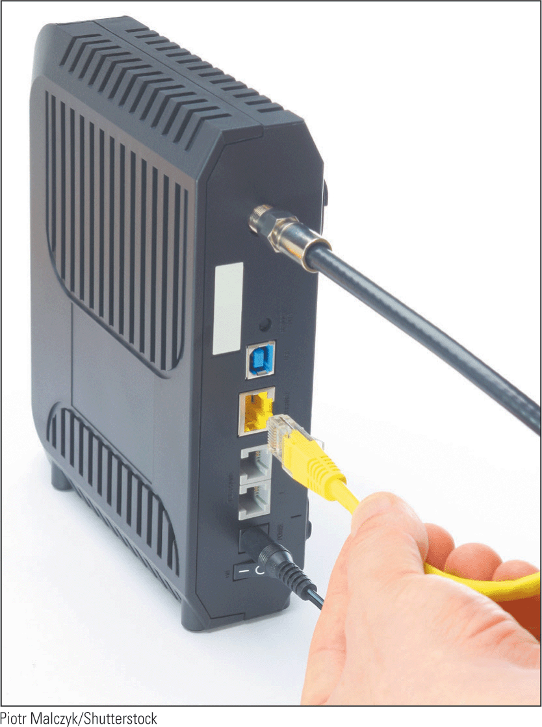
Identifying Network Components (continued)
Hardware Components (continued)
  Cable Media
    There are three types of cable media: coaxial cable, twisted pair, and fiber optic.
    An Ethernet cable is the most common type of connection used in a local area network (LAN).
    An Ethernet port looks like a regular phone jack but is slightly wider.

Slide 21
Identifying Network Components (continued)
Hardware Components (continued)
  T-1 Line
    A T-1 line is a type of fiber-optic telephone line that can transmit voice and data at the same time.
    It is ideal for businesses because the line is dedicated, meaning it is not shared with other businesses.
    The connection is more secure and doesn’t get bogged down.

Slide 22
Identifying Network Components (continued)
Hardware Components (continued)
  Hub
    A hub is a device that joins all the devices of a network together.
    Every network device connects directly to the hub through a port.
    The hub forwards data frames from a connected device to all other connected devices.

Slide 23
Identifying Network Components (continued)
Hardware Components (continued)
  Switch
    A switch performs the same tasks as a hub but works much faster.
    A switch filters the target for a data frame and forwards it only to a specific device in the LAN.
    Switches have replaced hubs in Ethernet networks and can be a hardware or software component, or a combination of both.

Slide 24
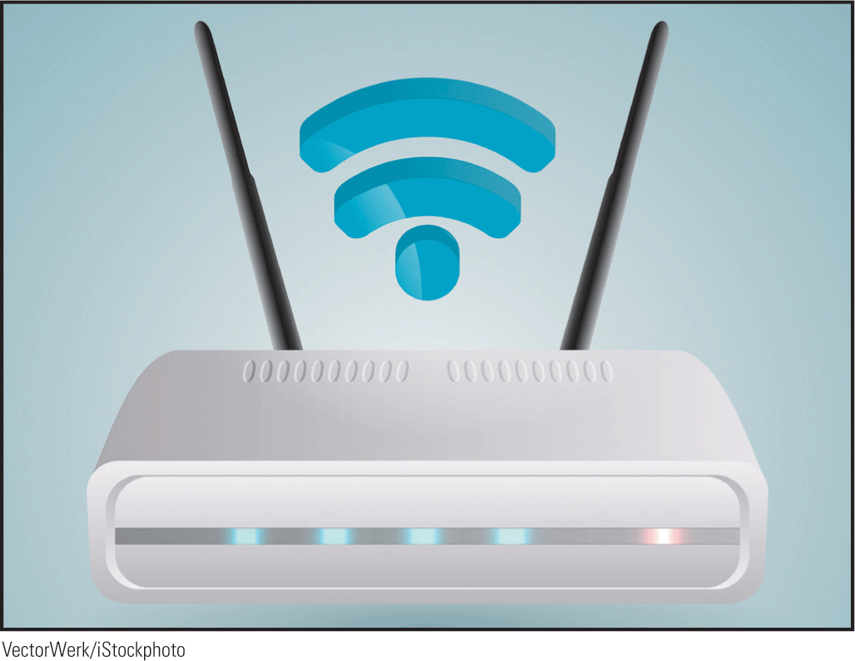

Identifying Network Components (continued)
Hardware Components (continued)
  Router
    A router directs the flow of data from a local area network (LAN) to another network connection.
    The router breaks down data into packets and identifies the best path for forwarding the packet to a specific target.

Slide 25
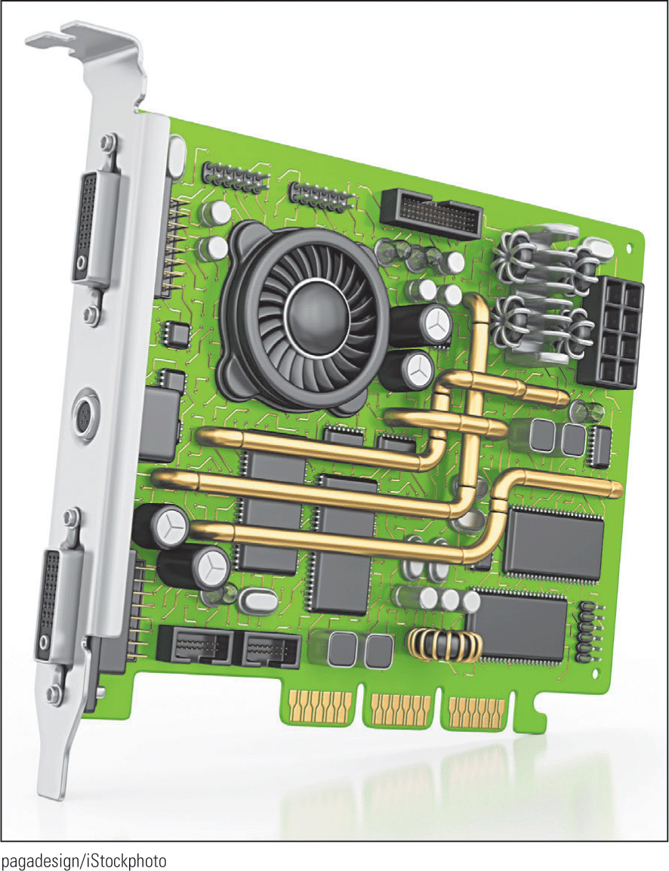
Identifying Network Components (continued)
Hardware Components (continued)
  Network Interface Card (NIC)
    A Network Interface Card (NIC) makes the electrical and electronic connections between a computer and a network.
    NICs are built into the motherboard or are installed as an expansion card.

Slide 26
Identifying Network Components (continued)
Software Components
Software is used to set up, manage, and monitor communication networks.
Applications or programs provide remote access to networks and the tools needed to transmit data in the required formats.

Slide 27
Identifying Network Components (continued)
Software Components (continued)
  Protocols
    A communications protocol is a description of the rules computers follow to identify devices and transmit data.
    The most common communications protocol is Transmission Control Protocol/Internet Protocol (TCP/IP), which is used for transporting data between computers on the Internet.

Slide 28
Identifying Network Components (continued)
Software Components (continued)
  Operating Systems
    Operating systems contain built-in services that support network protocols, and include functions for connecting computers and other devices to a network.
    Three of the most popular operating systems are Microsoft Windows, Mac OS X, and Linux.

Slide 29
Identifying Network Components (continued)
Software Components (continued)
  Addressing
    An address is a unique identifier for each computer or device on a network.
    Every NIC has a Media Access Control (MAC) address for communications on the physical network segment.
    The MAC address is assigned by the manufacturer of the device.

Slide 30

Identifying Network Components (continued)
Software Components (continued)
  Addressing (continued)
    Devices connected to a TCP/IP network are assigned an IP address, which identifies the host device and the network to which it belongs.
    IP addresses are usually assigned by the network administrator or the Internet Service Provider.

Slide 31
Identifying Network Components (continued)
Software Components (continued)
  Addressing (continued)
    Before a computer can access data on the Internet, the computer address must be translated into an IP address.
    Internet Service Providers access a Domain Name Server (DNS), which maintains a directory of domain names and their correlated IP addresses, to perform the translation and direct a connection to the correct address.

Slide 32
Identifying Network Components (continued)
Software Components (continued)
  Gateways
    A gateway connects networks using different communications protocols so that information can be passed from one network to the other.
    The gateway converts data to a form that is compatible with the destination network and then transmits the data.

Slide 33
Identifying Network Components (continued)
Software Components (continued)
  Packet Switching
    Packet switching splits data into manageable packets (small pieces), allowing a more efficient flow in the transmission of data.
    The NIC breaks down the data into packets before transmitting it to the hub.
    After the data packets are transmitted to the destination device, the NIC on the destination device puts the packets back together.

Slide 34
Identifying the Benefits of a Network
Enhanced communications: E-mail, text messages, social media, and other electronic communications have changed the way the world interacts.
Information sharing: Users around the world can connect to each other to access, share, and exchange information.

Slide 35
Identifying the Benefits of a Network (continued)
Searching and researching: The Internet provides an astronomical number of resources for finding information.
E-commerce: The Internet enables business owners to run their businesses online from desktop computers, laptops, tablets, or smart phones.

Slide 36
Identifying the Benefits of a Network (continued)
Online training: Online courses are convenient and offer flexibility. You can learn at your own pace, on your own schedule without taking time off from work or leaving your home.
Telecommuting: Working from home saves travel time and transportation expenses.

Slide 37
Identifying the Benefits of a Network (continued)
Collaborative environment: A shared environment enables users to exchange files and collaborate on group projects.
Hardware sharing: It is not necessary to purchase a printer or a scanner, for example, for each individual computer. A device connected to a network can serve the needs of many users.

Slide 38
Identifying the Benefits of a Network (continued)
Software sharing: Software installed on a network server can be accessed by many users. Sharing software saves money on licensing and makes installing software updates easier and more efficient.
Entertainment: Networks facilitate many types of games and entertainment, and the Internet offers many sources of entertainment.

Slide 39
Evaluating the Risks of Networked Computing
Privacy: Computer networks are vulnerable to unauthorized access. Hackers steal services and information.
Malfunctions and system failures: Users can lose access to network resources due to natural disasters such as storms and fires.
Malicious code: Networks are vulnerable to viruses, worms, and Trojan horses, which can cause equipment malfunctions and system failures.

Slide 40
Evaluating the Risks of Networked Computing (continued)
Individual loss of autonomy: Networks can play a part in taking away an individual’s autonomy by controlling which software programs are accessible, and keeping a record of how the computer is used and what sites are accessed.
Network faults: Network equipment problems can result in loss of data and resources.
Setup and management costs: Initial and ongoing investments of money and labor are required to set up and manage a network.

Slide 41
Solving Network Connection Problems
Some network connection problems are easy to identify and fix:
  First, check the physical connections.
  If everything is connected correctly, power down all the devices, and unplug the power to the router and modem. Wait 10 to 15 seconds, and then plug in the router and modem and turn on the computer again.
  If that doesn’t solve the problem, try the Windows troubleshooter wizards.

Slide 42
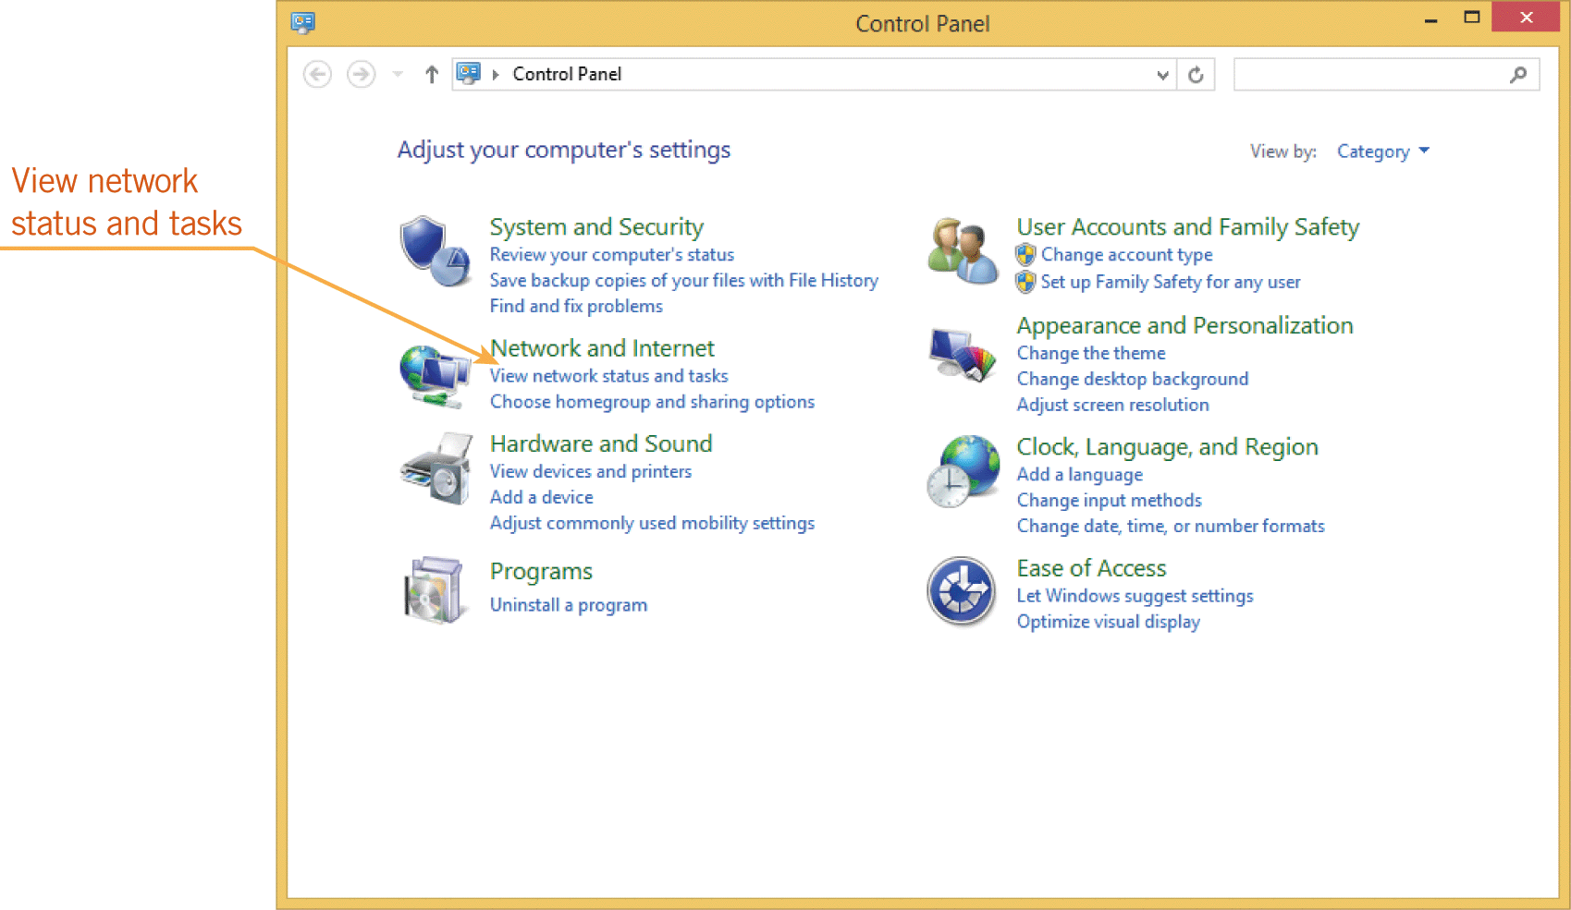
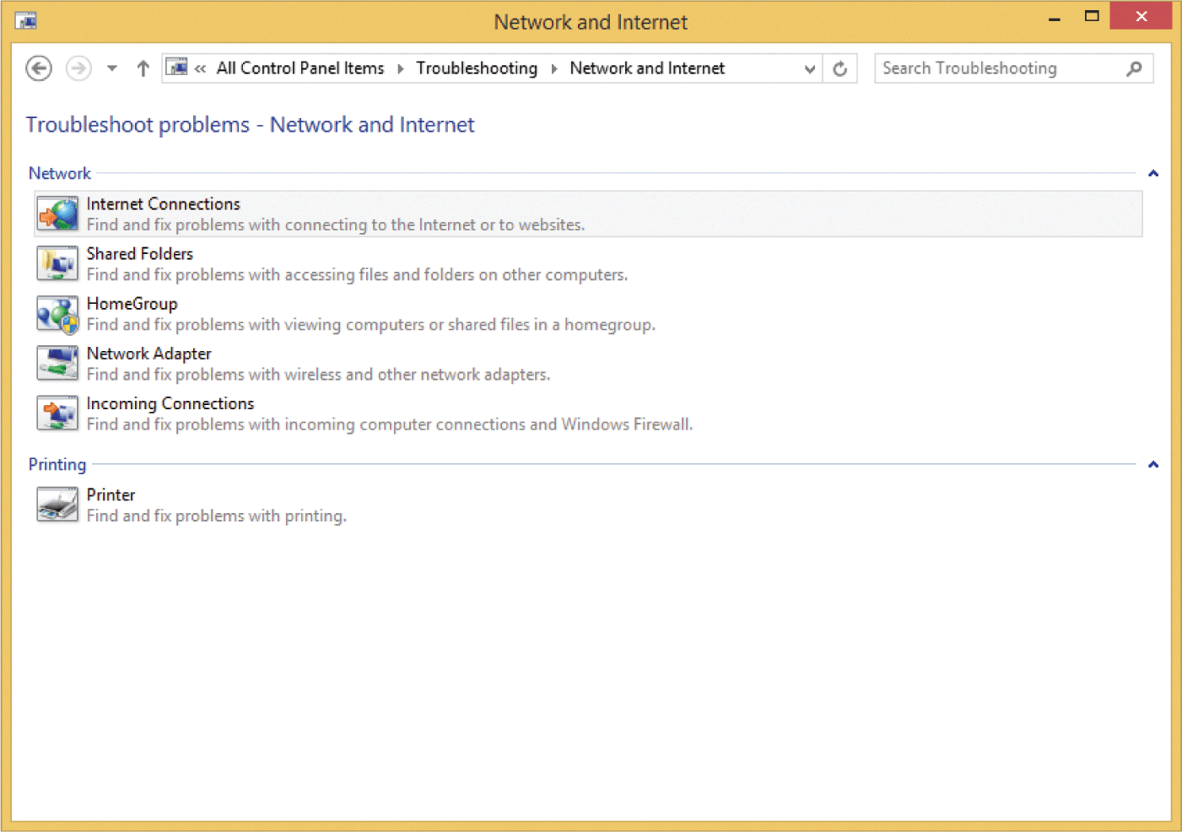
Solving Network Connection Problems (continued)

Slide 43
Summary
In this lesson, you learned:
Communication networks are used to transmit voice, data, video, and Internet traffic. Communication networks are created for both public and private use.
A computer network is a group of two or more computers linked together. As the size of a network increases, the network becomes more technical, but the networking concepts and terminology basically remain the same.
43
43

Slide 44
Summary (continued)
There are several types of networks. Networks can be categorized by the scope of the network and the design of the communication method.
Communication networks require hardware components. Multiple devices can connect to a network via wired or wireless connections.
Software components provide remote access to networks and the tools needed to transmit data in the required formats.
44
44

Slide 45
Summary (continued)
Society has benefitted in many ways because of developments in the Internet and network capabilities in the last several years.
Network connections also present challenges, and we should evaluate the risks when we access networks.
Although some connection problems are complex and require technical support, Windows provides troubleshooter wizards to help diagnose and repair network problems.
45
45

