Slide 1
Lesson 26 Communication Services
Computer Literacy BASICS: A Comprehensive Guide to IC³, 5th Edition
Morrison / Wells / Ruffolo

Slide 2
Objectives
Describe the components for electronic communication and identify several Internet communication services.
Explain the purposes of usernames, passwords, and credentials.
Manage e-mail folders.
Create and send e-mail messages.
2
2

Slide 3
Objectives (continued)
Receive and open e-mail messages and attachments.
Respond and reply to e-mail messages.
Create an e-mail signature and manage e-mail messages automatically.
Create appropriate professional and informal messages.
3
3

Slide 4
Words to Know
archiving
channel
conversation
credentials
domain name
HTML (Hypertext Markup Language)
password
Plain Text format
protocols
Rich Text Format
signature
spam
user agent
username
4
4

Slide 5
Describing Components of Electronic Communication
Electronic communication is the technology that transmits text, numbers, voice, and video from one computer or device to another.
Electronic communication requires a user agent, which is a software application such as an e-mail, text messaging, or instant messaging program.
The sender is the computer sending the message; the receiver is the computer receiving the message; and the channel is the media transporting the message.

Slide 6
Describing Components of Electronic Communication (continued)
Protocols are the rules that govern the transfer of data, and ensure that information created by one system can be interpreted and read by another system.
The communication is completed when the information is transferred between user agents.

Slide 7
Identifying Internet Communication Services
The Internet provides a wide range of services including the following:
E-mail (electronic mail) enables you to combine numerous media into a single message and then quickly exchange information in dynamic, two-way communications.
Instant messaging allows you to send and receive messages in real time while you and someone else are both connected to the Internet.

Slide 8
Identifying Internet Communication Services (continued)
Text messaging enables you to send short messages from one cell phone to another, or from the Web to a cell phone.
Voice over IP (VoIP) is a methodology and group of technologies that transport voice, data, and video communication using Internet Protocol (IP) networks such as the Internet.

Slide 9
Identifying Internet Communication Services (continued)
Online conferencing, also called video conferencing, uses computer networks to transmit audio and video data so that two or more participants can conduct a conference at different sites.
Chat rooms are Web sites that allow real-time communication so you can exchange messages with others through the computer.

Slide 10
Identifying Internet Communication Services (continued)
Social networking sites are Web sites that provide a way to build online communities of people who share common interests or activities.
A blog (short for Web log) is a type of personal journal created by one person or by a group.
Message boards and newsgroups provide bulletin board systems that serve as discussion sites; users can post messages asking for assistance.

Slide 11
Using E-Mail Communication
E-mail is similar to regular mail. You have a message, an address, and a carrier that transfers the message from one location to another.
The methods used to access e-mail have multiplied, and many are offered for a monthly fee or even at no charge.
Microsoft Outlook.com, Windows Live Mail, Google Gmail, and Yahoo Mail are examples of Web-based e-mail services.

Slide 12
Using E-Mail Communication (continued)
When you set up an e-mail account, the service provider requires credentials before you can access the service features.
Credentials are stored on the server of the e-mail provider and include information to authenticate your identity, such as a username and a password.
A username is a name that identifies you when you log on to a Web site or an Internet service.
A password is a word or string of characters that provides access to the service features.

Slide 13
Using E-Mail Communication (continued)
Your credentials can be used for e-mail and for a variety of other options such as setting up an online checking account or placing an online order.
Each user on the Internet must have a unique e-mail address, which consists of three parts: the user name, the @ symbol, and a domain name.
A domain name is an address of a computer network connection that identifies the owner of the address.

Slide 14
Managing E-Mail with Microsoft Outlook
Microsoft Outlook is a versatile Office application you can use to manage e-mail, and organize contacts, appointments, and tasks.
As you work with e-mail messages, you can manage other types of data.
For example, you can add contacts to your address book, schedule a meeting on your calendar, and add tasks to your to-do list directly from an incoming e-mail message.

Slide 15
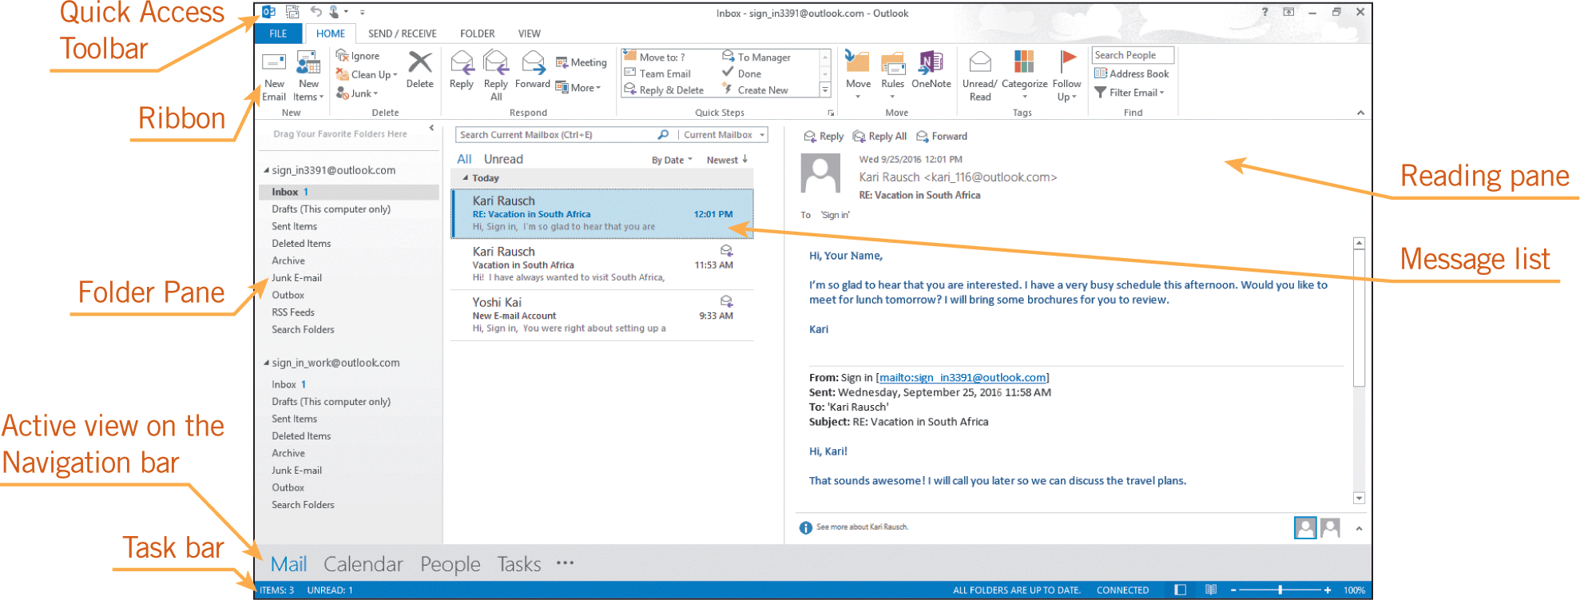
Managing E-Mail with Microsoft Outlook (continued)
Exploring the Outlook Features

Slide 16
Managing E-Mail with Microsoft Outlook (continued)
Managing E-Mail Account Folders
Outlook allows you to manage multiple e-mail accounts by organizing the messages in standard folders such as Inbox, Drafts, Sent Items, and Outbox. You can also add customized folders.
Mail management is handled mainly through the Inbox where Outlook displays incoming messages.
Archiving is the process of backing up your e-mail messages. Outlook runs an AutoArchive feature every 14 days, and you can choose settings to control deleting old messages or moving them to an archive data file.

Slide 17
Managing E-Mail with Microsoft Outlook (continued)
Creating and Saving an E-Mail Message
You can send an e-mail message to multiple recipients, and the message goes to all the addresses at the same time.
You can type the e-mail for the recipients, or you can access the addresses in your contacts.
You can send a courtesy copy (Cc) or a blind copy (Bcc) to another recipient. Other recipients can see the address of the courtesy copy but they cannot see the address of a blind copy.
The subject should be brief but descriptive.

Slide 18
Managing E-Mail with Microsoft Outlook (continued)
Creating and Saving an E-Mail Message (continued)
The body of the message should be clear, concise, and free from spelling errors.
Outlook and other e-mail programs provide at least two formatting options: HTML (Hypertext Markup Language) and Plain Text format.
HTML supports text formatting options such as multiple fonts, bold text, colored headings, graphics, and links to Web sites. Plain text format contains only text.
Rich Text Format, which is a Microsoft format, is similar to HTML but is supported only by Microsoft e-mail applications.

Slide 19
Managing E-Mail with Microsoft Outlook (continued)
Attaching a File and Sending a Message
You can include attachments such as pictures or documents in an e-mail message. When recipients receive the message, they can open or save the attached file.
You can add a tag to the message header to indicate if the message is high or low priority.

Slide 20
Managing E-Mail with Microsoft Outlook (continued)
Attaching a File and Sending a Message (continued)
Sometimes e-mail messages “bounce back” and are undeliverable. This can happen if:
The address is typed incorrectly.
The server is busy and the process is not completed within the specified amount of time.
The recipient has blocked messages from the sender.
The recipient’s mailbox is full.
The recipient’s security settings reject attachments or attachments with executable programs.

Slide 21
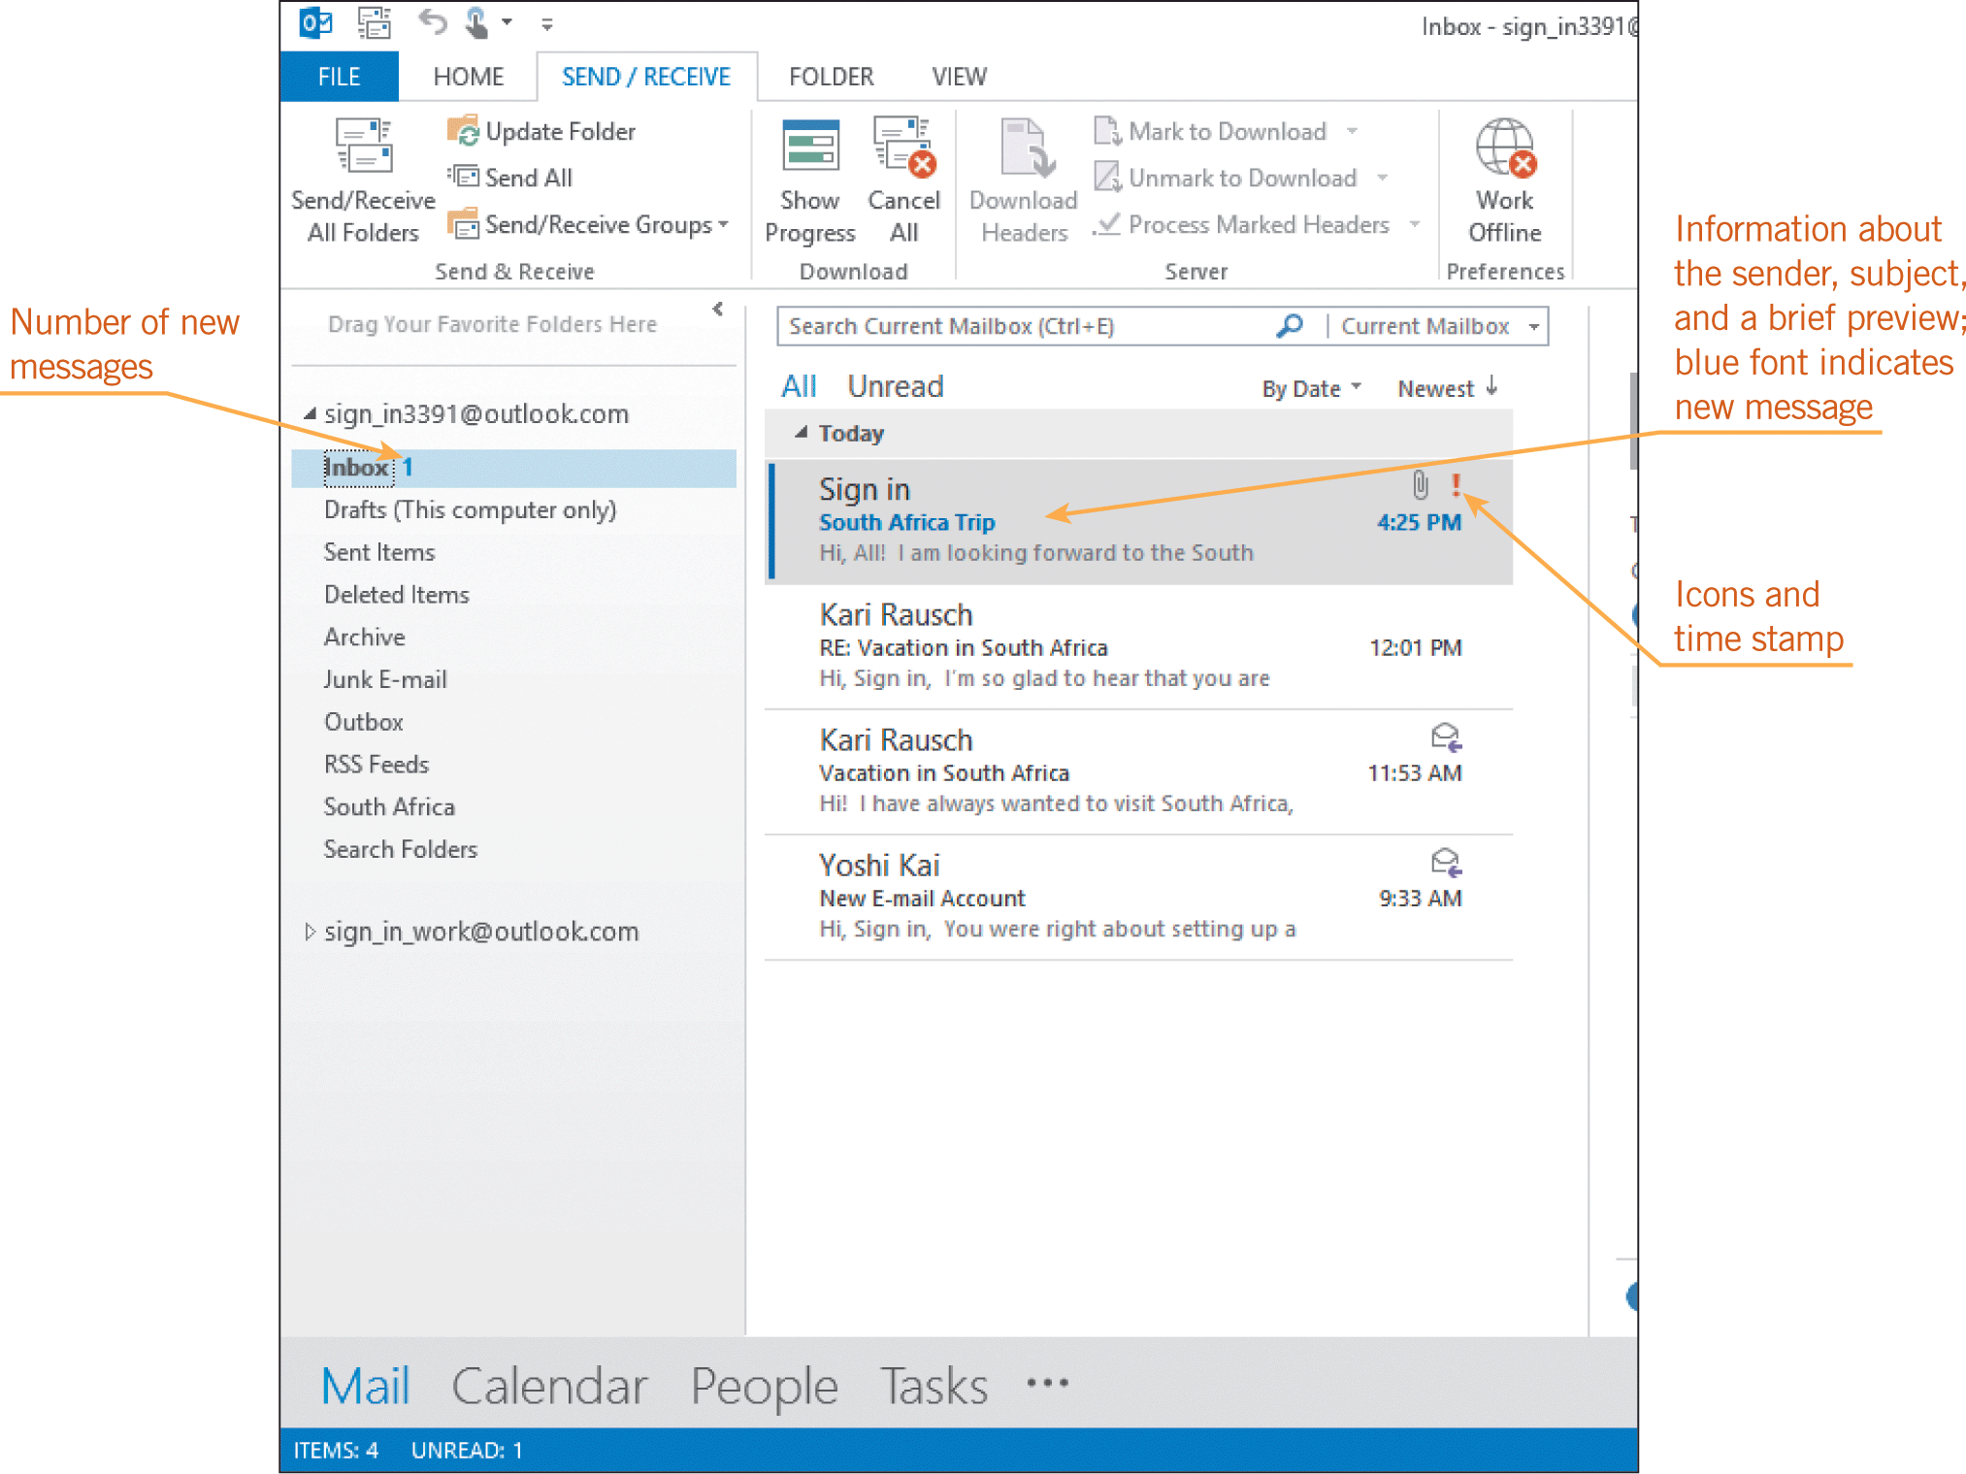
Managing E-Mail with Microsoft Outlook (continued)
Receiving and Opening E-Mail Messages
When you receive a message, Outlook automatically saves the message in the Inbox.
The message list displays who sent the message, the subject of the message, and the date and time your server received it.

Slide 22
Managing E-Mail with Microsoft Outlook (continued)
Receiving and Opening E-Mail Messages (continued)
When selected, the entire message displays in the Reading pane and scroll bars can be used to navigate through the message.
You can organize the message list by date or you can filter it so that only unread messages display.
You can search for keywords in messages that display in the message list.
You can manually mark a message as unread.

Slide 23
Managing E-Mail with Microsoft Outlook (continued)
Receiving and Opening E-Mail Messages (continued)
A red exclamation point icon indicates the sender considers the message urgent, or a high priority; a paper clip icon indicates that the message has an attached file.
You can add a flag icon as a reminder to follow up on the message.
Spam is unsolicited e-mail, often used to advertise products and services.
Most Internet service providers have tools that filter spam messages to help you avoid them.

Slide 24
Managing E-Mail with Microsoft Outlook (continued)
Opening E-Mail Attachments
You can preview an attachment in the Reading pane or you can open the file in an application such as Word or Adobe Reader.
You can also print an attached document or save the attachment file to your computer or device.

Slide 25
Managing E-Mail with Microsoft Outlook (continued)
Responding and Replying to a Message
The easiest way to reply to an e-mail message is to use the Reply command.
The original message is included along with your reply with “RE:” preceding the text in the subject line.
If more than one person is displayed as an e-mail recipient, you can use the Reply All command to reply to all recipients at the same time.

Slide 26
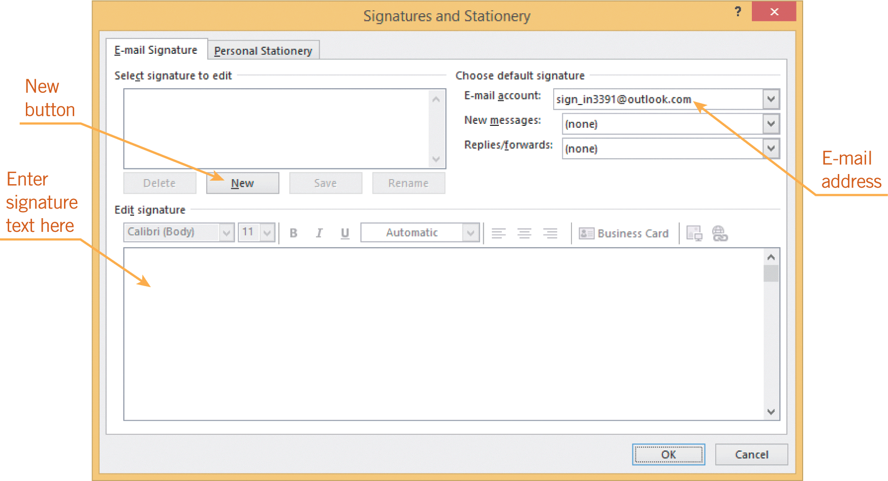
Managing E-Mail with Microsoft Outlook (continued)
Creating a Signature
A signature consists of text or graphics that you create so Outlook can automatically add it to the end of any outgoing message.

Slide 27
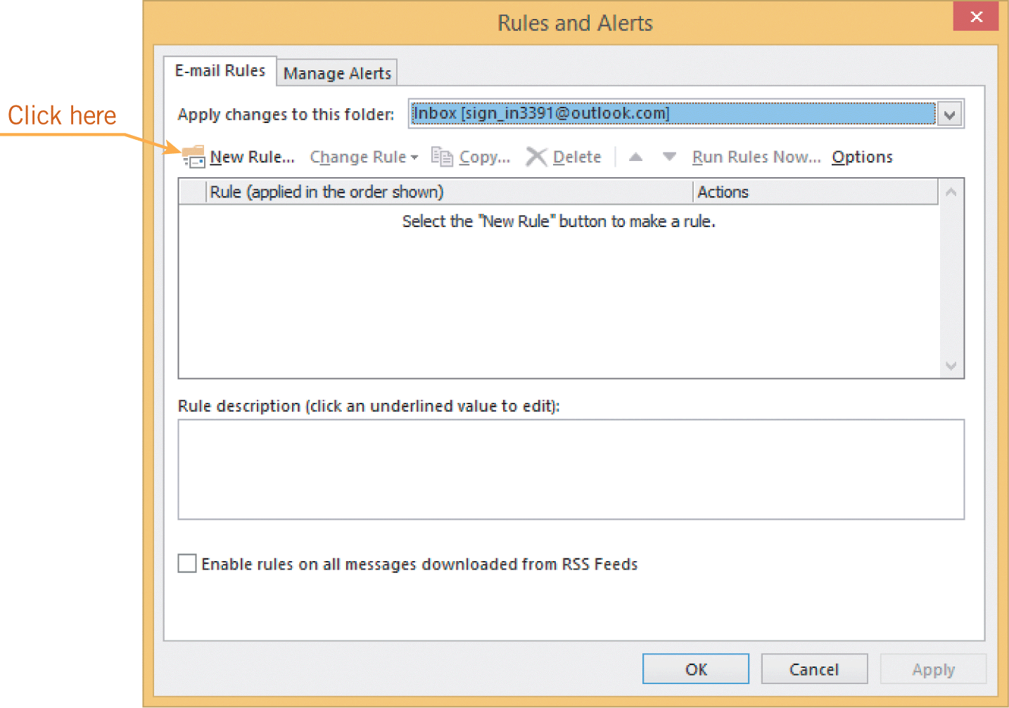
Managing E-Mail with Microsoft Outlook (continued)
Setting Rules for Auto-Responding to Messages
You can create an Outlook rule to automatically respond to some or all received e-mail messages.
To set up an auto-response for messages, you must first create a template for the message content, and then you set some rules.

Slide 28
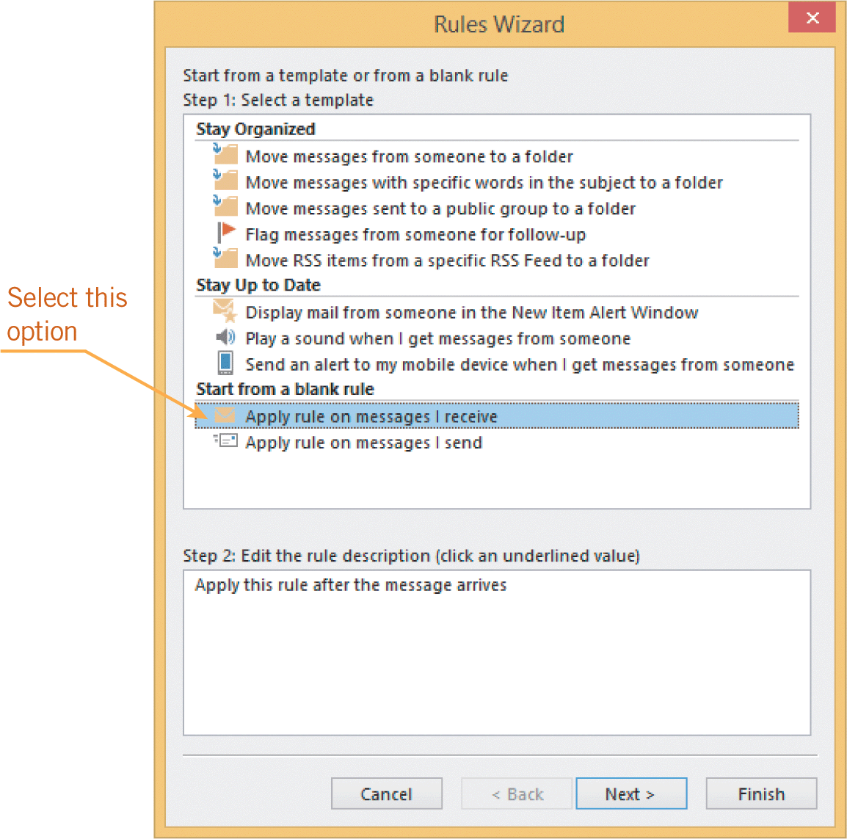
Managing E-Mail with Microsoft Outlook (continued)
Setting Rules for Redirecting Messages
You can also set rules that redirect incoming messages so they are automatically forwarded to another e-mail address.

Slide 29
Managing E-Mail with Microsoft Outlook (continued)
Cleaning Up Your Folders
Outlook provides a Clean Up Folder feature that automatically removes redundant messages from conversations.
Another way to clean up folders is to manually delete the messages.

Slide 30
Creating Appropriate Messages
The fast-paced media used for electronic communication demands a writing style that is clear and concise without sacrificing speed.
When writing professional communications, the language should be more formal and the information should be stated in complete sentences.
E-mails create electronic trails that document discussions, contact information, and access to attached files.

Slide 31
Creating Appropriate Messages (continued)
E-mail messages are not private; they can be restored and reviewed.
To avoid sending a message you may later regret, consider the following options:
Discuss the issue with someone else before you send an e-mail.
Do not include the e-mail address in the To line while you are creating the message.

Slide 32
Creating Appropriate Messages (continued)
Before you click Send, make sure you are sending the message to the right people, and proofread everything to confirm you have no misspelled words or grammatical errors.
Save the message overnight as a draft and then reevaluate your response the next day.

Slide 33
Summary
In this lesson, you learned:
Electronic communication is the technology that enables users to transmit text, numbers, voice, and video from one computer or device to another.
The Internet provides many communication services, such as e-mail, instant messaging, and text messaging, to billions of users around the world.
33
33

Slide 34
Summary (continued)
Even as technology evolves and provides new and enhanced methods of electronic communications, e-mail is still widely used.
Outlook provides several features that enable you to access calendars, contacts, and tasks as you work with e-mail messages.
Creating an e-mail involves entering the e-mail addresses of the recipients, adding a subject line, and typing the message.
34
34

Slide 35
Summary (continued)
E-mail messages are organized in folders. You can use the standard folders provided in the default settings, or you can create your own personal folders to store messages.
In response to an incoming message, you can reply to the message, forward the message to a new recipient, delete the message, or save the message.
You can automatically add a signature at the end of any outgoing messages.
35
35

Slide 36
Summary (continued)
Special e-mail features enable you to automatically respond and forward incoming messages to another address.
When creating e-mail messages, whether for professional or informal communications, it is important that the message is clear and accurate.
36
36

