Slide 1
Lesson 28 Using the Internet and the World Wide Web
Computer Literacy BASICS: A Comprehensive Guide to IC³, 5th Edition
Morrison / Wells / Ruffolo

Slide 2
Objectives
Define the Internet and the Web.
Set up and troubleshoot an Internet connection.
Define data usage and how it is calculated.
Categorize Web sites.
Navigate Web pages and use a browser effectively.
2
2

Slide 3
Objectives (continued)
Customize browser settings and manage plug-ins.
Manage browsing history.
Organize favorite Web sites and refresh Web sites.
3
3

Slide 4
Words to Know
browser plug-in
cache memory
domain
domain name
firewall
gateway
home page
hotspot
hyperlink
HyperText Markup Language (HTML)
HyperText Transfer Protocol (HTTP)
Internet
Internet service provider (ISP)
portal
streaming
4
4

Slide 5
Words to Know (continued)
subdomain
Uniform Resource Locator (URL)
Web app
Web browser
Web site
Wi-Fi
wiki
World Wide Web
5
5

Slide 6
Defining the Internet and the Web
The Internet and the Web are not the same.
The Internet can exist without the Web, but the Web cannot exist without the Internet.
The Internet is a huge global interconnection of computer networks around the world.
The World Wide Web is a global collection of interconnected documents (Web pages) and other resources.
A Web site is a Web page or a collection of related Web pages located on the Web.

Slide 7
Defining the Internet and the Web (continued)
Hyperlinks automatically connect you to another part of the same Web page or to another Web page.
HyperText Markup Language (HTML) is the main markup language used to create Web pages.
Web pages are transferred between computers via HyperText Transfer Protocol (HTTP), which is the underlying protocol for the Web.

Slide 8
Defining the Internet and the Web (continued)
Each Web site possesses at least one Internet Protocol (IP) address; the Uniform Resource Locator (URL) identifies the unique IP address.
A domain is a group of computers and devices on a network that are administered as a unit with common rules and procedures.
The domain name provides an online identity (such as an organization or company name).
A subdomain is a domain that is part of a larger domain and is dependent on the larger domain.

Slide 9
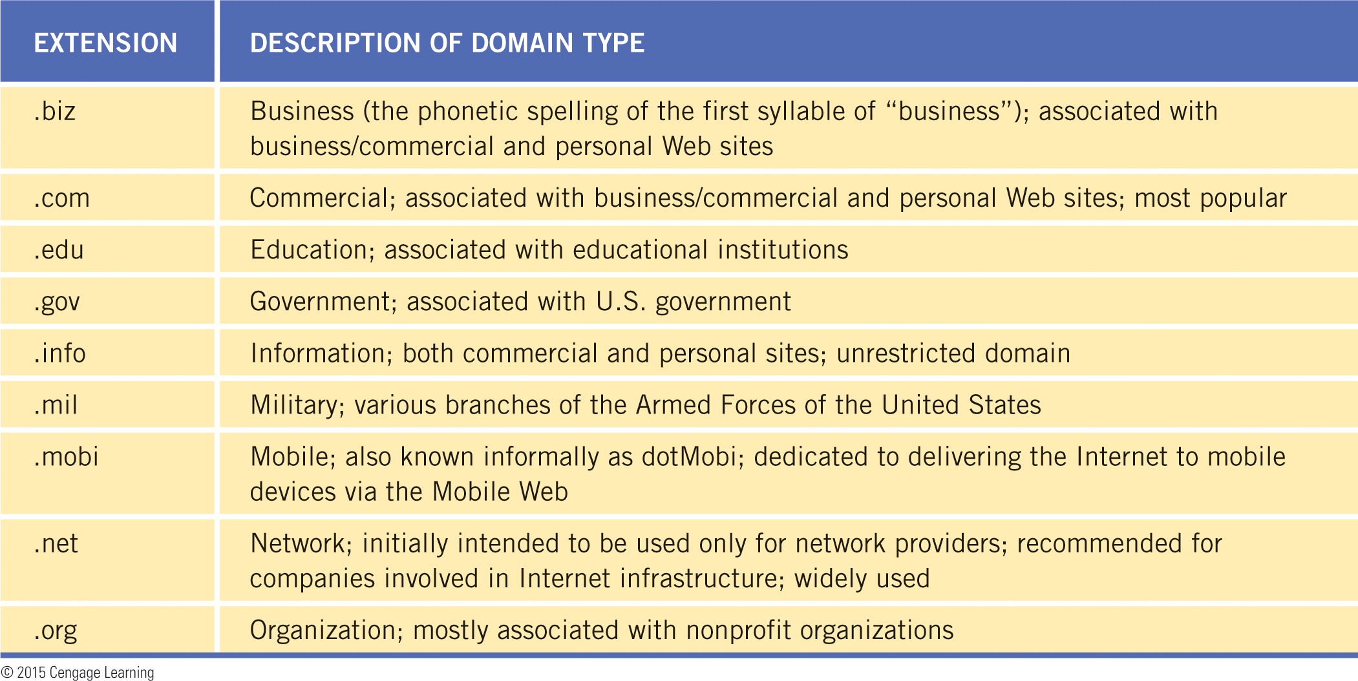
Defining the Internet and the Web (continued)
Every Web site domain name ends with a two- or three-letter extension that identifies the type of domain or the country of origin.

Slide 10
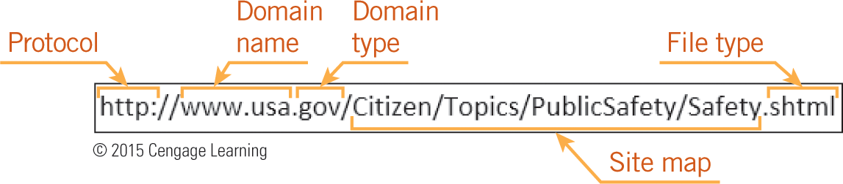

Defining the Internet and the Web (continued)
A URL always includes a protocol, the domain name, and the domain type or a country code.

Slide 11
Defining the Internet and the Web (continued)
A Web browser is a software application used to view and retrieve documents from the Web, and to display the documents in a readable format.
When you enter a URL in your browser, you send an HTTP command to the Web server to tell it to locate and transmit the requested Web page.
The browser extracts the HTML code to display the page.

Slide 12
Connecting to the Internet
In homes, the common methods of Internet access include dial-up, broadband, satellite, 3G/4G technology for cell phones, and Wi-Fi.
Wi-Fi uses radio waves to provide wireless high-speed Internet and network connections.
A hotspot provides Wi-Fi network access to a small area for wireless-enabled devices such as laptops, tablets, and smart phones.

Slide 13
Connecting to the Internet (continued)
Setting Up an Internet Connection
An Internet service provider (ISP) is an organization or company that provides connectivity to the Internet through a telecommunications line or wireless system.
The telecommunications software needed to connect to the Internet is usually provided by the ISP or is already installed on your computer.
The Web browser needed to display Web pages is already installed on most computers.

Slide 14
Connecting to the Internet (continued)
Downloading and Uploading Data
Many ISPs include a monthly data usage allowance; if you exceed the limit for your plan, you may have to pay an extra fee.
Almost every time you access the Internet, you will download (receive) or upload (send) data.
Streaming is a technique for transferring data in a steady and continuous stream so you can start displaying the data before the transmission is completed.

Slide 15
Connecting to the Internet (continued)
Downloading and Uploading Data (continued)
Data is transmitted in packets, and the size of the packet is defined with the following terms:
bit—the smallest possible unit of information
kilobit—1,000 bits
byte—8 bits
kilobyte—8 kilobits
megabit—1,000 kilobits
megabyte—8 megabits

Slide 16
Connecting to the Internet (continued)
Downloading and Uploading Data (continued)
File sizes vary depending on the amount of content, the format, the resolution, and the level of quality:
1 text e-mail message 75 KB
1-page PDF file 948 KB
Photo 1.5 MB
Web page 1.5 MB
1 music track 5 MB
30 minutes of gaming 25-75 MB
10-minute video 100-200 MB

Slide 17
Connecting to the Internet (continued)
Downloading and Uploading Data (continued)
Internet connection speeds are usually measured in seconds; Mbps (megabits per second) is the most common unit of speed used.
Generally, ISP services offer different download and upload speeds.
There are differences in download and upload speeds because most Internet connections are asymmetric, which means the bandwidth capacity for downloading is different than the capacity for uploading.

Slide 18
Connecting to the Internet (continued)
Downloading and Uploading Data (continued)
Several factors reduce the speed of an Internet connection:
The connection type
Peak times of access or multiple users on the same network
Devices, such as a household appliance, interfering with a wireless signal
Outdated equipment, or equipment that is not configured for optimal performance

Slide 19
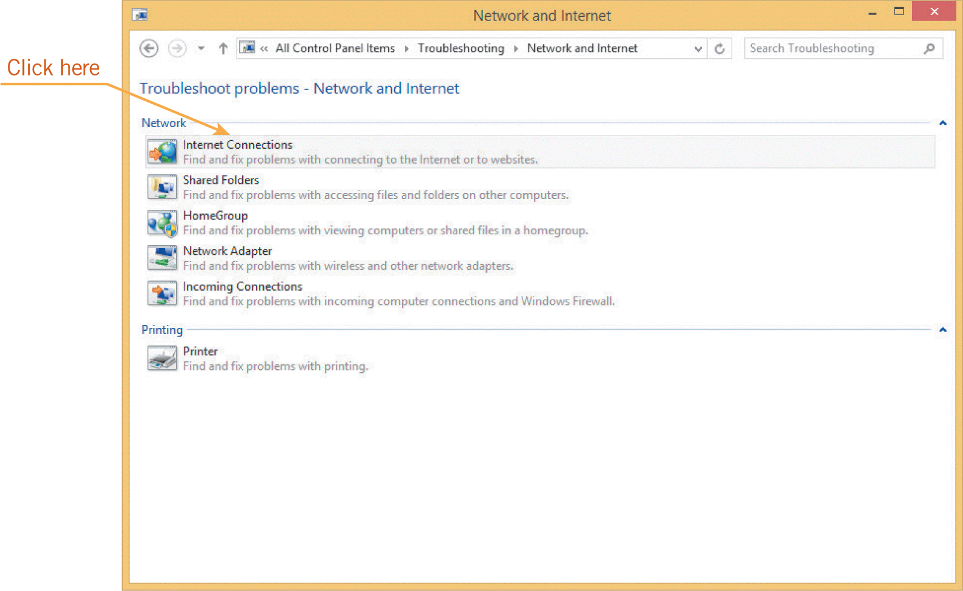
Connecting to the Internet (continued)
Troubleshooting Internet Connections
Depending on the problem, you may need to contact your ISP.
Alternatively, you may be able to repair the problem with the Internet Connections troubleshooter.

Slide 20
Categorizing Web Sites
Commercial—Also known as an e-commerce site, a commercial site sells or promotes products or services.
Academic—Most educational facilities have a Web site.
Organizational—Examples include Web sites of nonprofit organizations such as zoos, and advocacy groups such as wildlife and clean air supporters.
Governmental—Most local, state, regional, and national governments have numerous Web sites.

Slide 21
Categorizing Web Sites (continued)
International—Each country has unique search engines, which use different mathematical algorithms. Web page text also needs to be translated into the language of the country.
Search sites—A search engine is a software program used for online searching.
Membership sites—Some Web sites, such as those used for e-mail services and e-commerce, require you to register before access to the Web site is allowed.

Slide 22
Categorizing Web Sites (continued)
Online applications—Also known as Web apps, these online applications host programs you can access with your Web browser.
Portal—A portal is a Web site that features useful content, but it also contains links to other sites. You can use a portal as your home page. For example, MSN.com is a portal that includes links to Web sites for news, sports, entertainment, the Bing search engine, etc.

Slide 23
Categorizing Web Sites (continued)
Geographic imaging—Mapping and geographic imaging Web sites use technology to change the imagery of the Earth’s surface into valuable information. This information is used by geographical information systems (GIS) to capture, store, analyze, and manage images.
Wiki—A wiki is a collaborative Web site that people can use to add, edit, remove, and organize Web page content. Wikipedia is a popular online wiki.

Slide 24
Navigating the Web
Your browser was installed with a default home page, which is the first page that appears in the browser when you visit a Web site.
From the home page, you can navigate to various Web sites using browser tools as well as navigation menus and hyperlinks.
Tabs enable you to open multiple Web sites.
Cache memory is high-speed RAM (random access memory) that serves as a temporary storage area for data and is continually updated.

Slide 25
Navigating the Web (continued)
When you visit a Web site, a copy of the contents of the Web site is stored in your cache.
Instead of downloading the data again, your browser reuses the stored data, providing a faster loading time.
When you open a Web site in an InPrivate browser tab, data about your browsing session is not stored in your cache.

Slide 26
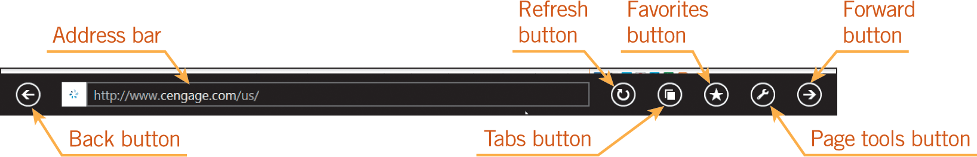
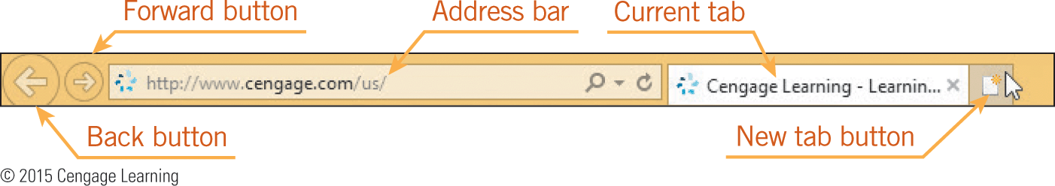
Navigating the Web (continued)
Navigating Internet Explorer
Navigating Internet Explorer 11 with the Windows 8.1 user interface:
Navigating Internet Explorer in Desktop Mode

Slide 27
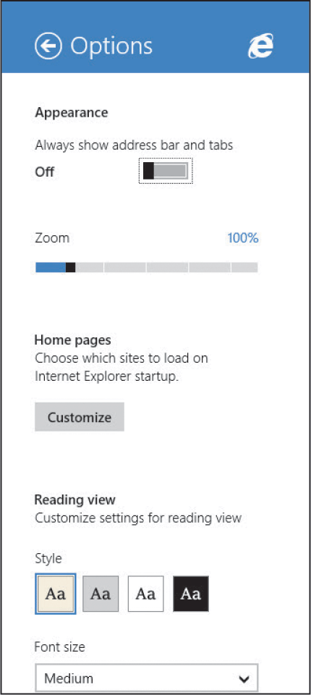
Navigating the Web (continued)
Customizing Web Browser Settings
You can reset the home page to a Web site of your choice.
You can switch to reading view and flip through Web page content like you are reading a book.

Slide 28
Navigating the Web (continued)
Managing Plug-Ins
Browser plug-ins (also referred to as add-ons) are optional software apps that add functionality to a Web browser.
Plug-ins enable you to watch movies, listen to music, play online games, open and read documents, and so on.
Common plug-ins include Adobe Acrobat Reader, Adobe Flash Player and Windows Media Player.

Slide 29
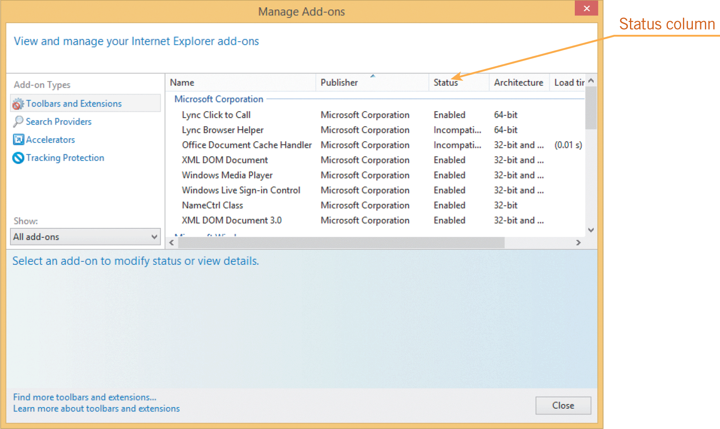
Navigating the Web (continued)
Managing Plug-Ins (continued)
To remove a plug-in, you must uninstall the software. If you need a new plug-in, you can search the Web for the plug-in and install it.

Slide 30
Managing Browser History
Your browser tracks the sites you have visited for a specified period of time.
Browsing history includes URLs for the Web sites you’ve visited, cached text of pages you’ve accessed, and passwords and information you’ve entered into online forms.
Browsing history saves time when you want to revisit a Web site.
If you share a computer, you may want to erase your browser history.

Slide 31
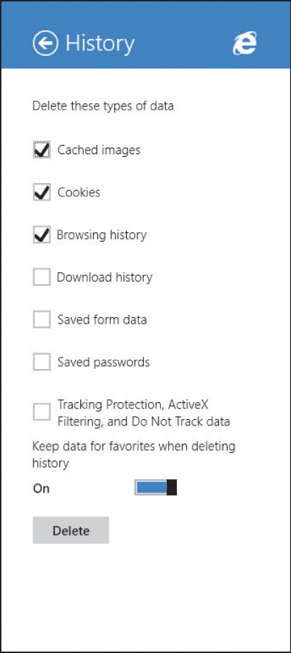
Managing Browser History (continued)
The default setting in Internet Explorer is to keep your browsing history for 20 days, but you can manually delete the history at any time.

Slide 32
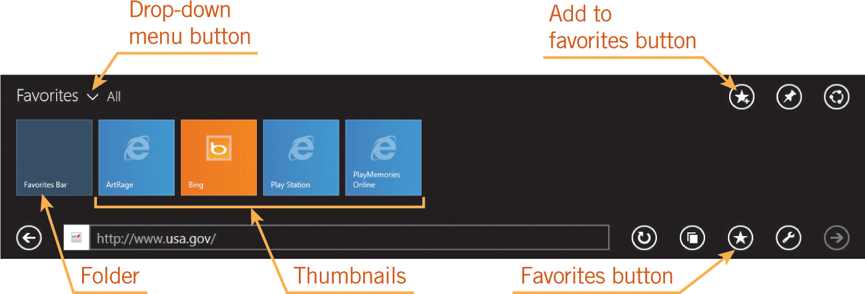
Organizing Favorites and Refreshing Web Sites
When you add a Web site as a favorite or bookmarked site to the Favorites bar, you can create a new folder to organize your favorites.

Slide 33
Addressing Web Site Issues
When you enter a Web site address and receive a “Page not found” message, it could be because:
The page was moved.
An old index is still maintained in a search engine.
You made a typing error when entering the Web sites address.
The Web site is temporarily unavailable because the server is offline or the site is being updated.

Slide 34
Addressing Web Site Issues (continued)
A Web page may load slowly because of heavy server traffic or because the page contains a large number of images.
Internet Explorer contains a pop-up blocker that limits most pop-ups; you can customize the settings to allow pop-ups from specific Web sites.
Internet security is essential to reduce the risk of unauthorized parties accessing sensitive resources.

Slide 35
Addressing Web Site Issues (continued)
Security management includes gateways and firewalls.
A gateway is a computer or dedicated hardware device that connects a LAN (Local Area Network) to another network or a WAN (Wide Area Network).
A firewall blocks unauthorized network access within its own LAN or to and from a WAN.
Antivirus apps help protect against viruses, and antimalware apps help protect against malware.

Slide 36
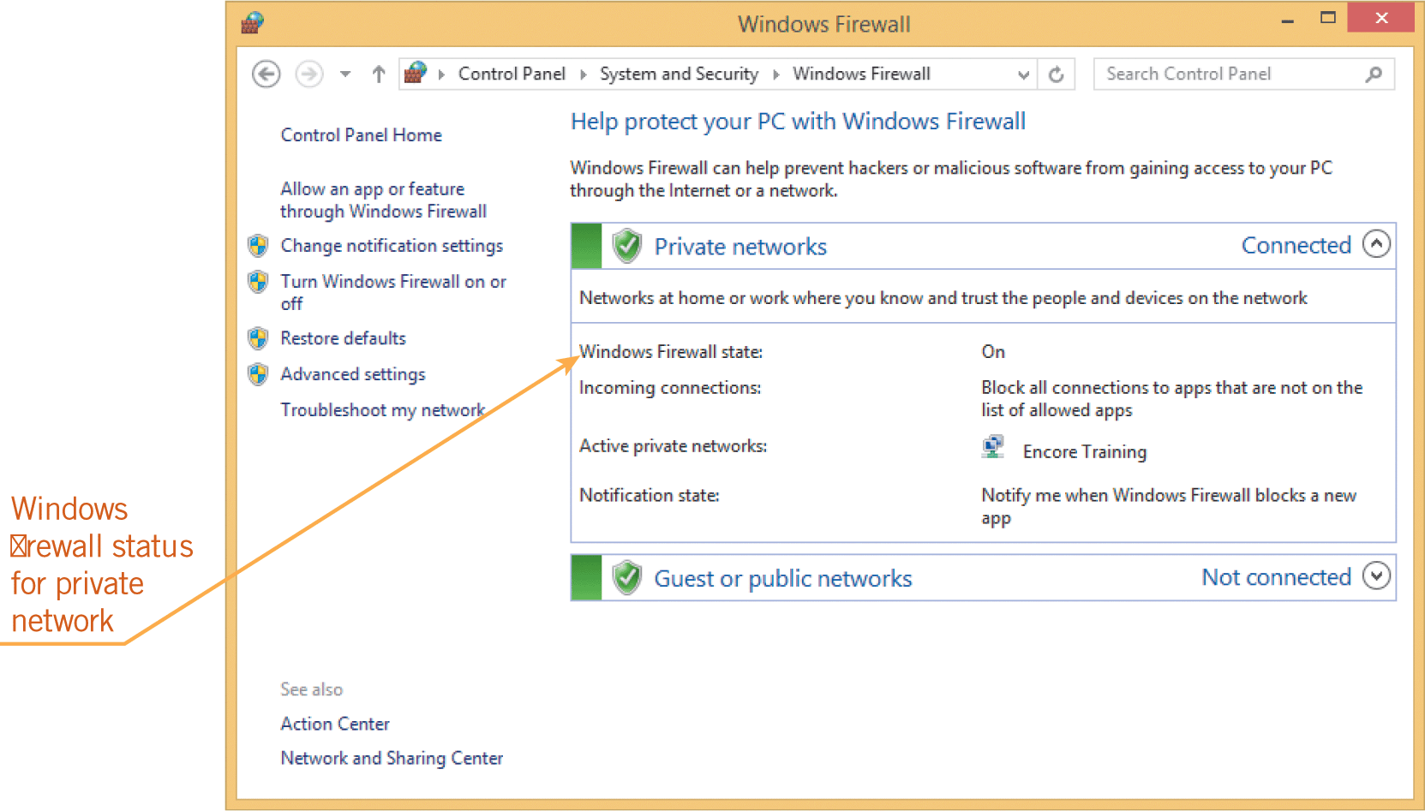
Addressing Web Site Issues (continued)
You need only one firewall app running on your PC.
Windows Firewall comes with Windows and is turned on by default.

Slide 37
Summary
In this lesson, you learned:
The Internet, the World Wide Web, and Web browsers have their own terminology.
There are several methods for connecting to the Internet, and different types of Internet connections provide a range of options.
Almost every time you access the Internet, you are using data. The data is transmitted in packets, and the size of the packet is defined in bits and bytes.
37
37

Slide 38
Summary (continued)
Web sites can be organized into categories, each with a different purpose and type of information.
Once you connect to the Internet, you need a Web browser to display Web pages. Basic elements exist in all browsers, and most browsers use universal symbols.
You can customize the browser so you can access the information you are seeking both easily and quickly.
38
38

Slide 39
Summary (continued)
A browser tracks Web sites you have visited and temporarily stores data you access on the Web.
Browsers provide features that enable you to easily access recently visited and frequently visited Web sites.
Internet security is essential. Each time you connect to the Internet, there is the risk of unauthorized parties accessing sensitive resources.
39
39

