Slide 1
Lesson 29
Web Content
Computer Literacy BASICS: A Comprehensive Guide to IC³, 5th Edition
Morrison / Wells / Ruffolo

Slide 2
Objectives
Use keywords to search for information.
Use advanced features to refine a search.
Search for specific types of media or disciplines.
Find content on a Web page.
Evaluate the quality of the Web page content.
Observe intellectual property laws.
Copy and print content on a Web page.
Cite Internet resources.
2
2

Slide 3
Words to Know
Boolean logic search
copyright
Creative Commons (CC) license
intellectual property
keywords
knowledge base
meta tag
metasearch engine
plagiarism
public domain
related search
search directory
search engine
spiders
stemming
trademark
Web directory
Webcrawlers
3
3

Slide 4
Searching for Information on the Web
The Internet is a valuable source for acquiring knowledge and solving problems.
Finding accurate and reliable Web sites, information, and answers to questions depends on using resourceful search tools effectively.
Two primary tools are available for online searches: a search engine and a Web directory.
A search engine is a program that searches documents for specified keywords, and then provides a list of the sources where the keywords were found.

Slide 5
Searching for Information on the Web (continued)
When using an online search tool, you are not really searching the Web; you are actually searching and viewing a database in a search engine.
Web search engines use Webcrawlers (also called spiders), which are automated software applications that use an algorithm to search Web sites for relevant information.
Webcrawlers read the page titles, textual content, and meta tags for a Web site.
  A meta tag is an HTML coding statement that describes some aspect of the Web page content.

Slide 6
Searching for Information on the Web (continued)
The Webcrawler follows the Web site links.
  When relevant information is found, the URL data is then transmitted to a central depository and indexed in the search engine’s database, so the URL will show as a search result.
Not all search engines use the same algorithm, which explains why you often see different results when you use different search engines.

Slide 7
Searching for Information on the Web (continued)
A metasearch engine sends queries to several other search engines.
Dogpile and Kayak are examples of metasearch providers.
The metasearch engine combines the results received from all the search engines.
The results are not always better because the metasearch engine must use its own algorithm to choose the best results.

Slide 8
Searching for Information on the Web (continued)
A Web directory (also referred to as a search directory) is a collection of Web sites organized by category, and then they are often further organized by geographic region.
The purpose of the Web directory is the same as the search engine. The difference is a Web directory is created by humans, not software.
Examples are Yahoo! Directory, Open Directory Project, and Bing Directory.

Slide 9
Searching for Information on the Web (continued)
A Web site owner can directly submit a URL to be added to a Web directory, or the directory editors can explore the Web and submit the URL.
Only information approved by the directory editors is indexed in the Web directory database.
There is sometimes a fee for submitting a URL to a search directory.
The advantage of a Web directory is its ability to organize data.

Slide 10
Searching for Information on the Web (continued)
Hybrids are search engines and directories that contain both a computer-generated index and a human-generated index.
If you are looking for comprehensive results, a search engine is your better choice.
If you want a selected guide with limited results, a Web directory may be the more useful tool.

Slide 11
Searching for Information on the Web (continued)
Searching for Keywords
You use a search engine to search for keywords, which are words that describe the information you are trying to locate.
By default, most search engines perform a Match Any search.
Some search engines provide an additional enhancement called concept-based searching. The search engine displays results that relate to documents containing related concepts, not just the keywords.

Slide 12
Searching for Information on the Web (continued)
Searching for Keywords (continued)
Another feature supported by most search engines is stemming.
  The search engine searches for root forms of the keywords, so the search results include additional variations of the keywords.
Another feature provided by several search engines is a related search.
  A related search involves preprogrammed queries or questions suggested by the search engine that often lead to other Web pages containing similar information.

Slide 13
Searching for Information on the Web (continued)
Refining Your Search
Using phrases, Boolean operators, or math symbols will help you control and refine a search.
If you want to search for words that appear next to each other, you can enter the phrase with quotation marks.
If you are searching for more than one phrase, you can separate phrases or proper names with a comma.
  For example, to find Mickey Mantle baseball cards, enter “baseball cards”,”Mickey Mantle”.

Slide 14
Searching for Information on the Web (continued)
Refining Your Search (continued)
To narrow your search results, you can use Boolean logic.
A Boolean logic search uses three primary logical operators (AND, OR, and NOT) to define the search.
The AND operator makes sure that all the terms in a search appear in the Web page. This is a Match All search rather than a Match Any search.
The more terms you combine with AND, the narrower the results.

Slide 15
Searching for Information on the Web (continued)
Refining Your Search (continued)
The NOT operator restricts the search by excluding pages that contain the specified term.
The OR operator searches for synonyms or similar concepts and creates more results.
Sometimes search engines support math equivalents of the operators.
  For example, instead of using the operator AND, you can insert a plus symbol (+) in its place.
  To subtract terms you do not want, you can use the (–) symbol.

Slide 16
Searching for Information on the Web (continued)
Refining Your Search (continued)
Some search engines provide options for specific time periods, and you may be able to use a date tool in the search query to filter the search by date.
Some search providers assist your search through the use of forms.
To access the form, look for a hyperlink such as “Advanced Search” or “Advanced Options” on the search engine’s main page.

Slide 17
Searching for Information on the Web (continued)
Searching for Specific Types of Media or Disciplines
You can refine your search by identifying a specific file type, such as .png.
You can search for different types of media by searching related databases such as youtube.com for videos, itunes.com for music, and flickr.com for photos.
Large Web sites often provide a search box, so you can search for keywords or characters on the current page.
You can also search for a specific domain type, such as government Web sites or education Web sites.

Slide 18

Finding Content on a Web Page
After searching for matches and navigating to a specific Web page, you can use search tools to find words and phrases on the Web page.
Most browsers provide a Find bar that enables you to quickly locate keywords.

Slide 19
Evaluating the Credibility of Web Page Content
The Internet does not enforce rules or quality controls about content. Therefore, you should not accept everything as true and accurate.
Follow these guidelines to assess the relevance and reliability of information on the Internet:
  What is the purpose of the Web site?
  Does the content meet your needs?
  Is the information accurate, current, and broad enough?
  Does the information come from a trusted source?

Slide 20
Evaluating the Credibility of Web Page Content (continued)
Look for references and links to outside sources that confirm the information.
For articles and opinions, check to see if there is an option to communicate with the Web site author.
Confirm the author’s knowledge and experience.

Slide 21
Evaluating the Credibility of Web Page Content (continued)
Blogs generally represent the views and beliefs of the author or owner, and their information might be skewed accordingly.
Consider whether the Web site layout is professional.
  The Web site should be well organized and well designed, and all the links should work.

Slide 22
Evaluating the Credibility of Web Page Content (continued)
Consider whether the writing style and language are appropriate:
  The page should be free of spelling and grammatical errors.
  Errors may be warning signs that the information itself is not completely reliable.
  The style of writing and the language used can reveal information about the quality of the site.
  If the style is objective, the information may be more worthy of your attention.

Slide 23
Observing Intellectual Property Laws
Information displayed on a Web site is easy to copy.
You can select the text or graphics that you want to copy, use your browser’s Copy command, and then paste the content into another document.
You can display a page on your monitor and print the entire page.
The ease with which information can be copied does not mean that users have the right to do this.

Slide 24
Observing Intellectual Property Laws (continued)
Most sites have copyright protections.
A copyright is the exclusive right, granted by law for a certain number of years, to make and use literary, musical, or artistic work.
The recognition of the ownership of those rights is referred to as intellectual property.
You cannot use the information as your own.
You must give credit to the person who created the work.

Slide 25
Observing Intellectual Property Laws (continued)
If the Internet content is copyrighted, it cannot be copied without the copyright holder’s permission.
Violating copyright laws can lead to criminal charges for theft as well as civil lawsuits for monetary damages.
A company’s logo or other graphic information may be protected as a trademark, which relates to the exclusive right to visual or commercial images.

Slide 26
Observing Intellectual Property Laws (continued)
Processes and business methods may be protected by patents, which guarantee the inventor exclusive rights to the process or method for a certain period of time.
When intellectual property rights have been forfeited or expired, the work is considered to be in the public domain and is available for anyone to copy or use.

Slide 27
Observing Intellectual Property Laws (continued)
The U.S. copyright law allows for the fair use of properly identified copyrighted material that is merely a small part of a larger research project or cited as part of a critique or review.
A Creative Commons (CC) license enables authors to control how others may use their work.
  The author keeps the copyright but grants permission to others to use his or her work, as long as the author is given credit and the conditions in the license are followed.

Slide 28
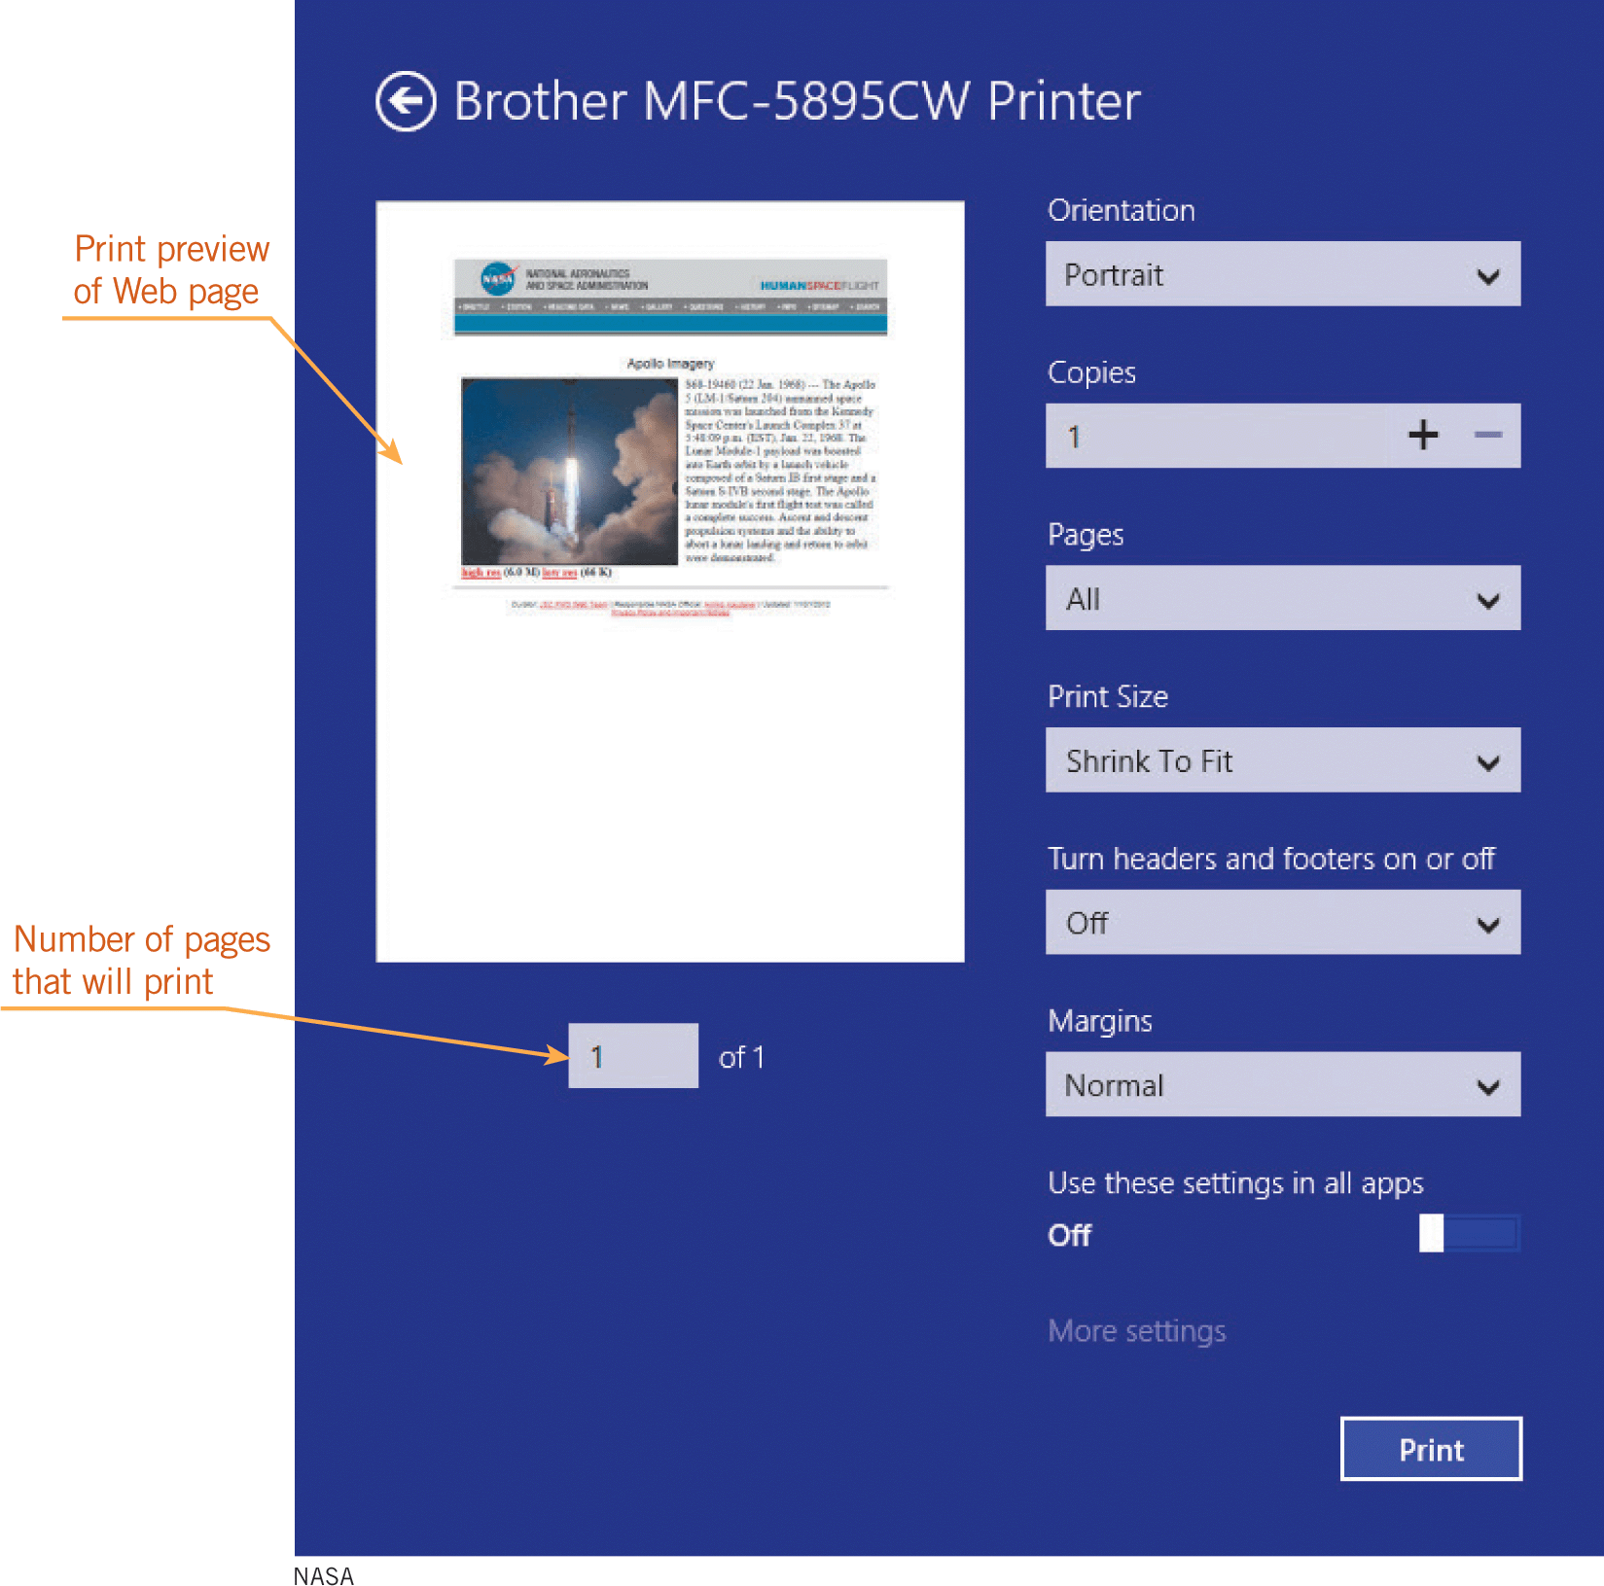
Copying and Printing Web Page Content
You can copy and
save specific
elements of a Web
page to a disk
or to the Cloud and
then use them in a
new document or file.
You can also print a
copy of a Web page
directly from your
browser.

Slide 29
Citing Internet Resources
You must cite Internet resources used in reports and other documents.
Claiming someone else’s words, or intellectual property, as your own is called plagiarism.
Core elements in citing material include the author’s name, the date of publication or last update, the document or Web page title, the URL, and the date you accessed the source.
Common citation styles include APA (American Psychological Association), Chicago/Turabian, and MLA (Modern Language Association).

Slide 30
Summary
In this lesson, you learned:
When searching online, one of the primary tools you can use to find information is a search engine.
You use a search engine to search for keywords.
Many search engines offer advanced search options that let you filter search results with specific criteria.
30
30

Slide 31
Summary (continued)
To filter your search, you can search for specific types of media or disciplines.
Many Web sites provide their own search engines so you can find content within the Web site.
Before accepting that the information is correct and truthful, you must evaluate the quality of the Web page content.
31
31

Slide 32
Summary (continued)
You can copy and print content on a Web page, but you must observe intellectual property laws so you don’t commit plagiarism.
When you use information from the Internet, you should cite the resources.
32
32

