Slide 1
Lesson 30 Technology and Society
Computer Literacy BASICS: A Comprehensive Guide to IC³, 5th Edition
Morrison / Wells / Ruffolo

Slide 2
Objectives
Describe how computers facilitate and enhance activities at work, school, and home.
Describe how devices are commonly used in daily life.
Describe how technology is used to transform traditional processes.
Identify assistive technologies.
2
2

Slide 3
Words to Know
assistive technologies
business-to-business (B2B)
business-to-consumer (B2C)
business-to-government (B2G)
critical thinking
crowdsourcing
e-commerce (electronic commerce)
point-of-sale (POS) system
RFID (radio-frequency identification) tags
telecommuting
3
3

Slide 4
Using Computers at Work, School, and Home
Collecting Information
Using the Internet is a fast and easy way to find the information you need.
Organizing Information
Computer software helps you organize information.
You can use databases and spreadsheets to organize and calculate data in a variety of ways.

Slide 5
Using Computers at Work, School, and Home (continued)
Evaluating Information
You can use spreadsheets to ask what-if questions and evaluate information.
You can use statistical functions such as Average, Count, Maximum, Minimum, and Percentile.
You can create charts to identify patterns or trends in the data.

Slide 6
Using Computers at Work, School, and Home (continued)
Communicating Information
When computers are connected through a network or the Internet, users can exchange information instantaneously.
Technology provides options such as e-mail, instant messaging, blogs, and audio visual communications.
Access to the Cloud allows users to share documents, images, music, and videos.

Slide 7
Using Computers at Work, School, and Home (continued)
Collaborating with Others and Solving Problems
You can share information you have stored on your computer or in the Cloud and collaborate with co-workers.
Using online communities, you can collaborate with other people all over the world.
The exchange and sharing of ideas helps you see a problem from different viewpoints.

Slide 8
Using Computers at Work, School, and Home (continued)
Collaborating with Others and Solving Problems (continued)
Crowdsourcing combines the collective effort of many people to complete a task.
Needed services and ideas are solicited from an online community instead of from employees or suppliers.
Participants are asked to brainstorm to solve a problem or share their opinions.

Slide 9
Using Computers at Work, School, and Home (continued)
Increasing Productivity
Having access to the Internet and the Web increases your productivity by providing online access to multiple resources, including communication with experts and specialists.
Applications can also enhance your output and productivity.

Slide 10
Using Computers at Work, School, and Home (continued)
Facilitating Learning
Many textbooks published today have an associated Web site with additional course materials, such as videos and exercises.
Electronic versions of a textbook (eBook) contain the full textbook and supplemental material.

Slide 11
Using Computers at Work, School, and Home (continued)
Promoting Creativity
Modern technology provides tools you can use to create artistic work that can be published for a real audience anywhere in the world.
Project-based collaborations can further enhance creative learning and problem-solving.

Slide 12
Using Computers at Work, School, and Home (continued)
Supporting Critical Thinking
Critical thinking is the process of analyzing information, combining information, and evaluating information as a guide to making judgments.
When reading information online, do not act until you have analyzed the point of view and motivations, gathered and combined information, and evaluated the information.

Slide 13
Using Computer Technology in Everyday Life
Facilitating Daily Life
You can access electronic catalogs, select goods, store them in a digital cart or bag, and then complete the purchase with a credit card or an online account.
You can purchase concert or sports tickets, order a program, and in some cases select your seats online for an upcoming event.

Slide 14
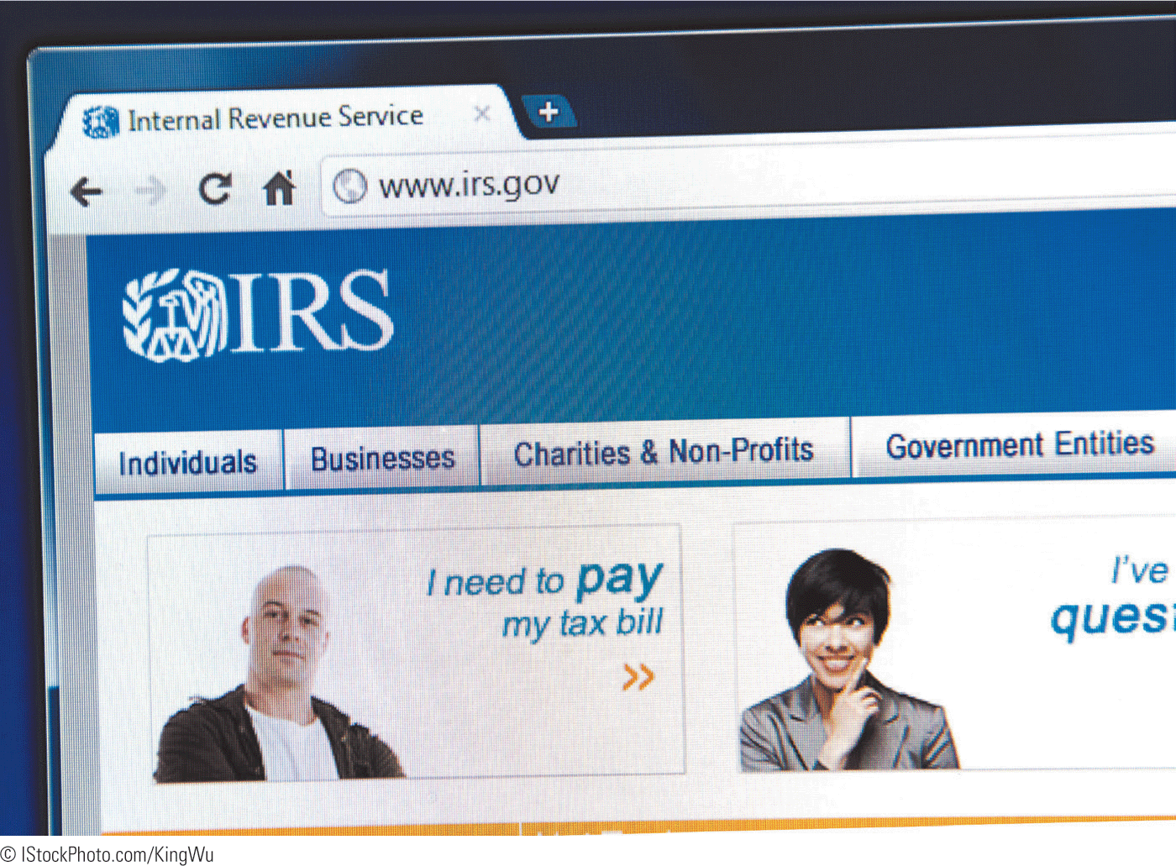
Using Computer Technology in Everyday Life (continued)
Facilitating Daily Life (continued)
Local, state, and national government Web sites provide access to many services.
For example, the Internal Revenue Service site provides forms and other services.

Slide 15
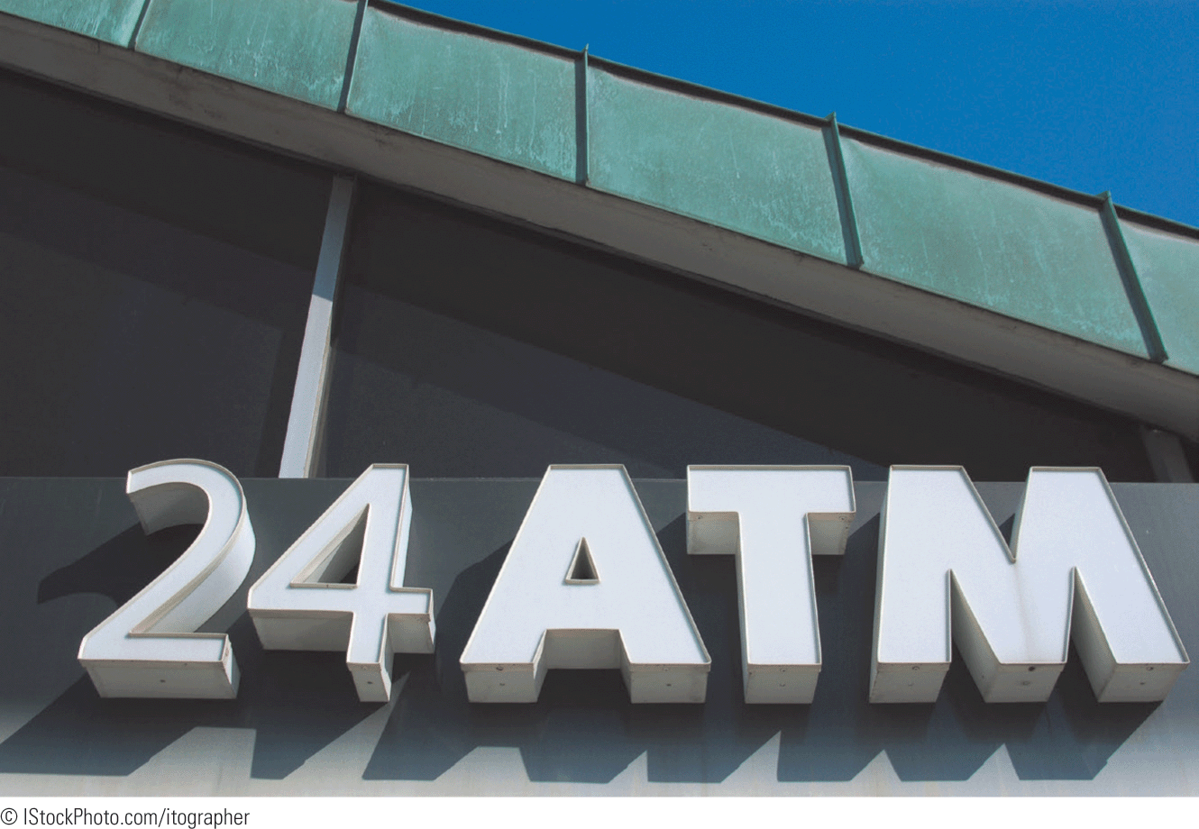
Using Computer Technology in Everyday Life (continued)
Automated Teller Machines
Automated teller machines (ATMs) can be used to deposit or withdraw money, and allow you to do your banking almost anywhere, anytime.

Slide 16
Using Computer Technology in Everyday Life (continued)
Credit and Debit Cards
Many people prefer to use ATM or credit cards instead of cash when traveling.
Using a card can help you keep track of travel expenses.
If the card is lost, it can be canceled immediately; whereas if cash is lost or stolen, the chances of recovery are very small.

Slide 17
Using Computer Technology in Everyday Life (continued)
Credit and Debit Cards (continued)
A security concern on the Internet is the theft of credit card information stored electronically.
Although effective encryption technologies keep credit card numbers secure, you can make your account even more secure.
Purchase items only from Web sites you know are reputable and trustworthy.

Slide 18

Using Computer Technology in Everyday Life (continued)
Credit and Debit Cards (continued)
Be sure any credit card information is transmitted in a secured, encrypted mode.
Take the same precautions whenever you are asked to disclose anything personal on the Internet.

Slide 19
Using Computer Technology in Everyday Life (continued)
Point-of-Sale Systems
A terminal used for electronic processing of payment transactions in a retail outlet is called a point-of-sale (POS) system.
When the cashier scans a product you purchase, the pricing can come from a centralized database. By tracking information about your purchases, coupons can be generated.
Many of the POS systems include a complete accounting, inventory, and management system.

Slide 20
Using Computer Technology in Everyday Life (continued)
Weather-Predicting and Reporting Systems
Numerical weather-prediction applications are used by most professional meteorologists.
Devices and apps enable you to access real-time weather data as well as current and continuously updated weather forecasts.

Slide 21
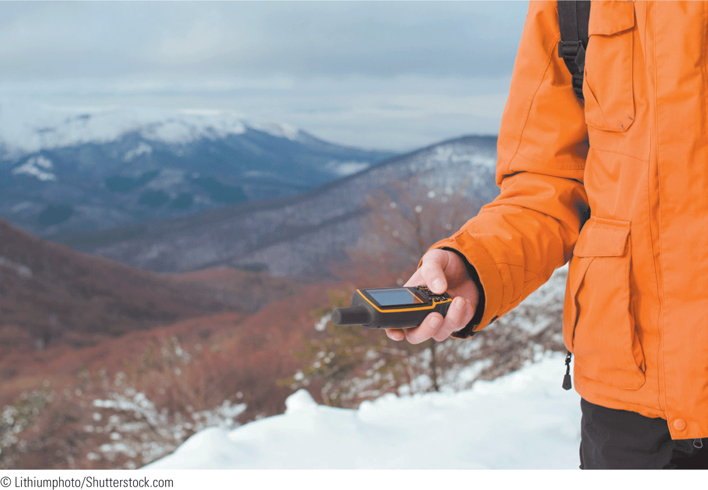
Using Computer Technology in Everyday Life (continued)
Global Positioning Systems
A global positioning system (GPS), combined with cell phone technology, can provide location information and directions.

Slide 22
Using Computer Technology in Everyday Life (continued)
Embedded Computers in Appliances and Equipment
An embedded computer is a special-purpose computer system incorporated into devices such as automobiles, appliances, and mechanical equipment.
An embedded computer is designed to perform one or a few dedicated tasks within a device or an appliance.

Slide 23
Using Computer Technology in Everyday Life (continued)
Embedded Computers in Appliances and Equipment (continued)
Newer cars have embedded computers that control systems such as ignition timing and antilock brakes.
Examples of appliances with embedded computers include digital clocks, microwaves, refrigerators, DVR recorders, washing machines, and water pumps.

Slide 24
Using Computer Technology in Everyday Life (continued)
Security Systems
Many cars today have a remote keyless ignition system.
Pressing a button opens or locks the doors, while pressing another button starts the car.
Keyless entry systems are also available for entrance doors to houses, businesses, and other buildings.
Most of these systems include a keypad.

Slide 25
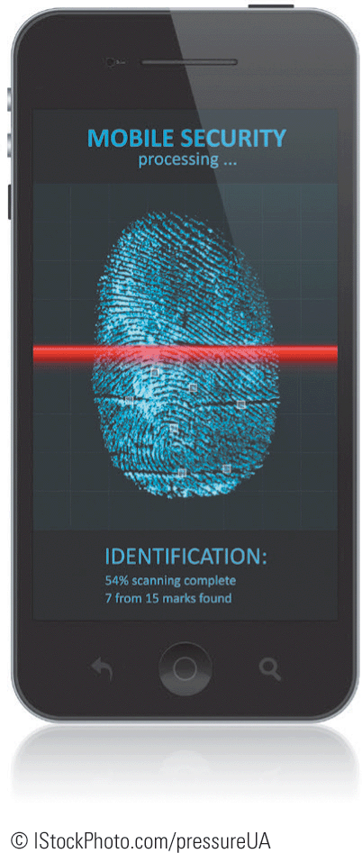
Using Computer Technology in Everyday Life (continued)
Security Systems (continued)
Some security systems require user identification.
A biometric device can confirm someone’s identity by matching patterns stored in a database with a person’s iris, retina, voice, fingerprint, or handprint.

Slide 26
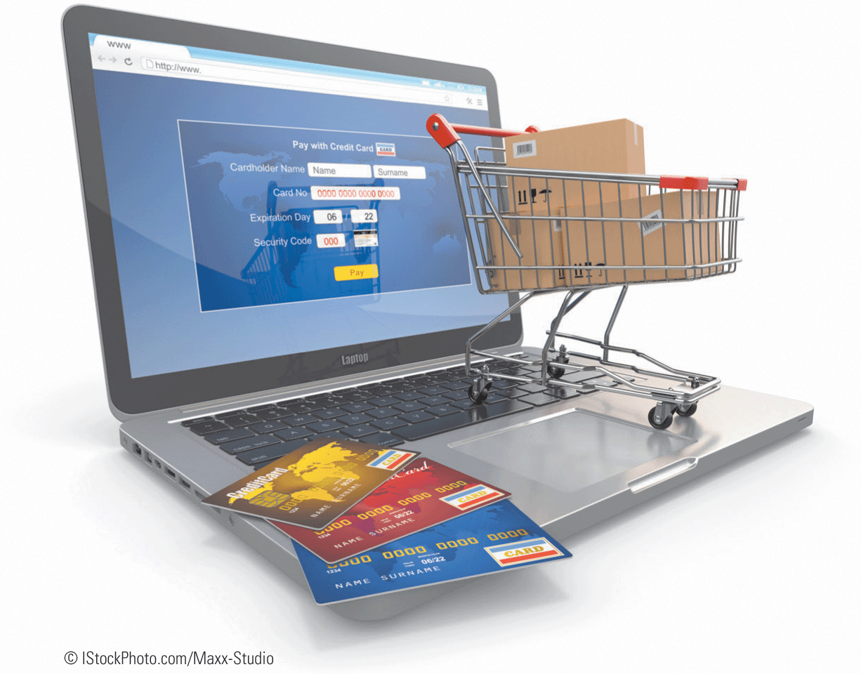
Using Technology to Transform Traditional Processes
E-Commerce
E-commerce (an abbreviation for electronic commerce) means conducting business on the Internet.
It primarily refers to purchasing and selling products on the Internet.

Slide 27
Using Technology to Transform Traditional Processes (continued)
Business Connections
Business-to-business (B2B) describes e-commerce transactions between businesses, such as between a company and a supplier.
Business-to-consumer (B2C) describes transactions between businesses and consumers.
Business-to-government (B2G) describes online transactions between businesses and government agencies.

Slide 28
Using Technology to Transform Traditional Processes (continued)
Business Connections (continued)
Retail businesses often use RFID (radio-frequency identification) tags, which are small electronic devices used to improve the efficiency of inventory tracking and management.
The RFID tags identify and track goods from the point of delivery or manufacturing to the point of sale.

Slide 29
Using Technology to Transform Traditional Processes (continued)
Business Connections (continued)
Scanners can read information from RFID tags from several feet away.
Governments are using RFID tags in passports and in transportation, such as electronic toll collection on highways and in mass transit passes.

Slide 30
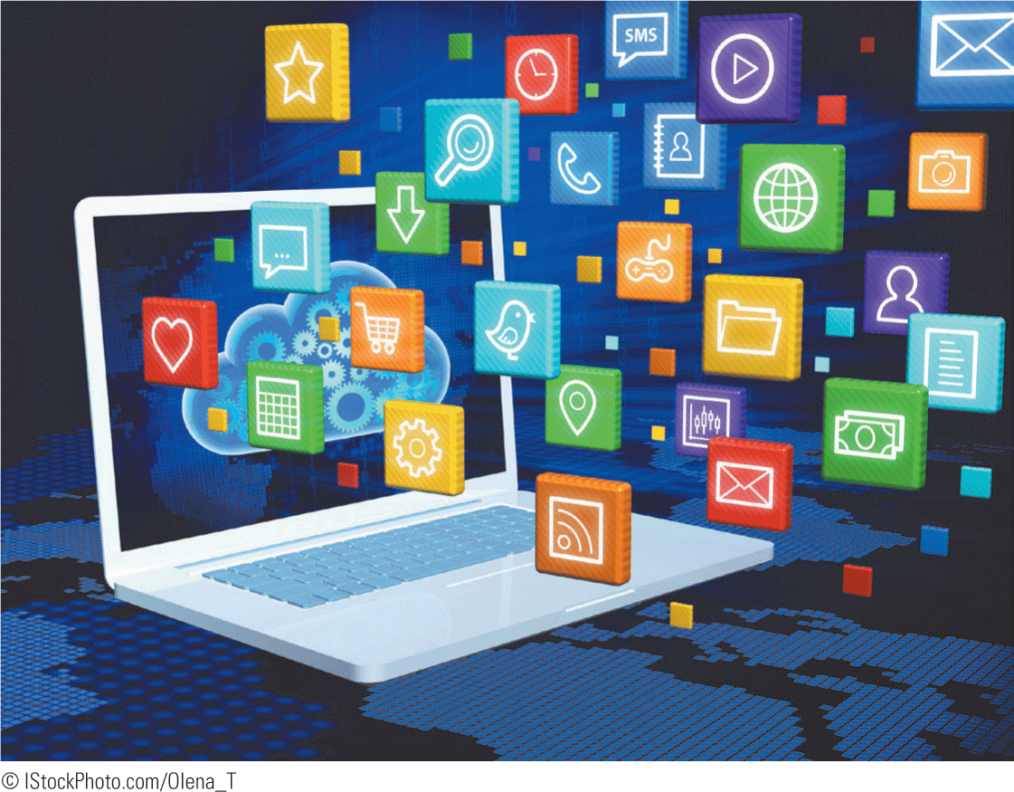
Using Technology to Transform Traditional Processes (continued)
Media
The Internet opened a new category of communications media.
Music, video, audio, pictures, and text can all be distributed through the Internet.

Slide 31
Using Technology to Transform Traditional Processes (continued)
Online Learning
Learning management system programs help teachers deliver online courses.
These programs are an integrated set of Web-based teaching tools that enable teachers to deliver e-learning courses or training, administer tests, and track and report on student performance.

Slide 32
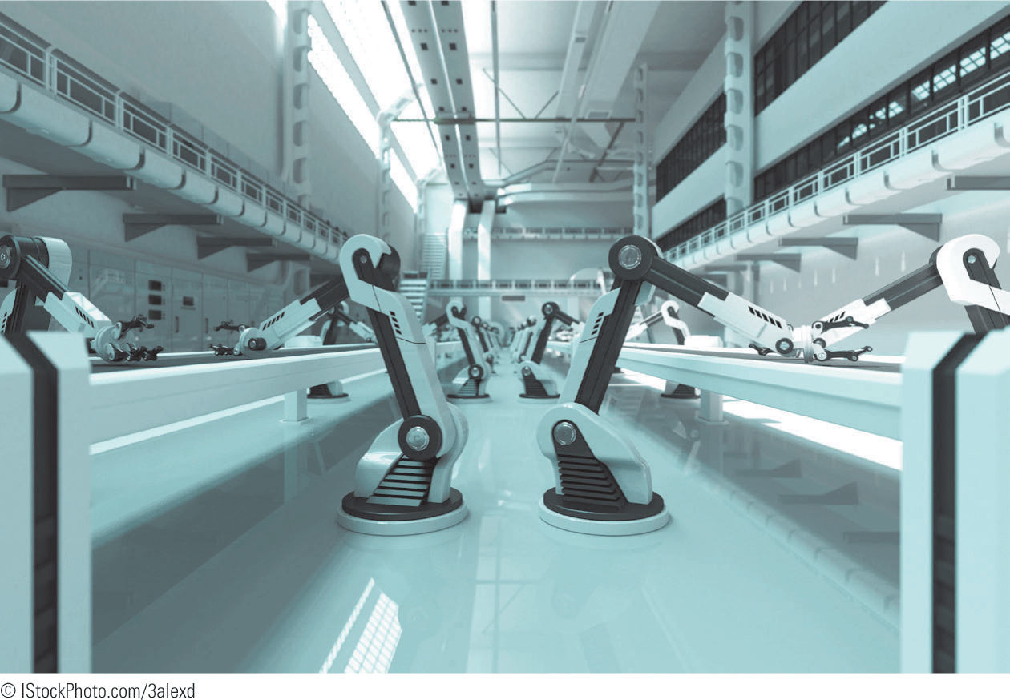
Using Technology to Transform Traditional Processes (continued)
Robotics
Robots have transformed industrial processes.
The use of computerized robots on assembly lines and in other industrial processes has expanded production capabilities in the manufacturing world.

Slide 33
Using Technology to Transform Traditional Processes (continued)
Telecommuting
Telecommuting involves using communications technology to allow an employee to work from home.
Employers save on overhead expenses; employees save on travel time and commuting expenses.
Projects and other relevant information can be shared through e-mail and other online distribution options.

Slide 34
Using Technology to Transform Traditional Processes (continued)
Online Communities
Online communities, also known as social networks, virtual communities, and e-communities, enable groups of people to interact online rather than face-to-face.
Social and professional groups use this type of communication to exchange ideas and share personal information.
Facebook is an example of a social network.

Slide 35
Using Technology to Transform Traditional Processes (continued)
Disaster Recovery
Hurricanes, tornadoes, and other recent disasters have increased awareness of the need for a disaster recovery plan for communities, cities, and states.
A segment of the plan should include options for electronic communications, such as a Web site that is updated periodically and provides a list of available resources and locations where help can be provided.

Slide 36
Identifying Assistive Technologies
Assistive technologies are software and devices used to maintain, increase, or improve the functional capabilities of individuals with disabilities.
Electronic software and devices help disabled people communicate, become more mobile, and participate in activities.
For example, TDD (telecommunications device for the deaf) technology allows hearing-impaired people to use a telephone.

Slide 37
Identifying Assistive Technologies (continued)
Adaptive software options available to aid people with visual impairment include:
Screen readers that provide alternative sensor guidance for computer navigation
Scanning and reading software
Braille translators
Text-to-speech applications

Slide 38
Identifying Assistive Technologies (continued)
Voice recognition tools enable users to dictate text and commands on computers and other electronic devices such as tables and smart phones.
E-learning and online courses allow disabled people to attend classes.
To make it easier for people with disabilities to board the bus, a “smart bus” provides steps that can be lowered, and has a lift for a wheelchair.

Slide 39
Identifying Assistive Technologies (continued)
Personal computers offer accessibility options that permit people with many types of disabilities to work and communicate more easily.

Slide 40
Summary
In this lesson, you learned:
Computers are used in different areas of work, school, and home to collect, organize, evaluate, and communicate information. Computers help users increase productivity, collaborate with others, facilitate learning, promote creativity, support critical thinking, and facilitate daily life.
40
40

Slide 41
Summary (continued)
Desktop and laptop computers represent only a fraction of interaction with computer technology. Daily, we use automated teller machines, credit cards, automated industrial processes, point-of-sale systems, weather-predicting and reporting systems, global positioning systems, embedded computers in appliances and equipment, and security systems.
41
41

Slide 42
Summary (continued)
The integration of personal computers and Internet services has transformed many of the traditional procedures and methods in business, education, and government. E-commerce, business connections, media, online learning, robotics, telecommuting, online communities, and disaster recovery are examples of how much has changed.
Advances in technologies provide beneficial assistance for individuals with disabilities.
42
42

