Slide 1
Lesson 4 Computer Maintenance
Computer Literacy BASICS: A Comprehensive Guide to IC³, 4th Edition
Morrison / Wells

Slide 2
Objectives
Identify maintenance issues.
Maintain hardware.
Upgrade and replace hardware components.
Perform preventive maintenance.
Request specialized maintenance.
2
2

Slide 3
Vocabulary
cable management
cookie
corona wires
defragmentation
ergonomic keyboard
fragmentation
maintenance
Recycle Bin
sector
seek time
touchpad
wireless keyboard
3
3

Slide 4
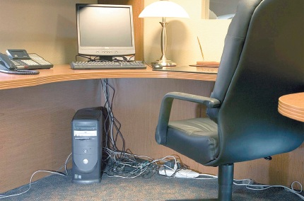
Identifying Maintenance Issues
A computer requires regular maintenance.
Managing computer cables is an overlooked problem when maintaining a computer system.
4
4

Slide 5
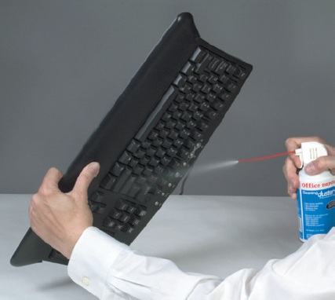
Maintaining Hardware
Keyboard and Mouse:
Use a can of compressed air to remove the dust from the keyboard.
5
5

Slide 6
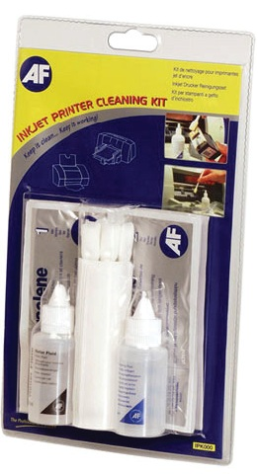
Maintaining Hardware (continued)
Inkjet Printers:
Small deposits of dry ink accumulate on the print head of an inkjet printer.
You can use special supplies to clean an inkjet printer.
6
6

Slide 7
Maintaining Hardware (continued)
Laser Printers:
Use a printer brush or a good paint brush and a lint-free cloth to clean inside the toner opening.
Remove paper fragments.
Use a clean cloth to wipe up any spilled toner and dust.
Clean the rollers, but don’t touch the transfer (sponge) roller.
Replace the toner cartridge
7
7

Slide 8
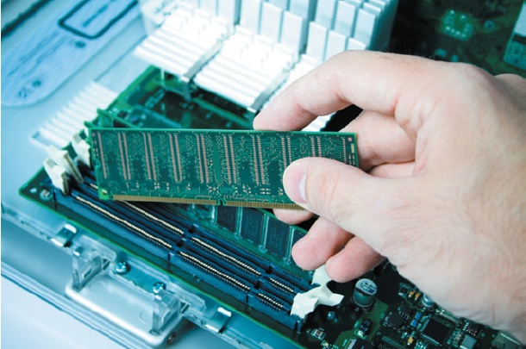
Upgrading and Replacing Hardware Components
Computer Memory:
RAM is made up of small memory chips that form a memory module, installed in the RAM slots on the motherboard of your computer.
8
8

Slide 9
Upgrading and Replacing Hardware Components (continued)
Keyboards:
Ergonomic keyboards allow for a more natural positioning of your arms and hands.
A wireless keyboard reduces the clutter of unsightly wires and other cable problems and improves mobility.
9
9

Slide 10
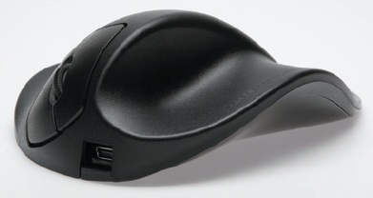
Upgrading and Replacing Hardware Components (continued)
Mouse:
You can replace a mouse without replacing any other computer hardware.
A touchpad is a pointing device you can use instead of a mouse.
10
10

Slide 11
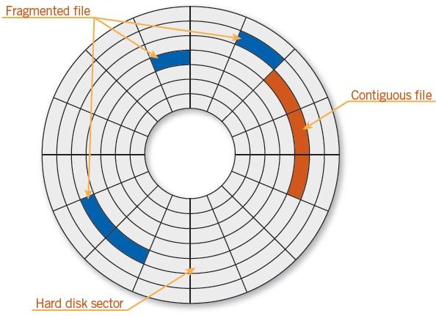
Performing Preventive Maintenance
Disk Defragmentation:
Disk fragmentation occurs when data is broken up into many pieces that are not stored close together.
11
11

Slide 12
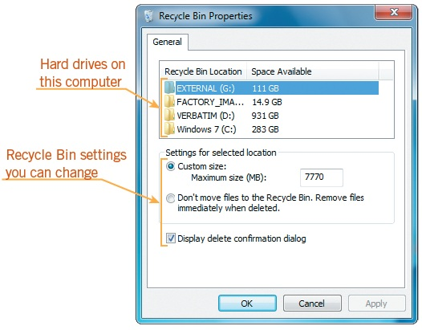
Performing Preventive Maintenance (continued)
Recycle Bin:
The Windows Recycle Bin is a holding area for files and folders before their final deletion from a storage device.
12
12

Slide 13
Performing Preventive Maintenance (continued)
Temporary Files:
Temporary files normally exist only during the current session of the program.
Cookies:
A cookie is a small text file that a Web site uses to identify a specific computer.
13
13

Slide 14
Requesting Specialized Maintenance
Generally should be performed by a computer professional:
Replacing the power supply or opening the power supply case
Replacing other electrical components
Replacing the processor
Replacing or adding a hard disk
Replacing or adding additional RAM
14
14

Slide 15
Summary
In this lesson, you learned:
A computer requires maintenance on a regular schedule to prevent problems such as the degrading of hard disk performance and monitor trouble.
Damaged and poorly maintained cables can prevent peripheral devices from communicating with the computer. Unorganized and unprotected cables can also create safety hazards. Cable management should therefore be part of a regular computer maintenance routine.
15
15

Slide 16
Summary (continued)
To maintain the computer keyboard, use a can of compressed air to remove the dust from the keyboard every six months.
Clean a mechanical mouse by removing its cover, removing debris from the roller and the ball, and then reassembling the mouse.
16
16

Slide 17
Summary (continued)
Printer maintenance helps to prevent common printing problems. Many inkjet printers have a self-cleaning mode. If yours does not, use an inkjet cleaning cartridge to flush dirt and debris out of clogged printer nozzles. Clean a laser printer when you change the toner cartridge.
Adding computer memory (RAM) often provides the best value for increasing overall system performance.
17
17

Slide 18
Summary (continued)
All computers slow down as you work with them. To improve or maintain computer efficiency, periodically use Windows tools to defragment hard drives, empty the Recycle Bin, delete temporary files, and remove cookies.
Some maintenance procedures are not suitable for the average computer user and should be performed by a computer professional, such as replacing the power supply or opening the power supply case, replacing other electrical components, including the processor and RAM, and adding an internal hard disk.
18
18

