Slide 1
Lesson 6
Software and Hardware
Interaction
Computer Literacy BASICS: A Comprehensive Guide to IC³, 4th Edition
Morrison / Wells

Slide 2
Objectives
Understand how hardware and software interact.
Explain how a software program works.
Track software development.
Compare application software and system software.
Identify options for software distribution.
2
2

Slide 3
Vocabulary
algorithm
application software
beta testing
bundleware
flowchart
inputting
network license
operating system
patch
service pack
single-user license
software
Software as a Service (SaaS)
3
3

Slide 4
Vocabulary (continued)
software development
software license
software piracy
system software
update
upgrade
Web application
4
4

Slide 5

Understanding How Hardware and
Software Interact
Inputting is the process of using an input device to enter data.
5
5

Slide 6
Understanding How Hardware and
Software Interact (continued)
The Role of Software:
Software (or a program) is programming code written to provide instructions to the hardware so it can perform tasks.
Hardware and software interact as a computer processes data.
6
6

Slide 7
How a Software Program Works
An algorithm is a set of clearly defined, logical steps that solve a problem.
When a programmer writes software instructions for a computer, every step must give explicit instructions.
A specialized computer program translates the programming language to machine language that the computer can understand.
7
7

Slide 8
Tracking Software Development
Software development is a multistep process that usually begins when someone recognizes a need to perform a task more effectively using a computer.
8
8

Slide 9
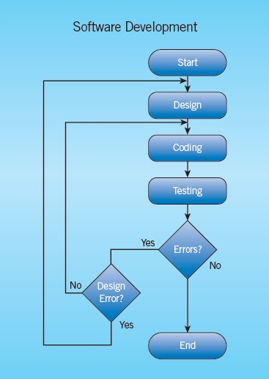
Tracking Software Development (continued)
A flowchart shows different paths the program will take depending on what data is inputted.
9
9

Slide 10
Tracking Software Development (continued)
Beta testing is a process that releases commercial software in development to a cross-section of typical users who evaluate the program and report any problems, or “bugs,” in the software before it is released to the public.
10
10

Slide 11
Comparing Application Software and
System Software
There are two basic types of computer software: application software and system software.
Application software helps you perform a specific task.
System software refers to the operating system and all utility programs that manage computer resources.
11
11

Slide 12
Comparing Application Software and
System Software (continued)
Application Software:
Common application programs are word processors, database systems, presentation programs, spreadsheet programs, and graphic design programs. Others are:
  Education, home, and personal software
  Multimedia software
  Workgroup computing software
12
12

Slide 13
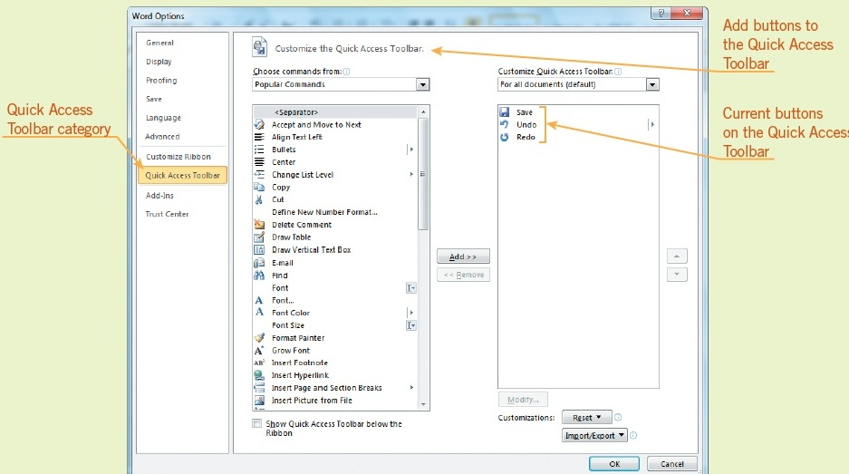
Comparing Application Software and
System Software (continued)
Using Application Software:
You can customize options, such as modifying the Quick Access toolbar.
13
13

Slide 14
Comparing Application Software and
System Software (continued)
System Software:
System software is a group of programs that coordinate and control the resources and operations of a computer system.
Operating Systems:
Operating systems provide an interface between the user or application and the computer hardware.
14
14

Slide 15
Comparing Application Software and
System Software (continued)
Utilities and Language Translators:
Utilities are programs that help to maintain computer hardware or other software, and usually perform a single task.
15
15

Slide 16
Identifying Options for Software Distribution
Software Licensing:
A software license gives you permission to use the program.
A single-user license gives you the right to install the software on a single computer.
A network license gives an organization the right to install a program on a server that can be accessed by a specific number of computers.
16
16

Slide 17
Identifying Options for Software Distribution (continued)
Updating and Upgrading Software:
Users who purchased the original version of the software can download a fix for the problem.
  A software patch is applied over software that you already have installed.
  An update is a collection of files for revising released software to fix bugs or provide enhancements.
  A service pack is a collection of updates, fixes, or enhancements to a software program delivered as a single file.
17
17

Slide 18
Identifying Options for Software Distribution (continued)
Updating and Upgrading Software (continued):
Upgrades are revised versions of a software program and require the purchase of a newer version of the software.
Web applications have no installation requirements, can be used on all operating systems, and are accessed through a Web browser over a network such as an intranet or the Internet.
18
18

Slide 19
Identifying Options for Software Distribution (continued)
Alternative Methods of Software Distribution:
  Open source
  Freeware
  Shareware
  Bundleware
Software piracy is the unauthorized copying of software.
19
19

Slide 20
Summary
In this lesson, you learned:
Hardware refers to anything you can touch, including objects such as the keyboard, mouse, monitor, printer, chips, disk drives, and CD/DVD recorders. Inputting refers to using an input device to enter data.
Software is programming code written to provide instructions to the hardware so that you can perform specific tasks. Using input devices, you interact with the software by typing commands, selecting an option from a menu, or clicking a button, for example.
20
20

Slide 21
Summary (continued)
Hardware and software interact as a computer processes data.
A computer processes data by applying rules called algorithms, which are sets of clearly defined, logical steps that solve a problem.
21
21

Slide 22
Summary (continued)
Software development usually begins when someone recognizes a need to perform a task more effectively using a computer. The programmer breaks down the task into an algorithm that covers all the actions needed to perform the task. The programmer often works out the logic for the steps in the algorithm by using a flowchart that shows different paths the program will take depending on what data is inputted.
22
22

Slide 23
Summary (continued)
The programmer writes the steps in a computer programming language or code that uses a formal set of terms and syntax, or rules for how the words are used together. The computer translates the code into language it can understand, and uses the translated commands to execute the program.
Software development also requires quality control, which involves running systematic tests, debugging (finding and correcting errors in the code), and beta testing.
23
23

Slide 24
Summary (continued)
The two types of software are application software and system software. Application software helps you perform a specific task. System software refers to the operating system and all utility programs that manage computer resources.
Operating systems provide an interface between the user or application and the computer hardware.
When you purchase software, you are purchasing a license that gives you permission to use the program. A single-user license gives you the right to install the software on a single computer. Organizations using networks can purchase network licenses.
24
24

