Slide 1
Lesson 7 Software Fundamentals
Computer Literacy BASICS: A Comprehensive Guide to IC³, 4th Edition
Morrison / Wells

Slide 2
Objectives
Use word-processing software.
Work with spreadsheet software.
Work with presentation software.
Use database software.
Work with graphics and multimedia software.
Use other types of software, including education, entertainment, utility, and miscellaneous programs.
2
2

Slide 3
Objectives (continued)
Select the right software for the task.
Integrate software.
3
3

Slide 4
Vocabulary
bitmapped graphics
cell
database
datasheet
field
multimedia
object
object linking and embedding (OLE)
presentation software
primary key
query
record
table
4
4

Slide 5
Vocabulary (continued)
text editor
utility program
vector graphics
word-processing software
workbook
worksheet
5
5

Slide 6
Using Word-Processing Software
Word-processing software is used to create, edit, and print documents and then save them electronically.
You can easily correct errors and modify data.
You can save the document in a variety of formats.
Microsoft Word includes basic and sophisticated features for creating, editing, formatting, and producing documents.
6
6

Slide 7
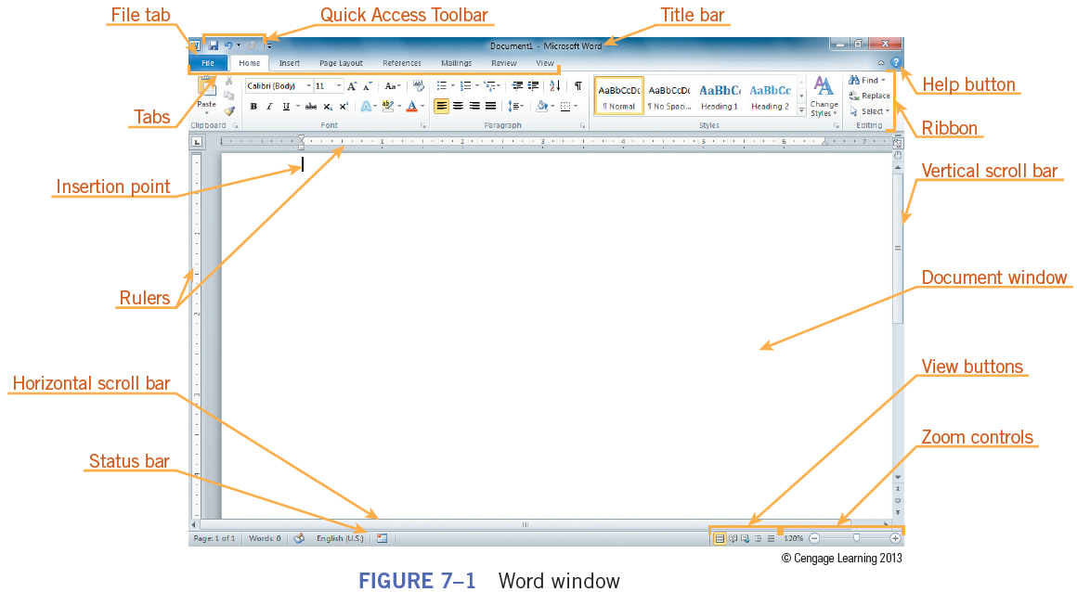
Using Word-Processing Software (continued)
Microsoft Word window
7
7

Slide 8
Using Word-Processing Software (continued)
Basic features of word-processing programs:
Accessibility
Copy and paste
Cut and paste
Delete
File management
Font selection
Graphics
8
8

Slide 9
Using Word-Processing Software (continued)
Basic features of word-processing programs (continued):
Page size and size margins
Print
Search and replace
Text insertion
Word wrap
9
9

Slide 10
Using Word-Processing Software (continued)
Additional features of advanced word-processing programs include the following:
Blogs: Publish blogs directly from the word-processing program.
Footnotes: Automate the numbering and placement of footnotes.
Headers and footers: Specify custom text and graphics at the top and bottom of a page.
Macros: Save a series of keystrokes that represent a series of commands.
10
10

Slide 11
Using Word-Processing Software (continued)
Additional features of advanced word-processing programs include the following (continued):
Merge: Merge text from one file into another.
Page numbering: Number pages in the format and position you specify.
Reference tools: Access reference tools such as a spell checker, dictionary, thesaurus, and language translator.
Windows: Display and edit two or more documents on the same screen.
WYSIWYG: Work with the document on the screen as it will look when printed—“what you see is what you get”.
11
11

Slide 12
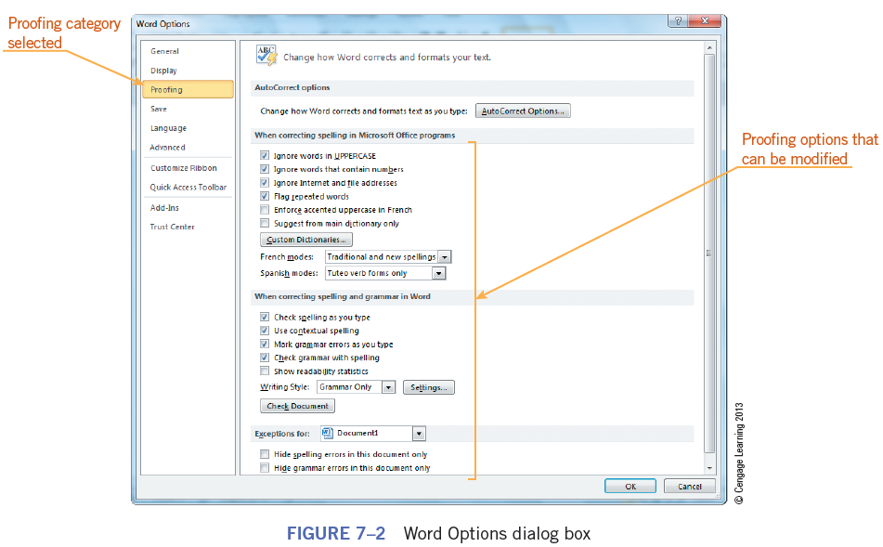
Using Word-Processing Software (continued)
Microsoft Word provides other options you can adjust and configure to suit your working style.
12
12

Slide 13
Working with Spreadsheet Software
A spreadsheet is a row-and-column arrangement of data.
You use spreadsheet software such as Microsoft Excel to evaluate, calculate, manipulate, analyze, and present numeric data.
A spreadsheet is a grid with columns and rows that contain text, formulas, and numbers (values).
The grid in Excel is referred to as a worksheet.
Each new workbook comes with three worksheets.
13
13

Slide 14
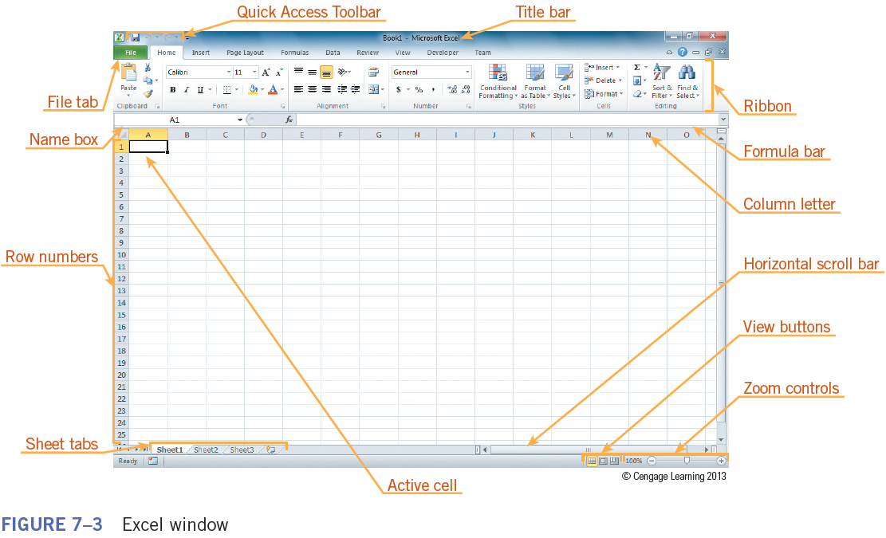
Working with Spreadsheet Software (continued)
The Excel window
14
14

Slide 15
Working with Spreadsheet Software (continued)
Columns are identified by letters and rows are identified by numbers.
The point at which a column and row intersect is called a cell.
Each cell has a name, called the cell reference, which is represented by the column letter and row number, such as A1.
15
15

Slide 16
Working with Spreadsheet Software (continued)
Basic features of spreadsheet programs:
Accessibility
Copy and paste
Cut and paste
Data filtering
Delete
File management
Font selection
Formulas
16
16

Slide 17
Working with Spreadsheet Software (continued)
Basic features of spreadsheet programs (continued):
Graphics
Headers and footers
Data entry
Macros
Merge
Page numbering
Print
17
17

Slide 18
Working with Spreadsheet Software (continued)
Basic features of spreadsheet programs (continued):
Search and replace
Reference and editing tools
Windows
18
18

Slide 19
Working with Presentation Software
Presentation software is a computer program you use to organize and present information, normally in the form of a slide show.
Equipment requirements for the presentation include a projector and computer.
Microsoft PowerPoint is the presentation program in the Microsoft Office suite.
19
19

Slide 20
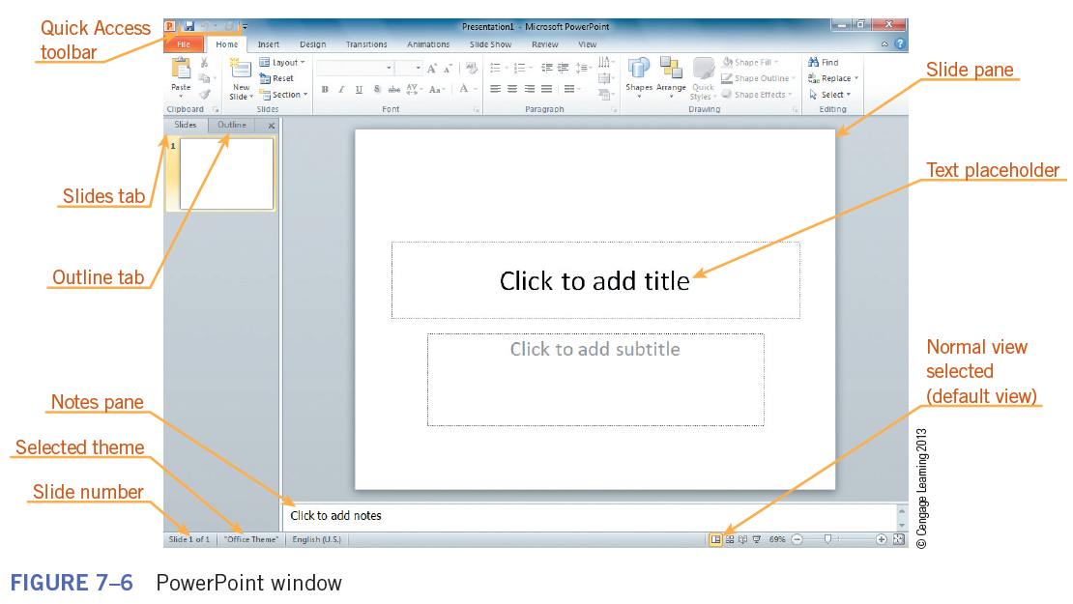
Working with Presentation Software (continued)
The PowerPoint window
20
20

Slide 21
Working with Presentation Software (continued)
Besides being excellent for creating on-screen shows, presentation software is also useful in the following scenarios:
Self-running presentation: Job fairs, demonstrations, and conventions are a few examples of where you might see a self-running presentation.
Presentation broadcasting: You can use the Web to broadcast your presentation to locations all over the world.
Overhead transparencies: If you do not have access to a computer and projector for your presentation, you can create and print black-and-white or color transparencies.
21
21

Slide 22
Working with Presentation Software (continued)
Besides being excellent for creating on-screen shows, presentation software is also useful in the following scenarios (continued):
Audience handouts: Printed handouts support your presentation. Smaller versions of your slides can be printed two, three, six, or nine to a page.
PDF document: Portable Document Format (PDF) is a common format for sharing documents online and through other channels.
22
22

Slide 23
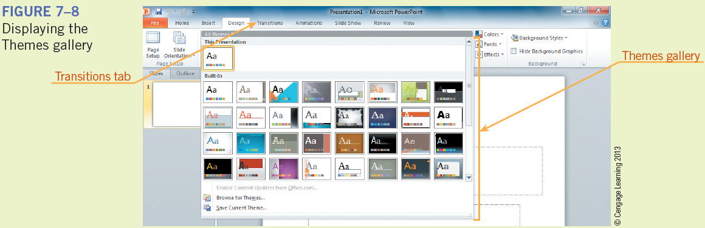
Working with Presentation Software (continued)
PowerPoint comes with a variety of designs, called themes, which you can apply to a presentation.
PowerPoint also provides transitions, which are animated effects that play between slides.
23
23

Slide 24
Working with Presentation Software (continued)
Effective Presentation Guidelines:
Develop an outline for your presentation, consider your audience and determine the presentation’s purpose, the location in which it will be given, and the equipment you will need.
Cover one topic per slide.
Keep the text simple—use the “6 by 6” rule, which is six lines of text, six words per line.
Use no more than 50 words per slide.
24
24

Slide 25
Working with Presentation Software (continued)
Effective Presentation Guidelines (continued):
Do not clutter your slide with large paragraphs displayed in a small font size.
Use short comments and fill in the details orally.
Use bullets, not numbers, unless providing specific step-by-step instructions.
Use readable typefaces and fonts, such as those provided in PowerPoint themes.
Choose color carefully.
25
25

Slide 26
Working with Presentation Software (continued)
Effective Presentation Guidelines (continued):
Use simple tables to present numbers.
Add clip art sparingly and only where appropriate.
Do not try to dazzle your audience with an overabundance of graphics, sound, transitions, and other effects.
26
26

Slide 27
Using Database Software
Database Software Defined:
A database is a collection of related information organized in a manner that allows for rapid search and retrieval.
A database management system (DBMS) is software used to create, maintain, and provide controlled access to data.
A database table contains the data to organize and is similar to a spreadsheet, but provides additional comprehensive functions for manipulating data.
27
27

Slide 28
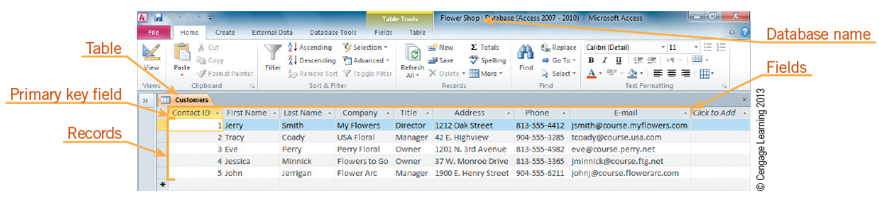
Using Database Software (continued)
Database Structure:
In Microsoft Access, a database can consist of one table or a collection of tables.
A table is composed of columns and rows, referred to as fields and records in Access.
28
28

Slide 29
Using Database Software (continued)
Database Structure (continued):
Rows in a table are called records. Each record is a group of related fields.
Columns in a table are called fields. Each field contains a specific piece of information within a record.
The primary key, which is assigned to a field, uniquely identifies each record in a table.
29
29

Slide 30
Using Database Software (continued)
Database Structure (continued):
The Access window does not have a standard document view. It changes based on the object you are using as you work with the database.
A query asks a question about the data stored in the table.
You use forms to enter data in a table and reports to print selected data.
All objects—tables, forms, queries, and reports—are stored in a single file, which is the database.
30
30

Slide 31
Using Database Software (continued)
Database Tables:
You can create a table three ways:
Create a new database.
Add a table to an existing database using the Tables group on the Create tab.
Create a table by selecting a table template using the Application Parts button in the Templates group on the Create tab.
Creating a table is the first step in a three-step process; adding fields is the second step. The third step is to add records to the table.
31
31

Slide 32
Using Database Software (continued)
Database Tables (continued):
You can display Access tables in the following views:
Design view
Datasheet view
A datasheet resembles an Excel worksheet.
When you enter data in a field, it is called an entry.
32
32

Slide 33
Using Database Software (continued)
Forms:
A form provides a convenient way to enter and view records in a table.
You can create a form manually or with the Form Wizard.
Queries:
A query enables you to locate records that match specified criteria.
33
33

Slide 34
Using Database Software (continued)
Queries (continued):
Access provides four query options:
Simple Query Wizard: Creates a select query from the selected fields
Crosstab Query Wizard: Displays data in a spreadsheet format
Find Duplicates Query Wizard: Locates records with duplicate field values
Find Unmatched Query Wizard: Locates records in one table that have no related records in another table
34
34

Slide 35
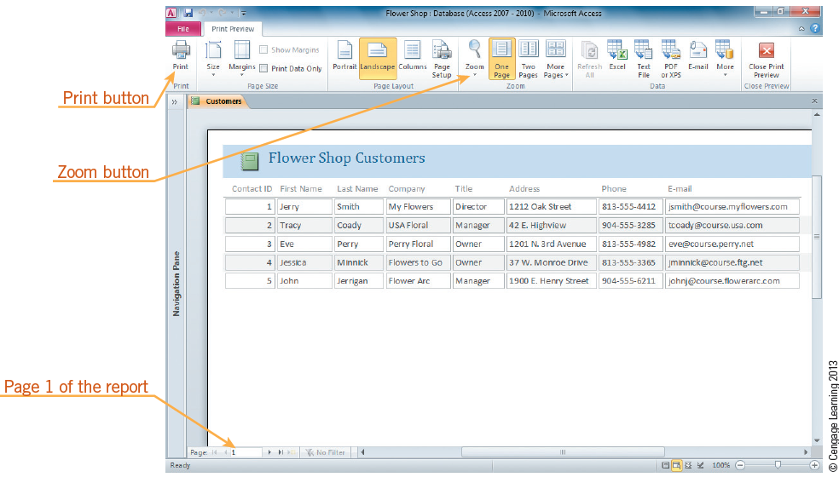
Using Database Software (continued)
Reports:
A report is a database object that allows you to organize, summarize, and print all or a portion of the data in a database.
35
35

Slide 36
Using Database Software (continued)
Online Databases:
Features of Web databases are as follows:
Create and update a contacts list.
Change photos frequently and update an online catalog.
Manage and keep your content current.
Use online documentation.
Generate formulas and calculated fields to automatically update your data.
Keep users up to date with the latest information.
Import and export information easily.
36
36

Slide 37
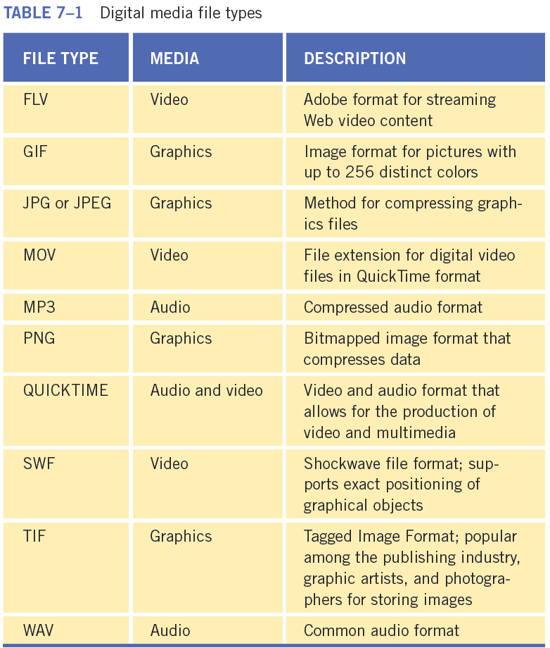
Working with Graphics and Multimedia
Vector images consist of many individual objects, each with properties such as color, fill, and outline.
Bitmap images are composed of pixels in a grid. They have a fixed resolution and cannot be resized without losing image quality.
37
37

Slide 38
Working with Graphics and Multimedia (continued)
Drawing Programs:
A drawing program is a graphics program used for creating illustrations. Images are saved in vector graphics format.
Paint Programs:
A paint program allows you to simulate painting on the computer through the use of a graphics table or a mouse.
Images are generated as bitmapped graphics.
38
38

Slide 39
Working with Graphics and Multimedia (continued)
Photo/Image Manipulation Programs:
You use digital editing software to edit images, photos, and logos.
Animation Programs:
You use animation software to create moving images and 3D graphics.
Multimedia Programs:
Multimedia is the use of text, graphics, and video in some combination to create an effective means of communication and interaction.
39
39

Slide 40
Using Other Types of Software
Education and Entertainment Programs:
Computer-based training (CBT)
Computer games
Audio and video
Virtual reality
Utility Programs:
File compression programs
Defragmentation
Antivirus, antiadware, and antispyware programs
Backup program
Single-purpose tools and accessories
40
40

Slide 41
Using Other Types of Software (continued)
Miscellaneous Software:
Financial and accounting programs
Electronic mail
Chat, messaging, and instant messaging software
Web browser
Computer-aided design (CAD)
Project management
Groupware
Web conferencing
Integrated programs
Specialized software
41
41

Slide 42
Selecting the Right Software for the Task
Choose software appropriate for the task.
An example of incorrectly selecting software is using word-processing software to keep copies of financial records when a spreadsheet or an accounting program would be a better choice.
42
42

Slide 43
Integrating Software
Microsoft Office provides three methods for inserting objects from one Office document into another Office document: copying and pasting, embedding, and linking.
Object linking and embedding (OLE) lets you create a document or object in one program and then link or embed the data into another program.
A linked object retains a connection to the original file, which contains the actual data represented by the linked object.
43
43

Slide 44
Summary
In this lesson, you learned:
You use word-processing software to create, edit, and print documents and then save the documents electronically. When creating a document, you can easily correct errors and modify data.
A spreadsheet is a row-and-column arrangement of data. You use electronic spreadsheet software to evaluate, calculate, manipulate, analyze, and present numeric data. A spreadsheet updates calculations automatically.
44
44

Slide 45
Summary (continued)
A database is a collection of related information organized in a manner that provides for rapid search and retrieval. You use database software to create, maintain, and provide controlled access to data.
A database can consist of one table or a collection of tables, which are composed of columns and rows, and referred to as fields and records. The primary key, which is assigned to a field, uniquely identifies each record in a table. You also can create queries, forms, and reports using database software.
45
45

Slide 46
Summary (continued)
You use graphics and multimedia programs to create and edit images and animation. Most graphics applications fall into one of two main categories: vector or bitmap graphics.
Educational and entertainment programs include computer-based training, computer games, audio and video software, and virtual reality software.
Utility programs help you perform computer housekeeping chores such as managing the computer’s resources and files.
46
46

Slide 47
Summary (continued)
Miscellaneous software includes programs such as e-mail applications, Web browsers, and project management software.
47
47

