Slide 1
Lesson 8 Operating Systems
Computer Literacy BASICS: A Comprehensive Guide to IC³, 4th Edition
Morrison / Wells

Slide 2
Objectives
Identify the purpose of an operating system.
Identify different operating systems.
Share files on different operating systems.
Identify user rights.
Troubleshoot common operating system problems.
2
2

Slide 3
Vocabulary
administrative rights
administrator account
driver
embedded operating system
emulation card
file system
Linux
Mac OS X
operating system (OS)
Palm OS
3
3

Slide 4
Vocabulary (continued)
system administrator
UNIX
Windows Embedded CE
Windows Phone
4
4

Slide 5
Identifying the Purpose of an Operating System
An operating system (OS) is system software that enables the computer hardware to communicate and operate with the application software.
Drivers are programs provided by peripheral device manufacturers that the operating system uses to communicate with various hardware devices.
The way an operating system stores files on disk is called a file system.
5
5

Slide 6
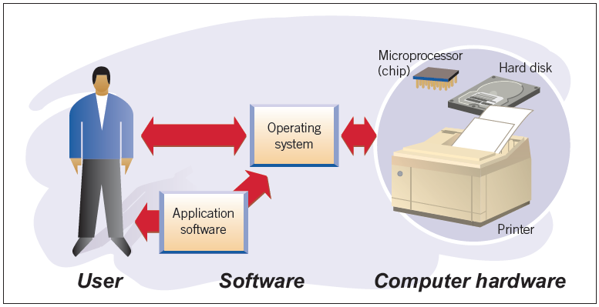
Identifying Different Operating Systems
An operating system provides an interface between the user or application program and the computer hardware.
6
6

Slide 7
Identifying Different Operating Systems (continued)
Personal Computer Operating Systems:
The Windows operating system is designed to work with an Intel processor or clone.
The Macintosh operating system is called Mac OS X.
UNIX is the operating system frequently used by scientists and programmers.
Linux is a variant of UNIX.
7
7

Slide 8
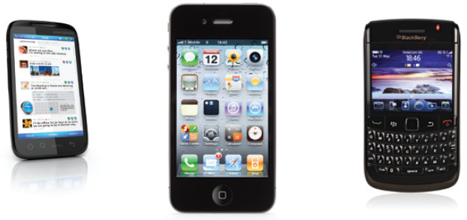
Identifying Different Operating Systems (continued)
Handheld and Embedded Operating Systems:
Also known as mobile operating systems, they are smaller and generally less capable than desktop operating systems.
8
8

Slide 9
Identifying Different Operating Systems (continued)
Handheld and Embedded Operating Systems (continued):
Popular handheld and embedded operating systems include the following:
Android
Apple iOS
BlackBerry
Embedded Linux
Palm OS
Symbian OS
Windows Embedded CE
Windows Phone
9
9

Slide 10
Sharing Files on Different Operating Systems
In many business, personal, and educational settings, people share files across operating system platforms.
One type of hardware solution is an emulation card that is added to the motherboard of a computer.
10
10

Slide 11
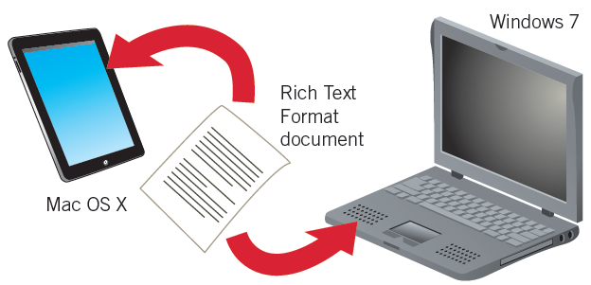
Sharing Files on Different Operating Systems (continued)
Rich Text Format (.rtf) documents can generally be transferred to other operating systems across a network, to a Linux server, or to a handheld or mobile device.
11
11

Slide 12
Identifying User Rights
The system administrator is a user who has an administrator account, which is a local account or a local security group.
The administrator can grant administrative rights to other users, allowing them to make specified types of changes.
12
12

Slide 13
Troubleshooting Common Operating System Problems
Incompatibility: Application software and files need to be compatible with the computer’s operating system.
File corruption: You can use a system utility that identifies and repairs corrupted files.
Disk crashes: In some instances, restarting, or rebooting, the system can solve the problem.
13
13

Slide 14
Summary
In this lesson, you learned:
An operating system is system software that enables computer hardware to communicate and operate with the application software. Without an operating system, a computer would not function because the operating system manages and coordinates the activities and resources of the computer.
14
14

Slide 15
Summary (continued)
Operating systems provide a consistent way for applications to communicate with hardware without duplicating settings or learning details about the hardware. They also perform system and file maintenance tasks.
Windows, Mac OS X, and Linux are common operating systems for personal computers.
15
15

Slide 16
Summary (continued)
Handheld and embedded operating systems, also known as mobile operating systems, are similar in principle to operating systems such as Windows or Linux. These systems, however, are smaller and generally have fewer capabilities than desktop operating systems.
To share files across operating system platforms, you can use solutions involving hardware, software, and data. For example, saving data or work files in the Rich Text Format means that most other operating systems can read the file.
16
16

Slide 17
Summary (continued)
An operating system sets limitations to protect itself and the data on the computer. The operating system grants permission to you to perform some tasks but prevents you from performing others according to your user rights.
The system administrator has unrestricted access to make system-wide changes to the computer, including those that affect other users. Without administrative rights, you cannot make changes such as system modifications, installing software, or changing network settings.
17
17

Slide 18
Summary (continued)
Typical operating system problems include file incompatibility, file corruption, and disk crashes.
18
18

