Slide 1
Lesson 2 Input, Output, and Processing
Computer Literacy BASICS: A Comprehensive Guide to IC³, 4th Edition
Morrison / Wells

Slide 2
Objectives
Identify and describe standard and specialized input devices.
Identify and describe standard and specialized output devices.
Connect input and output devices to a computer.
Consider computer performance factors.
2
2

Slide 3
Vocabulary
audio input
biometrics
digital camera
expansion slot
FireWire
inkjet printer
input
keyboard
laser printer
modem
monitor
mouse
output
plug and play
3
3

Slide 4
Vocabulary (continued)
pointing device
port
printer
scanner
trackball
Universal Serial Bus (USB)
4
4

Slide 5
Standard Input Devices
A modem is a device that allows one computer to talk to another.
Keyboards:
The keyboard is the most commonly used input device for entering text and numbers into a computer.
5
5

Slide 6
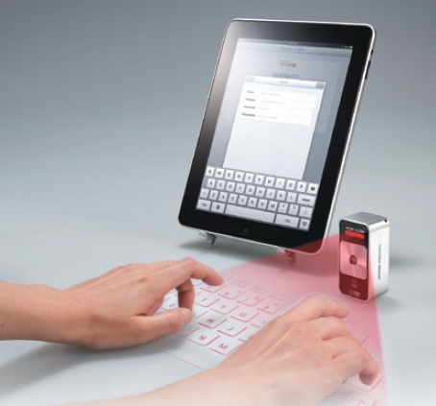
Standard Input Devices (continued)
Keyboards (continued):
Ergonomic
Cordless/wireless
Specialized
Security
Foldable/flexible
Laser/virtual
6
6

Slide 7
Standard Input Devices (continued)
Pointing Devices:
A pointing device is an input device you use to position the pointer on the screen.
The most common pointing device for personal computers is the mouse.
Mechanical
Optomechanical
Optical
Wireless
Trackball mouse
Radio frequency
Foldable mouse
7
7

Slide 8
Standard Input Devices (continued)
Pointing Devices (continued):
The trackball works like a mouse turned upside down; the ball is on top of the device.
A common feature on laptop computers is the touchpad, with a specialized surface that can convert the motion and position of your fingers to a relative position on screen.
8
8

Slide 9
Standard Input Devices (continued)
Pointing Devices (continued):
Some notebook computers contain a pointing stick, a pressure-sensitive device that looks like a pencil eraser and is located on the keyboard, generally between the G, H, and B keys.
Audio input is sound entered into a computer.
9
9

Slide 10
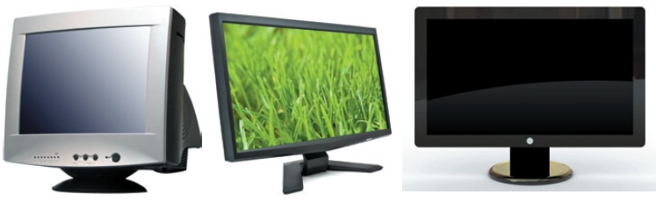
Standard Output Devices
Output is data processed into a useful format.
Monitors:
Desktop computers typically use a monitor as their display device, including CRT, LCD, and gas plasma.
10
10

Slide 11
Standard Output Devices (continued)
Printers:
Printers produce a paper copy, or hard copy, of processing results.
A laser printer produces high-quality output.
An inkjet printer provides good-quality color printing for less expense.
Speakers:
Speakers and headsets generate sound.
11
11

Slide 12
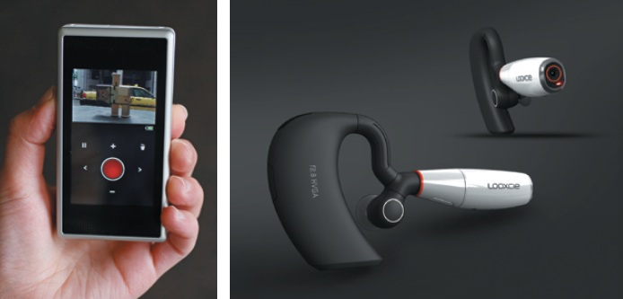
Specialized Input Devices
Digital Cameras:
The pictures you take are stored digitally and then transferred to the computer’s memory.
12
12

Slide 13
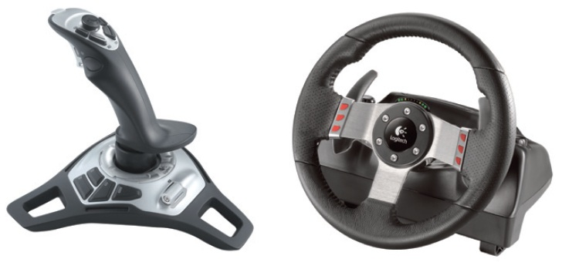
Specialized Input Devices (continued)
Game Controllers:
You use joysticks and wheels most often for games.
13
13

Slide 14
Specialized Input Devices
Scanners/Bar Code Readers:
Scanners are devices that can change images into codes for input to the computer.
Image scanners
Bar code scanners
Magnetic scanners
Wireless scanners
Optical character recognition (OCR) and optical mark recognition (OMR) scanners
14
14

Slide 15
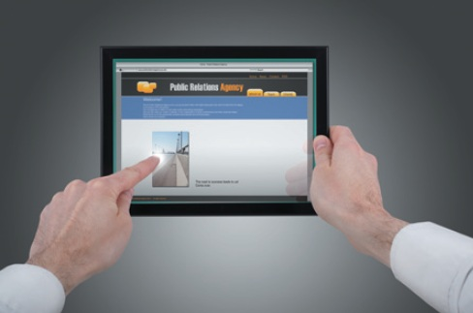
Specialized Input Devices (continued)
Touch Display Screen:
A special screen that reacts to direct touches within the display area, usually from a person’s finger or hand.
15
15

Slide 16
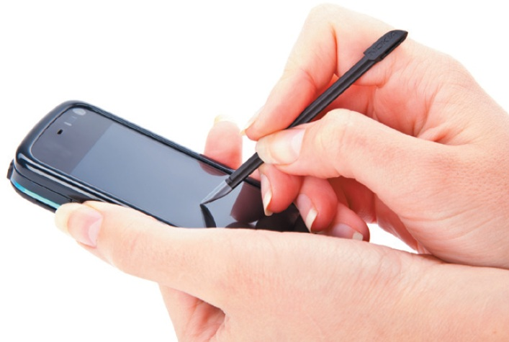
Specialized Input Devices (continued)
Stylus:
A stylus and digital pen are pen-like writing instruments used to enter information by writing on a screen on a mobile device or using the pen as a pointer.
16
16

Slide 17
Specialized Input Devices (continued)
Environmental Probes and Sensors:
Workers can view information such as the temperature and humidity of a remote environment, smoke detector readings, and pollution control readings.
Remote Controls:
Used to manage devices such as televisions, lights, and fans.
17
17

Slide 18
Specialized Input Devices (continued)
Security Devices:
Biometrics is an authentication technique using automated methods of recognizing a person based on a physiological or behavioral characteristic.
Enrollment
Submission
Verification
18
18

Slide 19
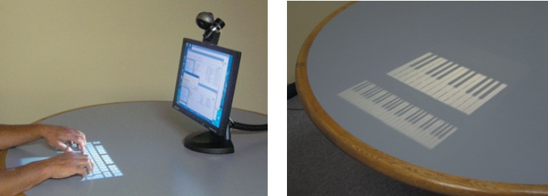
Specialized Input Devices (continued)
Virtual Devices:
Use the synchronized positioning of light-emitting and sensing devices to detect user input.
19
19

Slide 20
Specialized Input Devices (continued)
Touch-Sensitive Pads:
On a portable device, enables you to scroll through a list, adjust the volume, play music, view videos or pictures, and customize settings.
Input Devices for the Physically Challenged:
A variety of special input devices are available for the physically challenged.
20
20

Slide 21
Specialized Output Devices
Projectors
Fax machines and fax modems
Multifunction printer
Control devices/robots
Specialized Printers:
Thermal
Mobile
Label and postage
Plotters/large-format
21
21

Slide 22
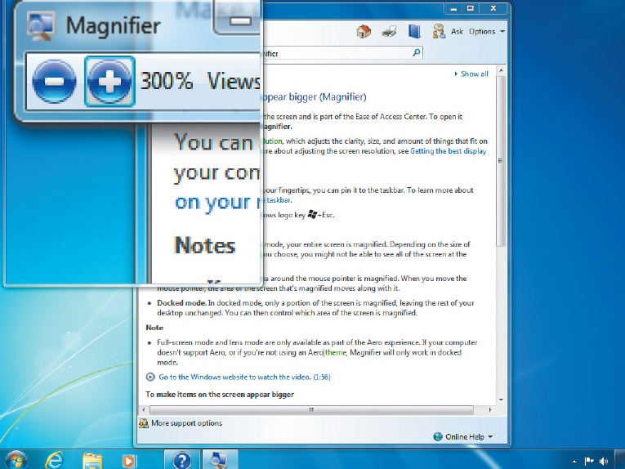
Specialized Output Devices (continued)
Output Devices for the Physically Challenged:
Screen magnifiers
Screen readers
Voice synthesizers
22
22

Slide 23
Connecting Input and Output Devices to a Computer
Ports and Connectors:
A port, also called a jack, is an interface to which a peripheral device attaches to or communicates with the system unit or other peripheral devices.
A Universal Serial Bus (USB) port can connect up to 127 peripheral devices with a single connector and transfer data at rates of up to 200 million bits per second (Mbps).
Plug and play refers to the ability of a computer system to configure expansion boards and other devices automatically.
23
23

Slide 24
Connecting Input and Output Devices to a Computer (continued)
Ports and Connectors (continued):
Another type of external bus is FireWire, which supports data transfers up to 400 Mbps and can connect up to 63 external devices.
Special-purpose ports are:
SCSI
IrDA
Bluetooth
Expansion slots are openings on the motherboard where an expansion board can be inserted.
24
24

Slide 25
Connecting Input and Output Devices to a Computer (continued)
Hardware Installation:
For most hardware devices to work, they need a set of instructions that communicates with the computer’s operating system. This set of instructions is called a driver.
25
25

Slide 26
Considering Computer Performance Factors
A variety of factors can affect a computer’s performance.
Microprocessor: The higher the generation, the faster and better the processing speed.
Random Access Memory (RAM): Helps to speed up the processing cycle.
Hard disk: The bigger and faster the hard drive, the faster it can process data.
Video: Need adequate video memory.
26
26

Slide 27
Summary
In this lesson, you learned:
Input devices enable you to input data and commands into the computer. The most common input devices are the keyboard and mouse.
Other types of input devices include the trackball, joystick, wheel, pointing stick, touch display screen, stylus, voice recognition device, touchpad, scanner, digital camera, video camera, and biometric scanner.
27
27

Slide 28
Summary (continued)
Monitors and printers are examples of output devices. Monitors produce soft copy. Printers produce a paper or hard copy of the processed result.
Criteria for selecting a printer include speed, print quality, and cost.
28
28

Slide 29
Summary (continued)
Input and output devices must be connected to the computer. Some input and output devices communicate with the computer through a physical connection. Wireless devices communicate with the computer through infrared or radio waves.
Peripheral devices can connect to the computer through serial, parallel, and Universal Serial Bus (USB) ports. USB is the current standard and replaces serial and parallel ports.
29
29

Slide 30
Summary (continued)
FireWire is a type of external bus that can connect up to 63 external devices.
SCSI, IrDA, and Bluetooth are special-purpose ports.
A computer’s performance is affected by the speed of the processor, the amount of RAM, hard disk size and speed, capability of monitor, and disk organization.
30
30

