Slide 1
Lesson 15
Working with Tables
Computer Literacy BASICS: A Comprehensive Guide to IC³, 5th Edition
Morrison / Wells / Ruffolo

Slide 2
Objectives
Create a table and insert text.
Insert and delete rows and columns.
Adjust column width and row height.
Use the Draw Table and Eraser tools to create and edit a table grid.
Format text alignment and direction within a table cell.
2
2

Slide 3
Objectives (continued)
Format borders and shading and apply table styles.
Sort data in a table.
Convert text to a table and vice versa.
3
3

Slide 4
Words to Know
ascending order
banded columns
banded rows
cell
descending order
gridlines
header row
merging cells
Quick Tables
splitting cells
4
4

Slide 5
Creating a Table
A table consists of cells that you add content to, such as text, numbers, or graphics.
A cell represents one intersection of a row and a column in a table.
In a table, rows go across and columns go down.
The first row in a table or data source with the column headings is referred to as the header row.
5
5

Slide 6
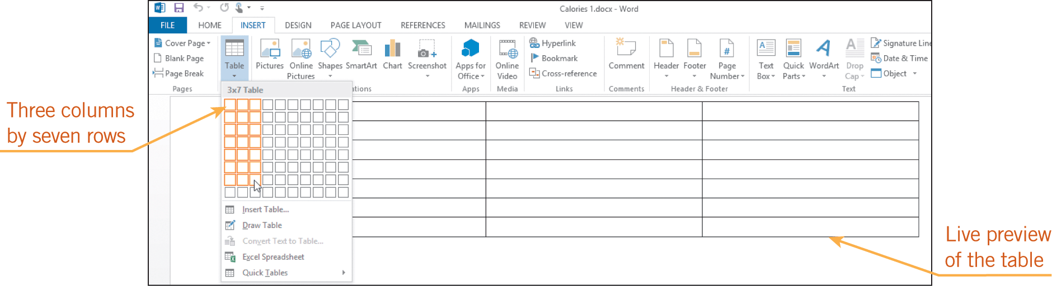
Creating a Table (continued)
To create a table, you must first decide how many columns and rows you want in the table. You can then create a table grid and enter the data.
6
6

Slide 7
Creating a Table (continued)
To move the insertion point from one cell to another, you can press the Tab key or the arrow keys.
When you reach the end of a row and press the Tab key, the insertion point moves to the first cell in the next row.
7
7

Slide 8
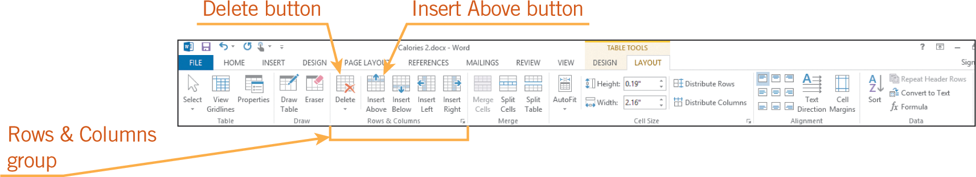
Modifying the Table Structure
Inserting Rows and Columns
To insert a new row at the end of the table, you can position the insertion point in the last table cell and press Tab.
To insert a new row anywhere else in the table or to insert new columns, you can use the Insert commands on the TABLE TOOLS LAYOUT tab.
8
8

Slide 9
Modifying the Table Structure (continued)
Deleting Rows and Columns
When you select cells and use Delete to remove content, only the cell contents are removed.
To remove rows or columns, you must use the Delete commands on the TABLE TOOLS LAYOUT tab or in a shortcut menu.
When you delete a row or column, the text in the cells is also deleted.
9
9

Slide 10
Modifying the Table Structure (continued)
Adjusting Column Width and Row Height
You can choose to automatically adjust the width of one or more columns to accommodate the contents within the cells, or you can automatically adjust all column widths at the same time.
You can also resize the table to fit in the document window.
When text wraps to a second line within a cell, the height of all the cells in that row is automatically increased.
10
10

Slide 11
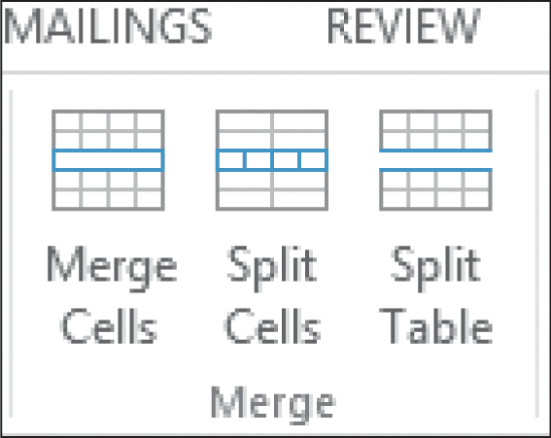
Modifying the Table Structure (continued)
Merging and Splitting Table Cells
When you remove the boundary between two cells, it is called merging cells.
When you convert a cell into multiple cells, it is called splitting cells.
11
11

Slide 12
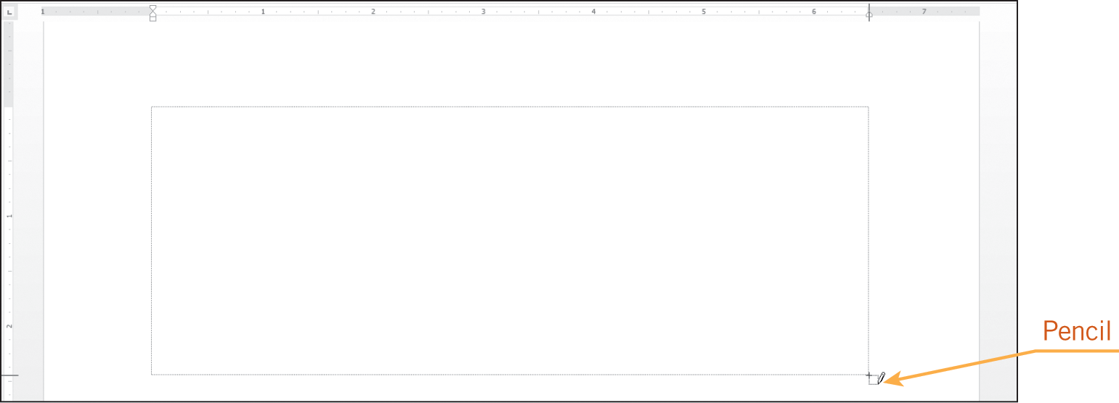
Drawing a Table
The Draw Table tool enables you to use the mouse to draw the table grid on the screen, the same way you would use a pen to draw the grid on a sheet of paper.
12
12

Slide 13
Formatting Tables
You can make a table easier to read by enhancing its appearance.
Aligning numbers within a cell can make the data easier to read.
Changing border colors and adding shading to some of the cells can help the reader quickly identify different types of data.
13
13

Slide 14
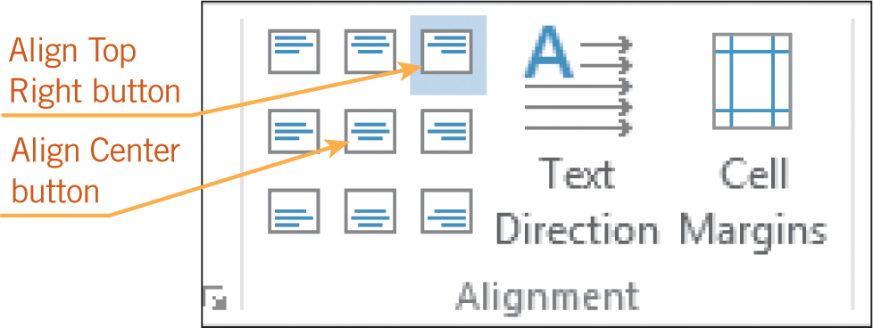
Formatting Tables (continued)
Aligning Data within Table Cells
The Alignment group on the TABLE TOOLS LAYOUT tab provides several commands to align text within cells.
You can align text at the top, center, or bottom of a cell, as well as to the left or right.
You can change the
direction of text: top
to bottom, bottom to
top, and horizontal.
14
14

Slide 15
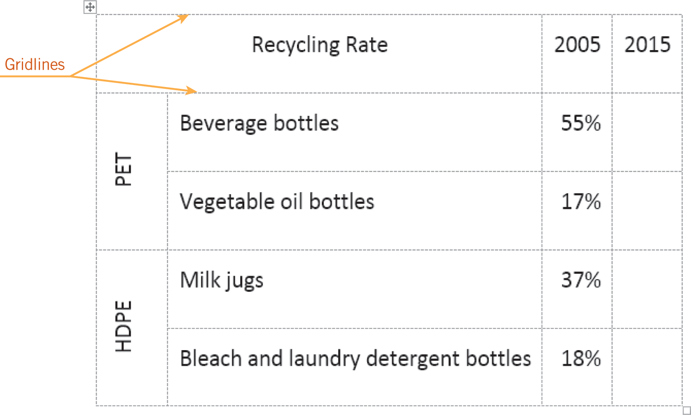
Formatting Tables (continued)
Formatting Borders and Shading
Boundary lines in a table are called gridlines.
Gridlines are
displayed on
the screen, but
they do not print.
15
15

Slide 16
Formatting Tables (continued)
Applying Table Styles
Word provides several table designs that enable you to apply multiple table formats with a single click.
Some table styles include shading formats for banded rows and/or banded columns in which even-numbered rows are formatted differently than odd-numbered rows.
16
16

Slide 17
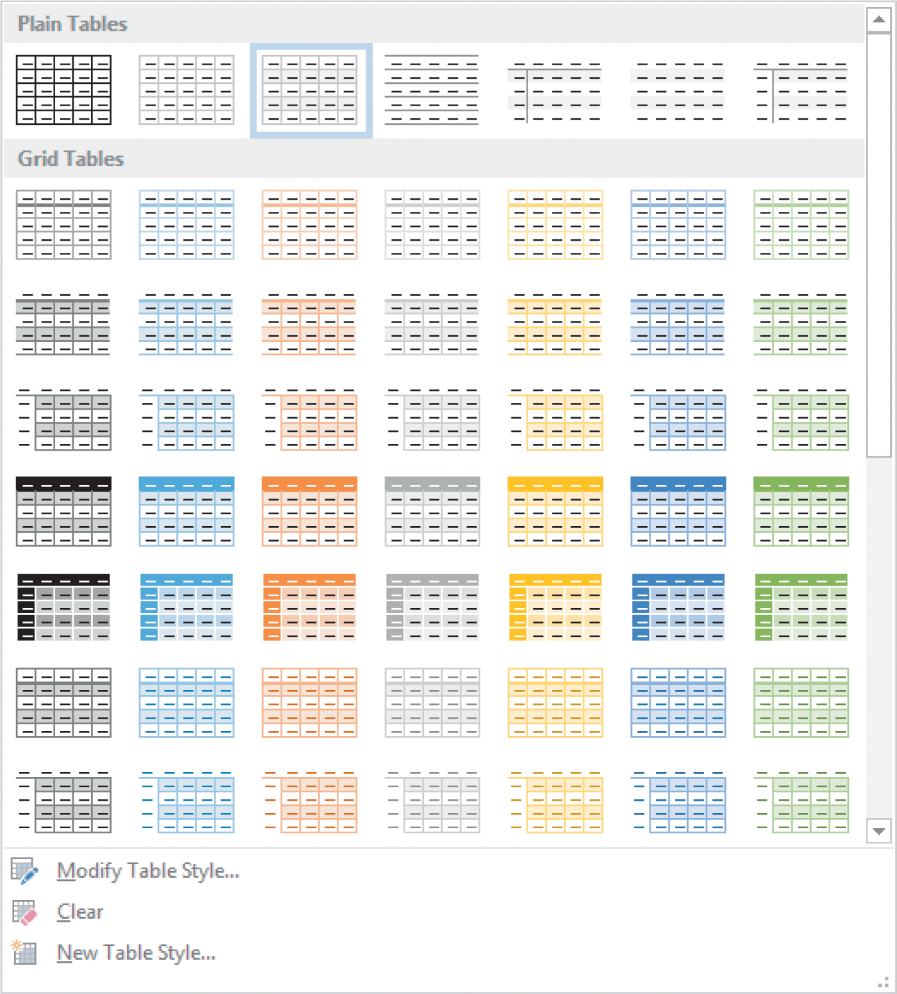
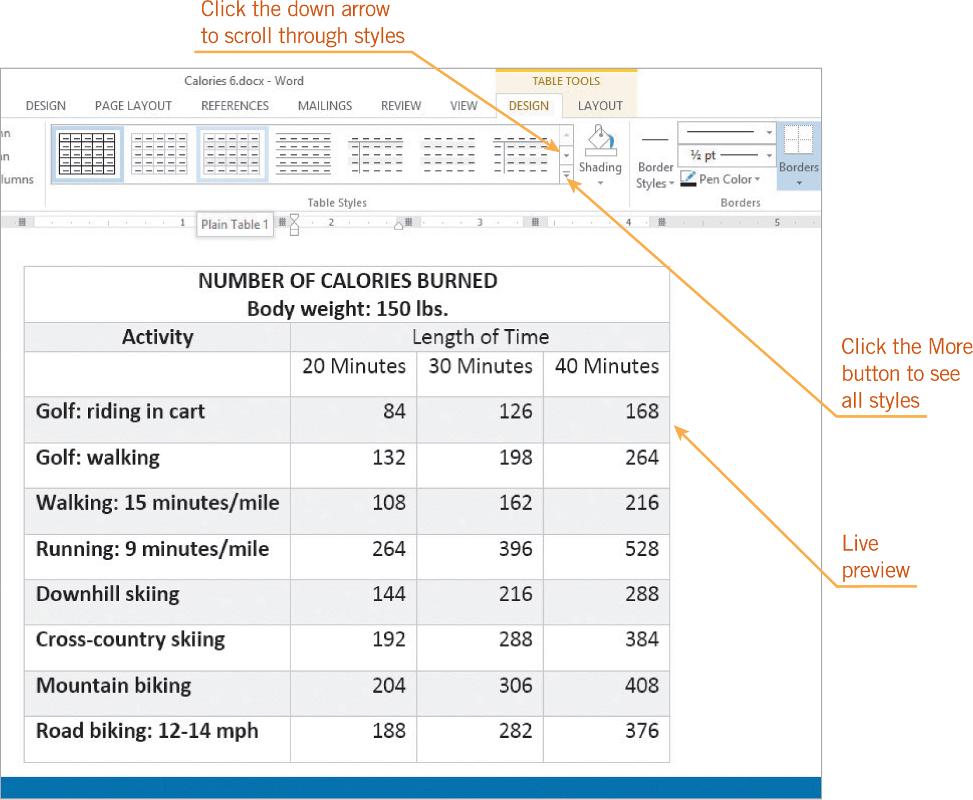
Formatting Tables (continued)
Applying Table Styles (continued)

Slide 18
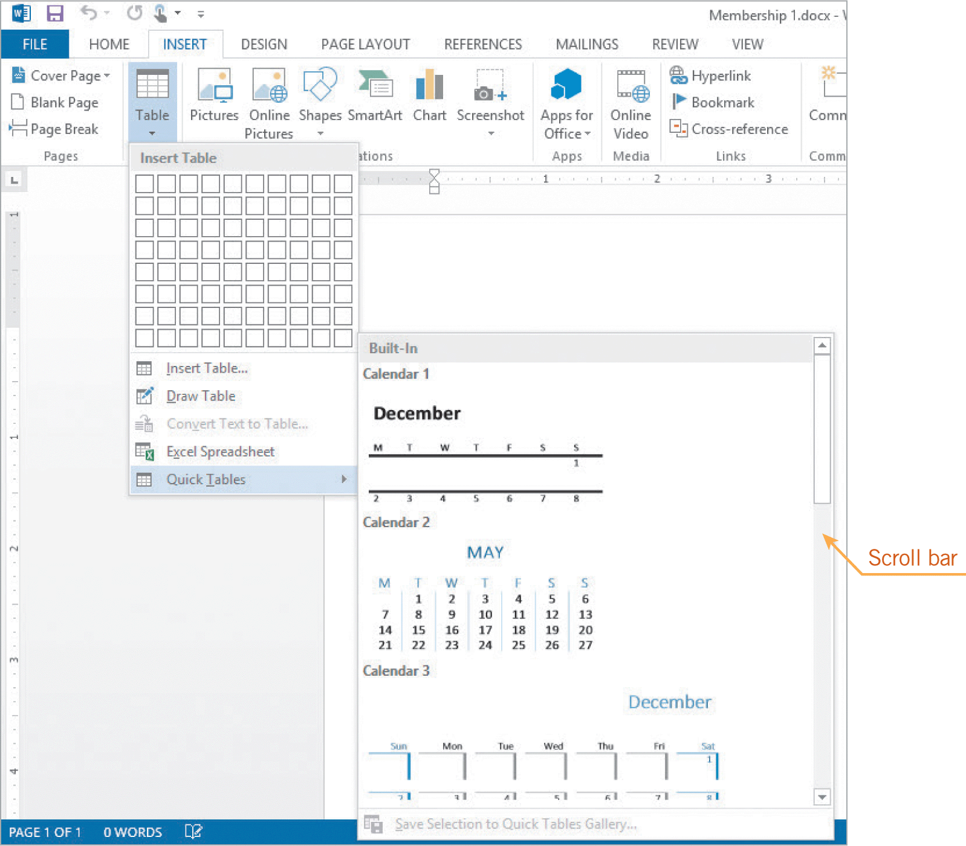
Using Quick Tables
Quick Tables include a table grid with sample data and table formats.
To save time creating a table, you insert a Quick Table in a document and then you replace the sample data with your own data.
18
18

Slide 19
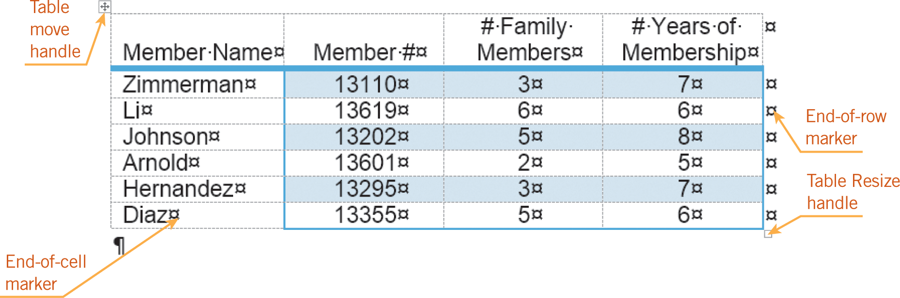
Using Quick Tables (continued)
Editing text in the cells of a table is similar to entering text in a document.
When you show nonprinting characters, you can see that every row ends with a marker.
19
19

Slide 20
Aligning and Resizing Tables on the Document Page
To align a table horizontally, you must select the table, and then you can format the alignment the same way you align text paragraphs.
The table move handle can be used to reposition the table on the page or to select the entire table.
The resize handle sometimes appears in the lower-right corner of a table. When you drag this marker, you can resize the table.
20
20

Slide 21
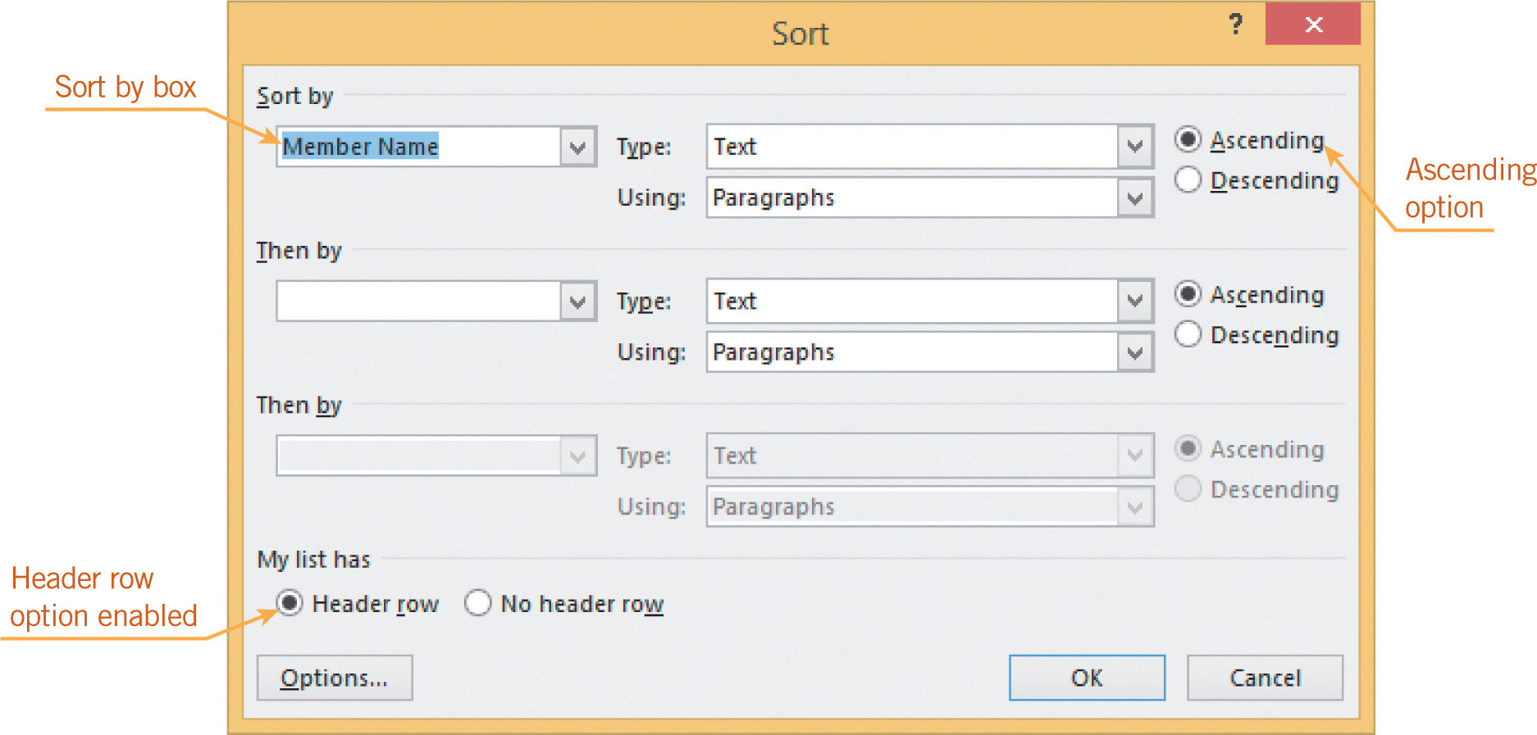
Sorting Data in a Table
Sorting data in ascending order rearranges it in alphabetical order from A to Z or in numerical order from lowest number to highest number.
Sorting data in descending order rearranges data in alphabetical order from Z to A or in numerical order from highest number to lowest number.
21
21

Slide 22
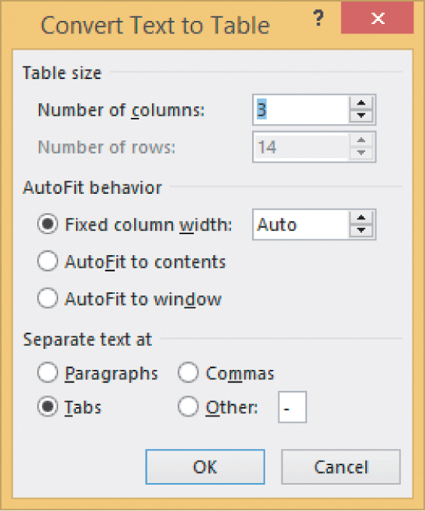
Converting Text to a Table and a Table to Text
Word can quickly convert text separated by paragraph markers, commas, tabs, or other characters into a table with cells.
Word also converts a table to text.
22
22

Slide 23
Summary
In this lesson, you learned:
The table feature in Word enables you to organize and arrange text and numbers easily.
To change the layout of information after you create a table, you can insert and delete rows and columns.
The AutoFit feature automatically adjusts the width of a column based on the contents of the cells in a column.
23
23

Slide 24
Summary (continued)
The Draw Table tool and the Eraser tool are especially useful when you need to create a complex table.
You can format text alignment in table cells the same way you apply those formats in other Word documents.
Borders and shading greatly enhance the appearance of a table and often make the table easier to read. Word provides several built-in styles to make it fast and easy to apply borders and shading to a table.
24
24

Slide 25
Summary (continued)
Word provides Quick Tables that are already formatted and contain sample data, so you can quickly create a table.
You can copy, cut, paste, and move contents within a table.
You can use the Sort feature to reorganize the table contents to emphasize data in different ways.
Word can convert text to a table or vice versa.
25
25

