Slide 1
Lesson 17 Working with Graphics
Computer Literacy BASICS: A Comprehensive Guide to IC³, 5th Edition
Morrison / Wells / Ruffolo

Slide 2
Objectives
Format columns, borders, and shading.
Insert clip art and pictures.
Resize, crop, and position graphics.
Modify graphic colors and apply styles and effects to clip art and pictures.
Remove the background from a picture and adjust the contrast and brightness.
Use drawing tools to create your own graphics.
2
2

Slide 3
Objectives (continued)
Use built-in, predesigned, and formatted layouts to create your own graphics.
Capture a picture of the application screen.
3
3

Slide 4
Words to Know
banner
clip art
crop
desktop publishing
drawing canvas
drawing objects
graphics
manual column break
outcrop
resizing
section
section break
shape
sizing handles
4
4

Slide 5
Words to Know (continued)
SmartArt
text box
WordArt
5
5

Slide 6
Formatting Columns, Borders, and Shading
Desktop publishing is the process of creating a document using a computer to lay out text and graphics.
One common example of desktop publishing is newsletters, which are often formatted in multiple columns with headings, borders, shading, and pictures.
6
6

Slide 7
Formatting Columns, Borders, and Shading (continued)
Formatting Text in Columns
A section is an area within a document that can have its own separate page formats such as the page orientation, margins, and the number of columns.
To change the page formats for one portion of the document, you must divide the document into multiple sections by creating a section break.
A section break controls the section formatting of the text that precedes it.
After dividing the document into multiple sections, you can apply different formats in each section.
7
7

Slide 8
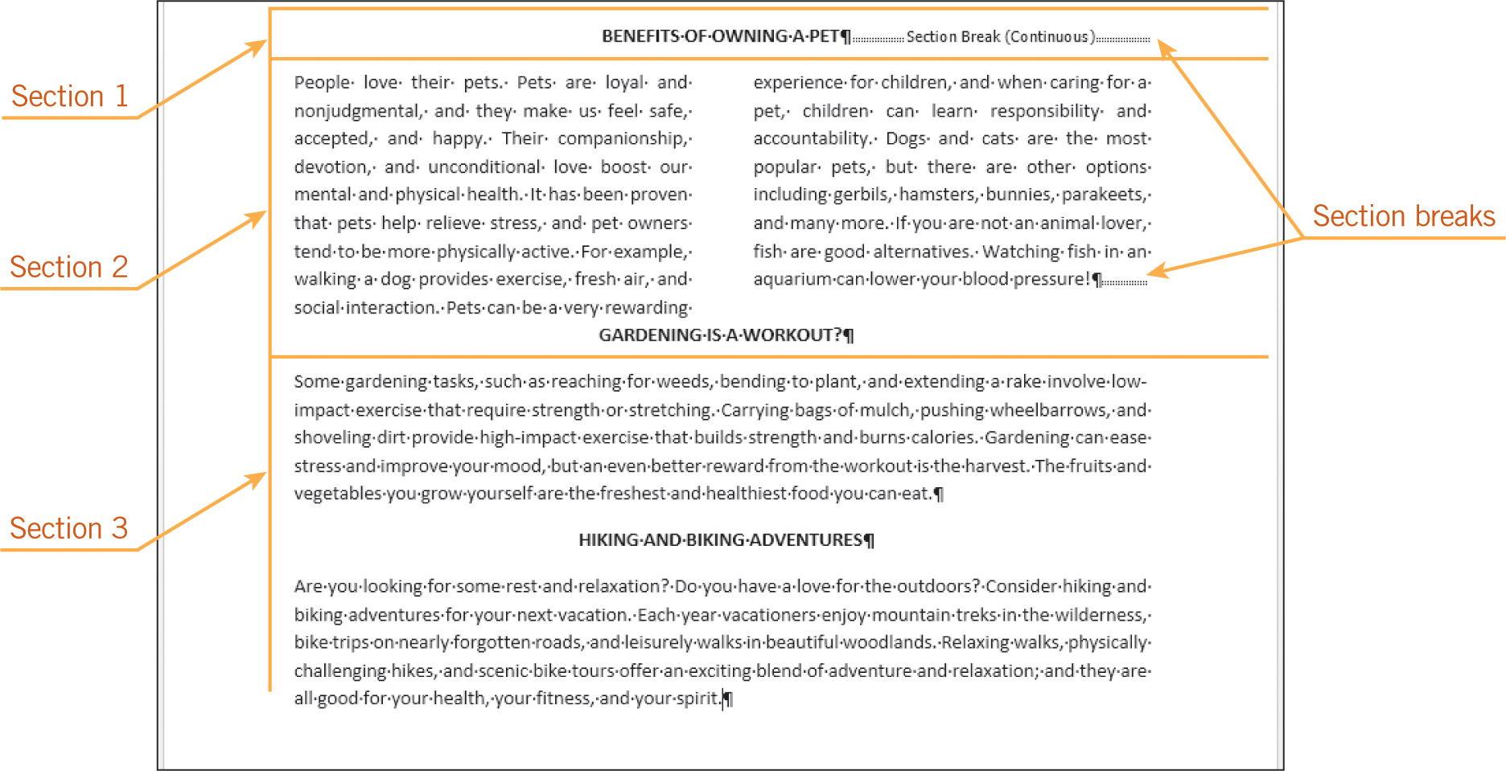
Formatting Columns, Borders, and Shading (continued)
Formatting Text in Columns (continued)
8
8

Slide 9
Formatting Columns, Borders, and Shading (continued)
Formatting Text in Columns (continued)
Word provides several multicolumn formats, and you can modify these formats to meet your needs.
A column heading often is formatted as a single-column banner, which is a headline that spreads the full width of the page.
A manual column break adjusts where a column ends.
9
9

Slide 10

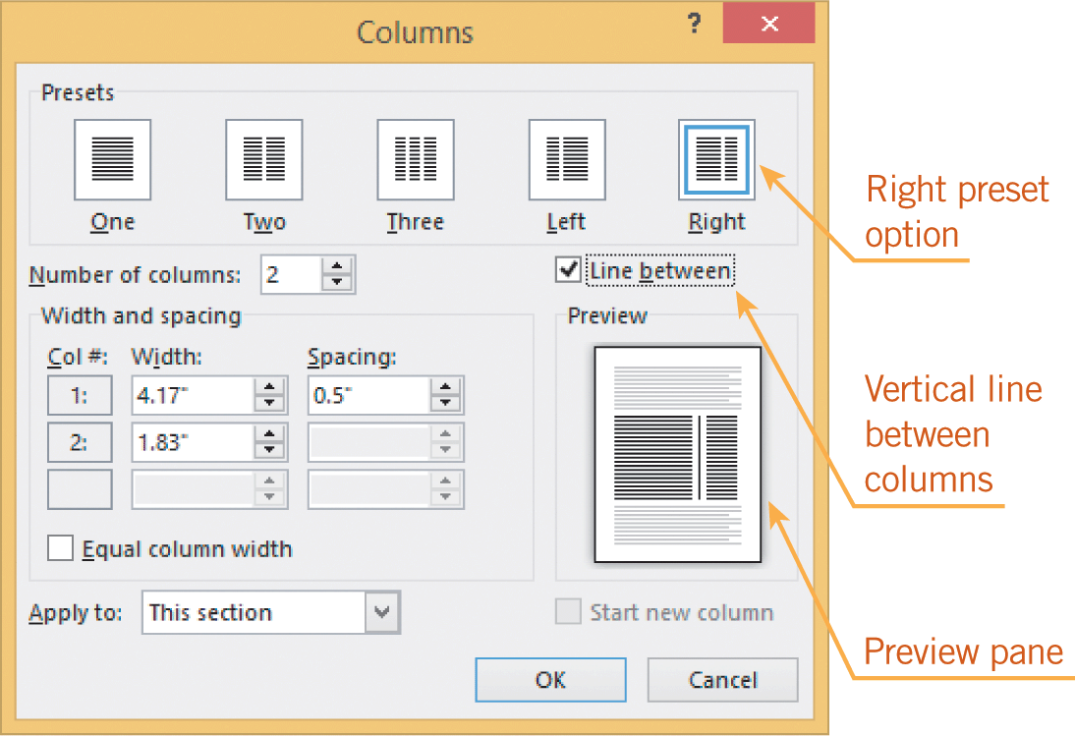
Formatting Columns, Borders, and Shading (continued)
Formatting Text in Columns (continued)
10
10

Slide 11
Formatting Columns, Borders, and Shading (continued)
Adding Borders and Shading
Word offers many options for applying borders above, below, and around paragraphs of text.
The borders can be customized by changing the line color, the line style, and the thickness of the line.
You can also enhance the document content by adding shading behind text.
11
11

Slide 12
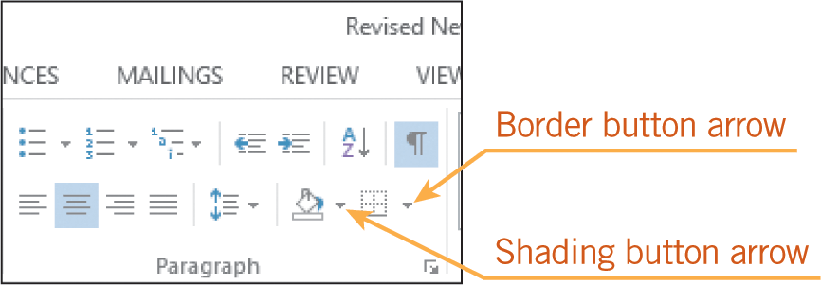
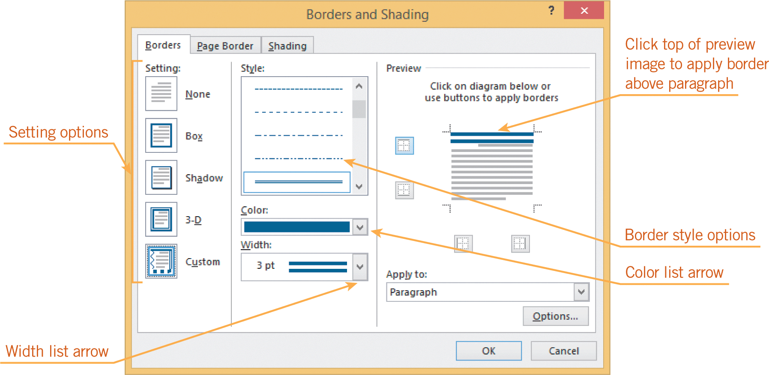
Formatting Columns, Borders, and Shading (continued)
Adding Borders and Shading (continued)
12
12

Slide 13
Inserting and Formatting Graphics
Graphics are non-text items such as digital photos, scanned images, and pictures.
You can insert images created or modified in other applications such as a graphics or drafting application.
Graphics created in other applications are saved in a variety of formats, including JPEG (*.jpg), TIFF (*.tif), and bitmap (*.bmp).
13
13

Slide 14
Inserting and Formatting Graphics (continued)
Inserting Clip Art and Pictures
Clip art is a graphic that is ready to insert into a document.
Word has numerous illustrations and photographs you can access online.
You can search for photos and clip art at the Microsoft Office.com Web site.
You can access pictures you have saved in the My Pictures folder, or on SkyDrive or other sites.
14
14

Slide 15
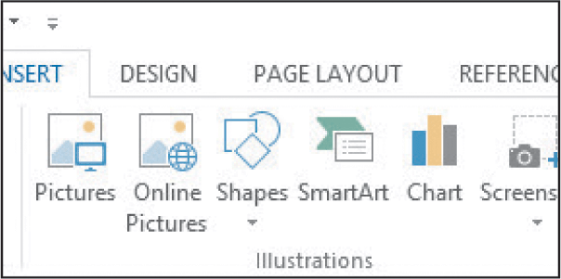
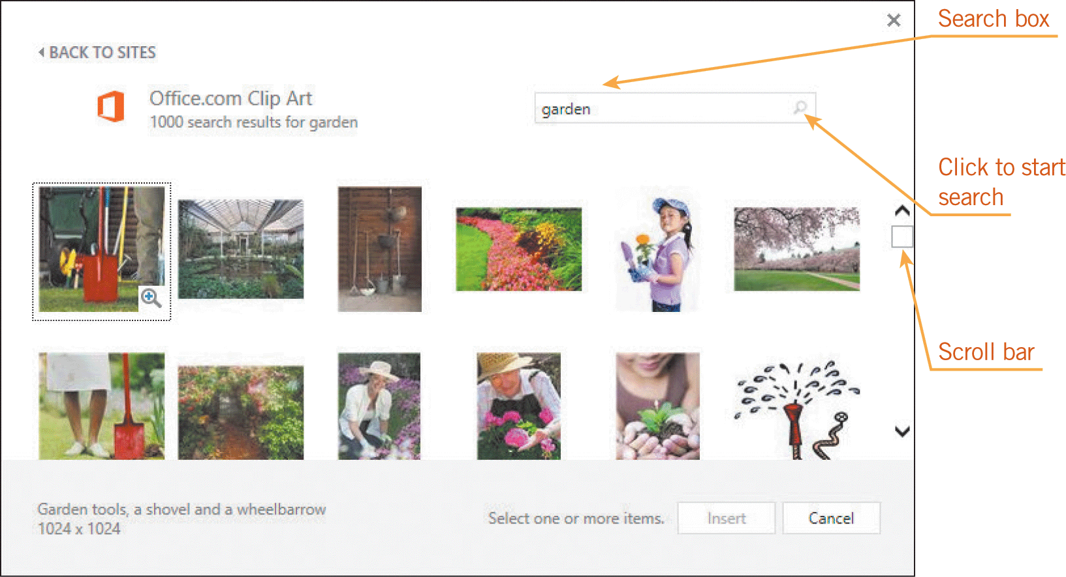
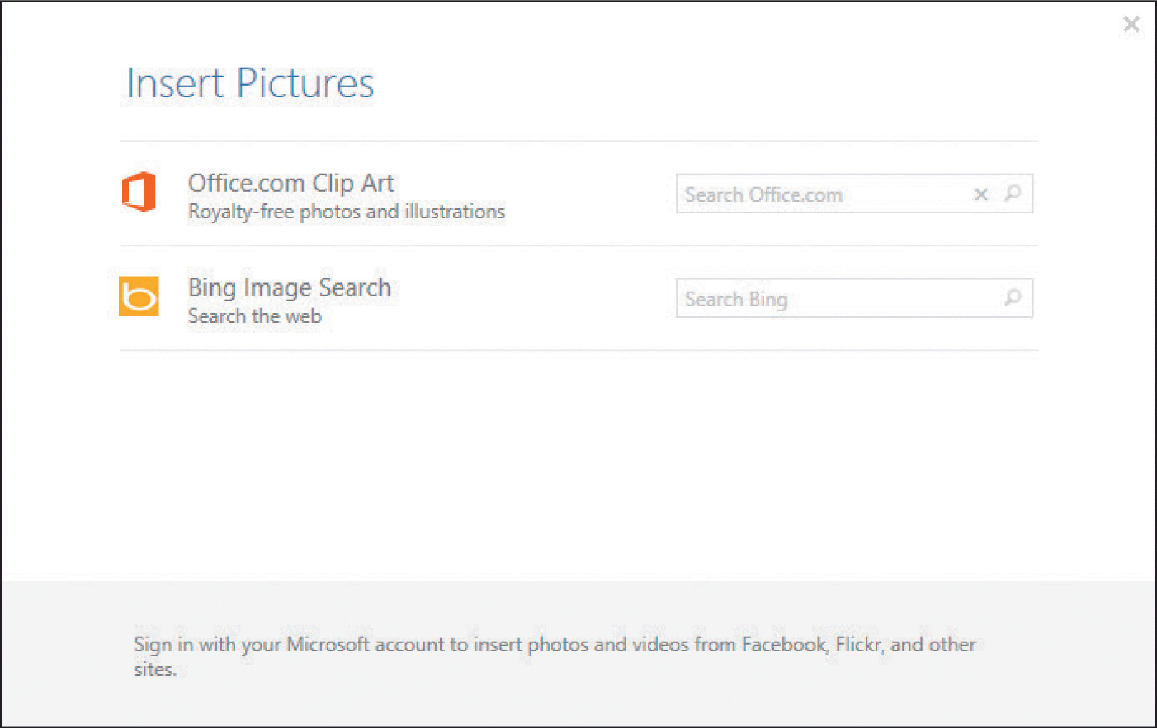
Inserting and Formatting Graphics (continued)
Inserting Clip Art and Pictures (continued)
15
15

Slide 16
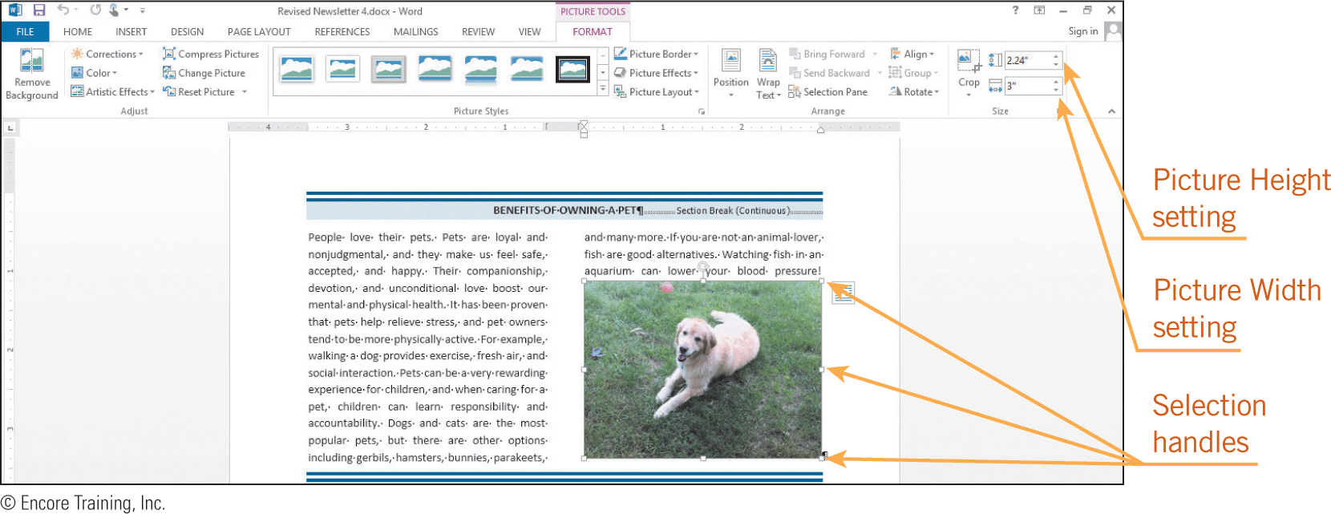
Inserting and Formatting Graphics (continued)
Resizing and Cropping a Graphic
To work with a graphic, you must select it.
You will know it is selected when you see sizing handles, which are eight small circles and squares on the border of the graphic.
When a graphic is selected, you can resize, cut, copy, paste, delete, and move it just as you would text.

Slide 17
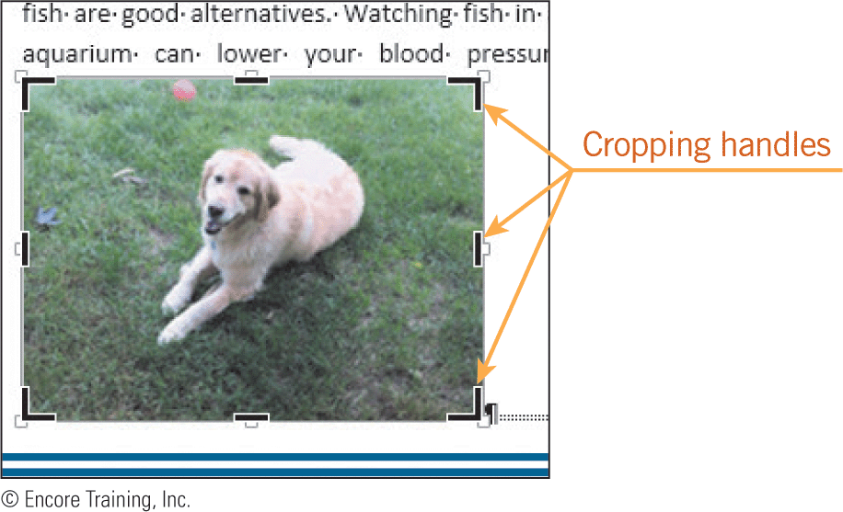
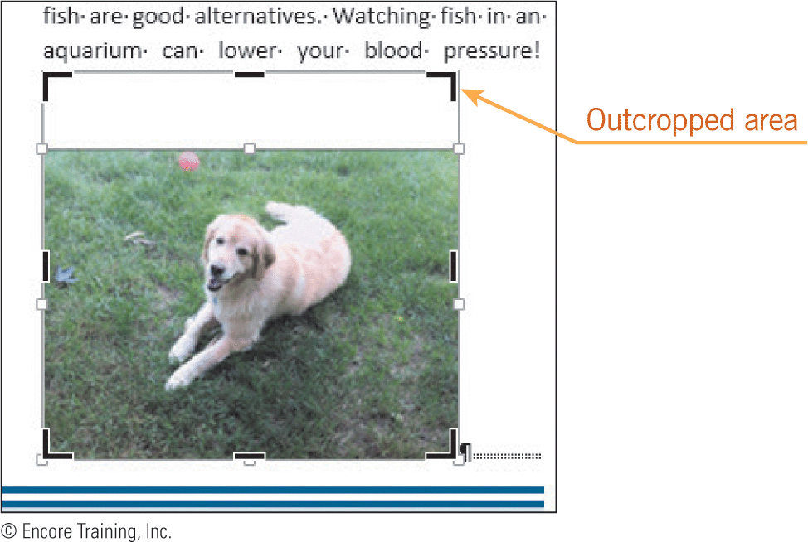
Inserting and Formatting Graphics (continued)
Resizing and Cropping a Graphic (continued)
Resizing stretches or shrinks the dimensions of a graphic.
When you crop a graphic, you cut off portions of the graphic that you do not want to show.
When you outcrop a graphic, you add extra white space around the image.

Slide 18
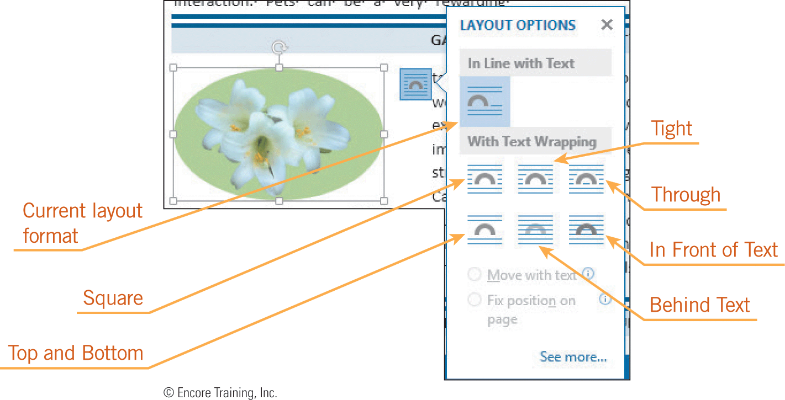
Inserting and Formatting Graphics (continued)
Positioning a Graphic
When you insert a graphic, Word positions it in the line of text.
You can format the text in the document to wrap around the graphic by applying a text-wrapping format to the graphic.
You can then drag and drop the graphic anywhere within the printable area of the page.

Slide 19
Inserting and Formatting Graphics (continued)
Adjusting Colors and Applying Styles and Effects
You can customize clip art or a photograph by changing its colors.
You can recolor both photos and illustrations.
For photos, there are also options for changing the color saturation and the color tone.
You can apply border styles and other special formats, such as shadows, soft edges, and 3-D effects.
You can add artistic effects to make a picture look like a sketch or a painting.
19
19

Slide 20


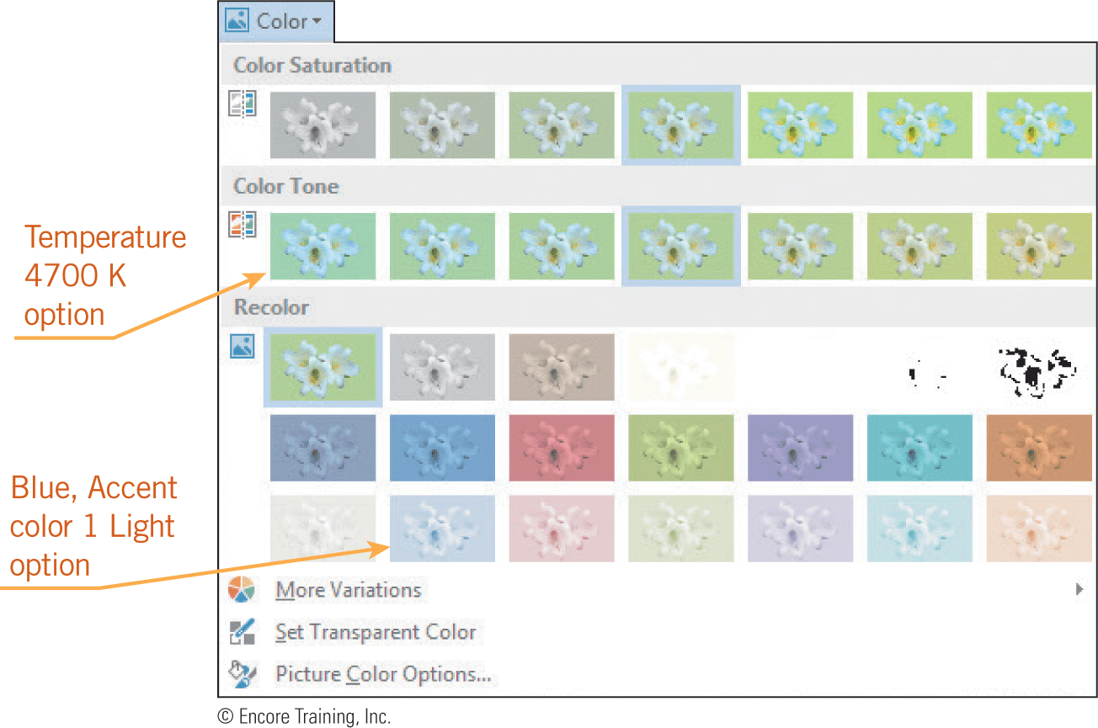
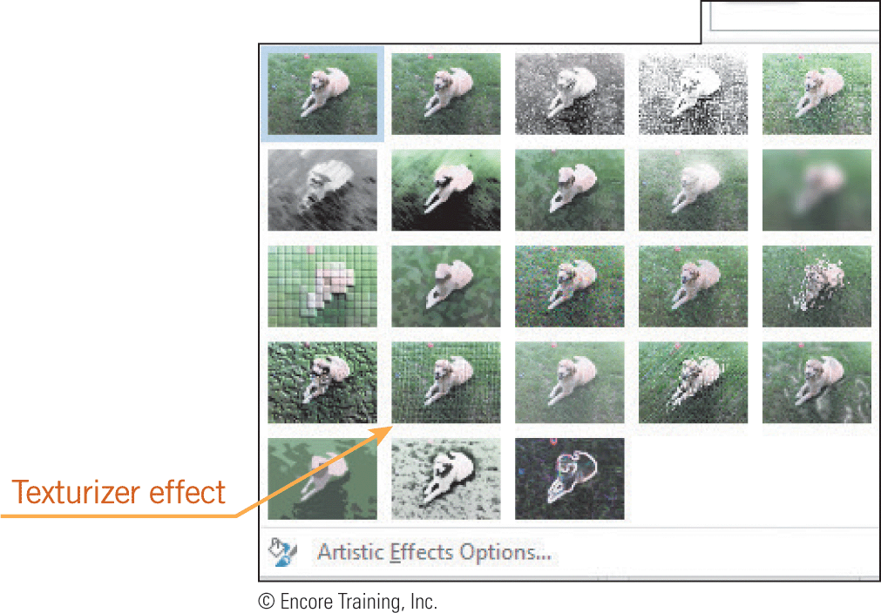

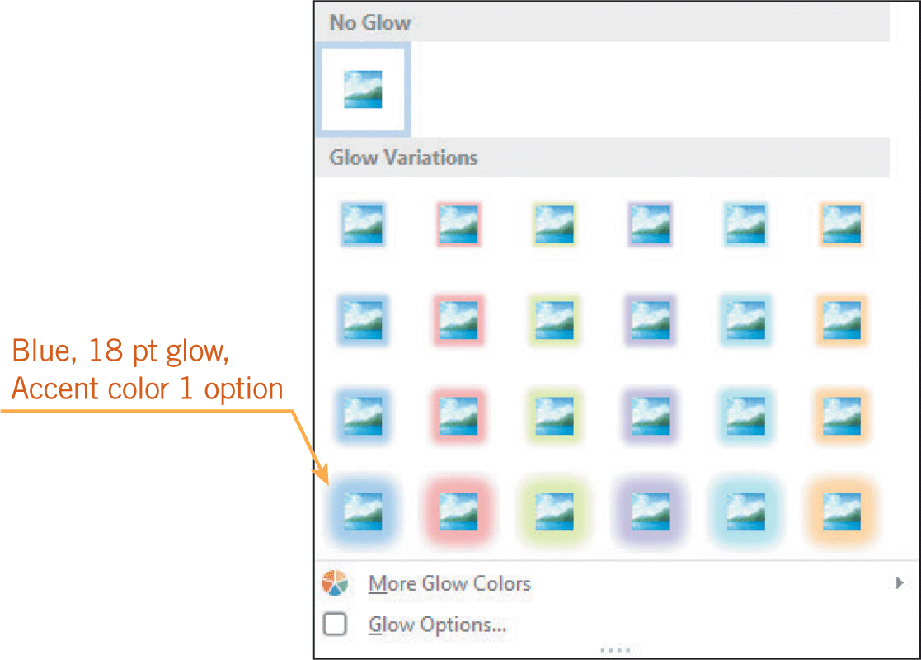

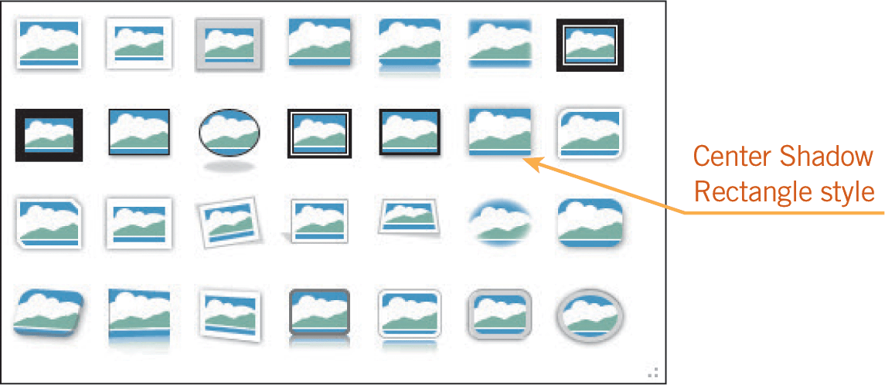
Inserting and Formatting Graphics (continued)
Adjusting Colors and Applying Styles and Effects (continued)

Slide 21
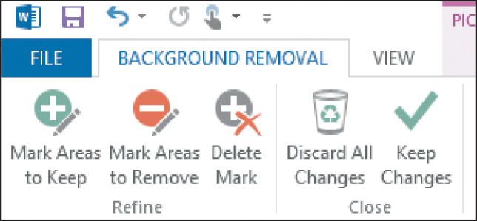
Inserting and Formatting Graphics (continued)
Removing Backgrounds from Pictures
When working with illustrations and photographs that have a solid color background, you can hide the background color by making the color transparent using the Set Transparent Color feature.
When you apply the Remove Background feature, Word automatically suggests the elements to be removed from the image.

Slide 22
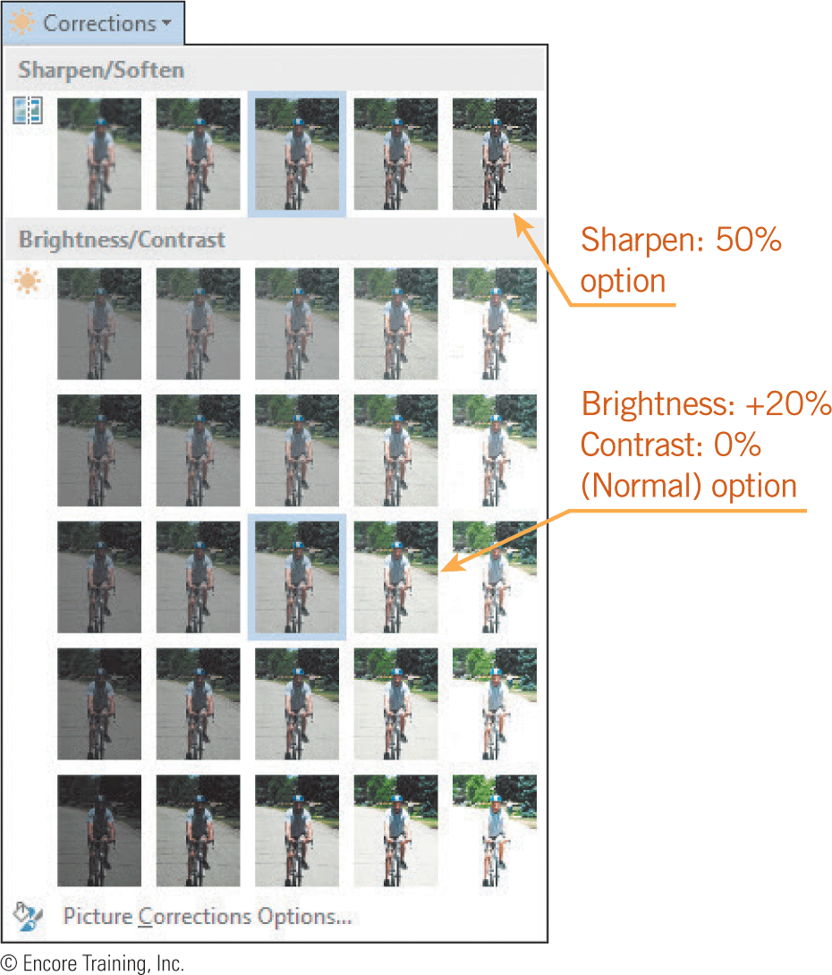
Inserting and Formatting Graphics (continued)
Removing Backgrounds from Pictures (continued)
After a background has been removed from illustrations and photographs, you can still add effects to the picture.
You can also clarify elements in a picture using contrast controls, and you can lighten or darken the picture by using brightness controls.

Slide 23
Creating Your Own Graphics
Sometimes you may need to create your own graphics.
For example, you may want to create a fancy title for a document, a map, or an organizational chart.
Word offers several tools to simplify these tasks.
23
23

Slide 24
Creating Your Own Graphics (continued)
Creating WordArt Objects
WordArt is a feature that transforms text into a graphic.
The WordArt graphic is created in a text box, which is a drawing object that displays text.
You can edit the text and you can fit the text within a preset shape, apply a gradient file, change the angle of the text, and apply special effects such as text borders and shadows.
24
24

Slide 25
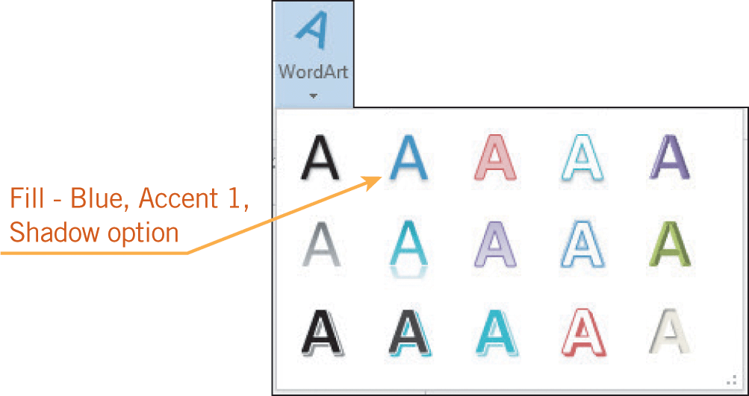
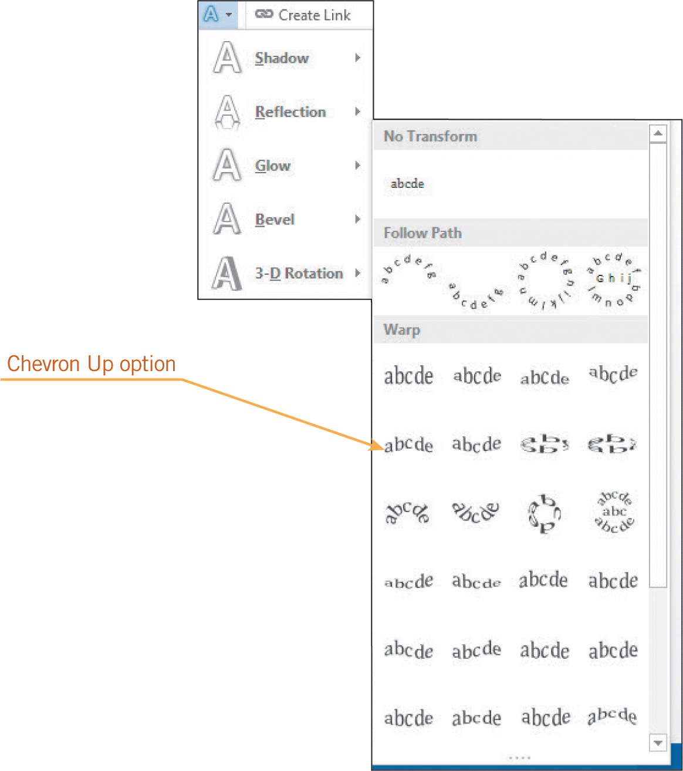
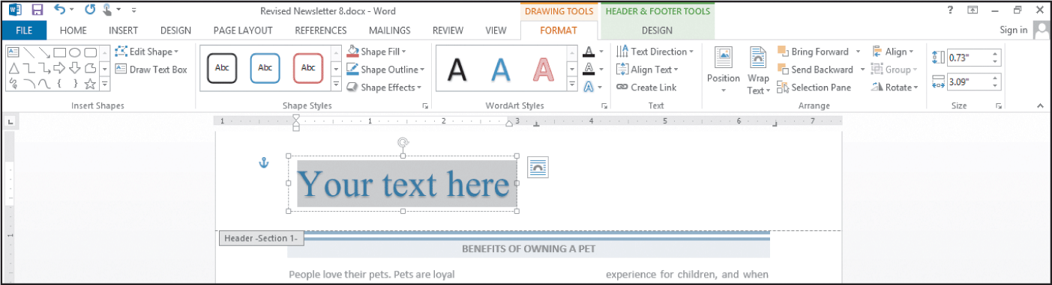
Creating Your Own Graphics (continued)
Creating WordArt Objects (continued)

Slide 26
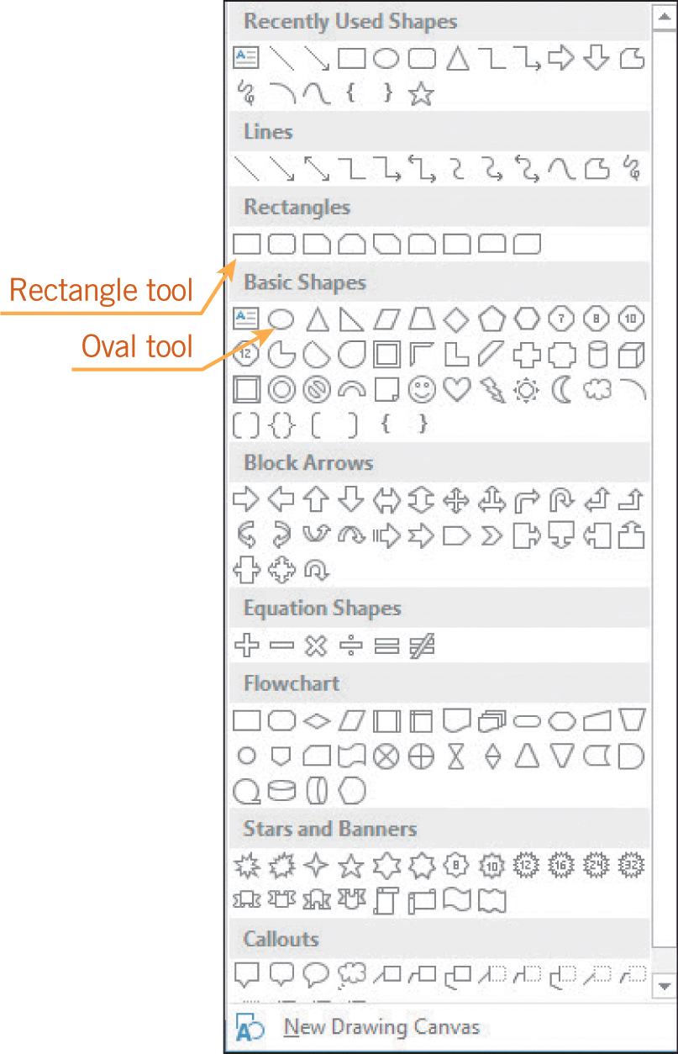
Creating Your Own Graphics (continued)
Inserting Lines, Shapes, and Text Boxes
You can use drawing objects, which are shapes, curves, and lines, to create your own graphic.
A shape is a predesigned drawing object, such as a star, an arrow, or a rectangle.
You can resize and reposition drawing objects, and you can copy and paste them.

Slide 27
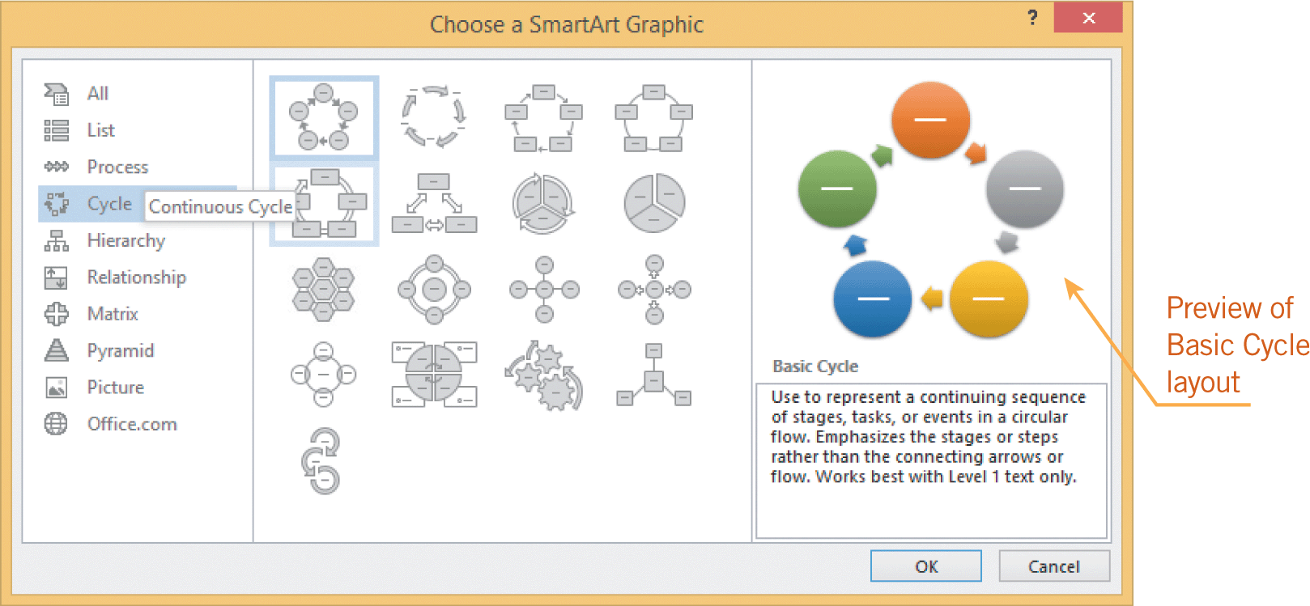
Creating Your Own Graphics (continued)
Creating SmartArt Graphics
SmartArt graphics are built-in, predesigned, and formatted layouts that you can use to illustrate concepts and ideas.
The graphics are organized in a gallery under eight different categories, and each category includes several layouts.

Slide 28
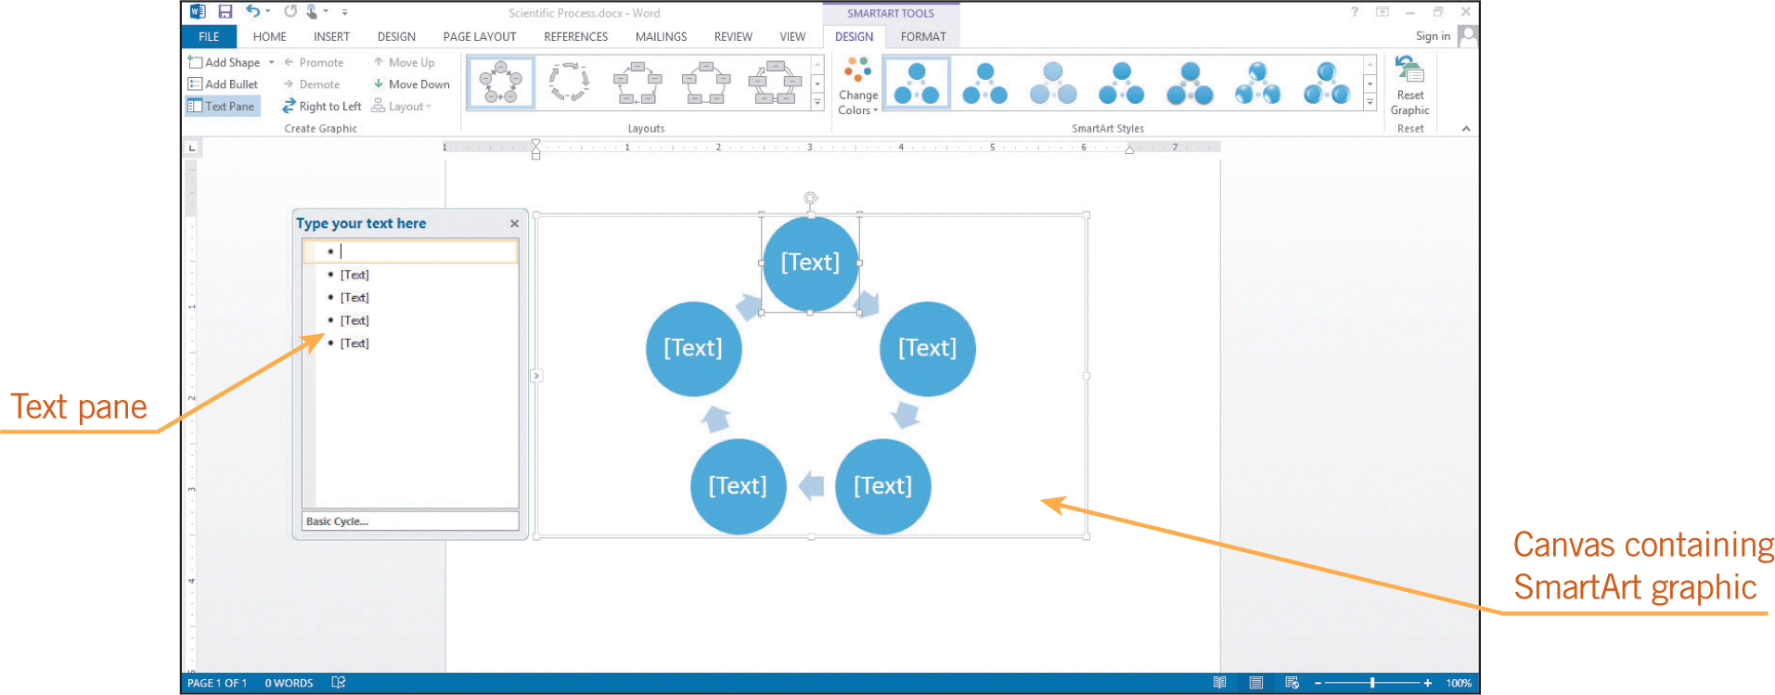
Creating Your Own Graphics (continued)
Creating SmartArt Graphics (continued)
A SmartArt graphic is inserted in the document in a drawing canvas that provides a frame-like boundary between the graphic and the rest of the document.

Slide 29
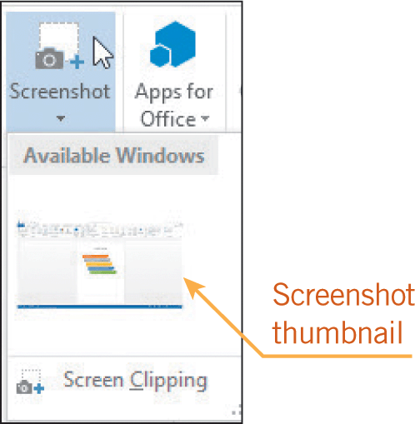
Creating Your Own Graphics (continued)
Creating a Screenshot
You can use the Screenshot feature to capture a picture of all or part of the application window.
Only windows that have not been minimized in the taskbar can be captured.
29
29

Slide 30
Summary
In this lesson, you learned:
Text can be arranged in a variety of multicolumn formats, all within the same document.
Borders and shading are effective tools for enhancing the appearance and effectiveness of a document. You can choose from a variety of options for line styles, colors, and shading effects.
30
30

Slide 31
Summary (continued)
Clip art and pictures help to enhance the appearance and effectiveness of a document.
You can resize and crop graphics, and you can choose from several options to position the graphic in the document.
You can further enhance graphics by changing the colors, applying special effects, removing backgrounds, and adjusting the contrast and brightness.
31
31

Slide 32
Summary (continued)
To add emphasis to your document, you can use the WordArt feature to make text decorative.
You can create your own graphics using drawing tools, shapes, and text boxes.
SmartArt graphics are useful in illustrating concepts and ideas.
The screenshot feature enables you to capture a picture of all or part of the application window.
32
32

