Slide 1
Lesson 18 Getting Started with Excel Essentials
Computer Literacy BASICS: A Comprehensive Guide to IC³, 5th Edition
Morrison / Wells / Ruffolo

Slide 2
Objectives
Identify the parts of the Excel screen.
Navigate through a worksheet and a workbook.
Change views and magnification in the worksheet window.
Use the AutoCorrect and AutoComplete features when entering data.
2
2

Slide 3
Objectives (continued)
Insert and delete rows, and change column width and row height.
Copy, clear, move, and delete data.
Use the Undo and Redo features.
Use the AutoFill feature to copy and enter data into a range of cells.
3
3

Slide 4
Words to Know
active cell
AutoFill
cell
cell reference
column heading
range
row heading
spreadsheet
value
workbook
worksheet
4
4

Slide 5
Introduction
A spreadsheet is a grid of rows and columns into which you enter text data (e.g., surnames, cities, states) and numerical data (e.g., dates, currency, percentages).
Excel is an electronic application that enables you to work with text, numbers, and formulas to create worksheets, tables, charts, and statistical analysis.
5
5

Slide 6
Touchscreen Users
The instructions in the Excel lessons generally provide directions for using a mouse to access commands and features.
If you are using a touch screen, you can use gestures, such as press, tap, slide, swipe, and drag instead of following the directions for using the mouse.

Slide 7
Identifying the Parts of the Excel Screen
Excel 2013 refers to spreadsheet as a worksheet.
The worksheet is always stored in a workbook that contains one or more worksheets.
The Excel worksheet is divided into columns and rows.
Columns appear vertically and are identified by letters at the top of the worksheet window.

Slide 8
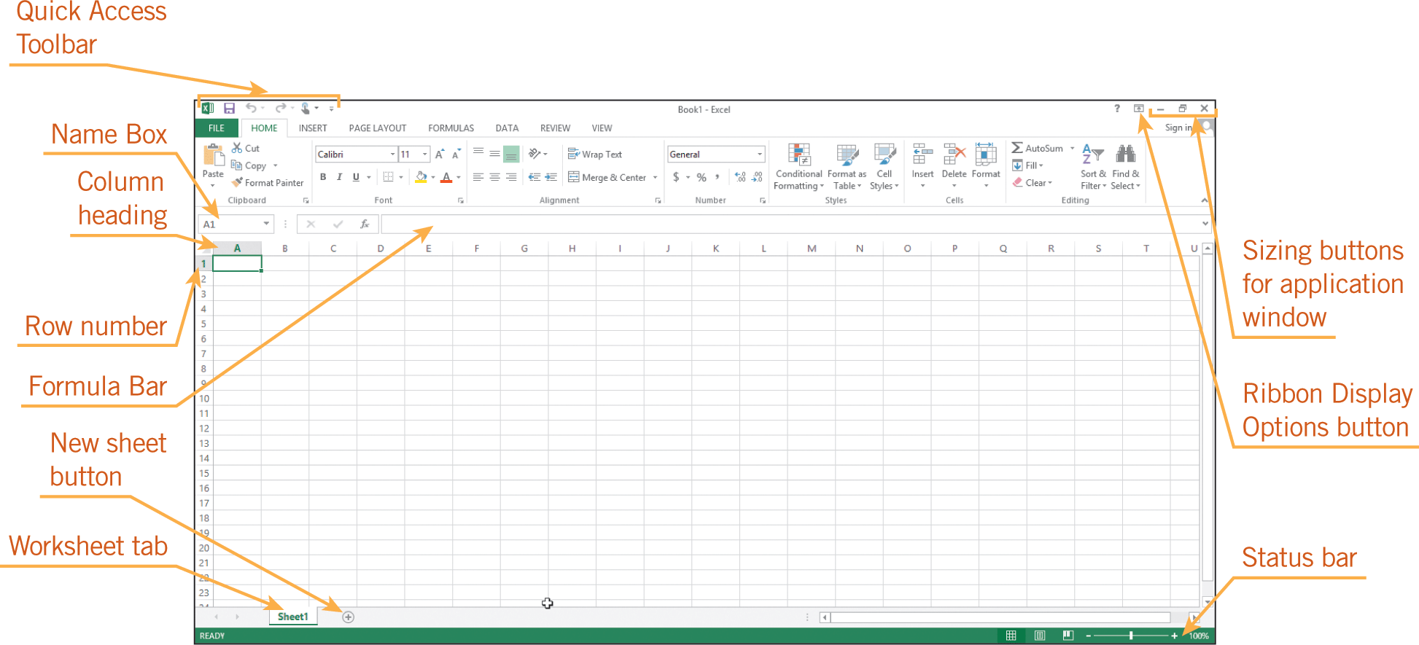
Identifying the Parts of the Excel Screen (continued)
Rows appear horizontally and are identified by numbers on the left side of the worksheet window.

Slide 9
Navigating a Workbook
A cell is the intersection of a single row and a single column.
The cell reference is the column letter followed by the row number (for example, A1 or B4).
When a cell is selected, it is called the active cell.
9
9

Slide 10
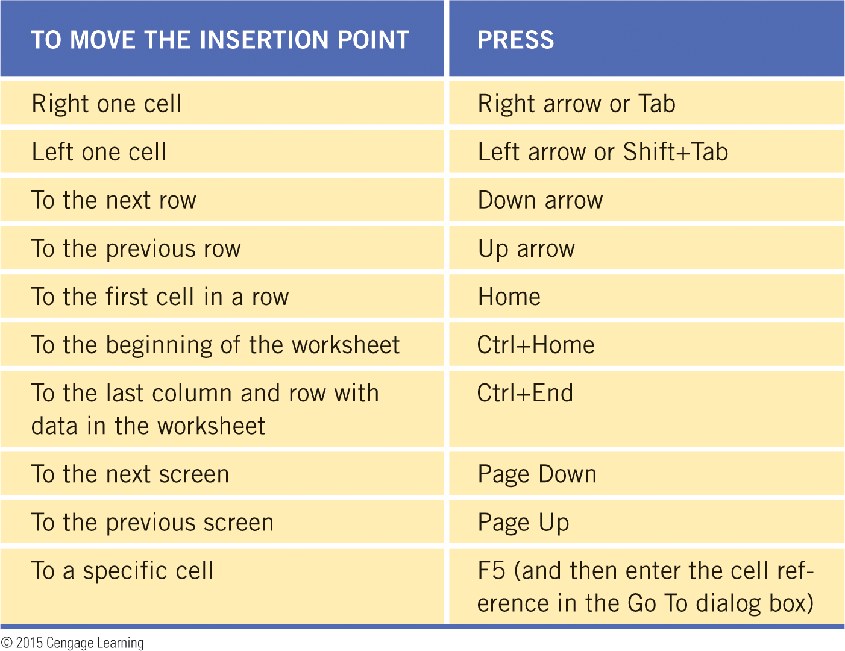
Navigating a Workbook (continued)
10
10

Slide 11
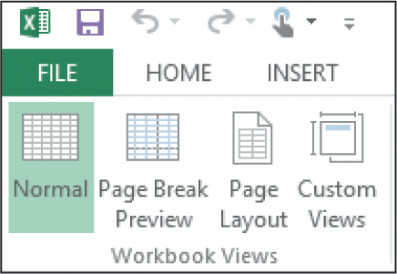
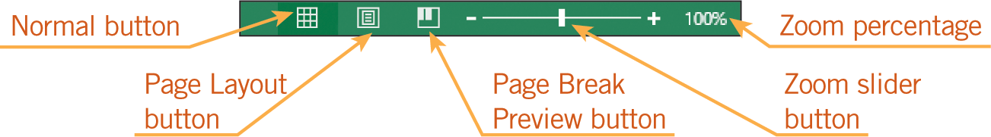
Changing the Workbook View and Magnification
You can change the view by selecting options from the Workbook Views group on the VIEW tab.
You can change the view by clicking one of the view buttons in the status bar in the lower-right corner of the worksheet window, and you can change the zoom settings.
11
11

Slide 12
Entering Data
You add data to the cells by entering text or a number in the active cell. The text or number is often referred to as a value.
Inserting Data
To enter data in a cell, the cell must be active.
By default, Excel shows approximately eight characters in each cell.
12
12

Slide 13
Entering Data (continued)
Inserting Data (continued)
When text is too long for the width of a cell, it spills over to the next cell if the next cell is empty.
If the next cell is not empty, the text that does not fit into the cell is not displayed but is still contained in the cell.
When you enter more numbers than can fit in the cell, a series of number signs (####) is displayed in the cell.
13
13

Slide 14
Entering Data (continued)
Using the AutoCorrect and AutoComplete Features
The AutoCorrect feature in Excel corrects common mistakes as you enter data.
With the AutoComplete feature, Excel compares the first few characters you enter in a cell to existing entries in the same column and proposes the existing entry. You can press Enter to accept the proposed entry.
14
14

Slide 15
Modifying the Worksheet Structure
You can change the structure of a worksheet by adding or deleting rows and columns.
Selecting Multiple Cells in the Worksheet
To select an entire row in a worksheet, click the row heading, which is the number at the left of the row.
To select an entire column, click the column heading, which is the letter at the top of the column.
When you select a group of cells, the group is called a range.
15
15

Slide 16
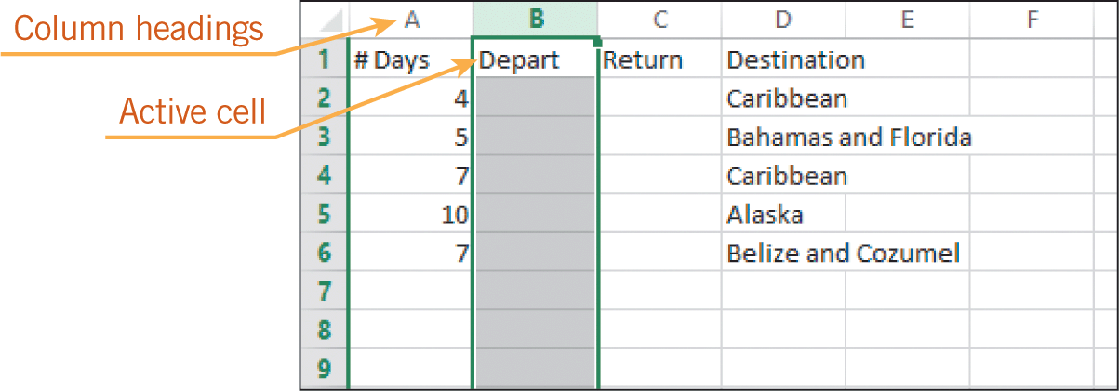
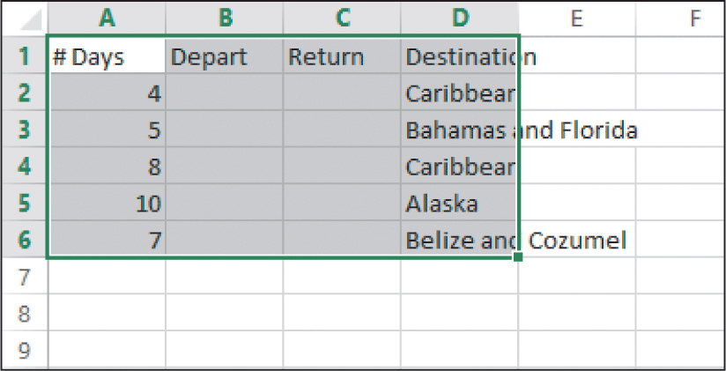
Modifying the Worksheet Structure (continued)
Selecting Multiple Cells in the Worksheet (continued)

Slide 17
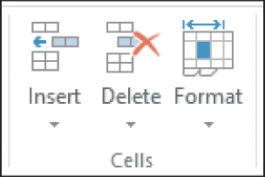
Modifying the Worksheet Structure (continued)
Inserting and Deleting Rows and Columns
To add or delete rows and columns, use the buttons in the Cells group on the HOME tab.
To insert or delete multiple columns and rows in a single step, select the desired number of columns or rows before executing the command.
17
17

Slide 18
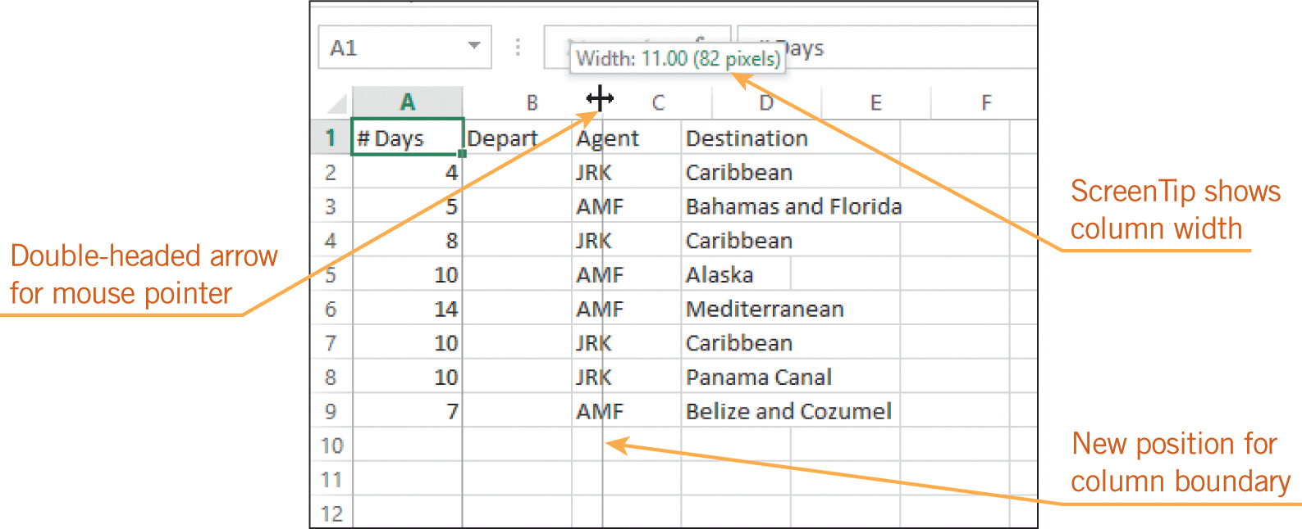
Modifying the Worksheet Structure (continued)
Changing Column Width and Row Height
To accommodate data that will not fit in a cell, you can widen the column and change the height of a row by dragging the cell boundary or by using the Format options in the Cells group.
18
18

Slide 19
Editing the Worksheet Data
Sometimes after entering data in a worksheet, you need to reorganize it.
You may even want to remove some of the data and not replace it.
Or, you may want to move or copy existing data from one location to another.
19
19

Slide 20
Editing the Worksheet Data (continued)
Clearing, Replacing, and Copying Existing Data
To replace cell contents, you can select the cell and enter the new data.
The process for deleting data can be as simple as pressing Delete or Backspace.
You can copy or move multiple cells of data at the same time.
When you paste data to a spreadsheet cell that already contains data, the data in the destination cell is replaced with the pasted data.
20
20

Slide 21
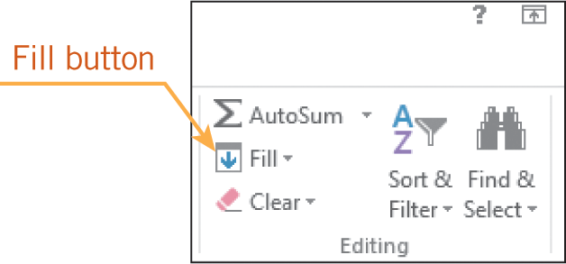
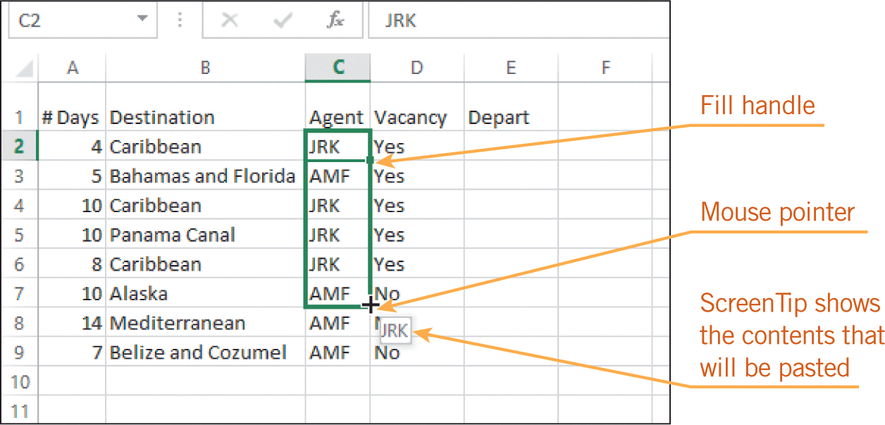
Editing the Worksheet Data (continued)
Using the AutoFill Feature to Copy Data
The AutoFill feature enables you to repeat the same data in a column or row.
21
21

Slide 22
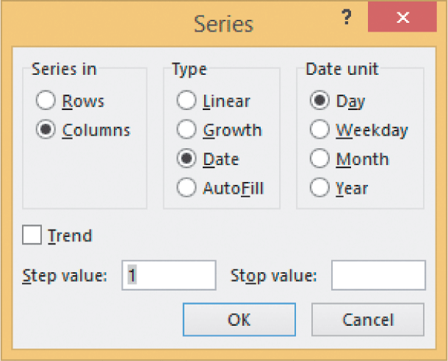
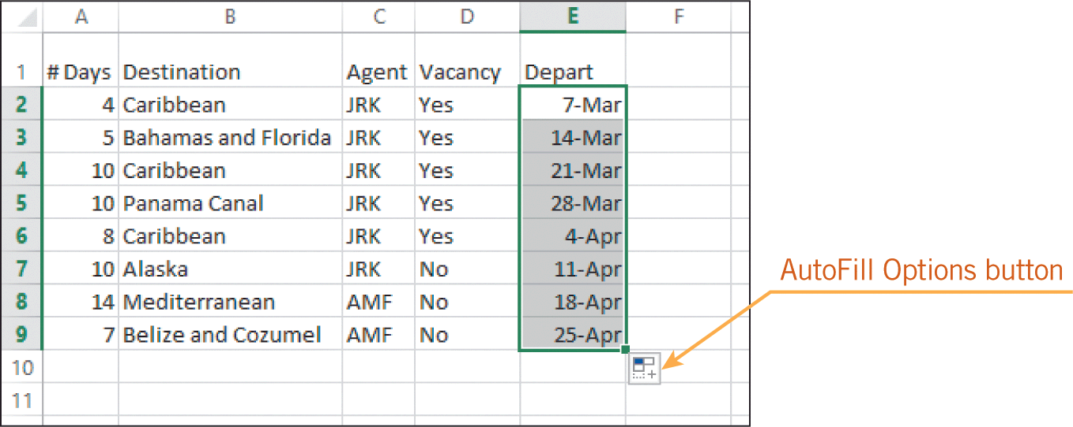
Editing the Worksheet Data (continued)
Using the AutoFill Feature to Fill in a Series
You can also use the AutoFill feature to fill in a series of numbers and dates.
22
22

Slide 23
Summary
In this lesson, you learned:
The Excel application window shows the Quick Access Toolbar, status bar, and other similar features used in other Microsoft Office applications.
To navigate the workbook, you can use keyboard shortcuts and the scroll bars.
You can choose from several options to view the worksheet, and you can change the zoom settings to specify the level of magnification.
23
23

Slide 24
Summary (continued)
To enter data in a cell, the cell must be active. Depending on the width of the column, all the data may not be displayed, but the data is still contained in the cell.
As you enter data, the AutoCorrect feature automatically corrects some of your keyboarding errors. If the data you are entering matches characters of existing entries in the column, the AutoComplete feature proposes the existing entry to save you time.
24
24

Slide 25
Summary (continued)
When you insert or delete cells, rows, and columns, all existing data is shifted up, down, left, or right.
To accommodate the data in a cell, you can widen the column and change the height of a row.
To reorganize a worksheet, you can add and delete columns and rows; you can also delete, clear, copy and paste, or move the data. The Undo and Redo commands are available on the Quick Access Toolbar.
The AutoFill feature enables you to quickly fill in a series of data.
25
25

