Slide 1
Lesson 19
Organizing and
Enhancing Worksheets
Computer Literacy BASICS: A Comprehensive Guide to IC³, 5th Edition
Morrison / Wells / Ruffolo

Slide 2
Objectives
Hide, show, and freeze columns and rows.
Create, rename, and delete worksheets.
Change the page setup of a worksheet and add headers and footers.
Customize the print options.
Apply fonts, alignments, number formats, and conditional formatting to worksheet cells.
2
2

Slide 3
Objectives (continued)
Apply borders, fill colors, and styles to worksheet cells.
Sort and filter data in a worksheet.
Save a workbook in PDF and XPS formats.
3
3

Slide 4
Words to Know
cell style
collated
conditional formatting
filter
footer
freeze
header
header row
split
table style
worksheet tab
4
4

Slide 5
Managing Worksheets
When working with electronic spreadsheets, you can keep expanding rows and columns, and then you can continue adding data.
As the spreadsheet grows in size, locating the data becomes more tedious.
Worksheets can be managed so you can access data more efficiently.

Slide 6
Managing Worksheets (continued)
Hiding and Showing Worksheet Data
A header row contains column headings or field names in a data source, such as a table or spreadsheet.
When navigating through a large worksheet, the header row sometimes scrolls out of view.
To overcome this, you can use the zoom setting or you can hide some of the rows and columns.
When you hide rows and columns, the data remains intact; it is just not visible on the screen.
6
6

Slide 7
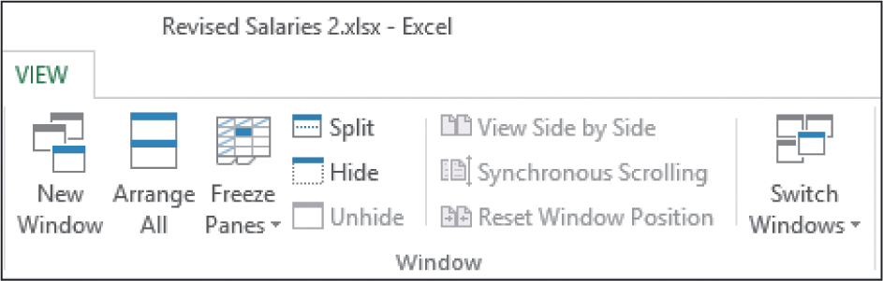
Managing Worksheets (continued)
Freezing Rows and Columns
When you freeze columns and/or rows, you lock them so you can keep an area visible as you scroll through the worksheet.
By freezing rows and columns, you do not have to hide any data.
7
7

Slide 8
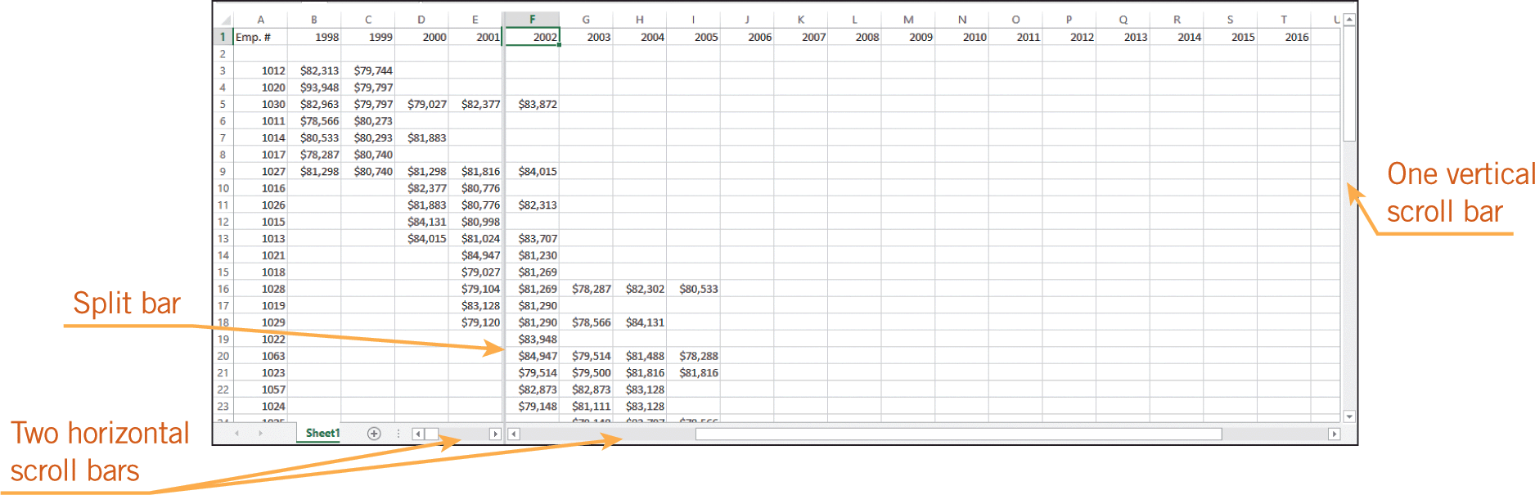
Managing Worksheets (continued)
Splitting Rows and Columns
Another way to display data is to split a worksheet, which divides the worksheet into either two or four panes.
Splitting the worksheet enables you to show different data in each pane.
You can increase or decrease the size of the panes by dragging the split bar.

Slide 9
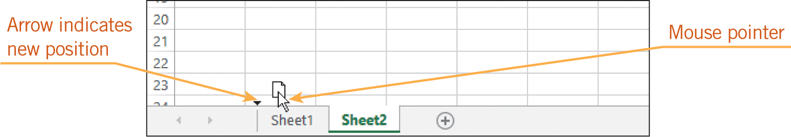
Managing Worksheets (continued)
Working with Multiple Worksheets
At the bottom of the workbook window, a worksheet tab is displayed for quick and easy access to the worksheet.
You can add a new worksheet, rename the worksheet tab, delete a worksheet, move a worksheet, and copy and paste data from one worksheet to another.
9
9

Slide 10
Formatting the Page Layout
A well-organized worksheet must also have an effective page layout.
When a worksheet contains a large amount of data, you can make some adjustments to the page layout so the data is easy to read and access.
10
10

Slide 11
Formatting the Page Layout (continued)
Changing the Page Setup
Page Break Preview shows you exactly how the worksheet will be printed.
Excel determines where to break the page and begin a new one.
You can create your own page break by dragging the page break to a new location, or by selecting a row or cell and inserting a manual page break.
11
11

Slide 12
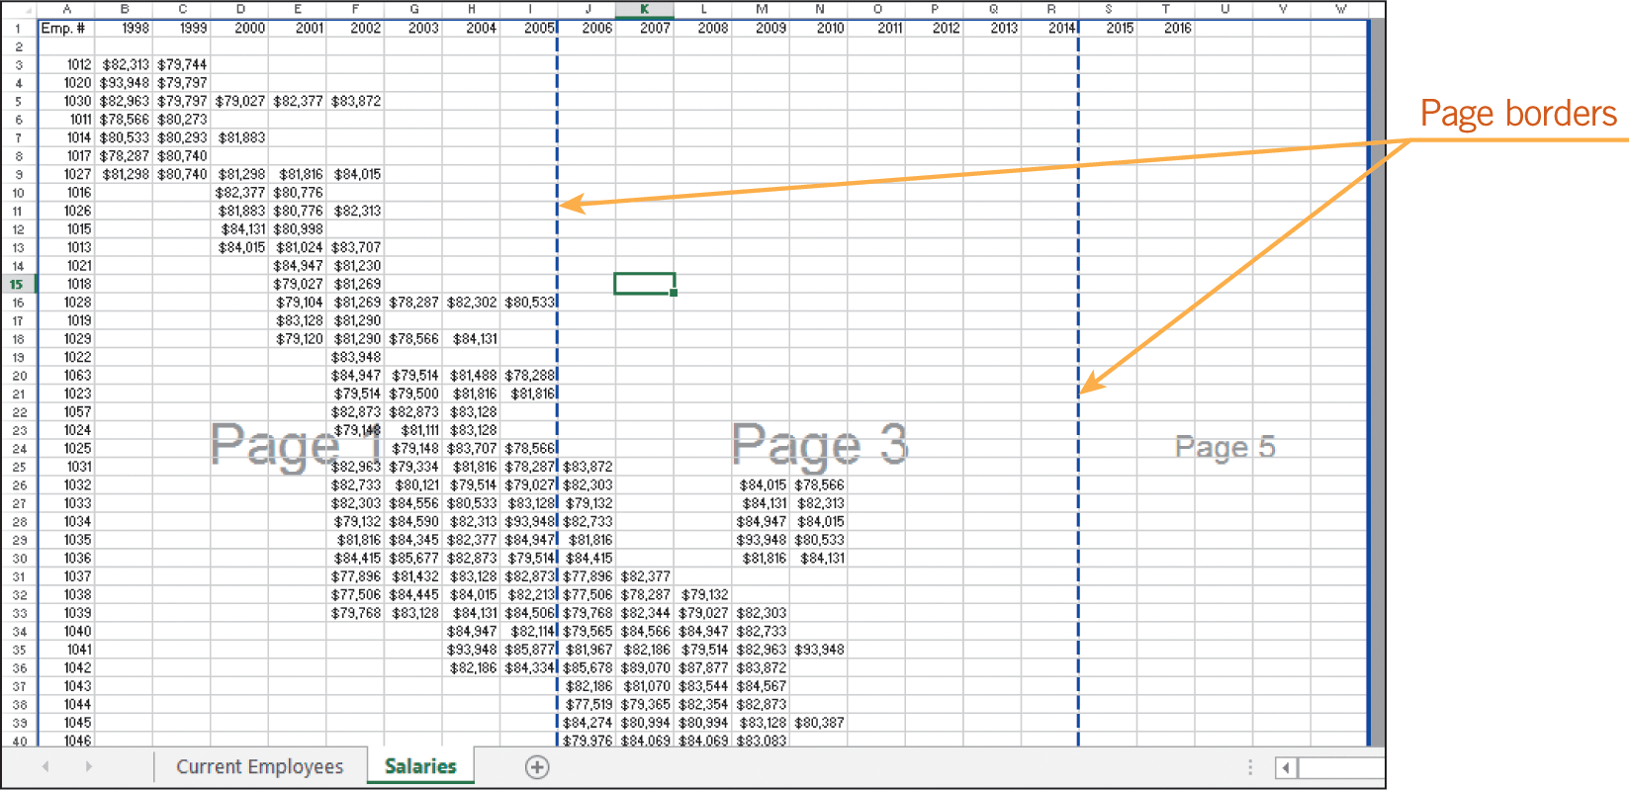
Formatting the Page Layout (continued)
Changing the Page Setup (continued)

Slide 13
Formatting the Page Layout (continued)
Changing the Page Setup (continued)
Portrait orientation formats the worksheet content with the short edge of the page at the top.
You can change to landscape orientation, which formats the worksheet content with the long edge of the page at the top.
Another option is the Fit command, which scales the worksheet to fit a number of pages you designate.
When you change the page setup settings, the new settings apply only to the current worksheet.
13
13

Slide 14
Formatting the Page Layout (continued)
Creating a Header and a Footer
A header is information and/or graphics that are printed in the top margin of a worksheet.
A footer is information and/or graphics that are printed in the bottom margin of a worksheet.
Fields can be used to automatically insert dates, times, filenames, the file path, the worksheet name, and page numbers.
You can choose from several built-in headers or footers, or you can create your own customized headers and footers.
14
14

Slide 15
Formatting the Page Layout (continued)
Customizing Print Options
By default, Excel prints the entire worksheet.
You can identify the range you want to print before you choose the Print command.
When printing multiple copies, you can use the collated setting. When printed pages are collated, the pages are organized in the proper sequence.
Before printing a worksheet, you can change the settings for worksheet orientation, page size, the margins, and scaling.
15
15

Slide 16
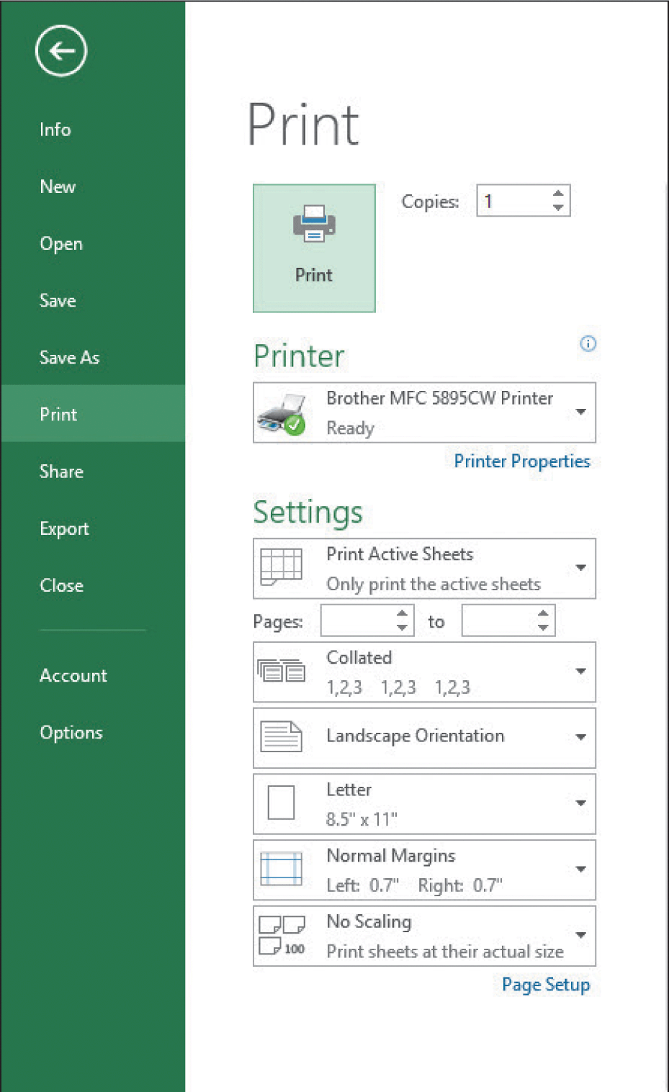
Formatting the Page Layout (continued)
Customizing Print Options (continued)
You can change the print settings using the command on the PAGE LAYOUT tab, in the Page Setup dialog box, or in Backstage view.

Slide 17
Formatting the Page Layout (continued)
Formatting the Cell Contents
You can control the font styles, sizes, and colors, and you can apply attributes such as bold and italic to the contents of a cell.
When you use the Cut and Copy commands to copy and move all the data in a cell, the formats are also moved and copied.
When you delete the contents of a cell, the formats for the cell remain in the cell.
To remove the contents and the formats, you need to clear the cell.

Slide 18
Formatting the Page Layout (continued)
Merging Cells and Changing Font Styles and Sizes
You can merge cells and combine several cells into a single cell to span several columns.
You can use a merged cell to create a title or other informational text for your worksheet.
Bold, italic, underline, and color formats can also add emphasis to the contents of a cell.
You can use the Format Painter feature to copy formats.
18
18

Slide 19
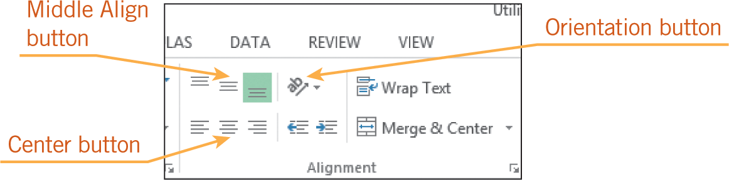
Formatting the Page Layout (continued)
Changing Alignment and Wrapping Text in Cells
Buttons for adjusting alignment, wrapping text, and more are in the Alignment group on the HOME tab.
19
19

Slide 20
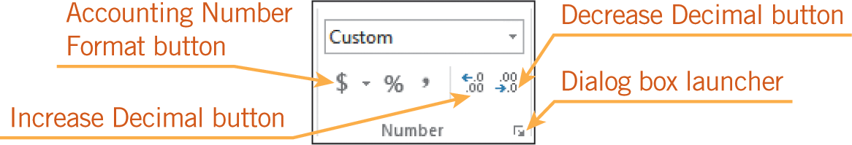
Formatting the Page Layout (continued)
Formatting Numbers and Dates
You can format numbers and dates using the commands in the Number group on the HOME tab.
20
20

Slide 21
Formatting the Page Layout (continued)
Applying Conditional Formatting
Conditional formatting applies designated formats to cells when the cell value meets specified conditions (criteria).
You can highlight cell values and use Data Bars, Color Scales, or Icon Sets to help visualize the data.
Built-in rules are available so you can specify criteria based on a comparison operator or a cut-off value.
21
21

Slide 22




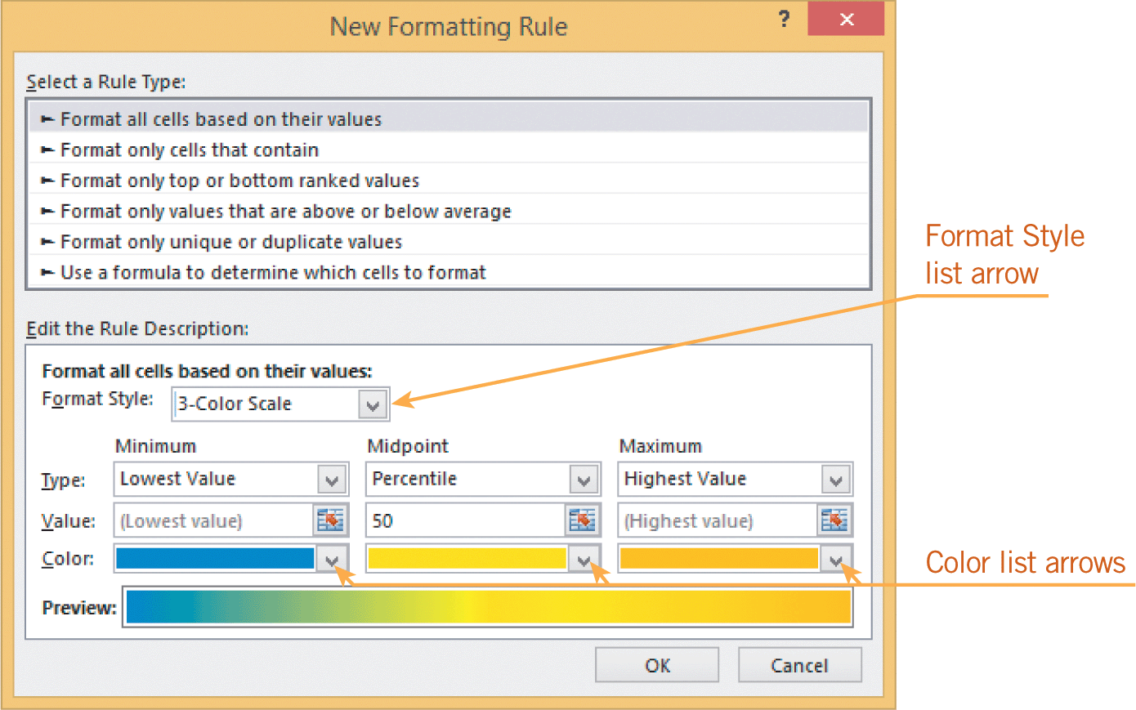
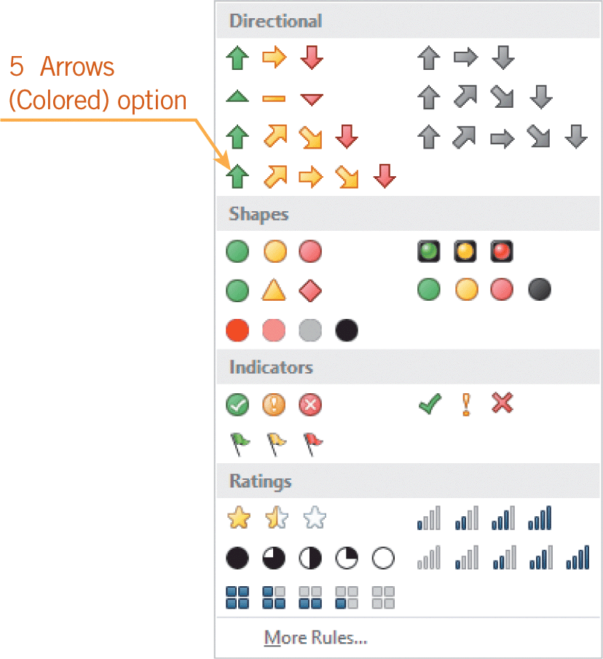
Formatting the Page Layout (continued)
Applying Conditional Formatting (continued)

Slide 23
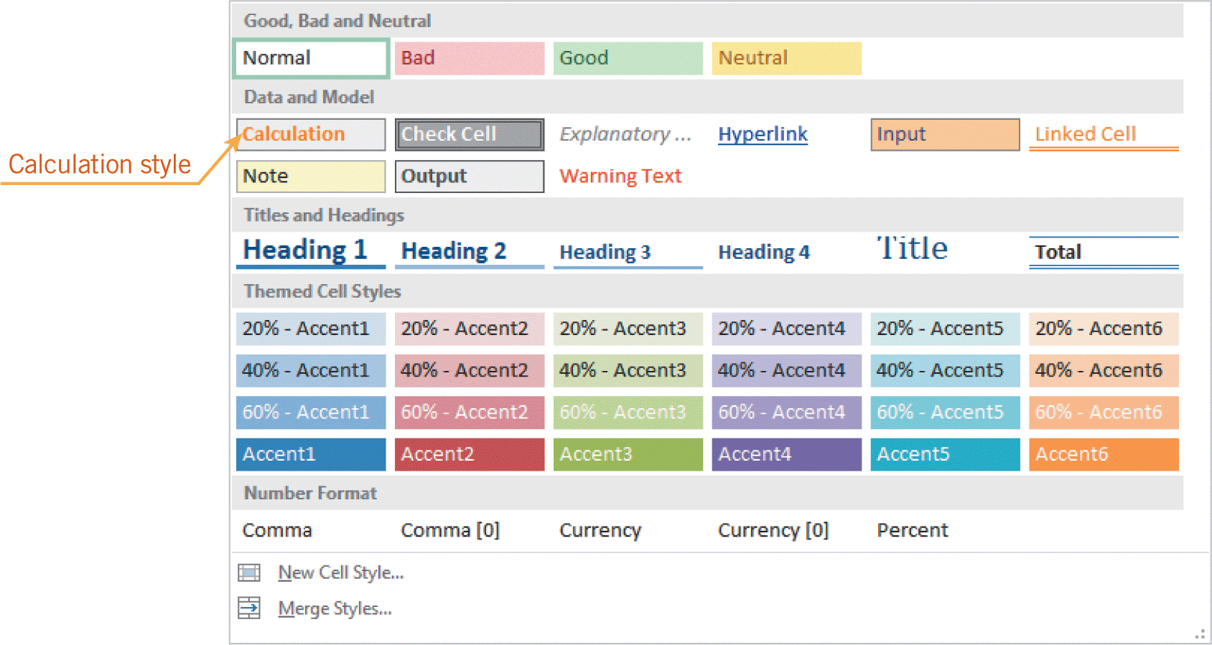
Formatting the Page Layout (continued)
Adding Fill Colors, Borders, and Styles
You can emphasize important information in a cell, a row of cells, or a column by applying fill colors and/or border formats.
A cell style is a set of predefined formats you can apply to some of the worksheet data, such as a header row, a cell showing a total, or cells showing the date and time.
23
23

Slide 24
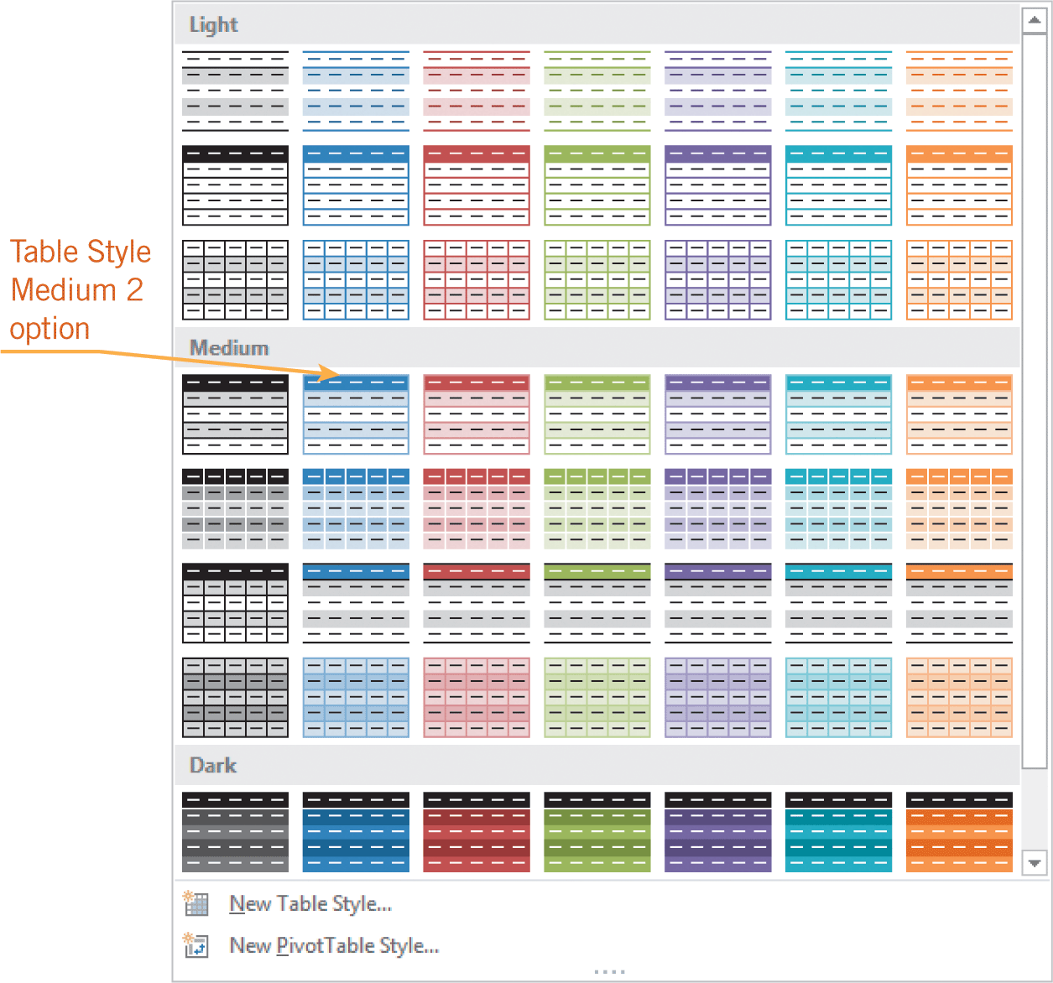
Formatting the Page Layout (continued)
Adding Fill Colors, Borders, and Styles (continued)
A table style is a set of predefined formats that you can apply to all the worksheet data with a single click.
24
24

Slide 25
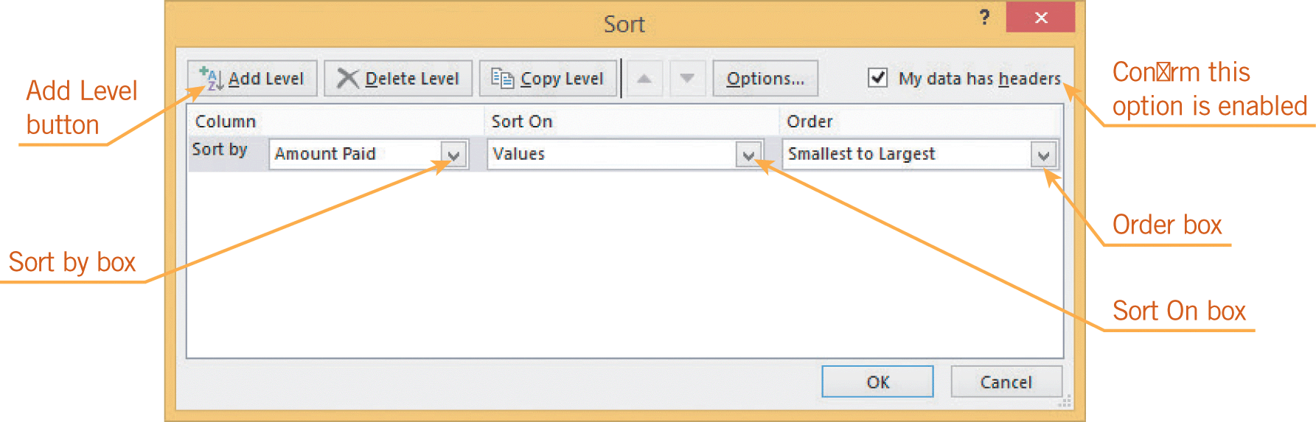
Sorting and Filtering Data
You can sort the data and numbers in the columns based on one criteria or on multiple criteria.
25
25

Slide 26
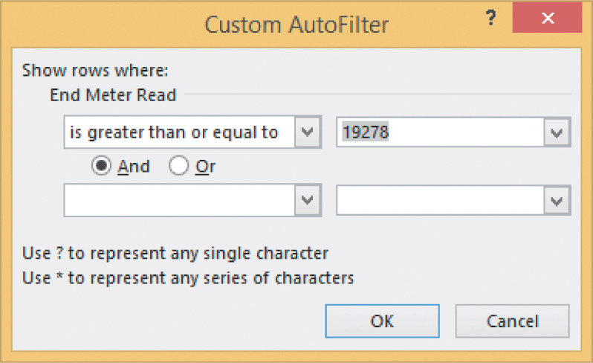
Sorting and Filtering Data (continued)
When you filter data, the data that does not meet the criteria is hidden, and only the data that meets the criteria is shown.
26
26

Slide 27
Sharing Workbooks
In a team effort to create and maintain a workbook, it is common for multiple users to access and edit the workbook.
It is also common to share workbook data without allowing edits.
Excel offers several options for sharing workbooks.
27
27

Slide 28
Sharing Workbooks (continued)
Tracking Changes and Adding Comments
When you track changes in Excel, cells are highlighted and details about the change can be viewed in a ScreenTip.
You can either accept or reject those changes.
You can also add comments to selected cells.

Slide 29
Sharing Workbooks (continued)
Saving a Workbook to Share
When sharing workbooks with others, you need to consider that not all users will be using Excel 2013.
You may need to save the file in a format that enables those working with different applications, platforms, and operating systems to access the file.

Slide 30
Sharing Workbooks (continued)
Saving a Workbook to Share (continued)
You can use SkyDrive to share your files.
You can share a workbook by attaching it to an e-mail message.
You can choose to save the attached file in either PDF or XPS format.
Both formats are designed to preserve the visual appearance and layout of each page.

Slide 31
Summary
In this lesson, you learned:
To keep the header row in view when navigating through a large worksheet, you can change the zoom setting.
If that does not work because the worksheet is too large, you can hide some of the rows and columns so you can focus on a particular range of data, or you can freeze some rows and columns.
31
31

Slide 32
Summary (continued)
You can delete or add one or several worksheets to a workbook, and you can rename each worksheet.
Headers and footers can be added to worksheets to provide information such as the source and date of the data.
You can change the page orientation or use the Fit to feature to fit all the data on a specified number of pages.
32
32

Slide 33
Summary (continued)
You can control the print output by inserting page breaks manually or creating a print area for the worksheet.
With the default settings, the gridlines and row and column headings appear on the screen in worksheets, but they do not appear when the worksheets are printed. You can change the settings to hide these elements on the screen and/or include them in printed worksheets.
33
33

Slide 34
Summary (continued)
Before you print, you can preview the worksheet to see what it will look like when it is printed.
You can choose to print the active worksheet only, or you can choose to print all worksheets in the workbook.
34
34

Slide 35
Summary (continued)
There are many options available for formatting cell contents, including merging cells, changing font styles and sizes, changing the alignment within the cells, and applying number and date formats.
Conditional formatting enables you to quickly identify exceptions or trends in data as well as unusual cell values.
35
35

Slide 36
Summary (continued)
To enhance the appearance of and highlight data within the worksheet, you can add borders and fill colors to cells.
There are also many predefined styles available that you can quickly apply to give the worksheet a professional look and make reading the data easier.
36
36

Slide 37
Summary (continued)
To organize worksheet data numerically or alphabetically, you can sort the data based on a single column, or you can sort the data based on multiple criteria. To screen for data that meets certain criteria, you can filter the data.
You can track changes and add comments to worksheets. To preserve the visual appearance and layout of each worksheet, you can save all the workbook data in PDF or XPS file format.
37
37

