Slide 1
Lesson 20 Creating Formulas and Charting Data
Computer Literacy BASICS: A Comprehensive Guide to IC³, 5th Edition
Morrison / Wells / Ruffolo

Slide 2
Objectives
Understand and create formulas in a worksheet.
Understand and use relative and absolute cell references.
Understand and use function formulas to calculate sums, the number of occurrences, averages, and the smallest and largest numbers in a range.
Use formulas with cell references to connect a worksheet to other worksheets.
2
2

Slide 3
Objectives (continued)
Identify and correct formula errors.
Create a chart from worksheet data, and interpret data from worksheets and charts.
Edit chart data, and change chart formats and options.
Use sparklines to create a visual representation of worksheet data.
Use Quick Analysis for quick access data analysis.
3
3

Slide 4
Words to Know
absolute cell reference
argument
chart
complex formulas
embedded chart
formula
function formula
mathematical function
mixed cell reference
operand
operator
order of evaluation
4
4

Slide 5
Words to Know (continued)
relative cell reference
sparkline
statistical function
5
5

Slide 6
Working with Formulas
The equation used to calculate values in a cell is known as a formula.
The operand is a number or cell reference.
The operator is a symbol that indicates the mathematical operation to perform with the operands.
In the formula =B5+6, the operands are B5 and 6; the operator is the plus sign.
6
6

Slide 7
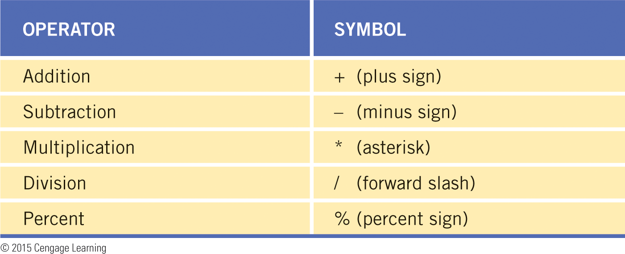
Working with Formulas (continued)

Slide 8
Working with Formulas (continued)
Formulas containing more than one operator are called complex formulas.
The sequence to calculate the value of a formula is called the order of evaluation.
You can change the order of evaluation by using parentheses; calculations enclosed in parentheses are performed first.
8
8

Slide 9
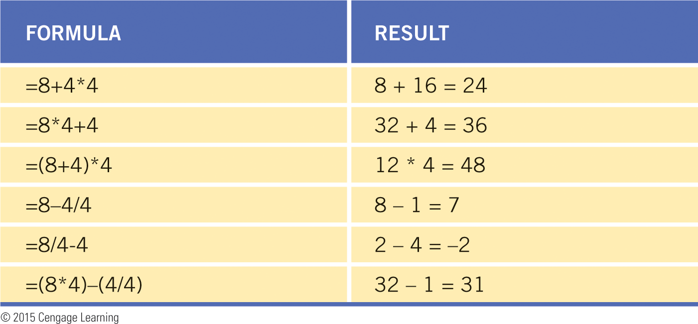
Working with Formulas (continued)

Slide 10
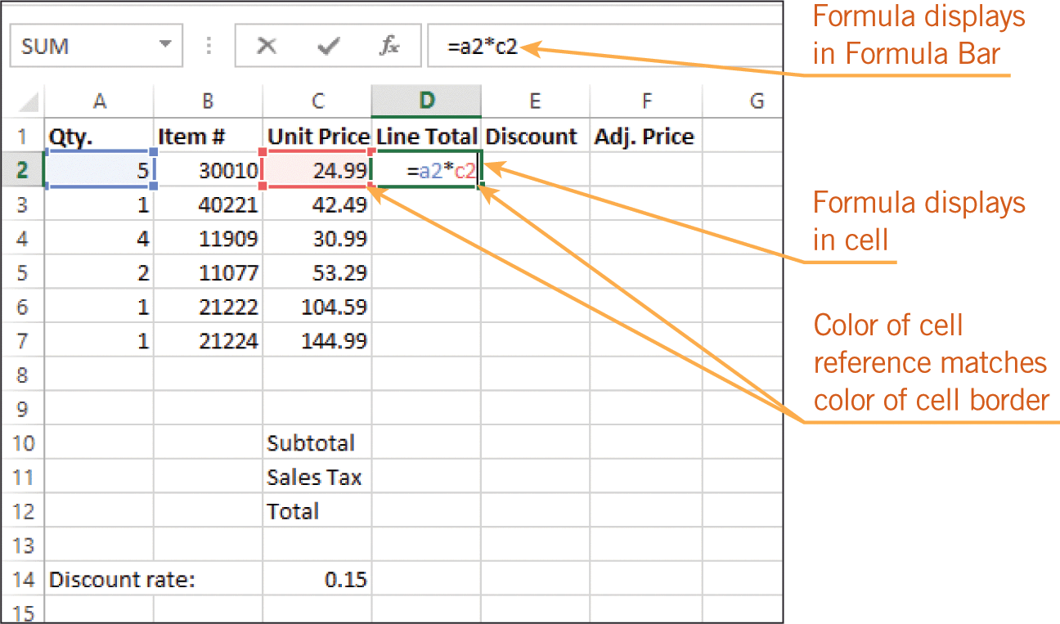
Working with Formulas (continued)
Creating and Editing a Formula
There are two ways to enter a cell reference into a formula: You can enter the cell reference, or you can click the cell.
10
10

Slide 11
Working with Formulas (continued)
Using Relative and Absolute Cell References
In relative cell references, when the formula is copied to another cell, the cell references will be adjusted relative to the formula’s new location.
An absolute cell reference does not change when the formula is copied or moved.
A cell reference that contains both relative and absolute references is called a mixed cell reference.
11
11

Slide 12
Using Function Formulas
A function formula is a special formula that names a function instead of using operators to calculate a result.
Mathematical functions perform calculations that you could perform using a scientific calculator.
Statistical functions are functions that describe large quantities of data.
12
12

Slide 13
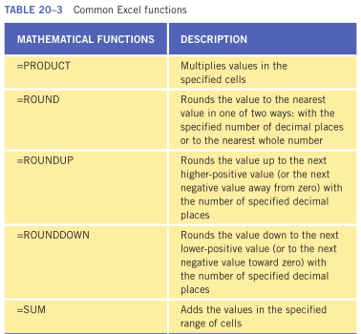
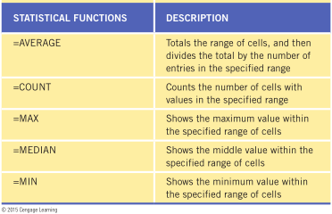
Using Function Formulas (continued)
13
13

Slide 14
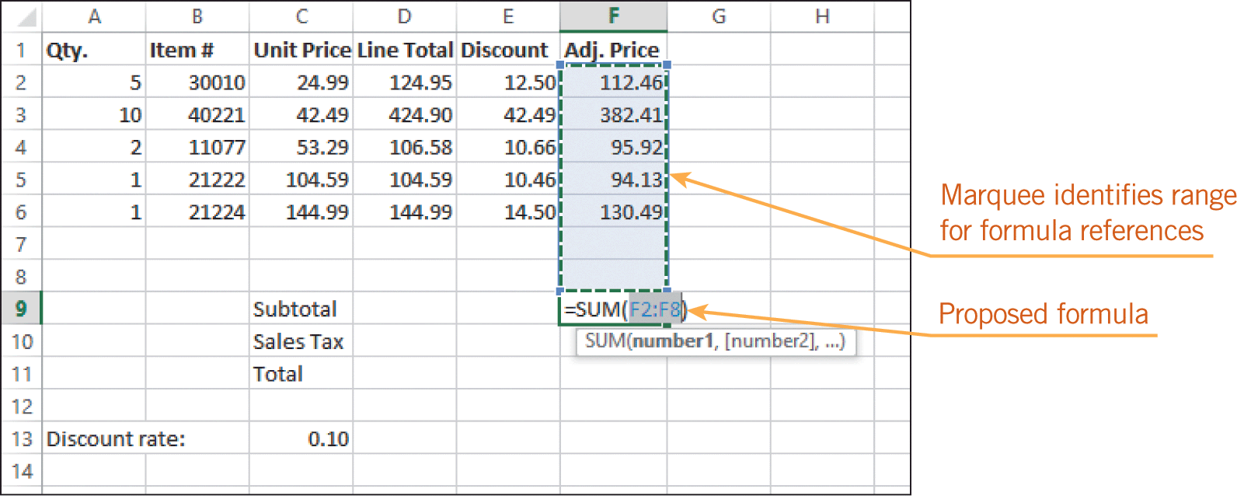
Using Function Formulas (continued)
Using the SUM Function
The AutoSum feature enables you to quickly identify a range and enter a formula.
14
14

Slide 15
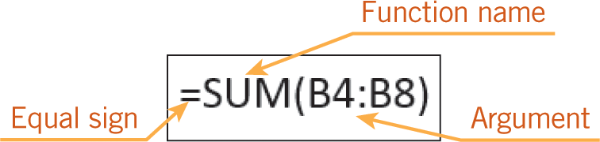
Using Function Formulas (continued)
Using the SUM Function (continued)
An argument is a value, a cell reference, a range, or text that acts as an operand in a function formula, and it is enclosed in parentheses after the function name.
15
15

Slide 16
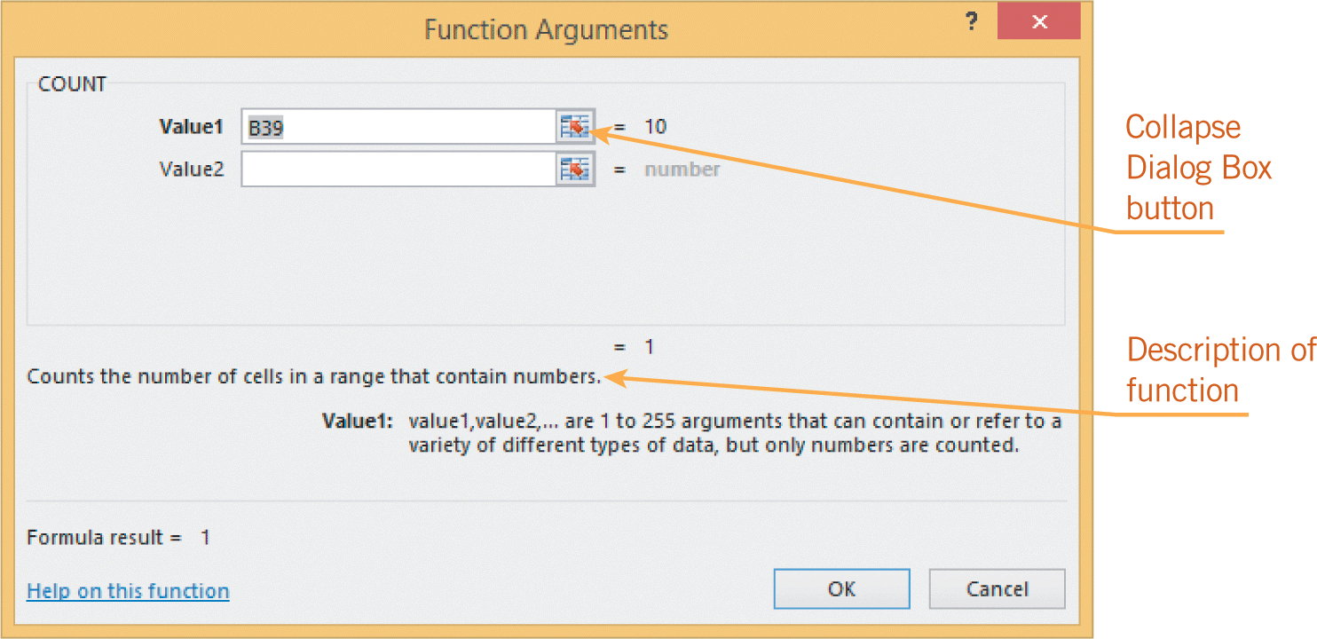
Using Function Formulas (continued)
Using the COUNT Function
COUNT is a statistical function that determines the number of cells in the argument range that contain numerical values.
You can enter the COUNT function by clicking a button on the Ribbon, or you can open the Function Arguments dialog box.
16
16

Slide 17
Using Function Formulas (continued)
Using the AVERAGE, MIN, and MAX Functions
AVERAGE is a statistical function that calculates the average of the range identified in the argument.
The MIN function shows the smallest number contained in the range identified in the argument.
The MAX function shows the largest number contained in the range identified in the argument.
17
17

Slide 18
Creating Formulas that Reference Cells in Multiple Worksheets
The 3D reference enables you to access data from three different dimensions in the workbook: length, width, and depth.
These 3D references are often used in summary worksheets to condense and total data from other worksheets.
18
18

Slide 19
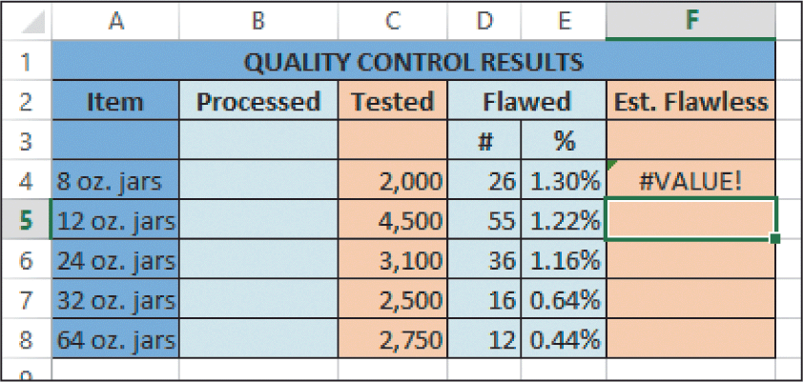
Troubleshooting Common Formula Errors
When Excel cannot properly perform a calculation, an error value appears in the cell where you entered the formula.
19
19

Slide 20
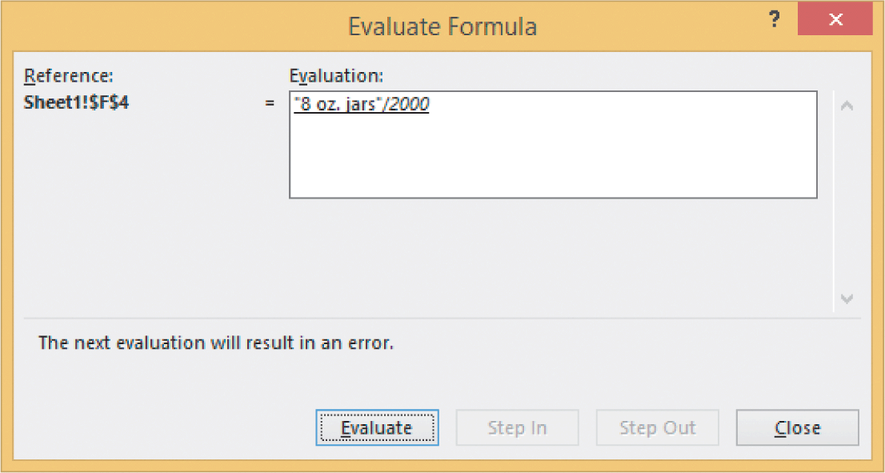
Troubleshooting Common Formula Errors (continued)
Excel provides help to solve formula errors.
20
20

Slide 21
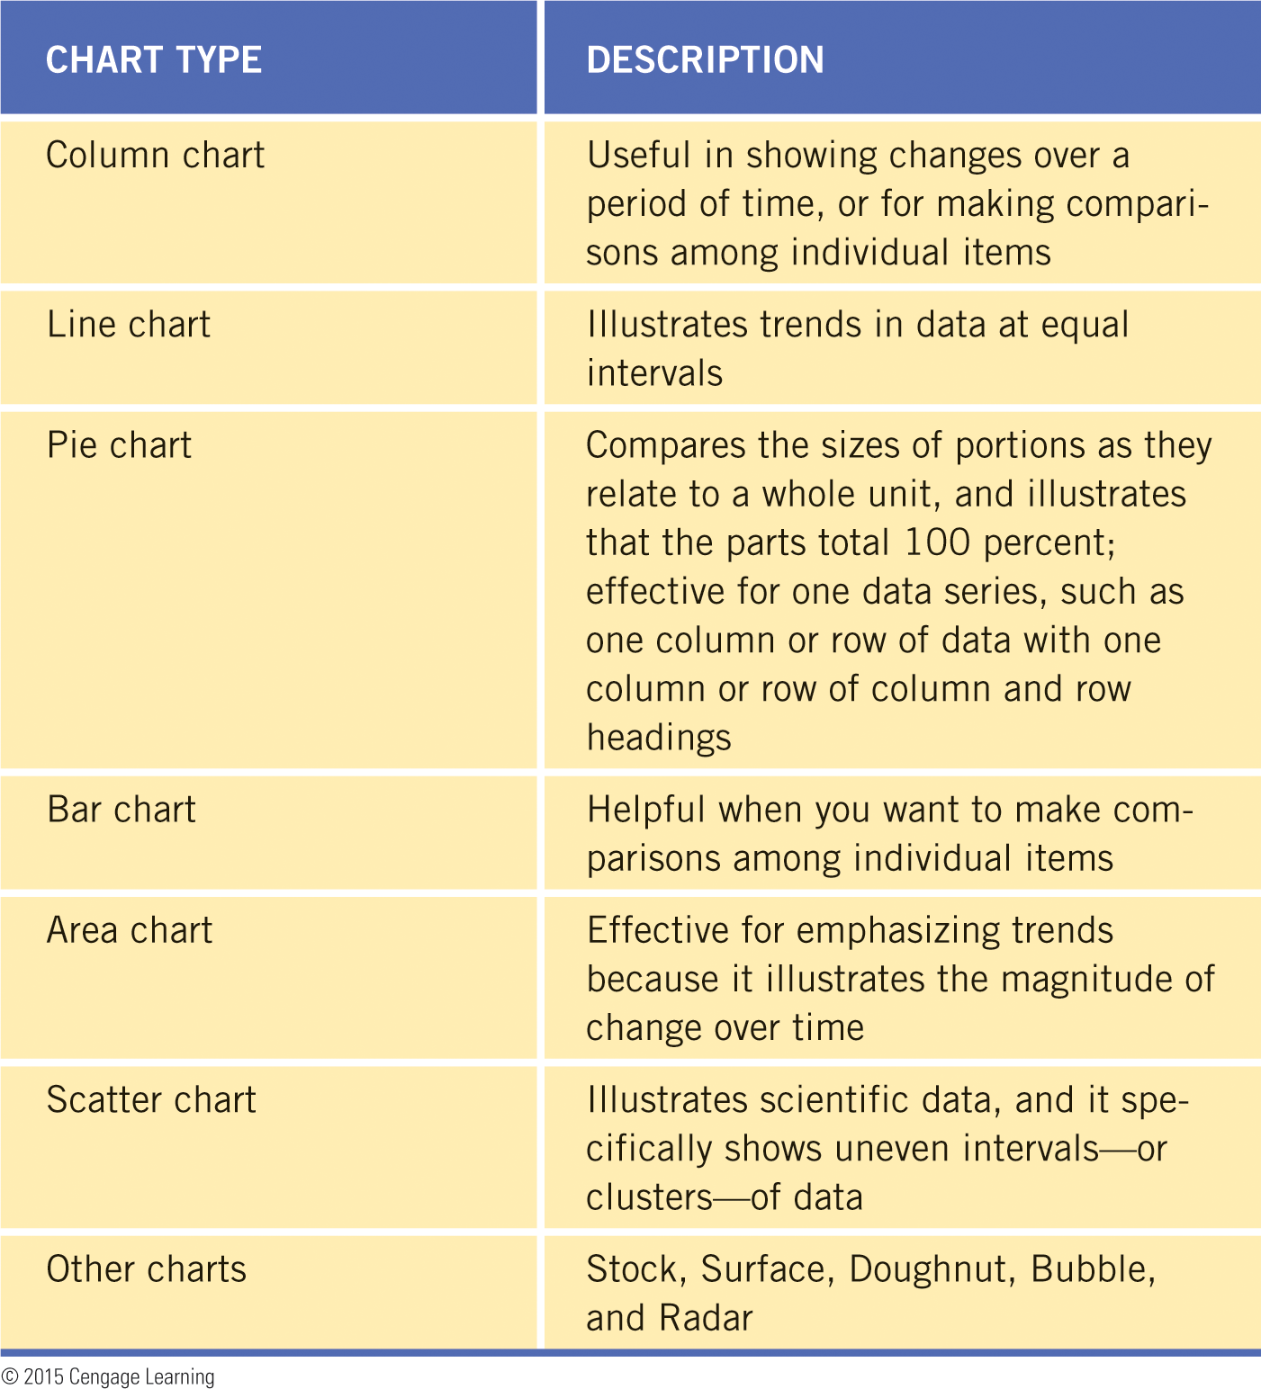
Using Graphics to Represent Data
To draw conclusions from the worksheet data, you can translate the data to a chart, which is a graphic representation of your worksheet data.
21
21

Slide 22

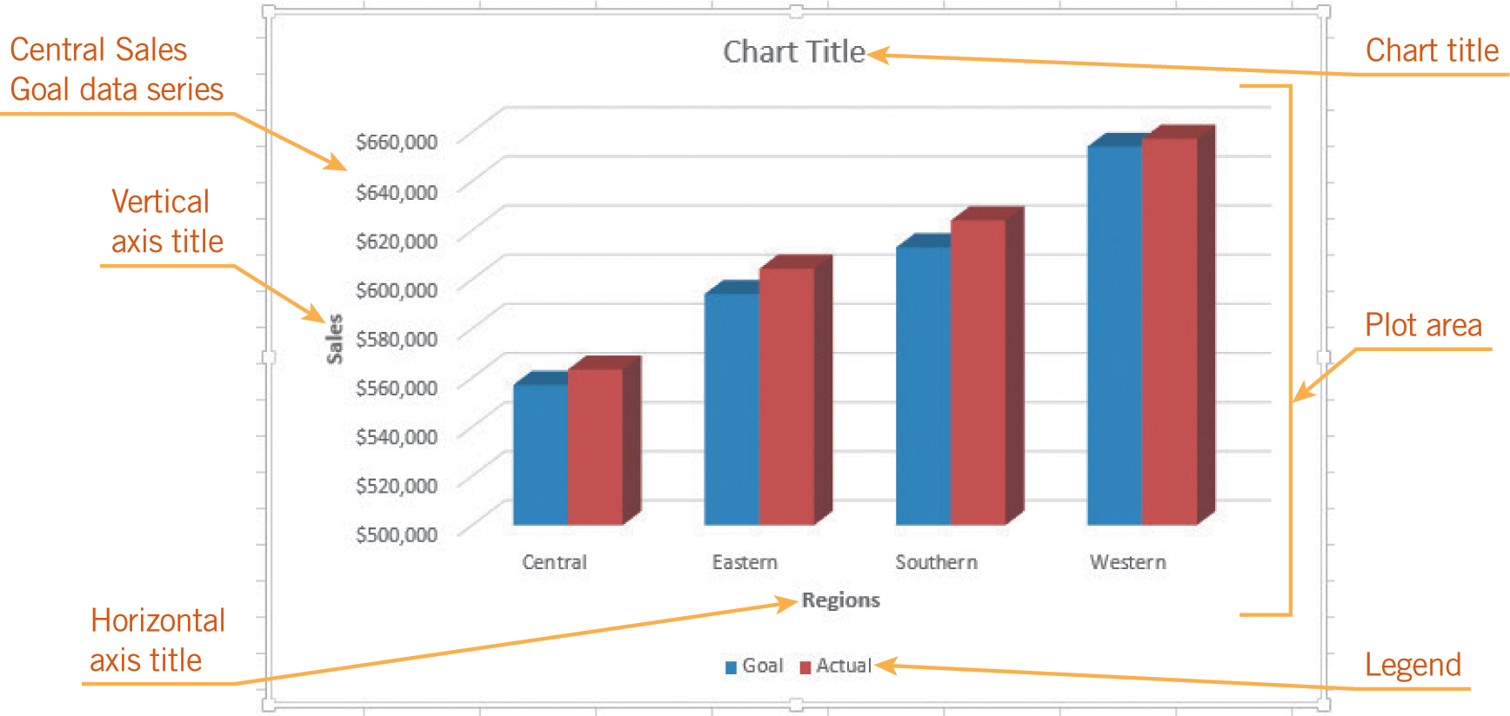
Using Graphics to Represent Data (continued)
22
22

Slide 23
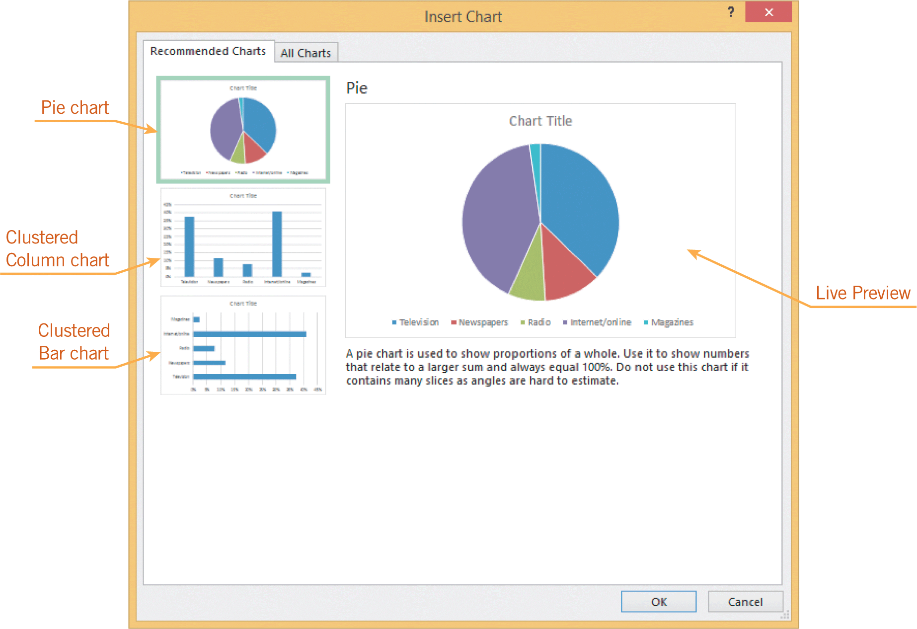
Using Graphics to Represent Data (continued)
Creating a Chart
When creating a chart, you define the specific data to be included in the analysis.
Once the data is identified, you choose a chart type.

Slide 24
Using Graphics to Represent Data (continued)
Changing Chart Formats
When you click the part of the chart you want to change, the object boundaries will appear, and then you can change the formats.
You can keep the chart in the same worksheet or you can move the chart to a different worksheet.
An embedded chart is a chart created on the same sheet as the data used in the chart.
24
24

Slide 25
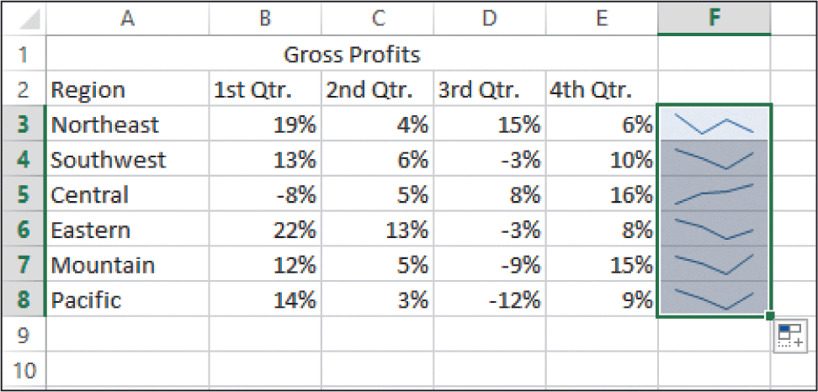
Using Graphics to Represent Data (continued)
Using Sparklines to Show Data Trends
A sparkline is a tiny chart embedded in a cell.
It provides a snapshot of data in a row or column, such as a trend or an increase or decrease in values.
25
25

Slide 26
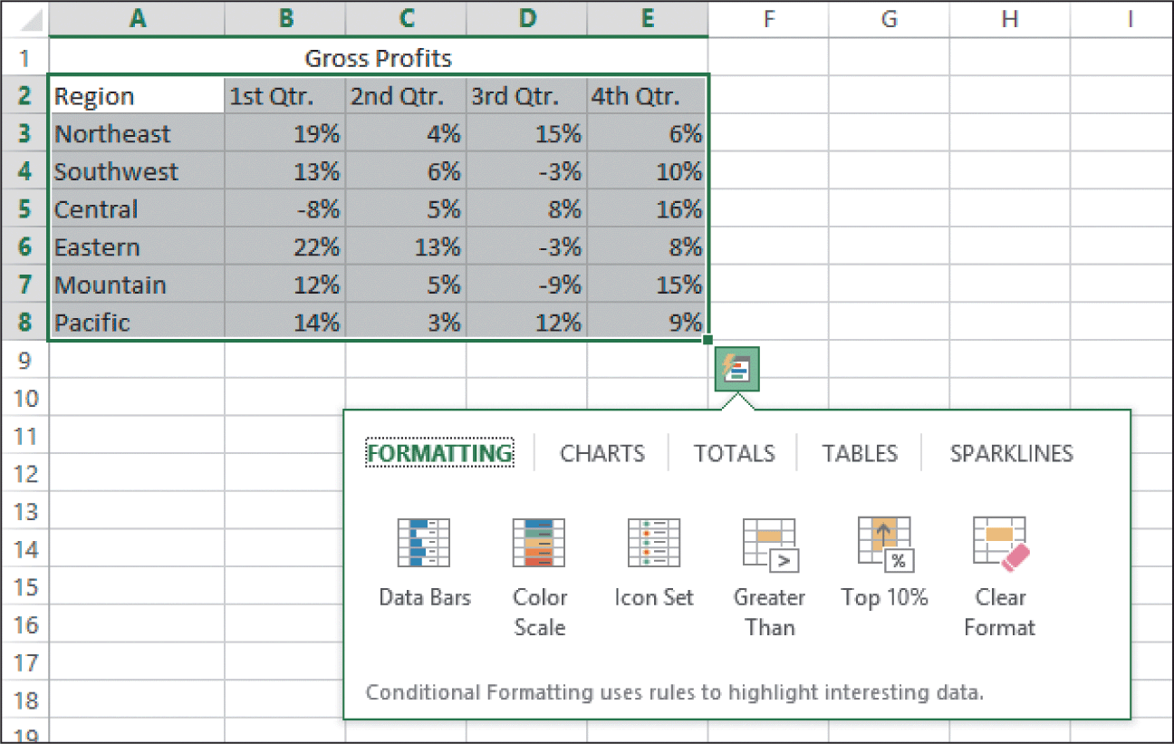
Using Quick Analysis Tools to Preview Data
The Quick Analysis feature provides quick access to data-analysis tools to preview worksheet data converted into visual forms.

Slide 27
Summary
In this lesson, you learned:
If you do not want the cell reference to change when the formula is moved or copied to a new location, the cell reference must be formatted as an absolute cell reference.
Functions are special formulas that do not require operators. Excel provides more than 400 built-in functions to help you perform mathematical, statistical, and other functions.
27
27

Slide 28
Summary (continued)
The AutoSum feature enables you to quickly identify a range of cells and enter a formula. For a range of cells specified in the argument, the AVERAGE function finds the average, the SUM function totals the values, and the COUNT function shows the number of cells with numerical values.
You can use the MIN and MAX functions to find the smallest or largest number in a range.
28
28

Slide 29
Summary (continued)
Formulas can reference cells in multiple worksheets, and 3D references are often used to condense and total data from other worksheets.
If Excel cannot perform a calculation, an error value and an Error Checking button will appear to alert you and help you fix the error. Then, you can edit the formula directly in the cell or in the formula bar.
29
29

Slide 30
Summary (continued)
A chart shows the worksheet data visually and often helps the audience understand and interpret the information more clearly.
To draw logical conclusions from the data and make a correct assessment, you must ensure that the data is accurate and that you know what the values represent.
30
30

Slide 31
Summary (continued)
When the worksheet data is changed, the chart is automatically updated to reflect those changes. Chart types, formats, and options can be changed at any time, even after the chart has been created.
Instead of using charts, you can use sparklines to provide a visual representation of the data.
The Quick Analysis tool provides a quick preview of worksheet data converted into visual forms.
31
31

