Slide 1
Lesson 22 Enhancing Presentations with Multimedia Effects
Computer Literacy BASICS: A Comprehensive Guide to IC³, 5th Edition
Morrison / Wells / Ruffolo

Slide 2
Objectives
Add clip art, pictures from files, shapes, and SmartArt graphics to a slide.
Change the size and position of a graphic object, and add styles, borders, and shape fills to graphic objects on a slide.
Create charts and tables using Excel and Word features.
Create hyperlinks on slides to link to Web pages, e-mails, and other documents.
2
2

Slide 3
Objectives (continued)
Add slide transitions to control how the slides are introduced in a slide show.
Animate objects on a slide to draw attention and add emphasis.
Insert sound and video clips to add an extra dimension to a slide show.
Prepare hard copies for handouts and speaker’s notes, and distribute presentations via electronic copies.
3
3

Slide 4
Words to Know
animation
emphasis effects
entrance effects
exit effects
motion paths
slide transitions
trigger
4
4

Slide 5
Inserting and Formatting Graphics
Graphics can help your audience remember your message.
Graphics include shapes, clip art, pictures, WordArt, SmartArt graphics, tables, and charts.
Use graphics only when they illustrate relevant points in a presentation.

Slide 6
Inserting and Formatting Graphics (continued)
Adding Pictures to a Slide
You can insert clip art and photographs from a gallery of online clip art files provided by Microsoft at Office.com.
You can also insert a picture from a file, such as a digital photograph or a scanned image.
You can access pictures you have saved on your computer, SkyDrive, Facebook, Flickr, and other sites.

Slide 7
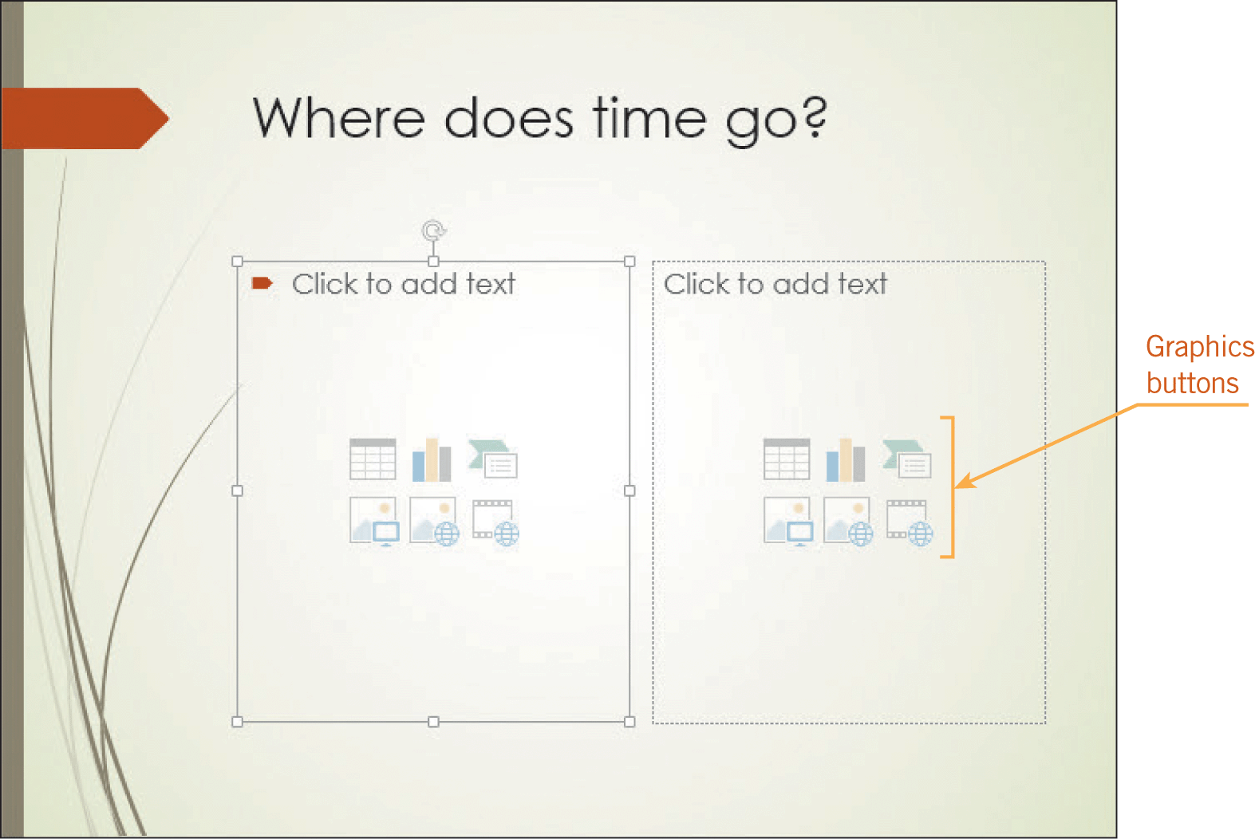
Inserting and Formatting Graphics (continued)
Adding Pictures to a Slide (continued)
Content placeholders simplify the task of inserting graphics.
When you insert a graphic using a graphic button placeholder, the graphic replaces the placeholder.

Slide 8
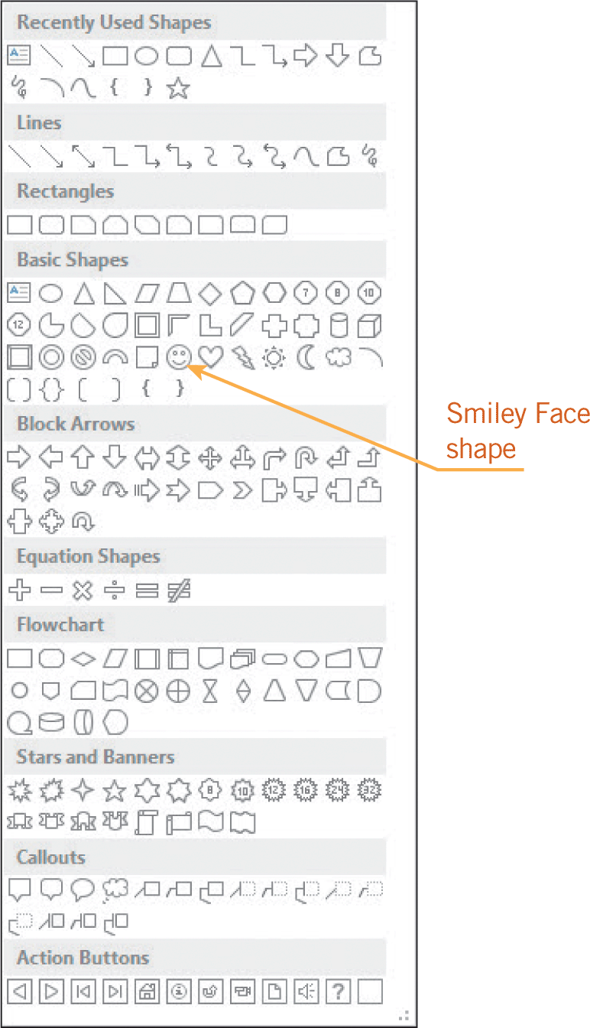
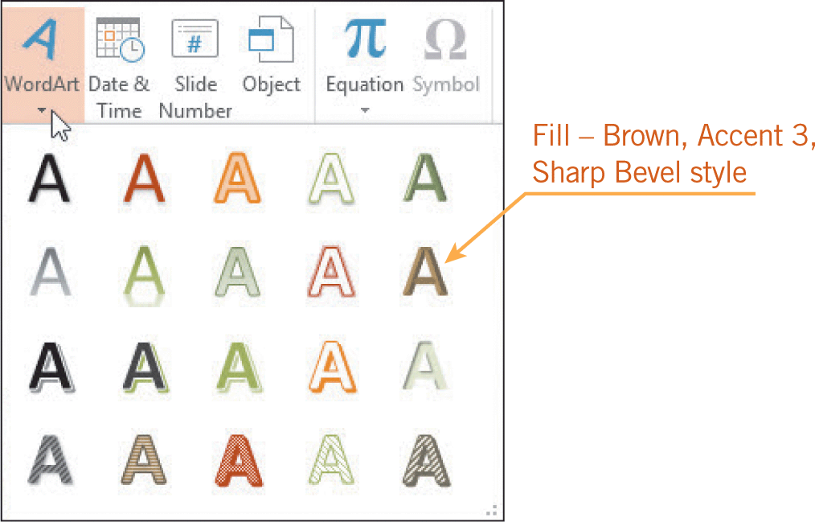
Inserting and Formatting Graphics (continued)
Adding WordArt, Shapes, and SmartArt Graphics to a Slide
You can create WordArt objects and draw objects using the same drawing tools that you learned to use in Word.
You can resize and reposition text boxes and shapes, and you can apply formatting options.

Slide 9
Inserting and Formatting Graphics (continued)
Adding Tables, Charts, and Text Boxes to Slides
You can add tables and simple charts to illustrate numerical data or trends.
Placeholders make it easy to create a table or chart using features in Word and Excel.
You can add additional text to slides by inserting a text box, and you can add styles, borders, and shape fills to text boxes to add emphasis.

Slide 10
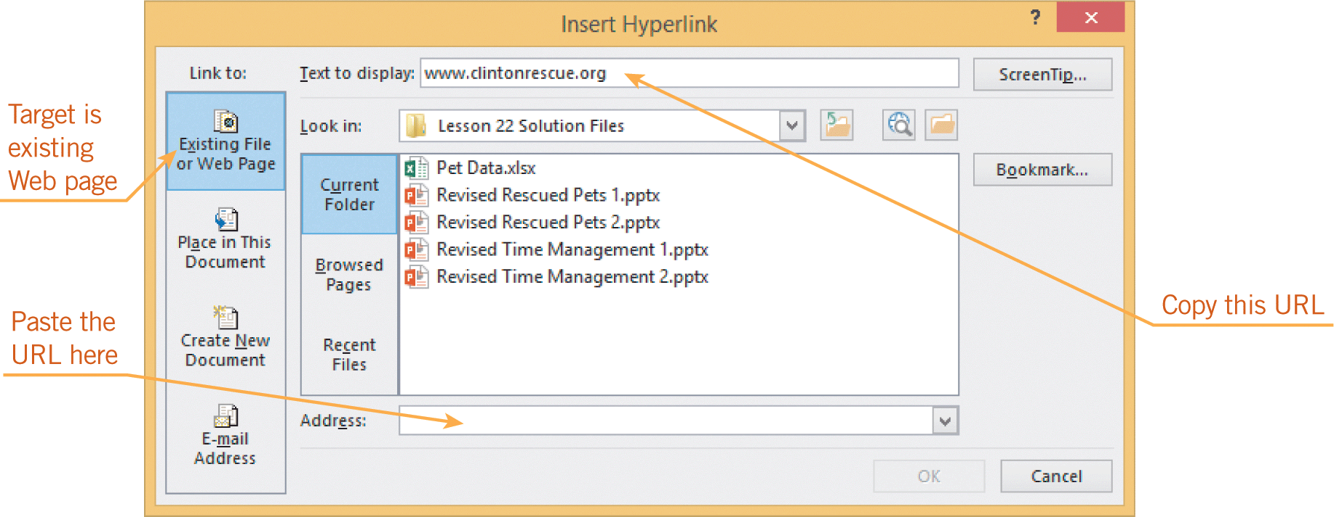
Creating Hyperlinks
In PowerPoint, you can create hyperlinks to slides in the same presentation, slides in another presentation, an e-mail address, a Web page, or another file.
You can create the hyperlink from text on a slide or from a graphic object on a slide.
Hyperlinks are only functional in Slide Show view.

Slide 11
Formatting Slide Transitions
Slide transitions are settings that control how a slide is introduced as you move from one slide to another slide in Slide Show view.
The transitions you add between the slides add interest and help keep the attention of your audience focused on the presentation.
You can apply the transition settings to a single slide or to all the slides in the presentation.

Slide 12
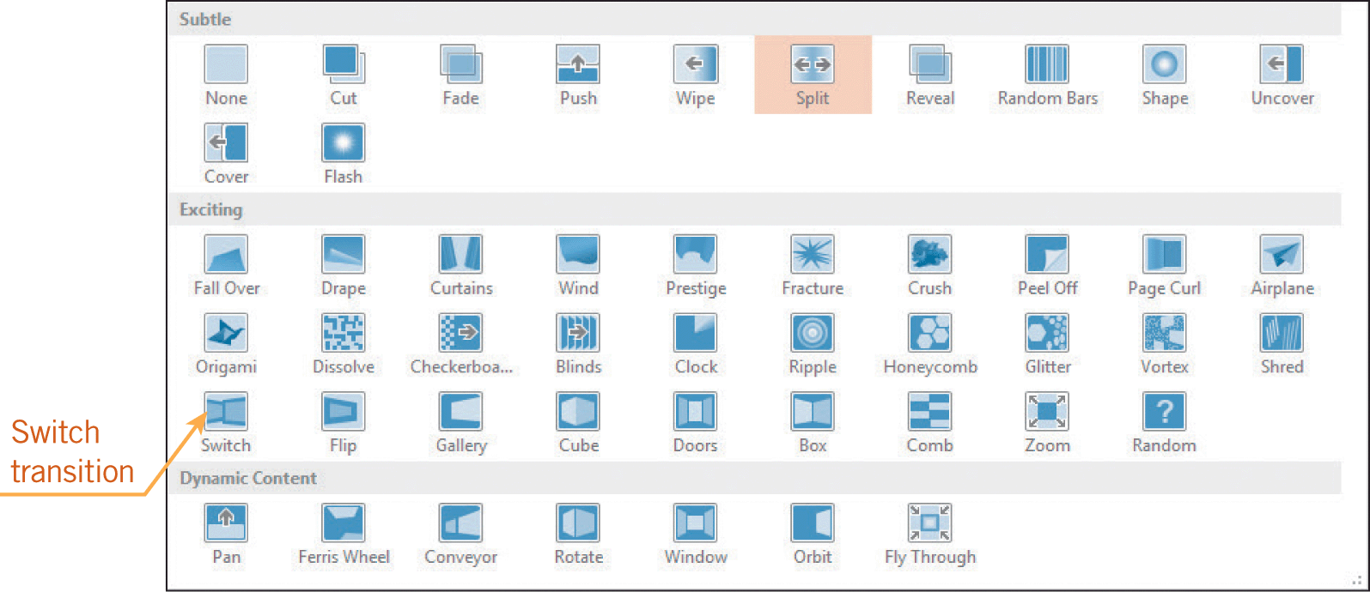
Formatting Slide Transitions (continued)

Slide 13
Formatting Animations
When you add animation, you add special visual or sound effects to text or an object.
Without animation, text and objects automatically appear all at once when a slide is opened in Slide Show view.
When you format animations for the text boxes and graphics, you can control how and when the text and graphics appear on each slide.

Slide 14
Formatting Animations (continued)
Applying Animations
PowerPoint provides many built-in animations for four types of effects:
Entrance effects control how the object enters onto the slide.
Emphasis effects draw attention to an object that is already visible on the slide.
Exit effects control how an object leaves the slide.
Motion paths enable you to create a path for the object to follow on the slide.

Slide 15
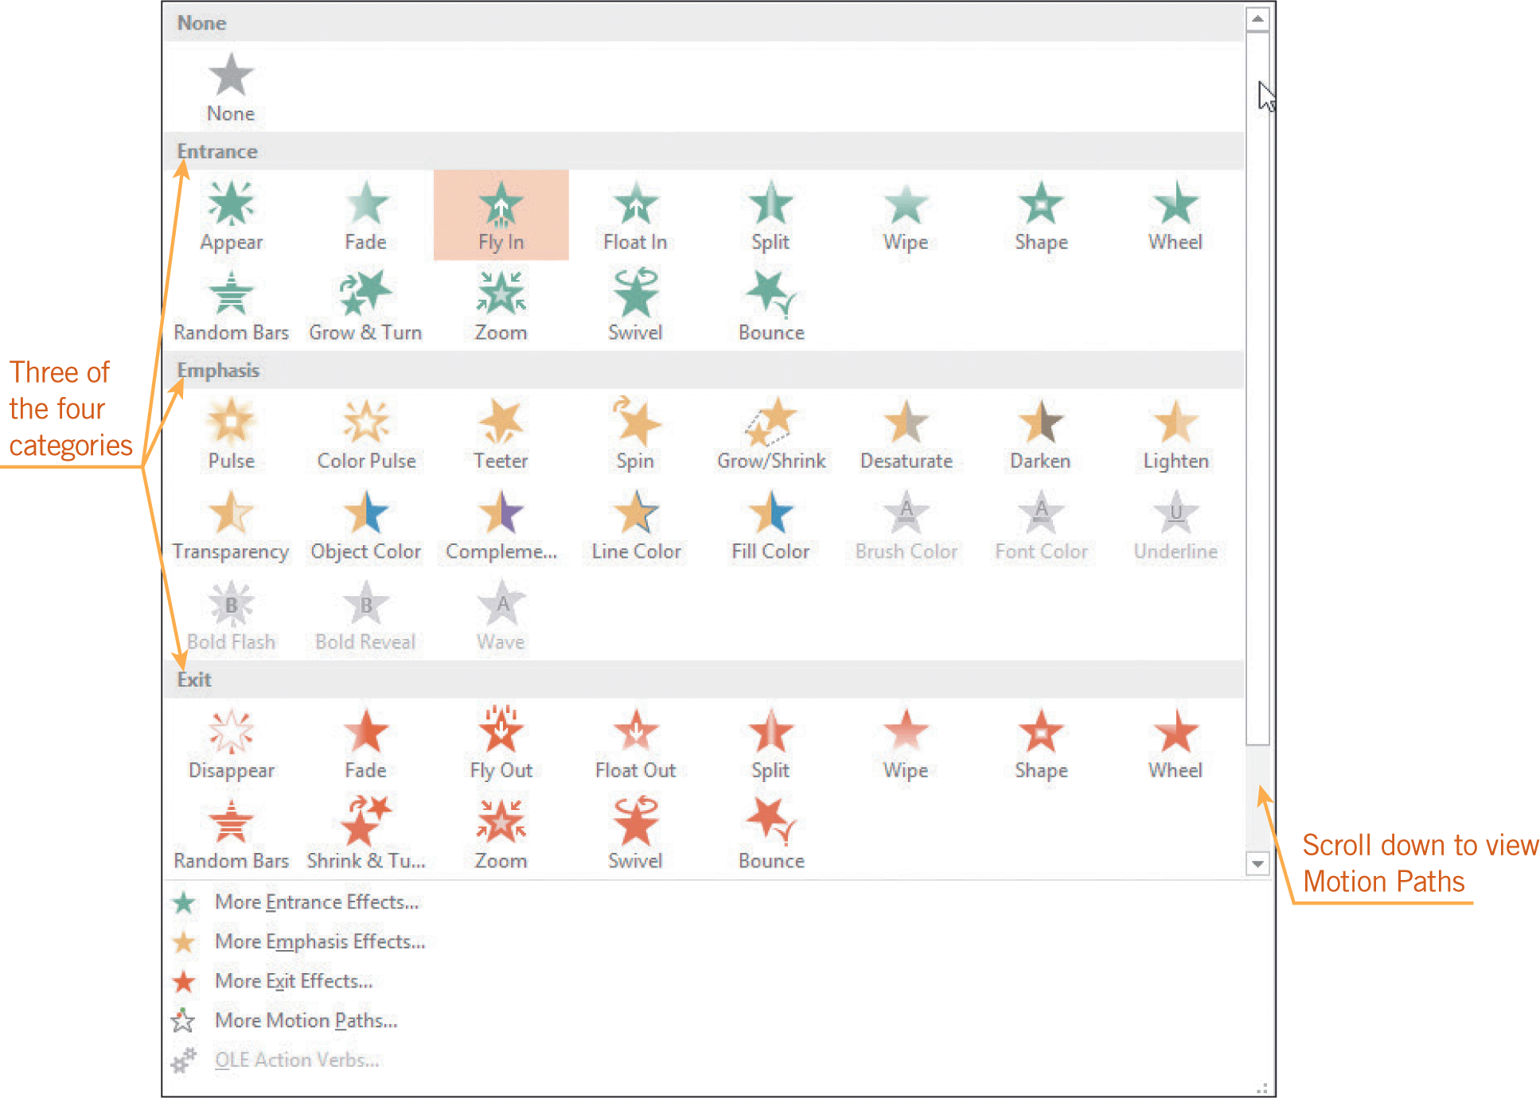
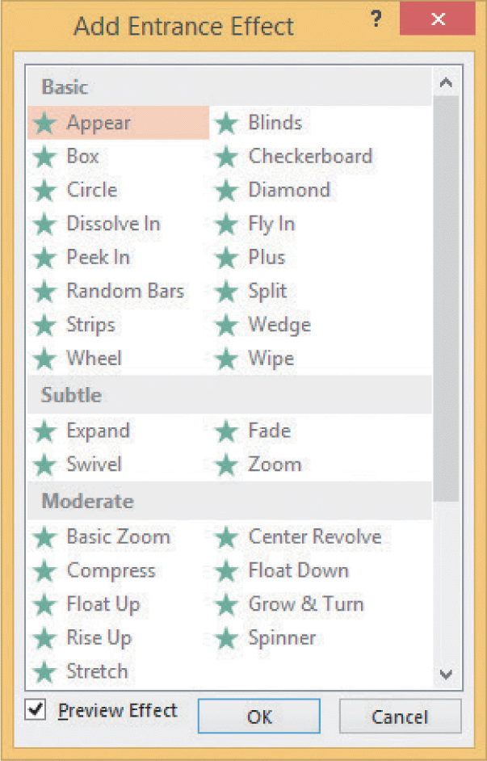
Formatting Animations (continued)
Applying Animations (continued)

Slide 16
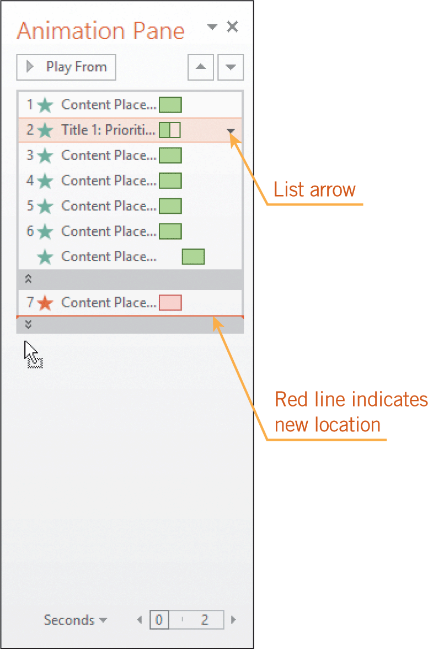
Formatting Animations (continued)
Rearranging, Changing, and Customizing Animations
You can rearrange the order of animations, remove an animation, or change an existing animation.
An object can have one or more animations.
You can customize the animations by modifying the timing of the effects.

Slide 17
Adding Audio and Video to a Presentation
You can use sound and video at any point in a presentation to add emphasis or set the mood for the audience.
Inserting Video and Audio Clips
PowerPoint supports many video and audio file formats.
You can insert audio files from Office.com, your computer, or another source such as a flash drive, a network connection, or the Cloud.

Slide 18
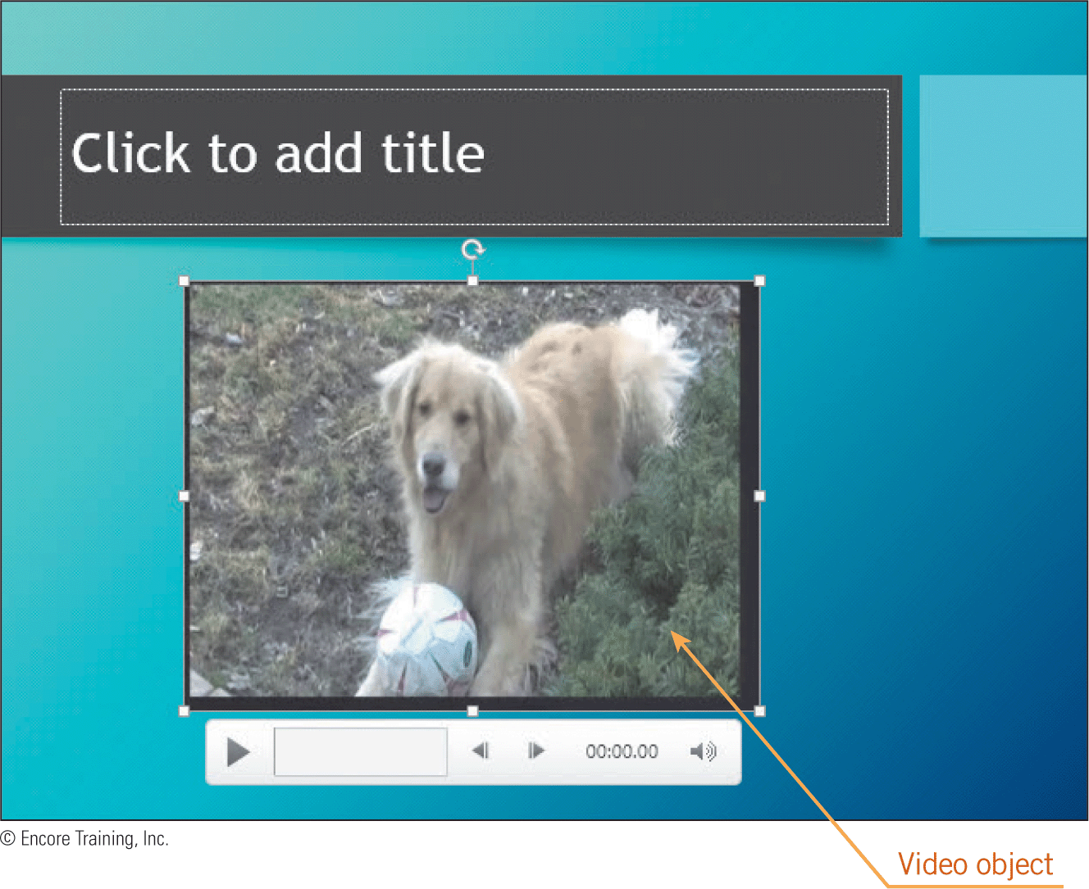
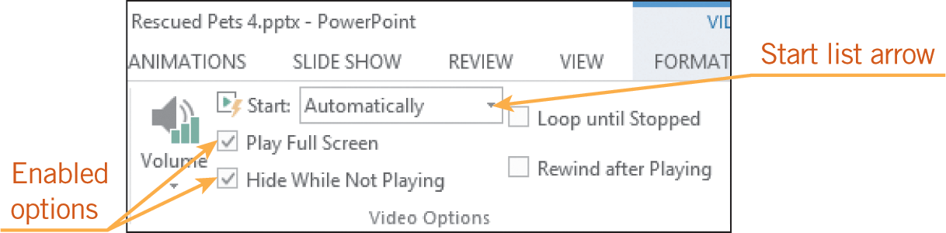
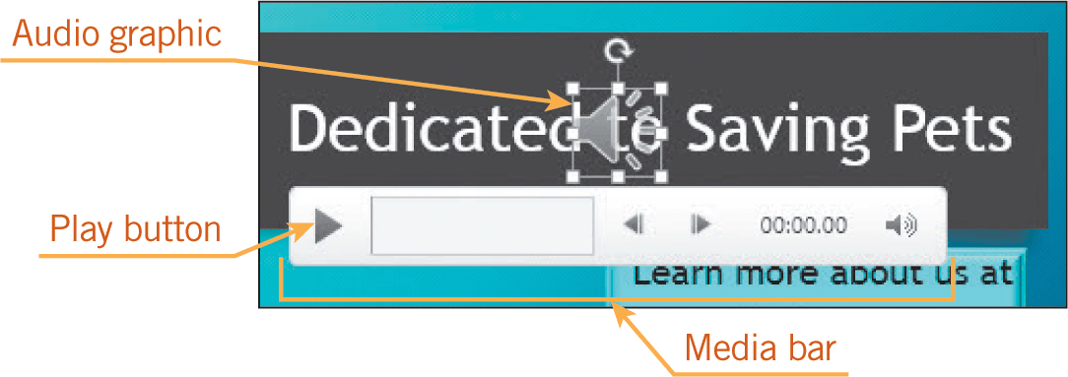
Adding Audio and Video to a Presentation (continued)
Inserting Video and Audio Clips (continued)

Slide 19
Distributing Presentations
The primary way to distribute a presentation is to project the slide show before an audience.
You can provide hard copies of slides, handouts, the presentation outline, and speaker notes.
You can distribute electronic copies of the presentation.
You can share a presentation via e-mail or Web pages, or over networks.

Slide 20
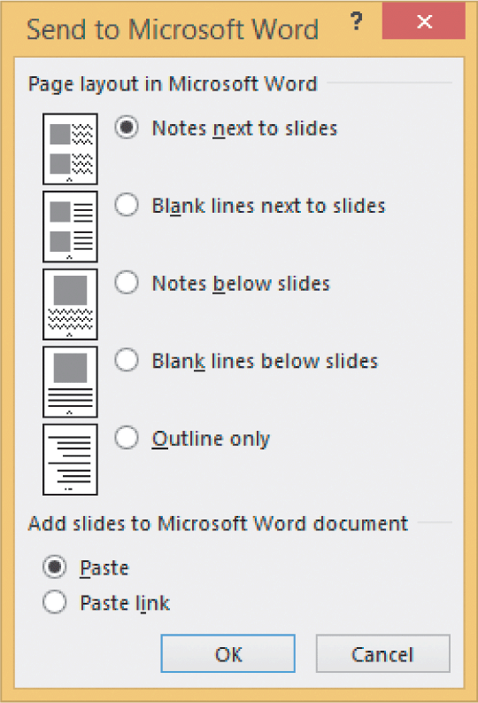
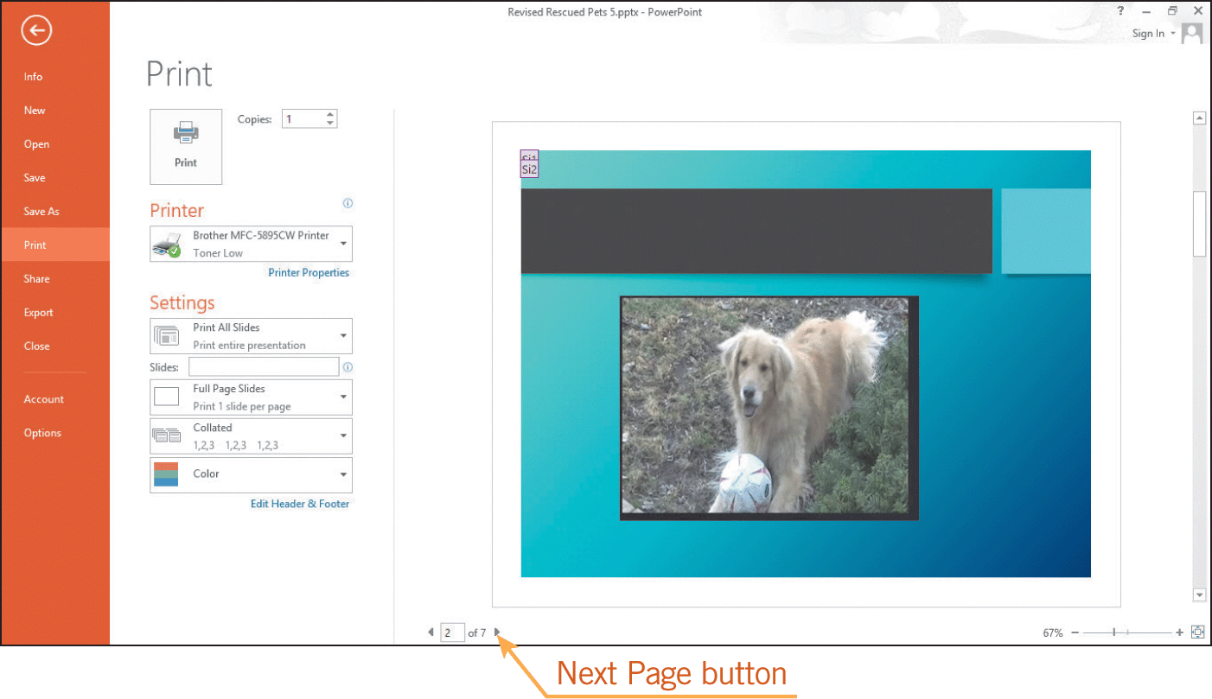
Distributing Presentations (continued)
Printing Handouts and Speaker Notes
You can print individual slides, the presentation outline, and speaker notes.
You can prepare handouts by formatting the slides in the various page layouts available in Word documents.

Slide 21
Distributing Presentations (continued)
Preparing Presentations for Electronic Distribution
To distribute electronic copies of a presentation, you must be connected to a network or the Internet, and you must have sufficient bandwidth for transferring the electronic files.
You can save presentations in PDF and XPS formats; readers can see the slides, but they cannot edit them.
You can share a presentation in the Cloud, or present the slides online using Office Presentation Service.
You can distribute a presentation by publishing the slides to a document management server or to a document workspace.

Slide 22
Summary
In this lesson, you learned:
Graphics help to clarify the message of your presentation. Graphics can help your audience remember your message, and PowerPoint makes it easy for you to add graphics to a slide.
You can create WordArt, shapes, and SmartArt graphics to add visual effects to slides.
You can easily reposition and resize graphics and text boxes on slides, and you can also format the objects with borders and shading.
22
22

Slide 23
Summary (continued)
Placeholders make it easy to create a table or chart to illustrate numerical data or trends.
You can add hyperlinks to text and graphics so you can link slides to other slides, other documents, or Web pages.
The slide transition affects how each new slide appears. You can apply transition settings to a single slide or to all the slides in the presentation.
23
23

Slide 24
Summary (continued)
PowerPoint provides special effects that can add emphasis, animation, or sound to the text and graphics, or that can enhance how a slide opens or closes.
You can easily insert sound and video clips on slides and format the clips to play automatically.
PowerPoint provides several options for distributing presentations via hard copies and electronic copies.
24
24

