Slide 1
Lesson 24
Managing and Reporting Database Information
Computer Literacy BASICS: A Comprehensive Guide to IC³, 5th Edition
Morrison / Wells / Ruffolo

Slide 2
Objectives
Create a form using the Form button and using the Form Wizard.
Enter and edit data in a form.
Sort table data in Datasheet view.
Find and replace table data in Datasheet view.
Create a query using the Query Wizard.
Create a report using the Report Wizard.
Preview and print a report.
Create mailing labels using the Label Wizard.
2
2

Slide 3
Words to Know
form
query
report
3
3

Slide 4
Creating a Form
You can create a form, which is a database object that provides a more convenient way to enter and edit data.
When you create a form, you add a new object to the database.
Access offers two features that make the process quick and easy: the Form button and the Form Wizard.

Slide 5
Creating a Form (continued)
Creating a Form Using the Form Button
You can create a form with a single click using the Form button.
All the fields from the table or query are included on the form, and the form is predesigned.
You can apply built-in designs, and you can modify the form layout and design using Layout view or Design view.

Slide 6
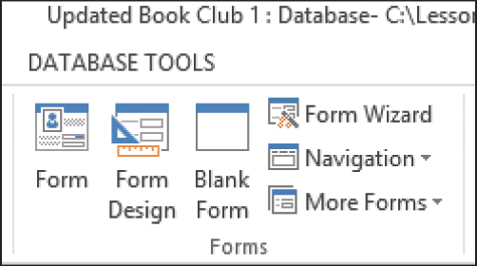
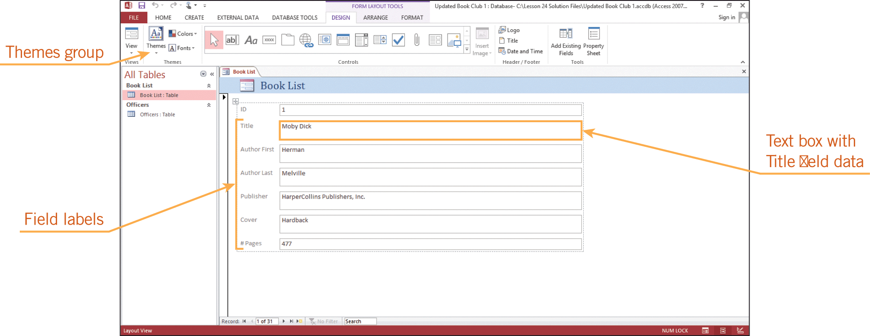
Creating a Form (continued)
Creating a Form Using the Form Button (continued)

Slide 7
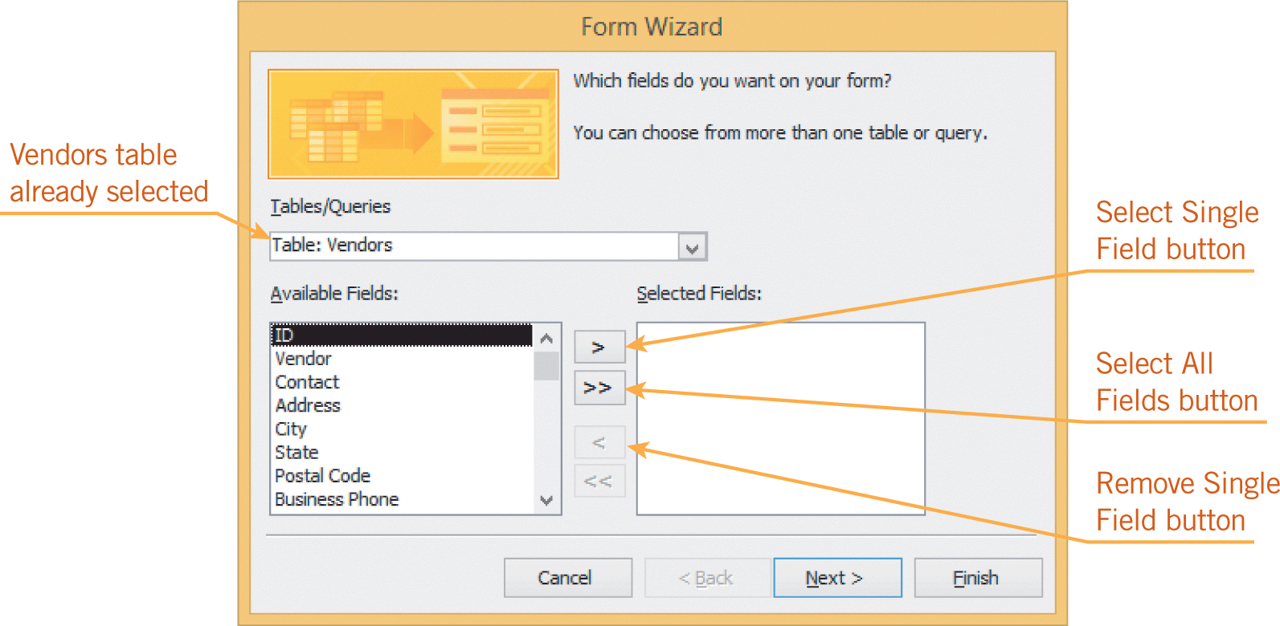
Creating a Form (continued)
Creating a Form Using the Form Wizard
You may not always want to include all the database fields on the form.
The Form Wizard makes it easy to create a form with your preferences because it prompts you to select the fields and the form layout for the new form.

Slide 8
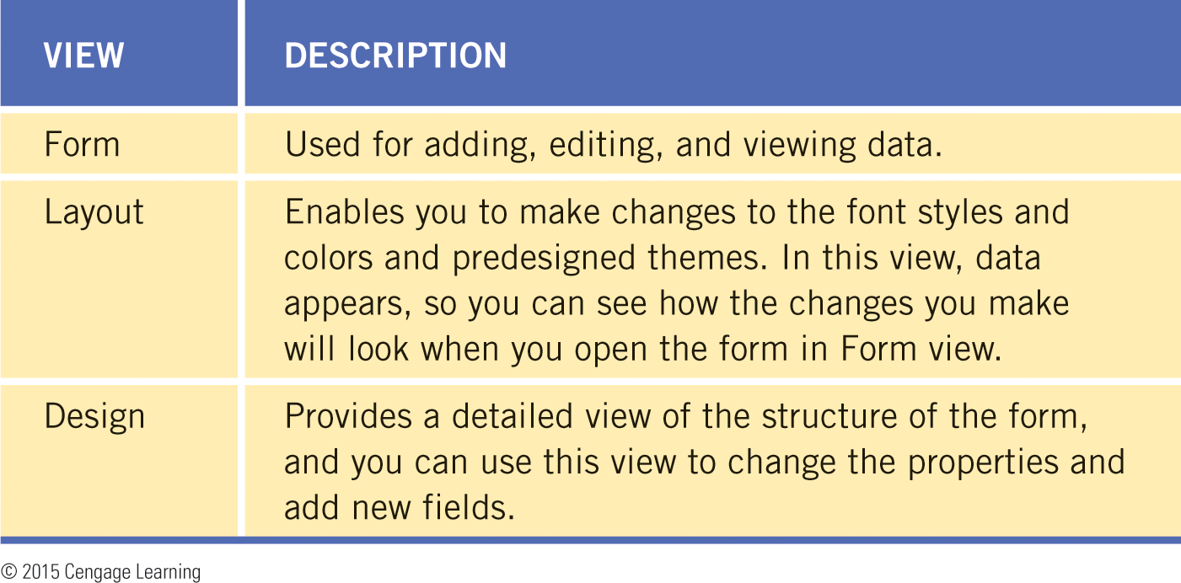
Creating a Form (continued)
Creating a Form Using the Form Wizard (continued)
When you work with a form, you have three options for viewing the object:

Slide 9
Entering and Editing Data in a Form
Entering data in a form is similar to entering data in a table in Datasheet view.
You can enter new data in Form view, and you can edit existing data.
If a related table is open when you enter new records in Form view, you must refresh the table data before the new records appear.
When you edit an existing record in Form view, Access automatically updates the records in the table.

Slide 10
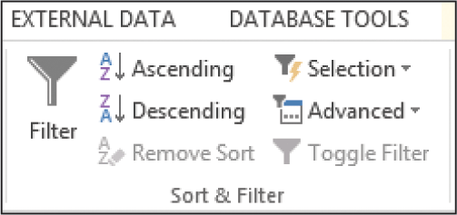
Sorting Table Data in Datasheet View
Organizing records in a specific order can help you access data more quickly.
You can sort text and numbers in either ascending or descending order.

Slide 11
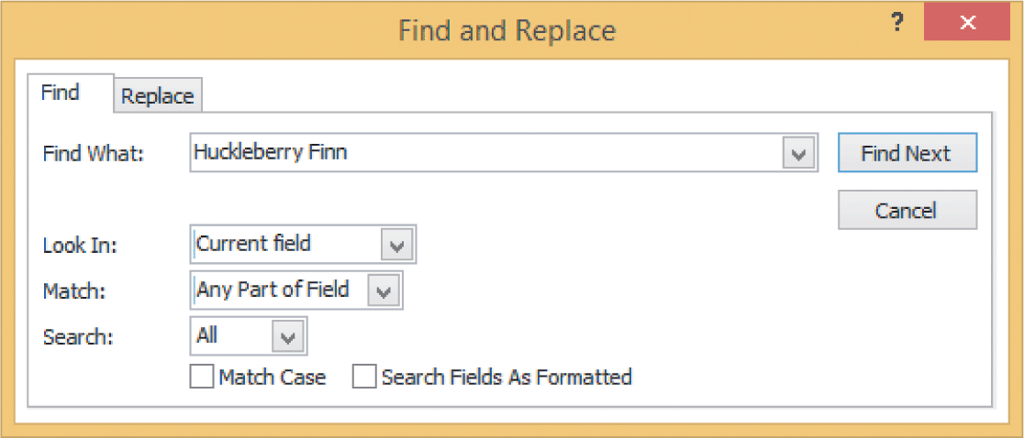
Finding and Replacing Table Data
Finding Data
The Find command provides a quick and easy way to locate specific records or find certain values with fields.
You can search for data within a specific field, or you can search the entire table.

Slide 12
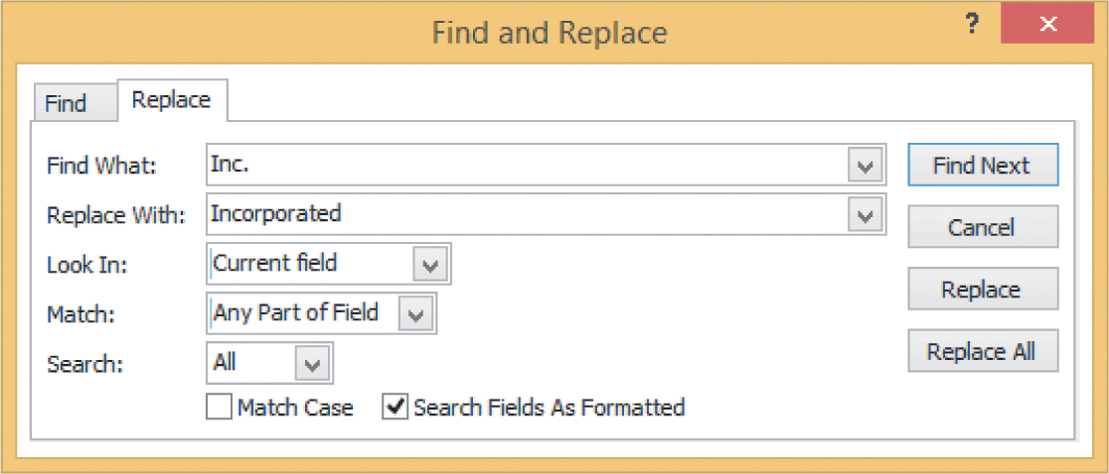
Finding and Replacing Table Data (continued)
Using the Replace Command
The Replace command locates the search text and replaces it with new text that you specify.
You can choose to view and confirm each replacement individually, or you can use the Replace All option.

Slide 13
Creating a Query
A query enables you to locate multiple records matching specified criteria.
The query provides a way for you to ask a question about the information stored in one or more tables.
Access searches for and retrieves data from the tables to answer your questions.

Slide 14
Creating a Query (continued)
When you create a query, you identify all the fields you want to retrieve.
The order in which you select the fields will be the order in which the information appears in the query results.
The easiest way to create a query is to use the Query Wizard, which guides you through the process.

Slide 15
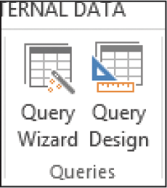
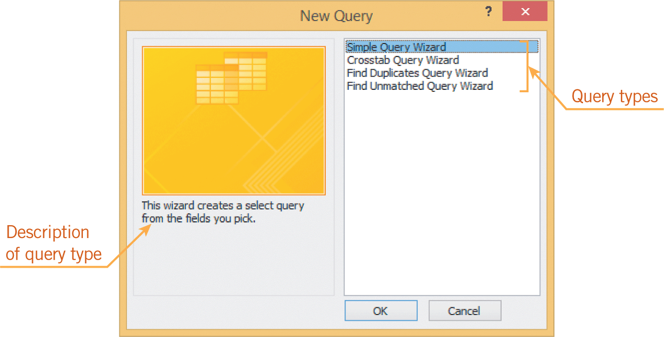
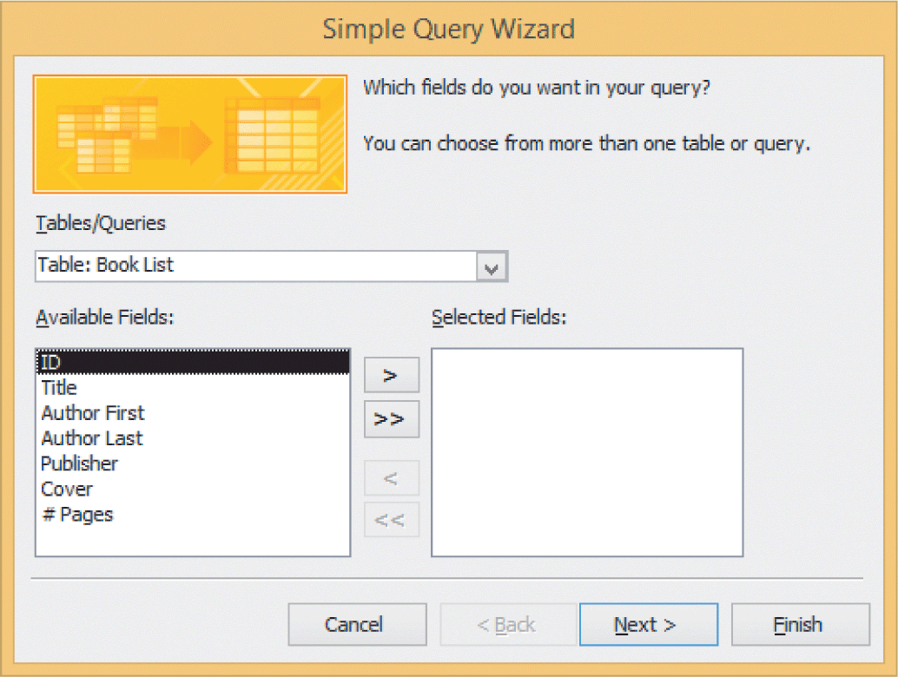
Creating a Query (continued)

Slide 16
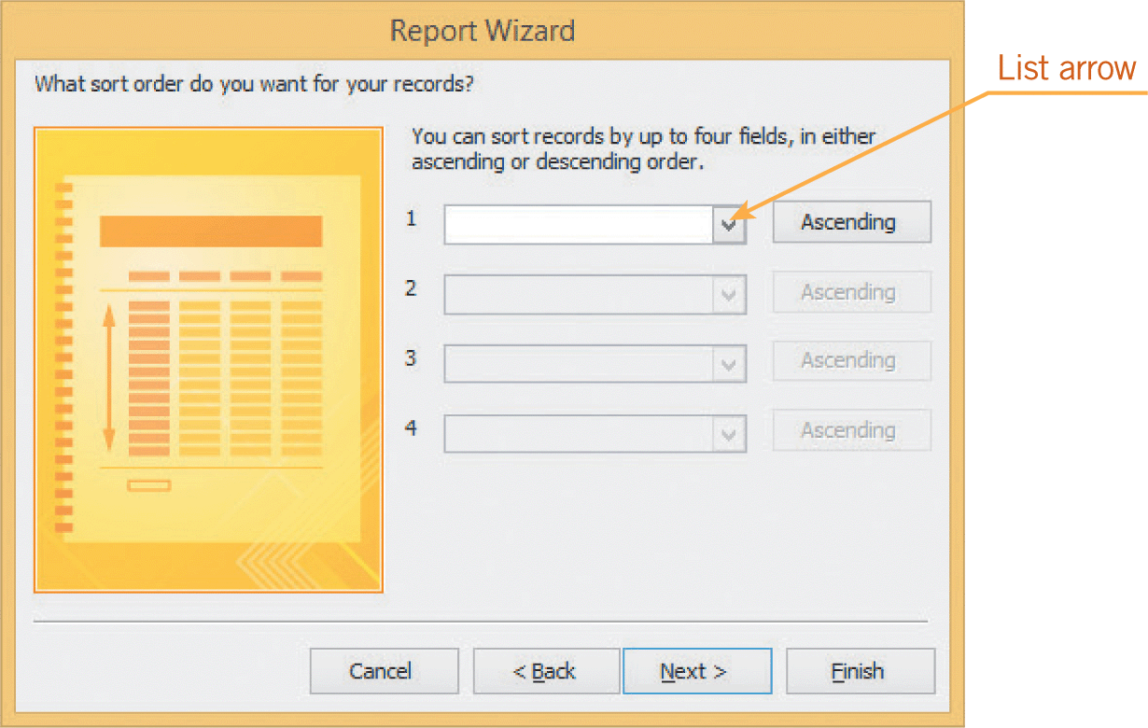
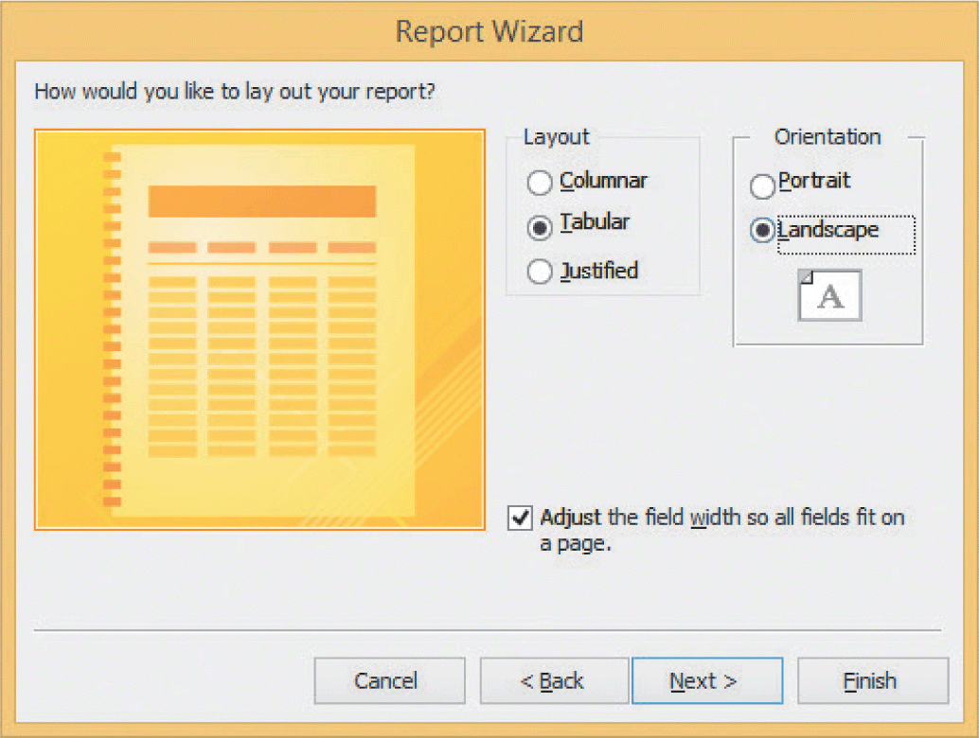
Creating a Report
A report is a database object that allows you to organize, summarize, and print all or a portion of the data in a database.
You can create a report based on a table or a query.
The Report Wizard prompts you to specify the data you want to include in the report and how you want to format the data.

Slide 17
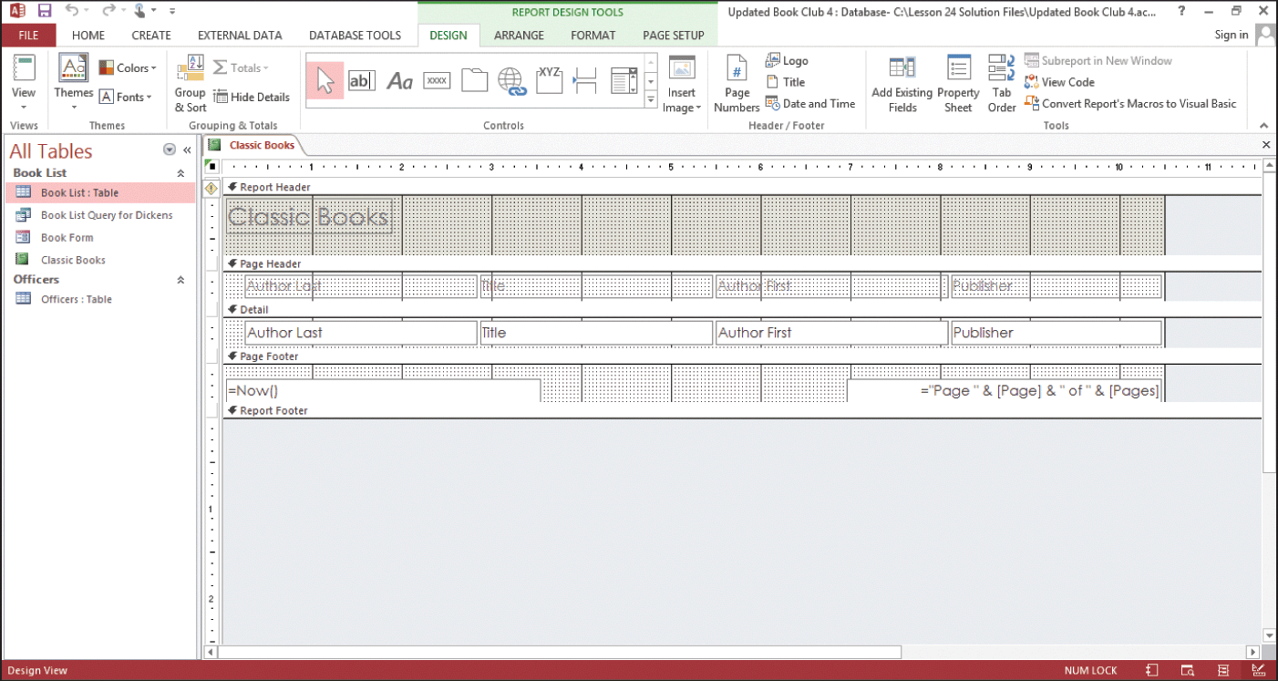
Creating a Report (continued)
In Design view, you can format headers and footers using page numbers, titles, and dates and times.
You can also add graphics to the header or footer.

Slide 18
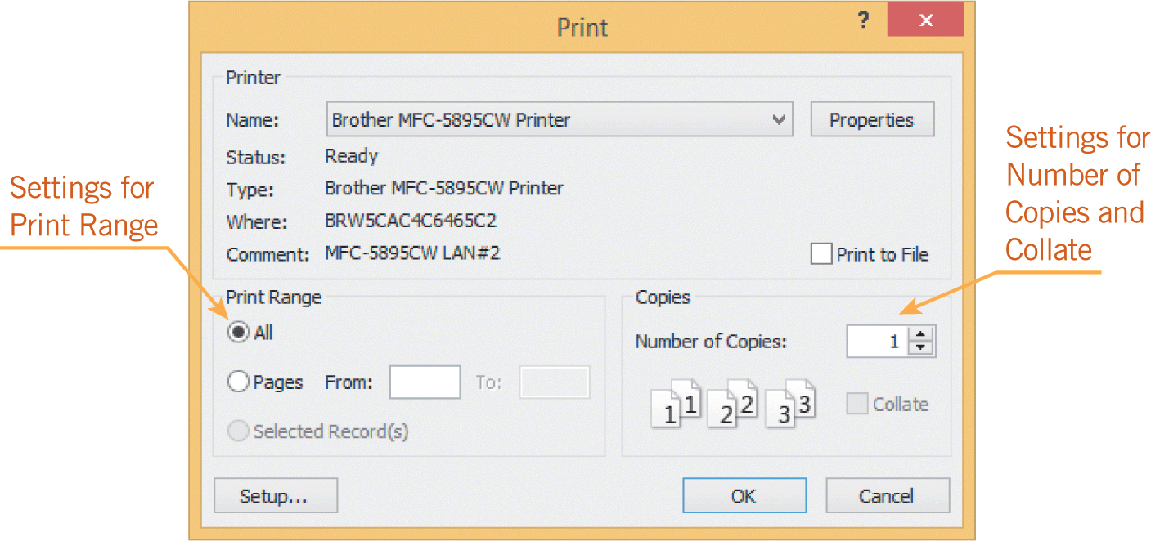
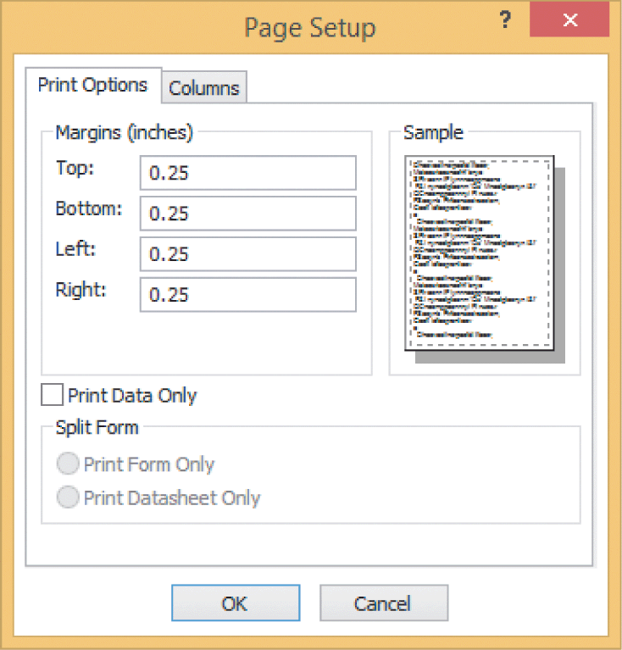
Printing a Report
Print options in Backstage view are not the same as for Word, Excel, and PowerPoint.
There are several options you can choose in the Print dialog box.
You can choose the number of copies to print, and you can change the margin settings.

Slide 19
Creating Mailing Labels
It is common to create mailing labels based on database information.
When you use the Label Wizard, you can customize the layout of the fields, which controls how the data appears on the label.
The Label Wizard includes a step to sort the database records—by postal code, for example.

Slide 20
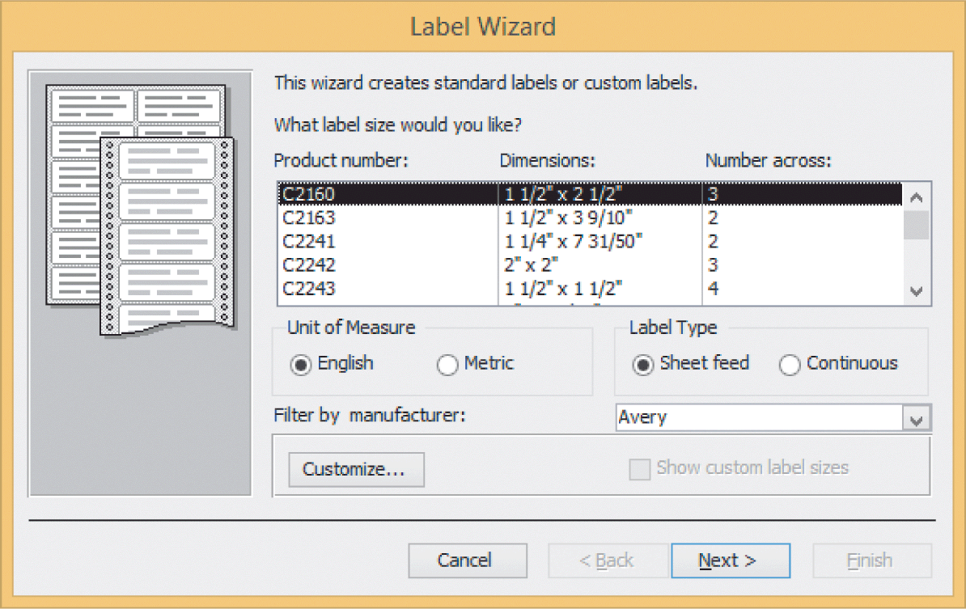
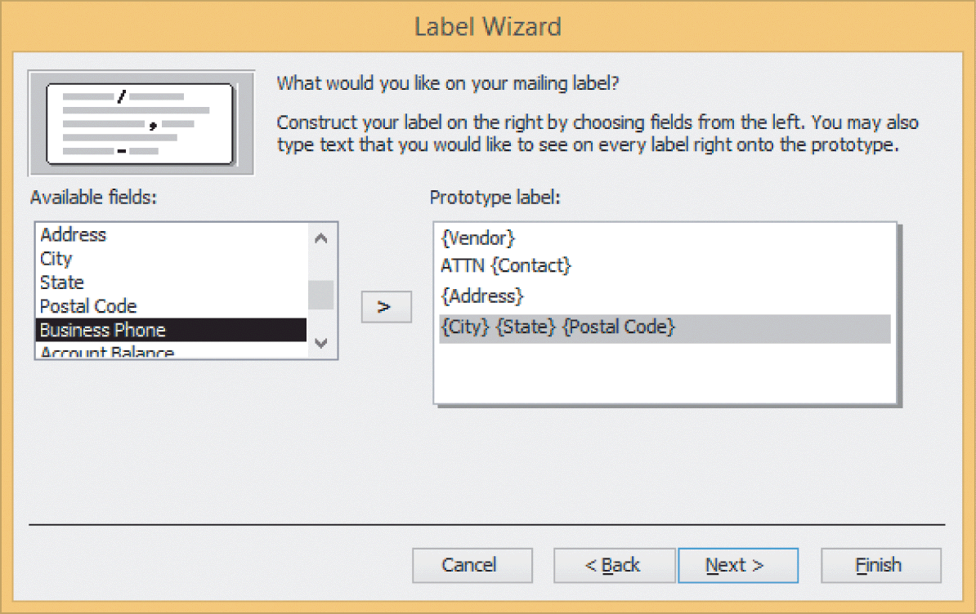
Creating Mailing Labels (continued)

Slide 21
Sharing Database Files
To share an Access database using SkyDrive or the Cloud, you must use an Access app to create the database so that you can publish it online.
Templates for the Access app are accessible in the Access startup screen.
The templates with a globe icon will create Access apps; the templates with the word desktop in the title will create traditional desktop databases.

Slide 22
Sharing Database Files (continued)
If you want to design an app on your own, you click the Custom web app template.
To create an Access app, you need Access 2013 and SharePoint Server 2013, or an Office 365 site.
Although you cannot track changes or add comments to a field in a traditional desktop database, you can create a Comment table in a database. Users can then add comments in the table and review comments from other users.

Slide 23
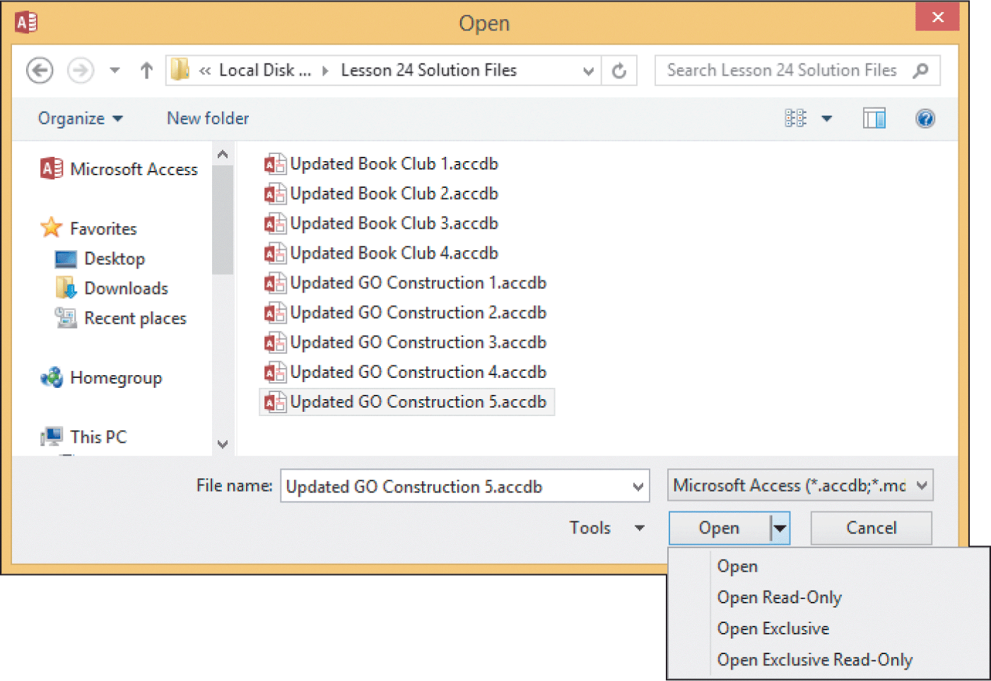
Sharing Database Files (continued)
You can attach a database file to an e-mail message.
You can encrypt the file by setting a password.
To encrypt (and decrypt) a database file, you must open the file in Exclusive mode, using the Open dialog box.

Slide 24
Summary
In this lesson, you learned:
You can create a form object using the Form button or the Form Wizard. The Form Wizard helps you create a customized layout for entering data.
Entering and editing data in a form is similar to entering data in a table in Datasheet view. You use the same navigation buttons to move from one record to another.
24
24

Slide 25
Summary (continued)
You can sort records in Datasheet view in either ascending or descending order.
The Find command can save you time looking for records and specific values in a table. The Replace command can save you time finding and replacing specific text. You can choose to replace text in individual occurrences or all at once.
25
25

Slide 26
Summary (continued)
You can create a query to find field data for records that match specified criteria.
A report allows you to organize, summarize, and print all or a portion of the data in a database. You can insert, reposition, and resize logo graphics in the header and footer panes.
After creating a report using the Report Wizard, you can review the report in Print Preview before sending it to the printer.
26
26

Slide 27
Summary (continued)
When you want to create mailing labels, you create a report object using the Label Wizard.
To add comments to a database, you can create a Comments table.
To prevent unauthorized access to a database file, you can encrypt the file.
27
27

